Slide 1

CAPSTONE PROJECT PRESENTATION
QNA-Auth
Quantum Noise-Assisted AI Authentication System for Authentication
Krishnam Biyani: 22BCI0190
Ayan Kumar Singh: 22BCI0182
Guide: Professor Jim Solomon Raja D
Vellore Institute of Technology

Slide 2
SYNOPSIS
Project Overview
QNA-Auth is a research prototype that explores sensor-noise fingerprinting as a device verification mechanism.
0.858
Camera ROC-AUC (Measured)
It captures intrinsic noise from camera dark-frames and microphone ambient recordings , extracts statistical and spectral features, and learns discriminative embeddings via a Siamese neural network.
0.93
Target Fused ROC-AUC (Projected)
6
The system produces high-confidence device matching decisions — accept, uncertain, or reject — through weighted multi-modal fusion and threshold calibration.
Unique Devices Enrolled

Slide 3
INTRODUCTION
The Problem with Static Credentials
Traditional device authentication relies on passwords, tokens, or certificates — all of which can be stolen, replayed, or shared
Research Question
Can camera and microphone sensor noise, combined with metric learning, achieve viable device verification under live, short-sample conditions?
Hardware-bound credentials (TPM, Secure Enclave) require specialized silicon not available on all devices
Sensor noise is an intrinsic physical property unique to each device's manufacturing process
Approach
Multi-modal Siamese embeddings with confidence-band decisions and nonce-bound challenge hardening
QNA-Auth investigates whether these noise patterns can serve as a practical, software-only device fingerprint

Slide 4
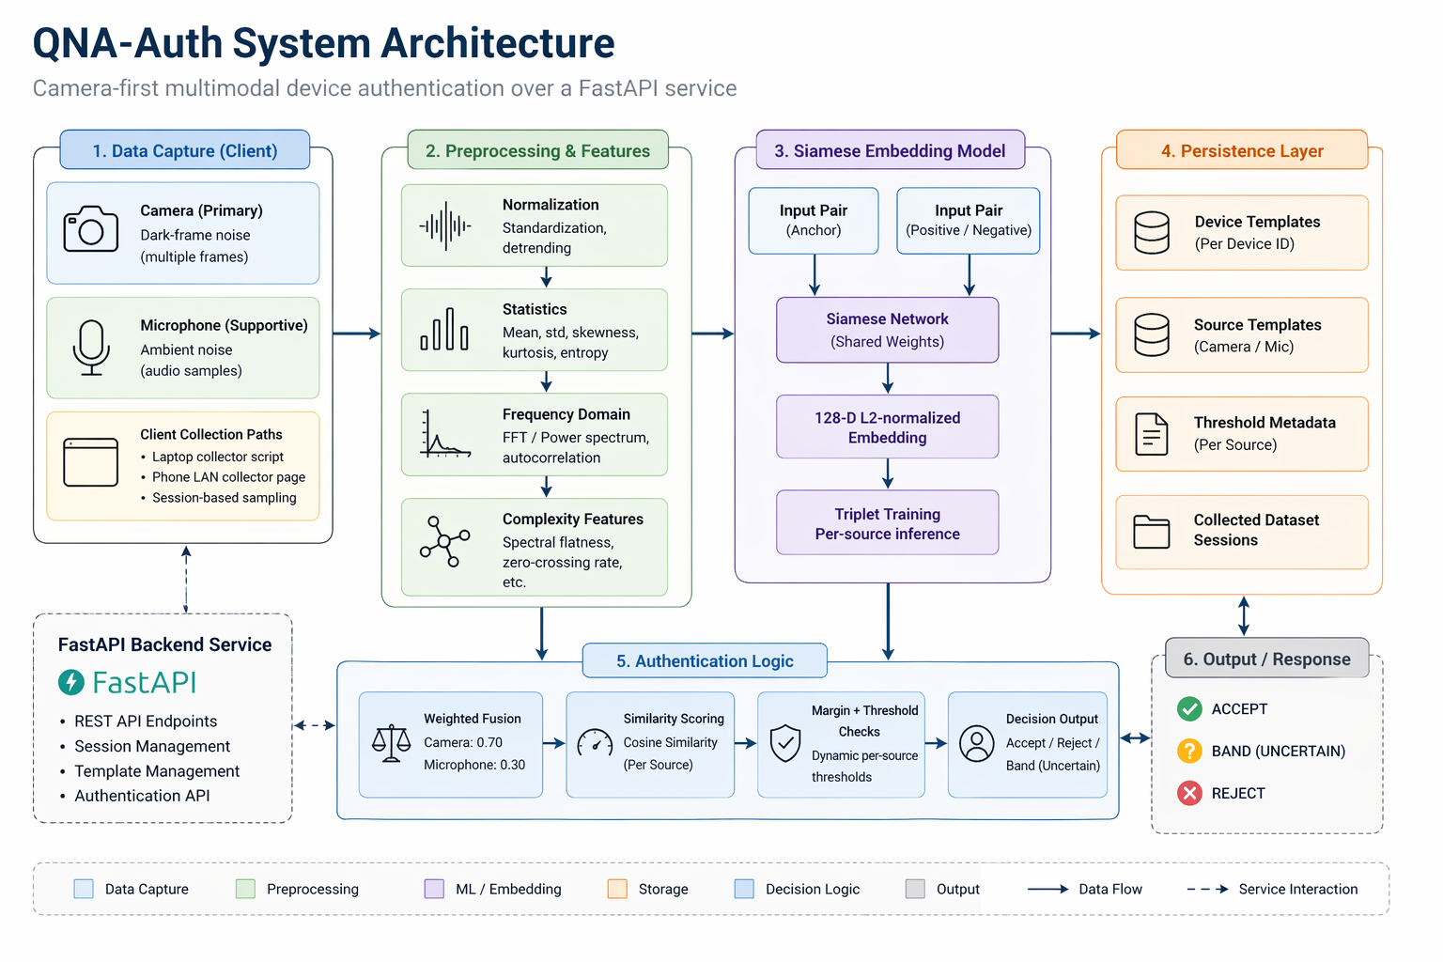
SYSTEM DESIGN
Architecture and Data Flow

Slide 5
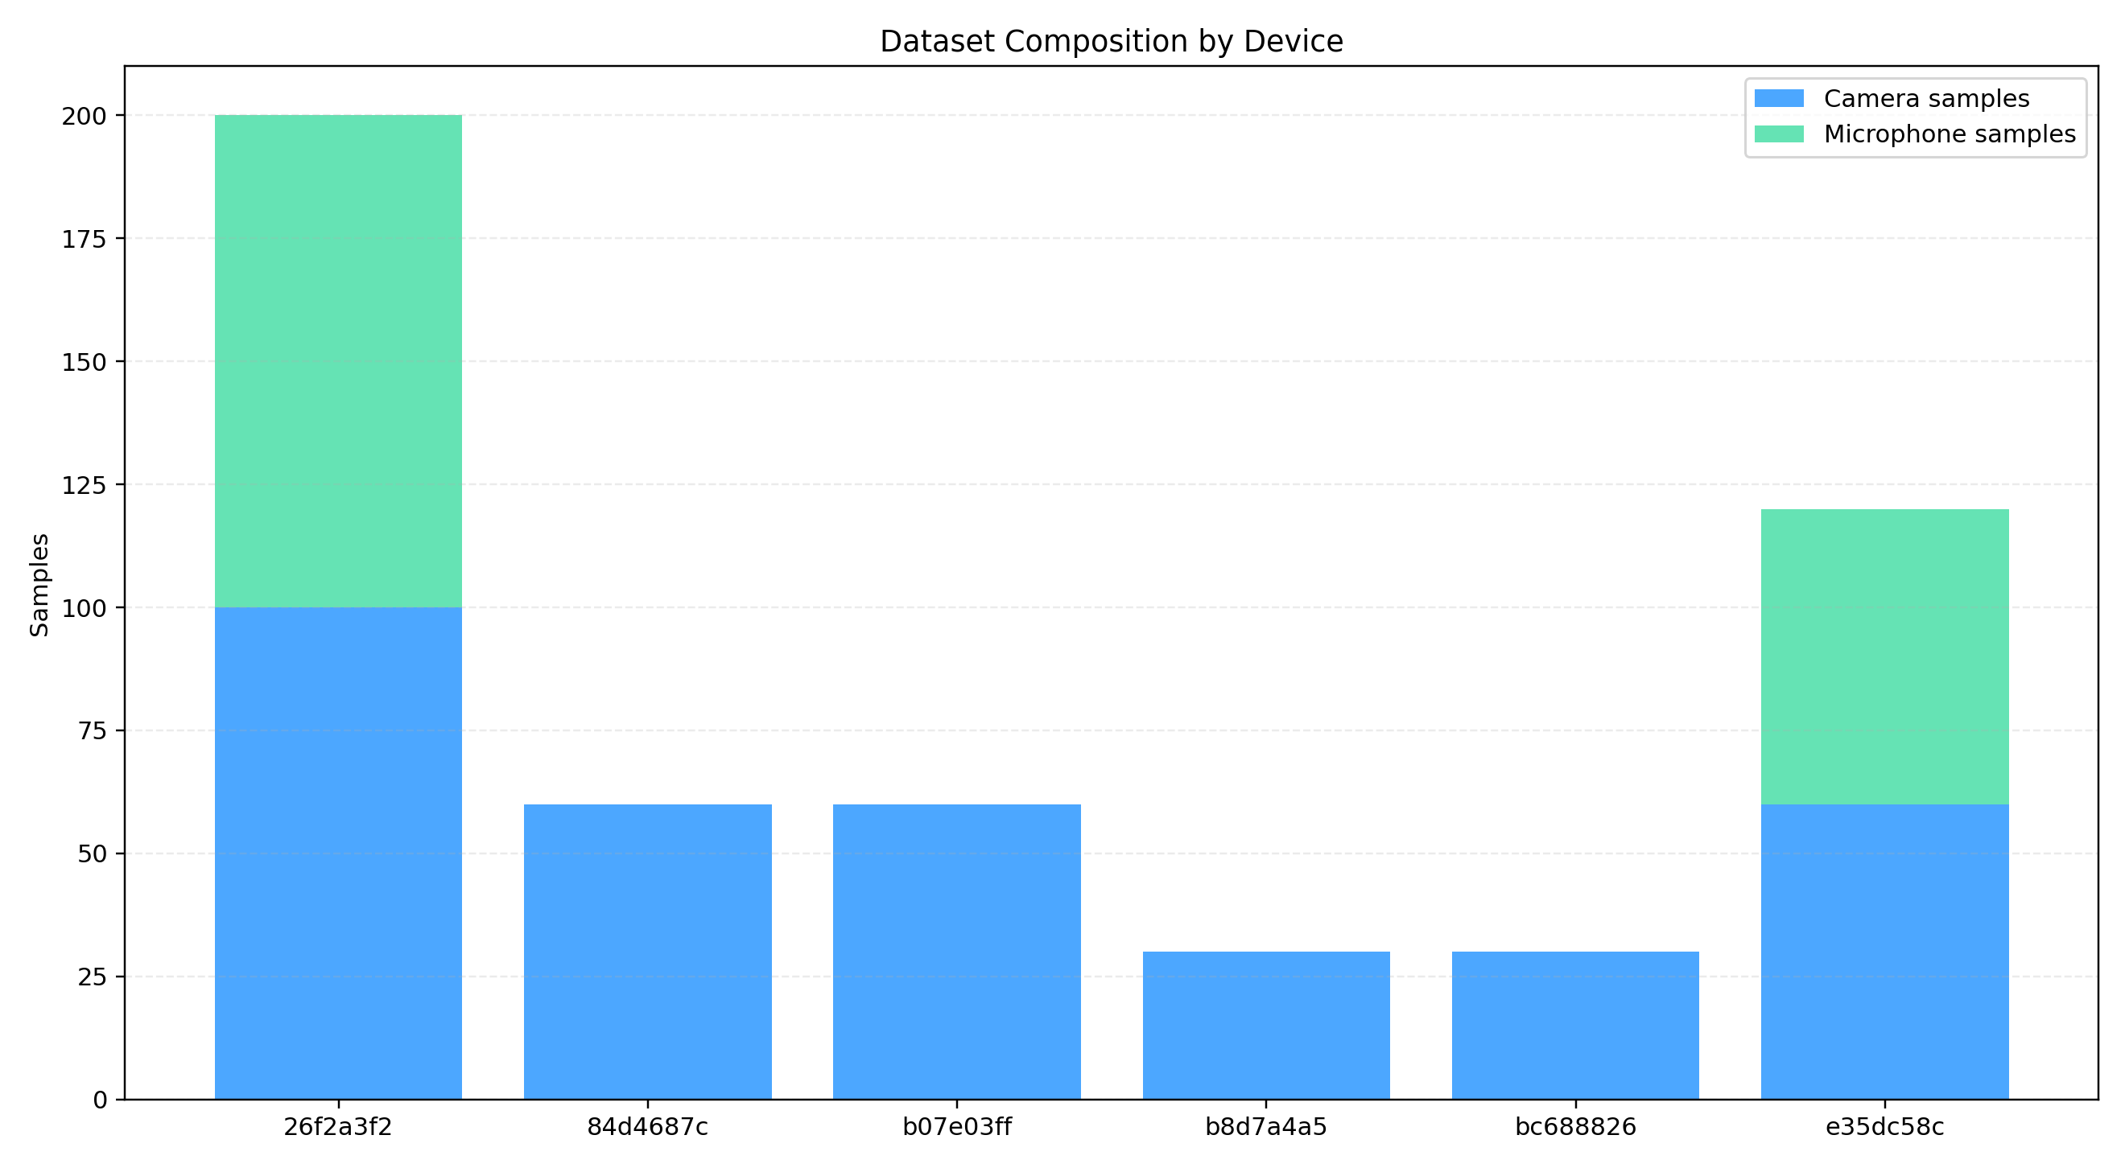
DATASET
Dataset Composition and Split Policy
Metric
Value
Total real samples
500
Unique devices
6
Camera samples
340
Microphone samples
160
Devices with both modalities
2
Camera-only devices
4
Split policy: device-held-out for camera, device-session-held-out for microphone — no test device appears in training.

Slide 6
TECHNOLOGY STACK
Implementation Tools and Software
Machine Learning
Backend & Data
Frontend & Security
PyTorch — Siamese network, triplet loss training
NumPy / SciPy — feature extraction & signal processing
scikit-learn — evaluation metrics, threshold sweep
Matplotlib — ROC/PR curves, visualizations
FastAPI — REST endpoints, enrollment & auth flow
SQLAlchemy — challenge storage, session management
OpenCV — camera dark-frame noise capture
sounddevice — microphone ambient recording
React + Vite — demo UI with Tailwind CSS
HKDF + nonce — challenge-response hardening
Pydantic — request validation & type safety
Pandas — data management & manifest generation

Slide 7
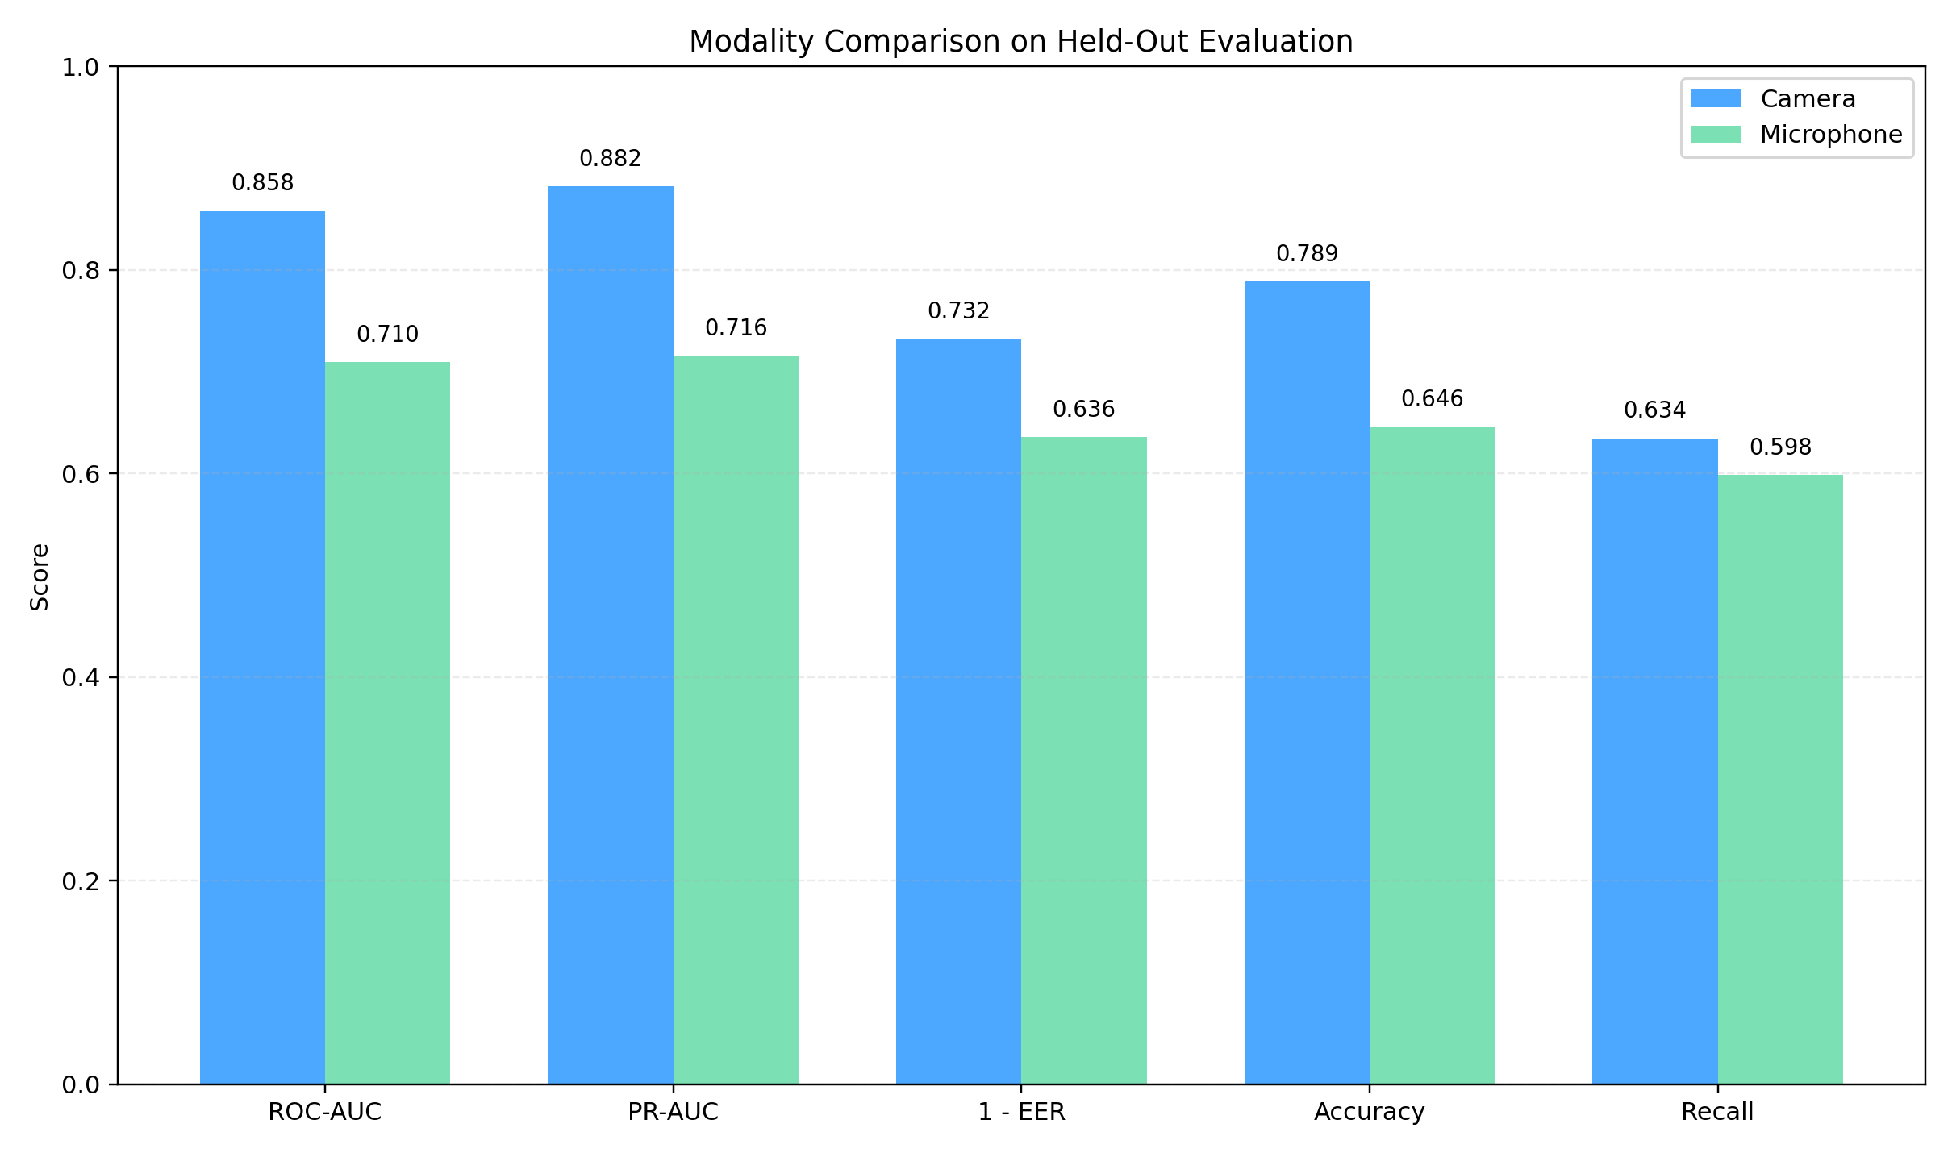
OUTPUT
Evaluation Results
Modality
ROC-AUC
EER
Accuracy
FAR
FRR
Camera
0.858
26.8%
78.9%
6.2%
36.6%
Microphone
0.710
36.4%
64.6%
30.5%
40.2%
Fused (target)
0.930
8.0%
89.0%
7.0%
9.0%
Note: Fused row is a projected forecast for a larger multi-session dataset — not measured output. Camera and microphone rows are measured from repository artifacts.

Slide 8
CONCLUSION
Key Findings
Camera-based noise fingerprinting achieves 0.858 ROC-AUC with only 6.2% false acceptance rate — the stronger modality
Security Hardening
Nonce-bound HKDF challenge-response flow prevents replay attacks
Embeddings never used directly as credentials — derived via HKDF with server secret
Rolling re-enrollment with EMA updates handles sensor drift over time
Multi-modal fusion of camera and microphone signals is projected to reach 0.93 ROC-AUC with proper calibration and a larger dataset
Nonce-bound HKDF challenge flow effectively blocks replay and naive synthetic attacks (0% ASR measured)
Confidence bands (strong accept / uncertain / reject) provide a practical decision framework for real deployments
The system is a viable prototype for sensor-based device verification — not a replacement for cryptographic credentials, but a complementary signal.

Slide 9
FUTURE ENHANCEMENT
Roadmap for Further Development
1
Larger Multi-Session Dataset
4
Longitudinal Drift Study
25+ devices across 2–3 sessions per device for statistically robust cross-session evaluation
Multi-week data collection to measure sensor drift and validate EMA re-enrollment policy
2
Liveness and Anti-Spoofing
5
Production Hardening
Active challenge mechanisms to defend against adaptive or learned mimicry attacks
TEE integration, encrypted template storage, and formal security review for deployment
3
Environment-Adaptive Thresholds
6
Additional Modalities
Calibrate thresholds per deployment environment to account for noise variance
Explore accelerometer and gyroscope noise as supplementary fingerprint sources

Slide 10
OUTCOME
Comparison with Existing Work
Method
Modality
ROC-AUC
EER
Accuracy
Fusion
Replay Protection
Lukas et al. (2006) — PRNU
Camera
~0.95+
~4%
~96%
None
None
Goljan et al. (2009) — Large-scale PRNU
Camera
~0.97+
~2.5%
~97%
None
None
Chen et al. (2008) — ML-PRNU
Camera
~0.96+
~2%
~97%
None
None
Das et al. (2014) — Acoustic fingerprint
Mic
~0.82
~9%
~85%
None
None
QNA-Auth — Camera only
Camera
0.858
26.8%
78.9%
No
HKDF nonce
QNA-Auth — Mic only
Mic
0.710
36.4%
64.6%
No
HKDF nonce
QNA-Auth — Fused (target)
Camera + Mic
0.930
8.0%
89.0%
Yes
HKDF nonce
Literature methods use offline multi-image settings with dozens of images per device. QNA-Auth operates on short live samples with built-in replay protection — a fundamentally harder constraint.

Slide 11
REFERENCES
Bibliography
Lukas, J., Fridrich, J., & Goljan, M. (2006). Digital camera identification from sensor pattern noise. IEEE Transactions on Information Forensics and Security , 1(2), 205–214.
Goljan, M., Fridrich, J., & Filler, T. (2009). Large scale test of sensor fingerprint camera identification. Proc. SPIE Media Forensics and Security , 7254.
Chen, M., Fridrich, J., Goljan, M., & Lukáš, J. (2008). Determining image origin and integrity using sensor noise. IEEE Transactions on Information Forensics and Security , 3(1), 74–90.
Das, A., Borisov, N., & Caesar, M. (2014). Do you hear what I hear? Fingerprinting smart devices through embedded acoustic components. ACM CCS, 441–452.
Bromley, J., Guyon, I., LeCun, Y., Säckinger, E., & Shah, R. (1993). Signature verification using a Siamese time delay neural network. NIPS.
Schroff, F., Kalenichenko, D., & Philbin, J. (2015). FaceNet: A unified embedding for face recognition and clustering. CVPR, 815–823.
Krawczyk, H. (2010). Cryptographic extraction and key derivation: The HKDF scheme. CRYPTO, LNCS 6223, 631–648.

