Slide 1
OOPS & FILE HANDLING IN JAVA
- Krishnamoorthy V

Slide 2
What is oops ?
OOP stands for Object-Oriented Programming.
Procedural programming is about writing procedures or methods that perform operations on the data, while object-oriented programming is about creating objects that contain both data and methods.

Slide 3
Advantages of oops
Object-oriented programming has several advantages over procedural programming:
OOP is faster and easier to execute.
OOP provides a clear structure for the programs.
OOP helps to keep the Java code DRY "Don't Repeat Yourself", and makes the code easier to maintain, modify and debug.
OOP makes it possible to create full reusable applications with less code and shorter development time.

Slide 4
Java – What are Classes and Objects?
Classes and objects are the two main aspects of object-oriented programming.
A class is a template for objects, and an object is an instance of a class.
When the individual objects are created, they inherit all the variables and methods from the class.

Slide 5
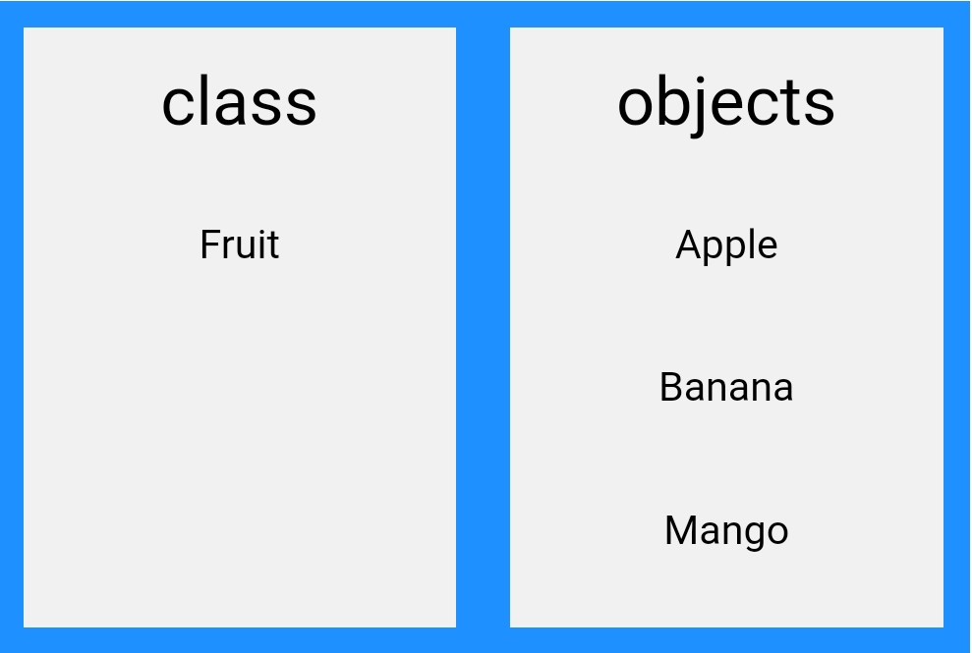
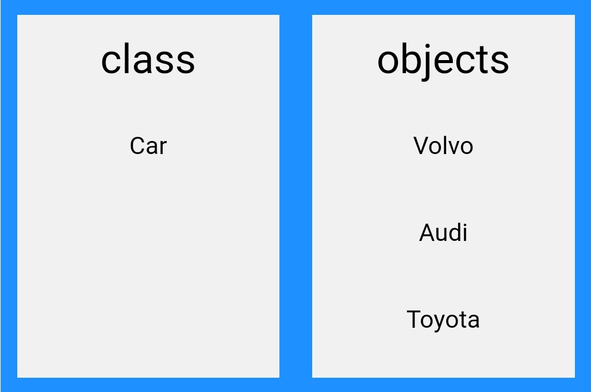
Example :
Look at the following illustration to see the difference between class and objects:

Slide 6
File handling in java :
File handling is an important part of any application. Java has several methods for creating, reading, updating, and deleting files.
The File class has many useful methods for creating and getting information about files.
The File class from the java.io package, allows us to work with files. To use the File class, create an object of the class, and specify the filename or directory name.

Slide 7
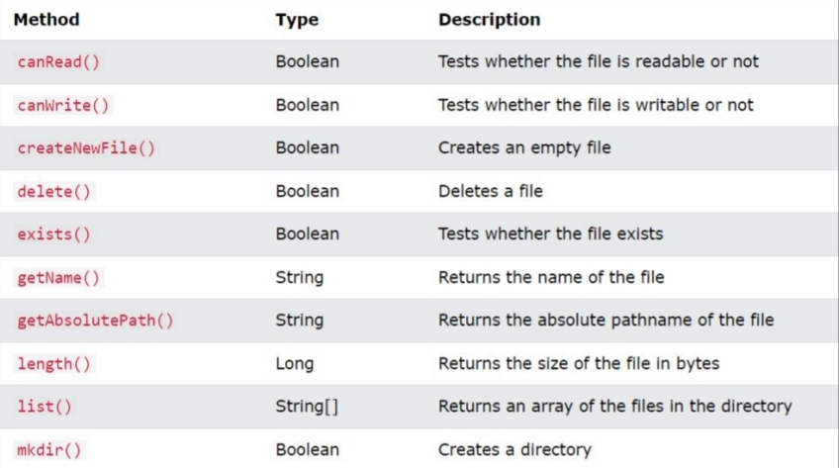
File methods

Slide 8
Thankyou !

