Slide 1


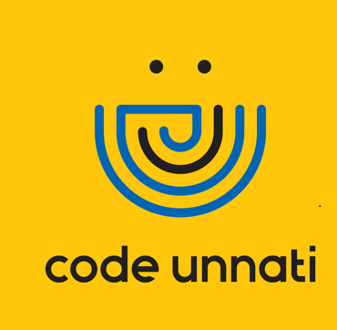

Osteoporosis Risk Prediction Using Machine Learning
Team ID - CU_CP_Team_9184
Team Leader: Aerupilli Krishnamraju
Under the mentorship of,
Makka Dwaraka Reddy

Slide 2

Project Objectives
Problem Statement
Project Overview – Introduction
End Users
Wow Factor in Project
Modelling/Block Diagram/Flow of Project
Result/outcomes
Conclusion
Future Perspective

Slide 3
Problem Statement
Osteoporosis is a condition characterized by weakened bones and an increased risk of fractures. It often remains undiagnosed until significant damage occurs, leading to severe health consequences. Globally, over 200 million people are affected, with a particularly high incidence among post-menopausal women and the elderly. Early detection is crucial for effective management and prevention of fractures. However, access to diagnostic tools like DEXA scans is limited due to high costs and inadequate infrastructure, especially in rural and resource-poor settings. This situation underscores the urgent need for a low-cost, accessible, and reliable predictive system that can identify individuals at risk of osteoporosis and enable timely intervention.

Slide 4
Project overview - Introduction
The project involves the development of a machine learning-driven diagnostic tool for osteoporosis risk assessment, utilizing basic demographic and medical data. The primary goal is to democratize early risk identification using artificial intelligence, thereby reducing reliance on costly diagnostic tests in the initial stages. By analyzing key indicators such as age, gender, BMI, lifestyle choices, and medical history, the model predicts whether an individual is at risk of developing osteoporosis.

Slide 5
Project overview - Introduction
Workflow Summary:
Data Collection & Preprocessing: Gathering relevant data and cleaning it for analysis.
Feature Engineering and Encoding: Transforming raw data into a format suitable for machine learning.
Splitting Dataset into Training/Testing Sets: Dividing the data to evaluate model performance.
Training Multiple Classifiers: Implementing various machine learning algorithms to find the best model.
Evaluating Performance: Assessing models based on accuracy, precision, recall, F1-score, and ROC-AUC.
Visualizing Confusion Matrix and ROC Curve: Providing insights into model performance through visual tools.

Slide 6
End User
Healthcare Providers: Physicians and specialists who can use the model to assess patient risk and make informed decisions regarding treatment and prevention strategies.
Hospitals and Diagnostic Centers: Institutions that can integrate the model into their patient management systems to enhance diagnostic capabilities.
Rural Healthcare Programs: Organizations focused on improving healthcare access in underserved areas, where traditional diagnostic methods may be limited.
Patients: Individuals seeking proactive measures for osteoporosis prevention and management.
Health Insurance Companies: Insurers interested in reducing costs associated with osteoporosis-related fractures by promoting early detection and preventive care.

Slide 7
Wow Factor in Solution
The project stands out due to its innovative approach to osteoporosis risk assessment. Key features include:
Machine Learning Integration: Utilizes advanced algorithms to analyze complex datasets, providing accurate risk predictions.
User -Friendly Interface: Designed for ease of use by healthcare professionals, allowing for quick assessments without the need for extensive training.
Real-Time Risk Assessment: Offers immediate feedback on patient risk levels, facilitating timely interventions.
Comprehensive Data Utilization: Incorporates a wide range of demographic and clinical factors, enhancing the model's predictive power.
Scalability: The model can be adapted for use in various healthcare settings, making it a versatile tool for osteoporosis management.

Slide 8
Modelling
The modeling process involves several key steps:
Data Collection: Gather demographic and clinical data from patients, including age, gender, BMI, medical history, and lifestyle factors.
Data Preprocessing: Clean and preprocess the data to handle missing values, encode categorical variables, and normalize numerical features.
Model Training: Train multiple machine learning models (e.g., XGBoost, Random Forest) using the processed data to predict osteoporosis risk.
Model Evaluation: Assess model performance using metrics such as accuracy, precision, recall, F1 score, and ROC AUC.
Deployment: Integrate the best-performing model into a web application for real-time risk assessment.

Slide 9
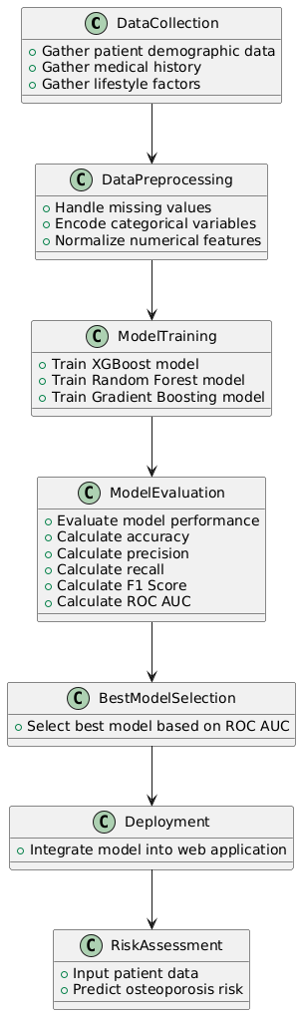
Modelling

Slide 10
Result / Outcomes
Model | Accuracy | Precision | Recall | F1 Score | ROC AUC
Decision Tree | 0.7993 | 0.7729 | 0.8647 | 0.8162 | 0.7968
Random Forest | 0.8435 | 0.9203 | 0.7624 | 0.8339 | 0.8928
Gradient Boosting | 0.9167 | 1.0000 | 0.8383 | 0.9120 | 0.9239
XGBoost | 0.8827 | 0.9209 | 0.8449 | 0.8812 | 0.9261
K-Nearest Neighbors | 0.8537 | 0.9189 | 0.7855 | 0.8470 | 0.8980
AdaBoost | 0.8690 | 1.0000 | 0.7459 | 0.8544 | 0.9145
Naive Bayes | 0.8520 | 0.9154 | 0.7855 | 0.8455 | 0.8993
Support Vector Machine | 0.8452 | 0.9454 | 0.7426 | 0.8318 | 0.9000
Extra Trees | 0.7976 | 0.8333 | 0.7591 | 0.7945 | 0.8552
Stacking Classifier | 0.8452 | 0.8655 | 0.8284 | 0.8465 | 0.9036
Bagging Classifier | 0.9099 | 0.9735 | 0.8482 | 0.9065 | 0.9238

Slide 11
Conclusion
Best Model: XGBoost
Accuracy: 0.8827
Precision: 0.9209
Recall: 0.8449
F1 Score: 0.8812
ROC AUC: 0.9261
The XGBoost model emerged as the best performer in the osteoporosis risk prediction task, achieving the highest ROC AUC score of 0.9261. This indicates that XGBoost is highly effective in distinguishing between individuals at risk and not at risk for osteoporosis.

Slide 12
Future Perspective
Model Refinement: Continuously improve the model by incorporating more diverse datasets and refining algorithms to enhance accuracy.
Integration with Healthcare Systems: Work towards seamless integration of the model into electronic health record (EHR) systems for widespread use.
User Training and Support: Develop training programs for healthcare providers to maximize the model's utility and effectiveness.
Mobile Application Development: Create a mobile app version of the risk assessment tool to increase accessibility for both healthcare providers and patients.
Research and Collaboration: Collaborate with research institutions to explore additional factors influencing osteoporosis risk and expand the model's capabilities.

Slide 13
Thank you...!
Notes:
13

