Slide 1
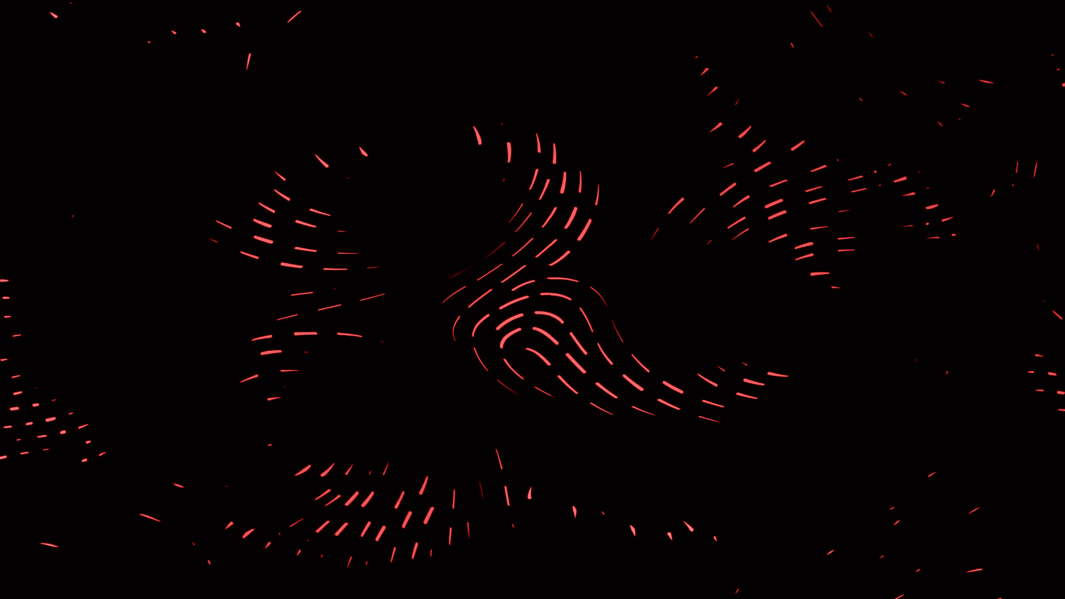
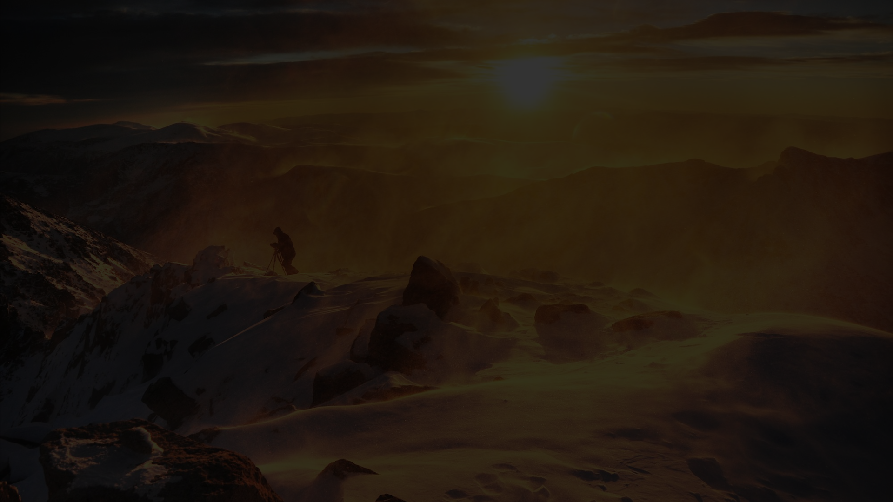
Welcome to EnviroWatch!
Our project is designed to provide you with real-time weather and clothing recommendations to make your day easier and more enjoyable. With cutting-edge technology and expert knowledge, we ensure that you are always prepared for whatever the day brings. Click the button below to learn more!

Slide 2
A Team of Experts
We are a team of three individuals with extensive knowledge in their respective fields: Deep Rathi specializes in IoT, V S Krishnan in machine learning, and Kim Sharma in environmental science. We have combined our expertise to create a powerful all-in-one weather monitoring system.
Deep Rathi
V S Krishnan
Kim Sharma
Specializes in IoT and has experience working on various IoT-based projects with a keen interest in machine learning. He graduated from Vellore Institute Of Technology.
Specializes in machine learning and has worked on various projects related to pattern recognition, computer vision, and predictive models. He is currently pursuing his studies in Vellore Institute of Technology.
Specializes in environmental science and is passionate about using technology to create a positive impact on the world. She has completed her studies in Vellore Institute of Technology and is now working towards making the environment safer.

Slide 3
Real-Time Weather Monitoring
Our project takes in temperature, humidity, and sound as inputs and using machine learning, predicts wind pressure and wind speed. The temperature, humidity, and sound graphs are constantly updated on Thinker Speak. We have also integrated a deep learning model using chatgpt which takes temperature and humidity and suggests the optimal attire to wear. With our project, you can easily check the weather conditions through WhatsApp.
1
2
3
Temperature Monitoring
Humidity Monitoring
Noise Monitoring
Our project takes real-time temperature readings to give you a better understanding of the current weather conditions in your area.
We monitor the humidity levels in your area so that you know how much moisture is in the air.
We also monitor the noise levels in your area to give you an idea of the ambient noise around you.

Slide 4

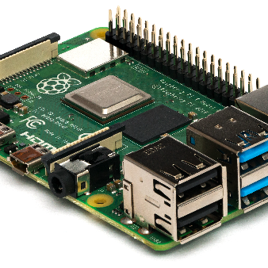
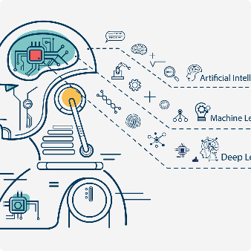
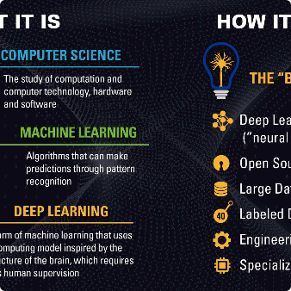
How We Do It
We use a combination of IoT, machine learning, and deep learning technologies to provide real-time weather updates and clothing recommendations. Our team is constantly working to improve our algorithms so that we can provide the most accurate predictions possible.
IoT Technology
Machine Learning
Deep Learning
We use IoT technology to gather real-time data from various weather monitoring sensors in your area.
By using machine learning algorithms, we accurately predict the weather conditions in your area.
We use deep learning algorithms to take temperature and humidity readings to suggest the optimal attire for the user.

Slide 5
The Benefits of EnviroWatch
Our project provides real-time weather updates and clothing recommendations, making your day easier and more enjoyable. With our cutting-edge technology, you can always be prepared for whatever the day brings.
Easy to Use
Accurate Predictions
Convenient Updates
Our project is easy to set up and use, with intuitive interfaces and easy-to-follow instructions to help you along the way.
By using a combination of IoT, machine learning, and deep learning technologies, we are able to provide highly accurate weather predictions.
With our project, you can easily check the weather conditions through WhatsApp, making it convenient and hassle-free.
Optimal Clothing Suggestions
Our deep learning algorithm suggests the optimal attire based on temperature and humidity levels, ensuring that you are always comfortable and stylish.

Slide 6
Application of Machine Learning in Wind Speed and Pressure Prediction
Our latest project incorporates the use of machine learning to predict wind speed and pressure based on temperature and humidity, providing highly accurate results. With our cutting-edge technology, you can stay ahead of the weather and be well-prepared for any conditions. Join the growing number of satisfied customers and experience the benefits of EnviroWatch today.

Slide 7
Future of EnviroWatch
EnviroWatch has been designed with the future in mind. We are constantly working to improve our algorithms and add new features to make our project even more useful for you.
Predicting Natural Disasters
We plan to use our technology to predict natural disasters and give people an early warning, potentially saving many lives.
Air Quality Monitoring
We also plan to integrate air quality monitoring into our project, providing real-time updates on the air quality in your area.
More Clothing Recommendations
We will continue to refine our clothing recommendation algorithm to give even more accurate suggestions and provide a more comprehensive range of clothing options.

Slide 8

Get Started Today
Don't let the weather catch you off guard. Sign up for EnviroWatch today and stay ahead of the game. Click the button below to get started!

