Slide 1
Stock Tracking Web Application
By Group 23
Anirudh, Rani, Sanjna, Shwetha

Slide 2
Goals and Project Objectives
The Goal of this project is to create a web application that allows users to track price fluctuations in their stocks of interest through an interactive user-friendly interface.
To attain our project goals, we need to:
Implement a feature that allows a new user to input their username and password to sign up, after which a notification pops-up indicating that the user has signed up
Implement a feature that allows the user to input their username and password to login, after which a notification pops-up indicating that the user has logged in
integrate a functionality that allows users to choose the stocks they wish to monitor
input a feature that allows users to input their pre-set threshold and loss-stop values.
Implement a checker in place to ensure values inputted into the system are valid (no letters, special characters, etc.)
Implement a notification system in place that will inform the user if the pre-set threshold and stop-loss value are reached.
Implement a dynamic graph that will display price trends in real time

Slide 3
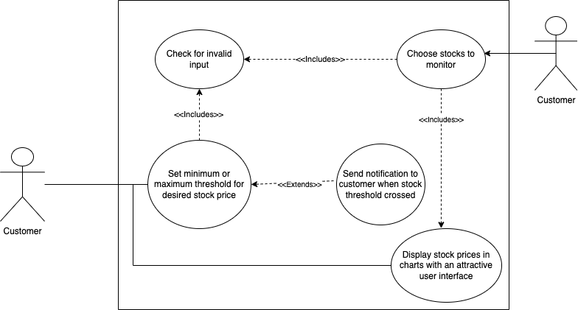
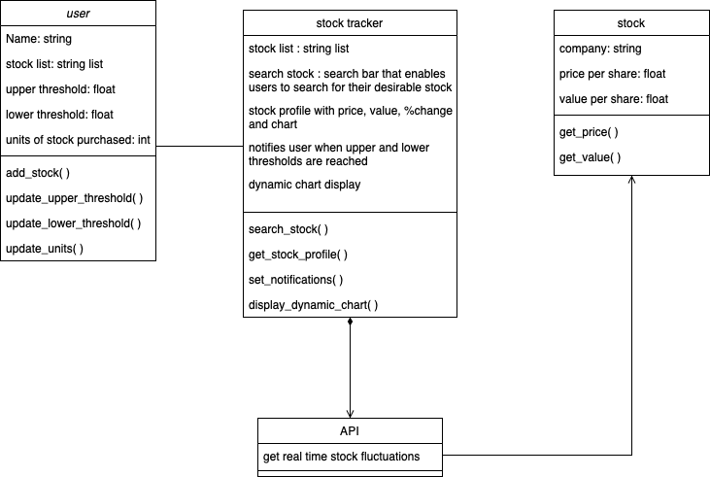
System Diagrams
2. Detailed Class
1. Use Case
Notes:
On this slide we can see a use case description for the diagram. There are two main functionalities that need to be included in our project. The customer has to be able to choose a stock to display it’s chart and be able to choose a threshold stock price. When the client chooses a stock, the stock of that particular company needs to be displayed in our user interface. When the customer chooses a threshold value, the customer should be notified when that threshold value is breached by the stock. We can also see a detailed class diagram that has been implemented. The three main classes are user stock tracker and stock. The user class gets user input for the given attributes. The stock tracker calls the API to get the stock values and chart. This is then passed to the stock class.

Slide 4
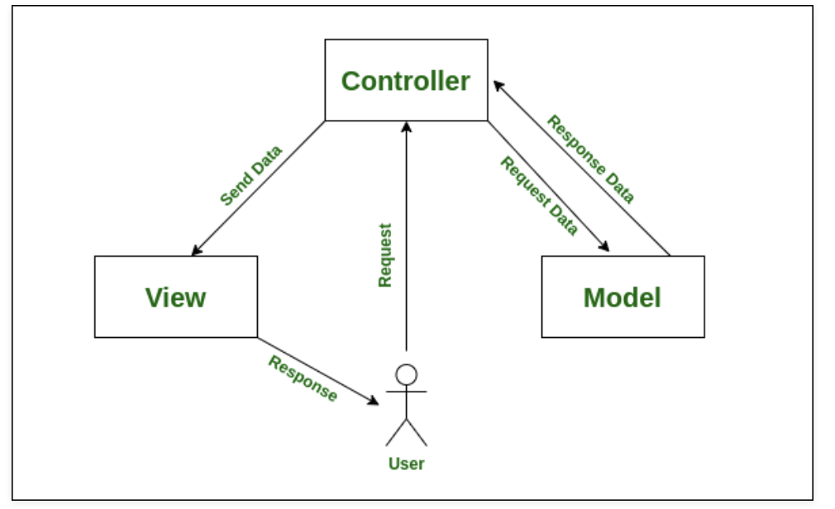
Discussion on the Application Architecture
For our application architecture, we made the choice of using the Model-View-Controller Architecture.
This is because:
It is easier to pull data from a model of the stock market.
the controller aspect is integrated because we make decisions based on user actions and breakpoints to decide what to display on view.
Notes:
For the application architecture we are using the MOdel view controller method. The controller request data from the API for the stock. This data is passed into view to present a dynamic chart. The chart is sent back to controller and returned by it on the UI. This the system architecture we are using

Slide 5
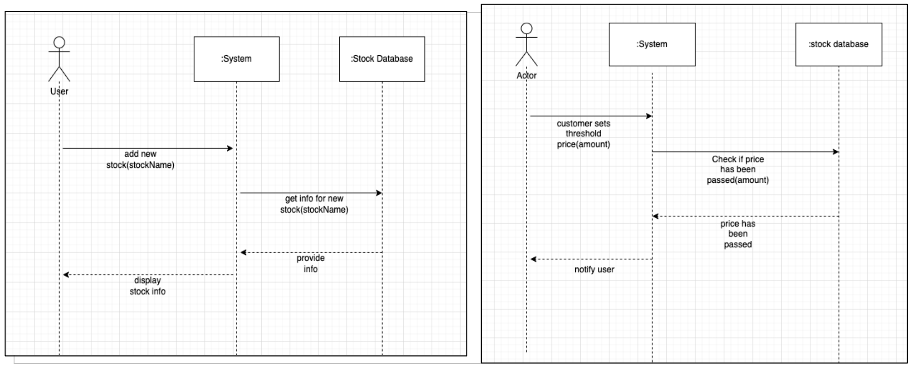
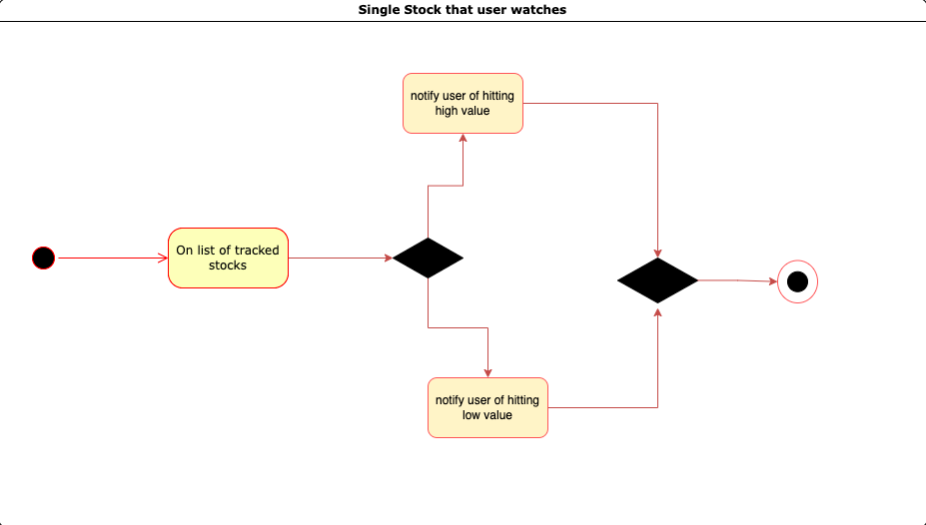
App Structure and States
1. Sequence Diagrams
2. State Diagram
Notes:
The sequence diagrams in this slide highlights the functionality of our application and the interactions between the user, system, and the stock database. The leftmost diagram highlights the users ability to search up and add a stock. The user inputs a stock name to the System. The System makes an API call to the Stock database, which in turn fetches the stock requested and its corresponding data. The API used for our application is Alpha Vantage. The data is then returned to the system and displayed for the user.
This slide also presents the State Diagram. This represents the states that the application is supposed to take on. This specific diagram represents the notification states that the System implements. Once a list of stocks to track has been administered, the System can notify the user when the set highpoint or low point have been reached. On successfully notifying the user, the state terminates.

Slide 6
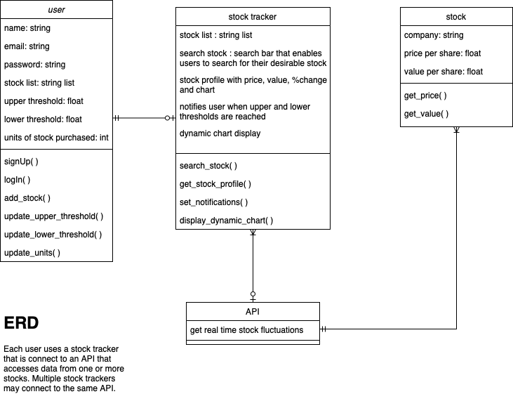
App Data Model
Notes:
We chose to use an ER Diagram as our App Data Model. This model represents the 4 entities in our application. The user, the stock tracker itself, the stock inputted by the user, and the API used. As seen by the relationship symbols used, each user has access to one stock tracker application. The stock tracker application has 1 user and 0 or 1 API. Each API has 1 or many stocks and each stock is connected to 1 API.

Slide 7
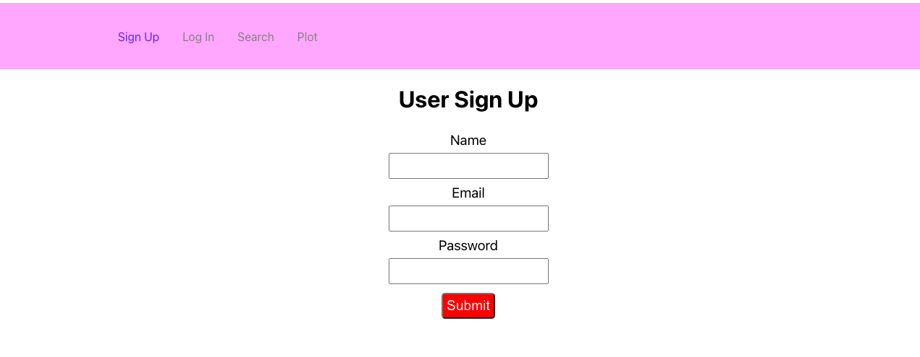
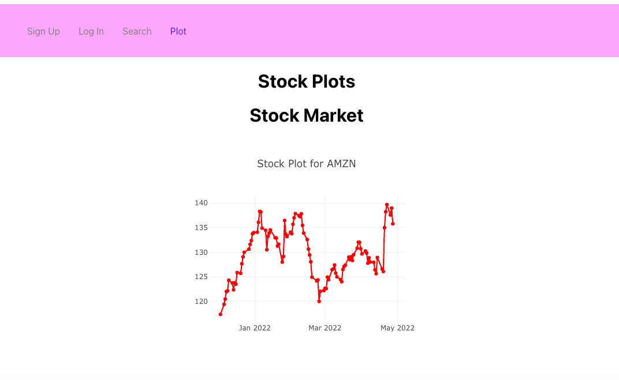
Demonstration of how our App Works
Our app allows a user to search for stocks and choose specific ones to track. This gets displayed on the main page in the form of charts.
Photos:

Slide 8
Lessons Learned and Concluding Thoughts
Our group learned many valuable lessons during the life-cycle of this project. The most important things we learnt are the following:
⁃ 1 Communication is key
- We realized that we needed to be flexible, and work through all of our ideas to reach one conclusion as a group.
- We learned how best to communicate between our members by updating each other on the state of our project as a whole and our individual assigned work
- Being receptive to everyone’s feedback and asking for help when needed
⁃ 2 Planning and being organized is essential
- We learned that planning is essential and we learned how to plan well with the help of various diagrams that helped us understand our product better: such as the system diagrams and app structure and state diagrams.
- We used a Gantt chart to plan, track and schedule meetings and attain our project goals through stepwise tasks
- We also learned the importance of documentation
⁃ 3 Project assessment, monitoring, and testing is crucial
- we did so through Peer-reviews and testing our product multiple times
- we learnt that even after good planning, things can get in the way of our goals, for eg: not having enough time to implement the notification feature that shows threshold values.
⁃ 4 Other technical skills
- How to connect the front and back end, how to use an API, etc.

