Slide 1
ChatBot
Presented By
Krishnan U
Software Developer Trainee

Slide 2
ChatBot Introduction
Chat Bot: A computer program that can talk to humans in natural language!
Uses Artificial Intelligence Markup Language (AIML) to represent knowledge.
Can replace a human for monotonous jobs of answering queries, e.g. E-help desk.

Slide 3
Looks for certain patterns of words in the user's input.
Replies with pre-determined output, if the pattern is matched.
Needs to have an idea of what the user will chat
Has suitable responses defined in the AIML file

Slide 4
Responder
AIML Interpreter
AIML Objects
A Chat Bot

Slide 5
Types of AIML objects
Topics
Categories
E.g. :
<aiml>
<topic name=“the topic” >
<category>
<pattern>PATTERN</pattern>
<that>THAT</that>
<template>TEMPLATE</template>
</category>
</topic>
</aiml>

Slide 6
Topic: an optional top-level element that contains category elements
Category: consists of an input question (pattern) and an output answer (template)
Types of Categories
Atomic Category
Default Category
Recursive Category

Slide 7
Atomic Category
Contains patterns that does not have wildcards
“*” or “_”.
Example:
Conversation:
<category>
<pattern>10 DOLLARS</pattern>
<template> wow, what a cheap </template>
</category>
User: This watch is for 10 dollars
Chat Bot: Wow, what a cheap watch!

Slide 8
Default Category
Contains patterns that have wildcards “*” or “_”.
Example:
Conversation:
<category>
<pattern>10 *</pattern> <template> It is ten.</template>
</category>
User: 10 dollars.
Chat Bot: It is ten.

Slide 9
Recursive category
Template calls the pattern matcher recursively
Uses <srai> tag, that stands for symbolic recursion artificial intelligence
For example,
In English there are different ways to ask about X:
Describe x?
Tell me about X?
Do you know what X is?
The knowledge is stored in the simplest way.
Whatever the question is, it will be reduced to category like <What is>.

Slide 10
Graph-master – an example interpreter
AIML interpreter: tries to match word by word to obtain the largest pattern matching which is the best one.
Graph-master: an interpreter that models this behavior
Contains a set of nodes called Node-mappers .
Node-Mappers : map branches from each node where branches represent the first words of all patterns.
Each leaf node contains a template.

Slide 11
AIML Object
<category>
<pattern>HELLO</pattern>
<template>Hi there!</template>
</category>
Chat Sequence
User: Hello!
Chat Bot: Hi There!
<category>
<pattern>YES</pattern>
<that>DO YOU LIKE MOVIES</that> <template>What is your favorite movie?</template>
</category>
Chat Bot: Do you like Movies?
User: Yes
Chat Bot: What is your favorite movie

Slide 12
Example
<category>
<pattern>HELLO</pattern>
<template> <random>
<li>Well hello there!</li>
<li>Hi there!</li>
<li>Hi there. I was just wanting to talk</li>
<li>Hello there !</li>
</random></template></category>
<category>
<pattern>WHAT IS 2 *</pattern>
<template><random>
<li>Two.</li>
<li>Four.</li>
<li>Six.</li>
<li>12.</li>
</random></template></category>
<category>
<pattern>_ WHAT IS 2 AND 2</pattern>
<template>
<sr/><srai>WHAT IS 2 AND 2</srai>
</template>
</category>
<category>
<pattern>HALO</pattern>
<template>
<srai>HELLO</srai>
</template>
</category>

Slide 13
Convenience
Quick & Accurate response
Complete& Robust Resolution
Service at anytime , anywhere

Slide 14
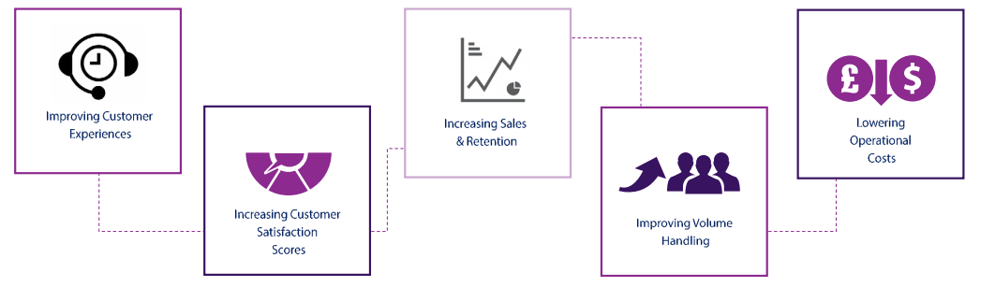

Slide 15
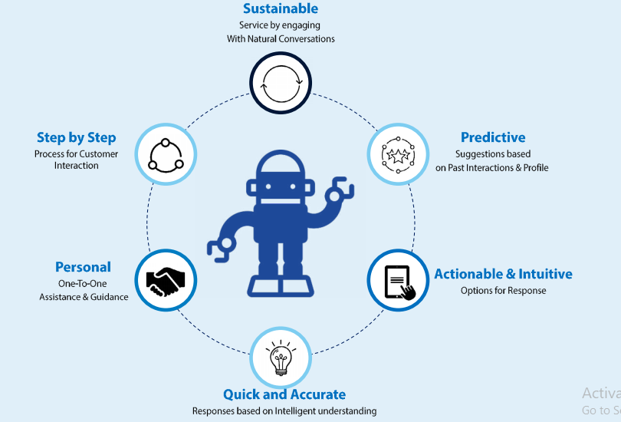

Slide 16
