Slide 1


Low Battery
Voltage Indicator

Slide 2






Prepared by
Krishna Patel
Shlok Prajapati
e.no:-21002170110139
Roll No.:-07
Raj Shah
e.no:-21002170110148
Roll No.:-24
e.no:-21002170110108
Roll No.:-14
Diya Shah
e.no:-21002170110171
Roll No.:-26
Aaliya Rangoonwala e.no:-21002170110152
Roll No.:-19

Slide 3

01
Introduction
TABLE OF CONTENTS
02
Circuit Diagram
03
Working
04
Merits & Demerits

Slide 4



Introduction
This circuit alerts the user when the battery needs changing or charging.
We have chosen the simplest way of determining that the battery capacity is low, and that’s using the battery terminal voltage.
Here the circuit comprises of components like NPN Transistor, Different types of Resistors, Led , Battery, GPB board.
4

Slide 5
NPN Transistors
They are a type of bipolar transistor with three layers that are used for signal amplification.
Resistors
They are used to reduce current flow, adjust signal levels, to divide voltages, bias active elements, etc.

Slide 6

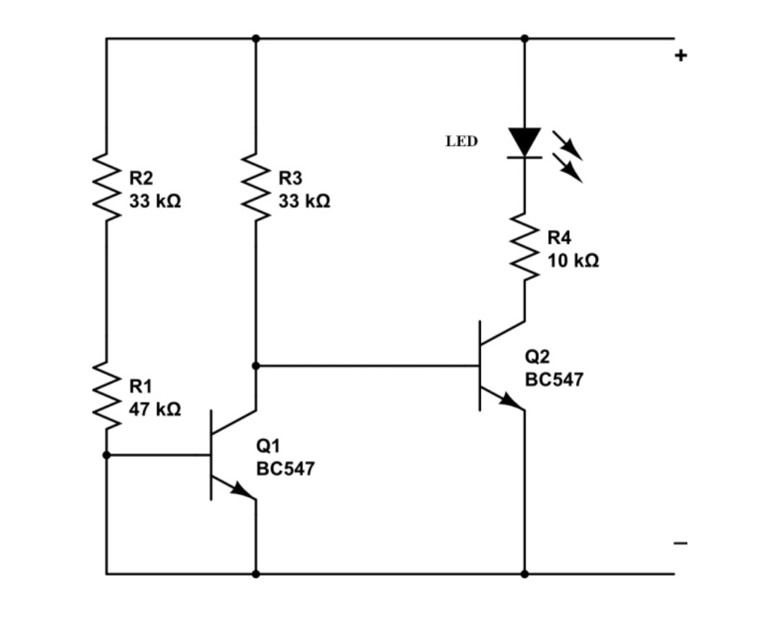

Slide 7
WORKING
The first transistor on the left senses the threshold voltage level as per the setting of the 47 K preset. As long as this transistor conducts, the current from first transistor flows to the base of second transistor.
The second transistor on the right senses the threshold voltage and then the current flows from the base and collector to the emitter and the circuit completes and gets the ground.
And the LED is turned ON. If the second transistor does not sense the threshold voltage then the circuit is not completed and it does not allow the current to flow and the LED is OFF.

Slide 8

WORKING DEMO

Slide 9

Merits and Demerits
Merits
Highly Efficient
Low Current
Consumption
Low Cost
Protects rechargeable batteries from deep discharge.
Demerits
Works only for small voltages.
Thermal runaway can occur with improper charging.

Slide 10

THANK YOU

