Slide 1

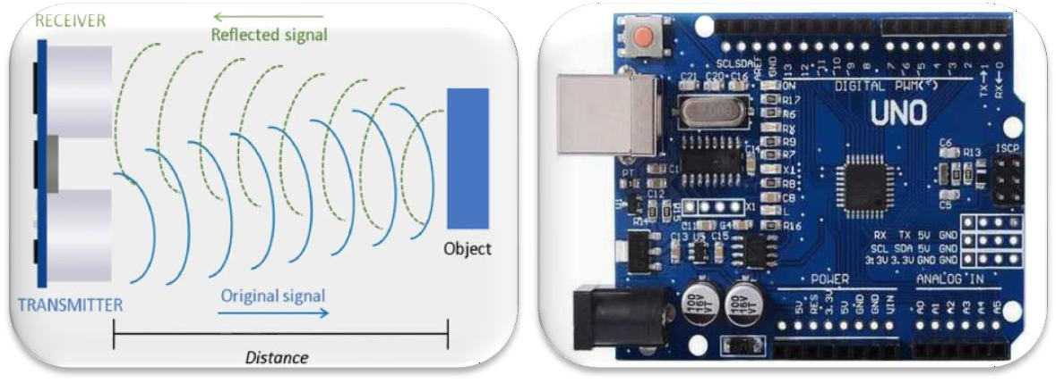
Ultrasonic based water tank measurement system

Slide 2





TEAM PRESENTATION
Yagna Dipak Patel ROLL NO : 065 ENROLLMENT NO :
2021002170110128
BATCH & DIV. : 2A-CE
Krishna Arvindkumar Patel
ROLL NO : 060
ENROLLMENT NO :
2021002170110108
BATCH & DIV. : 2A-CE
Shlok Dhirendra Prajapati
ROLL NO : 057
ENROLLMENT NO : 2021002170110139
BATCH & DIV. : 2A-CE
Rishi Dinesh Kothari
ROLL NO : 058
ENROLLMENT NO : 2021002170110062
BATCH & DIV. : 2A-CE
00

Slide 3





PROJECT OUTLINE
MERITS & DEMERITS
Practical applications & real life problems
03
INTRODUCTION
Arduino based water
level indicator system
01
02
SYSTEM DESIGN & FUNCTIONALITY
Circuit diagram &
connections
01

Slide 4

INTRODUCTION
▹ This project is an Arduino-UNO based water level indicator system.
▹ It is achieved with help of HC-SR04 ultrasonic sensor.
▹ Here the concept of depth finding is used with the help of ultrasonic waves to find water level.
02

Slide 5


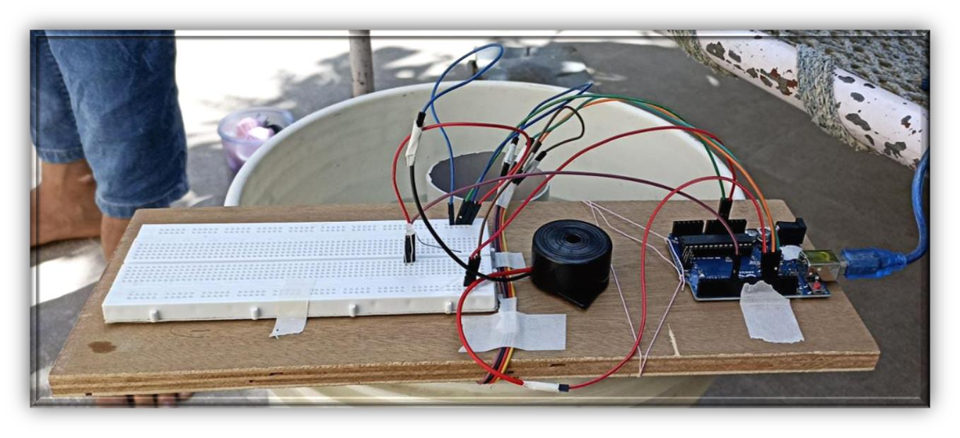
SYSTEM DESIGN
Buzzer
PVC Pipe
LED
Bread board
Arduino UNO
02

Slide 6


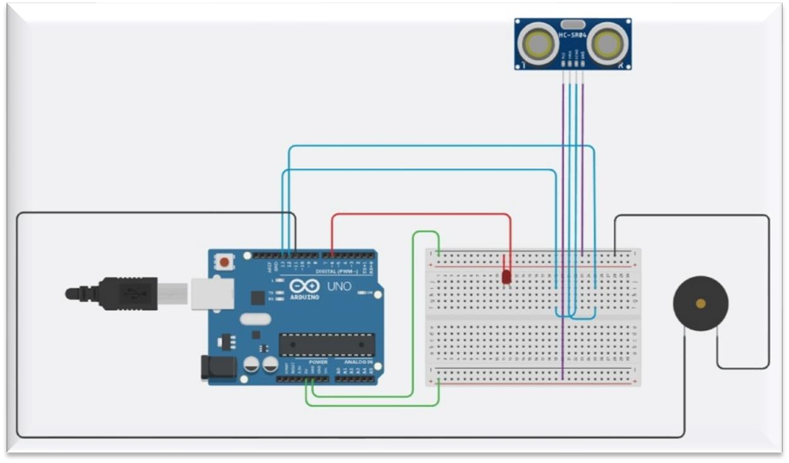
CONNECTIONS
03

Slide 7
FUNCTIONALITY
▹ This system works with ultrasonic waves detection.
▹ The waves are reflected back from a plastic ball floating on water inside PVC pipe indicating water level.
▹ LED will remain ON till water level reaches 5 cm.
▹ BUZZER will start alarming after the rise in water level of 5 cm.
04

Slide 8
MERITS & DEMERITS
▹ Can be used as an automation system on industrial level.
▹ Water pollution & wastage can be controlled.
▹ Difficult installation.
▹ May require heavy maintainance frequently.
▹ Electronics for this system
need to be build separately.
▹ Easy monitoring with LED & BUZZER system.
05

Slide 9
















THANKS!

