Slide 1

FASTEST FINGER FIRST
USING FLIP FLOP

Slide 2


TABLE OF CONTENT
2
CIRCUIT DIAGRAM
1
INTRODUCTION
3
4
WORKING
BENEFITS

Slide 3
Introduction
1
Fasted Finger First is an important circuit which is commonly used in
quizzes, games and other multi-player activities.
In quiz events, the circuit is generally used in rapid fire rounds where it has to be determined that which participant has first responded to the question.
It is necessary to use such circuit in a quiz as many times, there is a minor difference between the responses of participants.
In such cases, it becomes difficult by a human observer to determine
which participant has responded first to the query.

Slide 4
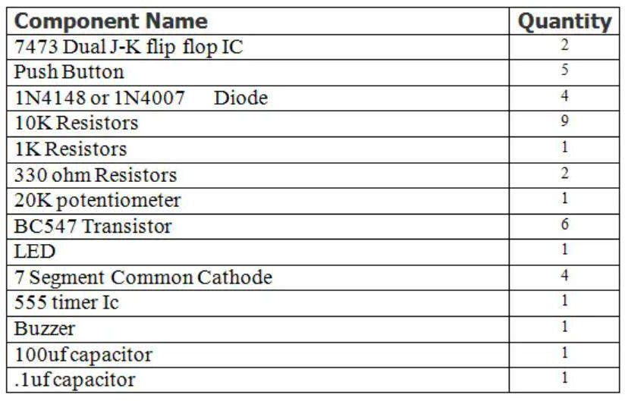
Components
2

Slide 5

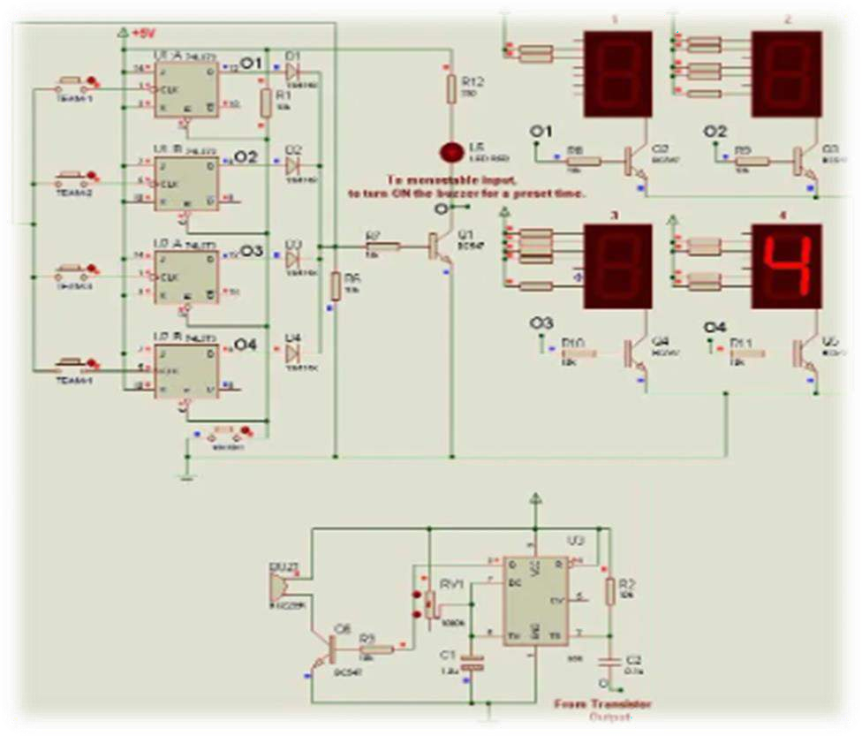
Circuit diagram
3

Slide 6
Working
4
Initially, when no participant has pressed any switch, the output of the JK Flip-Flops stays LOW and so the output of the diodes also stays LOW. When any participant presses her push button, a LOW signal is supplied to the clock input of the respective JK Flip-Flop. This LOW input appears as a negative edge of a pulse. So, the output toggles from LOW to HIGH of the respective JK Flip-Flop.
feedback is provided using shorted diodes, even if one of the outputs is HIGH, the feedback signal also sets to logic HIGH. So, the common node of the push buttons is set to logic HIGH. Now, even if, another participant operates the push button, the clock input would remain HIGH. So, only the output corresponding to the participant, which operated first, will stay HIGH.

Slide 7
Before going to the next event/question, the outputs of all the JK Flip-Flops must be LOW. For this purpose, a RESET button is connected with all the Flip Flops, which clears the outputs of all the Flip Flops.
The output of JK Flip-Flops is connected to seven-segment displays. four single digit 7-segment displays are connected such
that each display shows a fixed number. The first 7-segment display is wired to show number 1, second 7-segment display is wired to show number 2 and so on. The respective display is enabled by using the output of its JK Flip-Flop.
an LED is connected at the output stage of shorted diodes using a transistor. A buzzer can also be used instead of LED.

Slide 8
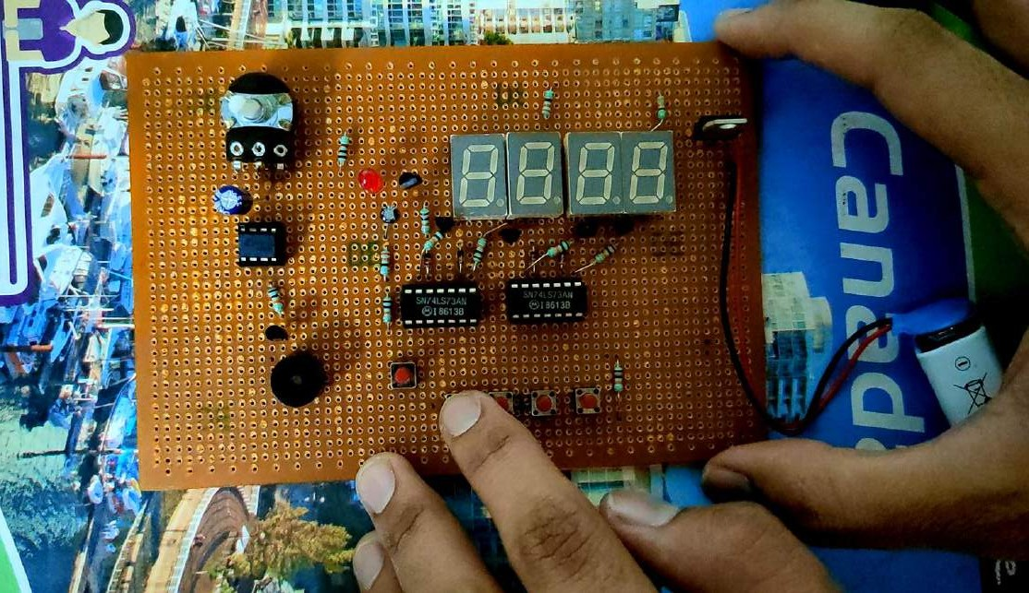
Working video
5

Slide 9
Benefits
6
1
Game shows:
In game shows, a fastest finger first circuit is often used to determine the order in which contestants get to answer a question.
2
Quiz competitions:
In quiz competitions, a fastest finger first circuit is used to determine which contestant buzzes in first with the correct answer.
Education:
Fastest finger first circuits can also be used in educational settings to create interactive learning environments. For example, a teacher can use the circuit to set up a quiz or a game where students have to answer questions as quickly as possible.
3

