Slide 1
Age and Gender Detection using CNN
Submitted by
Name: KRISHNAPRABHA K R
RegNo: 715521104025
NM Id: au715521104025
College: PSG Institute of Technology and Applied Research
Gmail: prabhakrishna2003@gmail.com
Degree: B.E Computer Science Engineering –Year III

Slide 2
PROJECT TITLE
Age and Gender Detection using CNN

Slide 3

AGENDA
The goal of the "Age and Gender Detection using CNN" project is to create an advanced computer vision system that can reliably identify a person's age and gender from face photographs. The main goal is to use Convolutional Neural Networks (CNNs) to construct a reliable model for practical uses where gender and age estimation must be done automatically.
The goal of the project is to estimate age and gender with high accuracy and efficiency using CNNs. This will make CNNs a useful tool for applications and businesses that need to extract demographic information from visual data.

Slide 4
PROBLEM STATEMENT
The problem addressed by the "Age and Gender Detection using CNN" project is the need for an automated system to reliably identify a person's age and gender from facial photographs. Traditional techniques are manual and error-prone, causing inefficiencies in marketing, retail, entertainment, and security sectors. The project aims to develop a robust system utilizing Convolutional Neural Networks (CNNs) to automate age and gender estimation. This system will provide accurate demographic insights for identity verification, content personalization, and targeted advertising.

Slide 5
PROJECT OVERVIEW
The "Age and Gender Detection using CNN" research aims to create an automated system that can reliably identify a person's age and gender. The project intends to simplify age and gender estimate procedures by utilizing Convolutional Neural Networks (CNNs). These processes are crucial in a number of industries, including marketing, retail, entertainment, and security.
The project aims to contribute to improved decision-making processes and enhanced user experiences by delivering accurate insights for identity verification, content personalization, and targeted advertising applications.

Slide 6

WHO ARE THE END USERS?
The people in the following fields are the end users,
Retail and Marketing: Using the system, marketers can assess client demographics and adjust their advertising strategies. Based on age and gender preferences, retailers can maximize their product choices.
Entertainment: By suggesting content that is catered to particular age and gender categories, content providers can customize user experiences.
Security: To improve overall security measures, age and gender detection in security applications might be useful for identity verification and access control.
Individuals: By customizing recommendations and advertising based on age and gender preferences, individuals can enhance their overall user experience.

Slide 7
SOLUTION AND ITS VALUE PROPOSITION
The solution offered by the "Age and Gender Detection using CNN" project is a robust system powered by Convolutional Neural Networks (CNNs) that automates the identification of age and gender from facial photographs. By leveraging advanced techniques in computer vision, the system ensures accurate and efficient demographic analysis, addressing the need for precise age and gender estimation across various sectors.
The value proposition of this solution includes:
Accuracy: Precise age and gender estimation minimizes errors and ensures reliable results.
Efficiency: Automation saves time and resources compared to manual methods, improving operational efficiency.
Insights: Accurate demographic insights empower businesses to tailor their strategies and offerings to specific age and gender demographics.
User Experience: Personalized content and targeted advertising based on demographic data enhance user engagement and satisfaction.

Slide 8
THE WOW IN MY SOLUTION
State-of-the-Art Accuracy: By utilizing convolutional neural networks (CNNs), our system accomplishes age and gender detection with unprecedented accuracy. It can analyze facial features more accurately than ever thanks to advanced deep learning techniques, outperforming conventional approaches and raising the bar for demographic analysis dependability.
Real-Time Efficiency: Our system's exceptional speed and efficiency allow for the real-time estimation of gender and age from facial photos. Using CNNs to automate this process removes the need for time-consuming manual analysis and provides quick insights that can be easily incorporated into a variety of applications.

Slide 9
MODELING
The frameworks commonly used in the "Age and Gender Detection using CNN" project include Keras and TensorFlow for building and training deep learning models, OpenCV for image processing tasks, NumPy for numerical computations and data manipulation, and Matplotlib for visualization of model training and evaluation metrics. These frameworks provide essential tools and libraries for developing, training, and evaluating Convolutional Neural Networks (CNNs) for age and gender detection tasks efficiently and effectively.

Slide 10
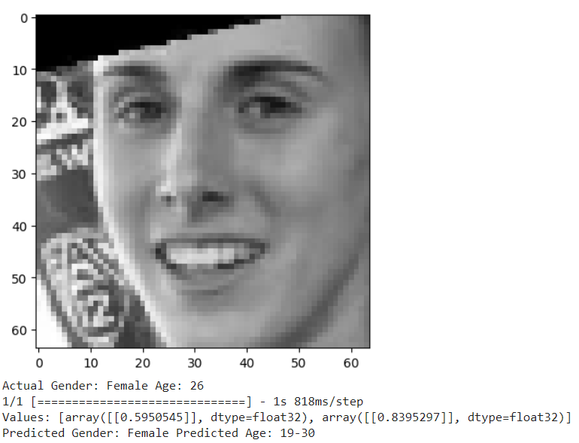
RESULTS

Slide 11
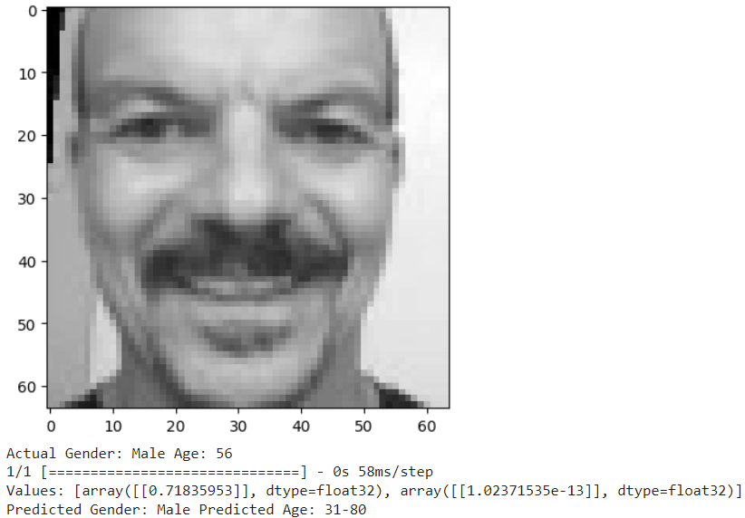
RESULTS

