Slide 1
Human resources slide 1
POPULATION CENSUS
AND
DEMOGRAPHIC INSIGHTS
ANALYTICS SYSTEM
An End-to-End Data Analytics Pipeline
Presented By K. Krishna Priya

Slide 2
Human resources slide 2
AGENDA
Introduction
Problem Statement & Objective
Datasets
Project Architecture
The Medallion Architecture
Workflow Orchestration
Visualizations
Use Cases
Limitations
Conclusion

Slide 3

Human resources slide 3
WHAT IS MEANT BY POPULATION CENSUS?
WHAT IS MEANT BY DEMOGRAPHIC INSIGHTS AND HOW POPULATION CENSUS IS USEFUL FOR DRAWING INSIGHTS?
Population refers to the total number of people living in a particular area at a specific time.
Population Census is the official counting of the population of a country carried out by the government at regular intervals (usually every 10 years).
A population census collects detailed information such as age, sex, occupation, literacy, and living conditions of people.
The data from a population census helps the government in planning development, making policies, and allocating resources like schools, hospitals, and housing.
Demographic insights are the meaningful conclusions or understandings drawn from population data
A population census collects detailed data about the people living in a country.
This collected data is then analyzed to produce demographic insights.
These insights are used for policy-making, development planning, and resource distribution.
INTRODUCTION

Slide 4
Human resources slide 4
PROBLEM STATEMENT & OBJECTIVES
Problem Statement
Data Fragmentation: Census datasets are massive and stored across disconnected files, creating a "data silo" effect that prevents a unified national view.
Manual Inefficiency: Traditional demographic analysis relies on slow, manual spreadsheet processing, leading to human error and inconsistent reporting.
Data Quality Issues: Raw public data often contains missing values, duplicates, and non-standardized geographic codes that distort policy decisions.
The "Insight Gap": Without automation, policymakers lack real-time visibility into how literacy, age, and employment correlate across different regions.

Slide 5
Human resources slide 4
PROBLEM STATEMENT & OBJECTIVES
Objectives
Automated Pipeline: Standardize data ingestion and cleaning using Python and PySpark for high-speed processing.
Workflow Orchestration: Ensure 100% data reliability by scheduling and monitoring the end-to-end flow using Apache Airflow.
Strategic Visualization: Deliver DirectQuery Power BI Dashboards to provide stakeholders with localized (District) and strategic (State) demographic KPIs.
Actionable Insights: Enable policymakers to track critical trends like Gender Ratios, Urbanization Rates, and Literacy levels through interactive drill-downs.

Slide 6
Human resources slide 5
Population
DATASETS
Region
The region dataset defines the geographical hierarchy used across the project.
Population
To capture population distribution across regions and demographic dimensions.
Region
Literacy
Employment
Literacy
To analyze literacy levels across regions and demographic groups.
Employment
To study workforce participation and employment structure.

Slide 7
DATASETS DESCRIPTION
Region
Description: It contains official state and district identifiers along with their names and administrative classification (state or union territory). This dataset acts as a master reference and is used to validate regional identifiers in other datasets.
Key Use Cases In Project:
Regional validation and consistency checks
Joining population, literacy, and employment data
Enabling region-wise analytics and comparisons
Population
Description: This dataset records population counts by state and district, segmented by year, age group, gender, ethnic group, and area type (total, rural, urban). It provides the foundation for demographic and growth analysis.
Key Use Cases In project:
Population growth analysis
Age and gender distribution trends
Rural vs urban population comparison

Slide 8
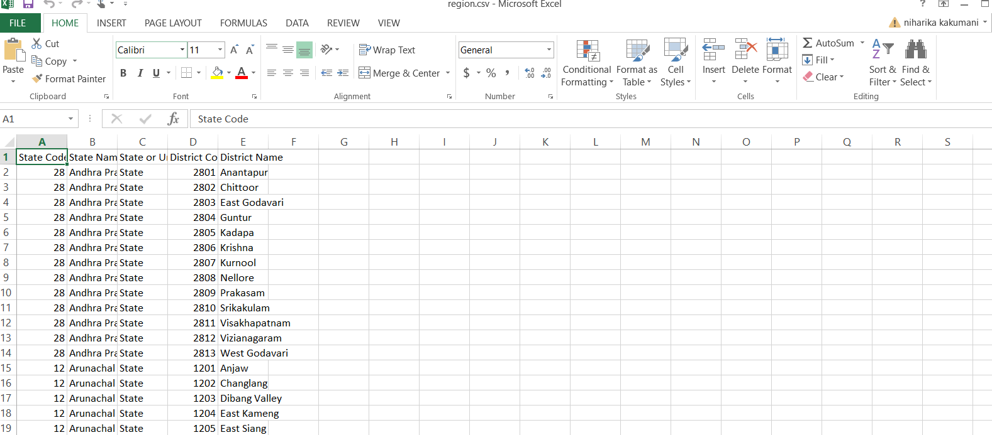
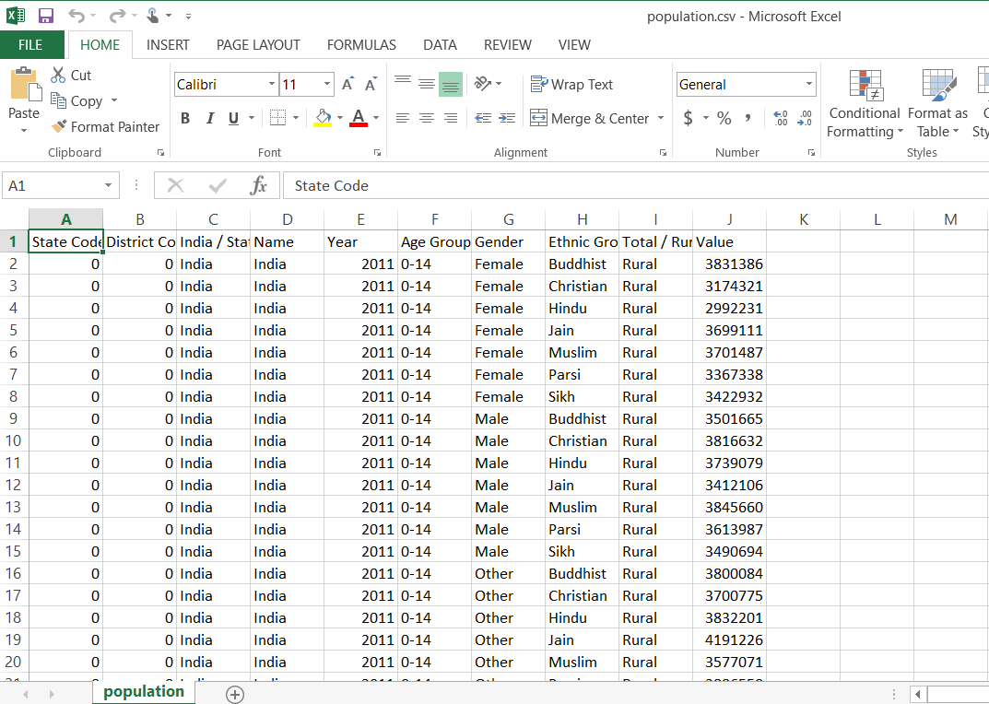
DATASETS DESCRIPTION
Region Dataset-182 Records
Population Dataset-120330 Records

Slide 9
DATASETS DESCRIPTION
Literacy
Description: The literacy dataset contains population counts classified by literacy status (Literate or Illiterate), along with age group, gender, ethnic group, year, and area type. It is used to compute literacy rates and identify regional disparities.
Key Use Cases In Project:
Literacy rate calculation
State and district-level literacy comparison
Correlation analysis with employment and population
Employment
Description: This dataset records employment counts by State and District, categorized by age group, gender, ethnic group, employment status, and economic sector (Primary, Secondary, Tertiary, and Not in Labour Force). Special handling is applied for age groups not eligible for employment.
Key Use Cases In Project:
Employment rate analysis
Sector-wise employment distribution
Workforce planning and policy insights

Slide 10
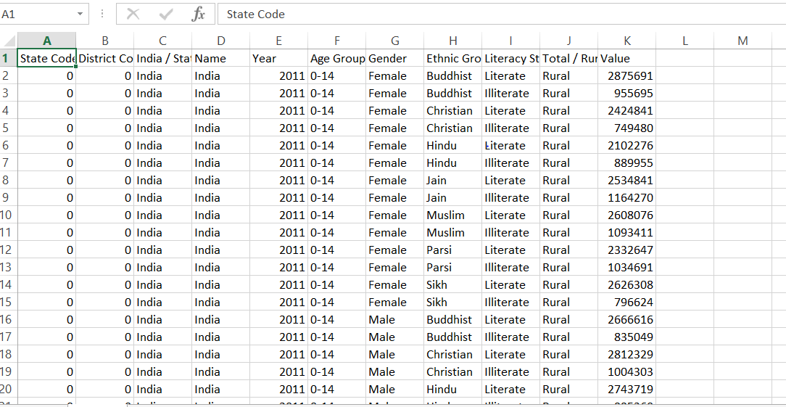
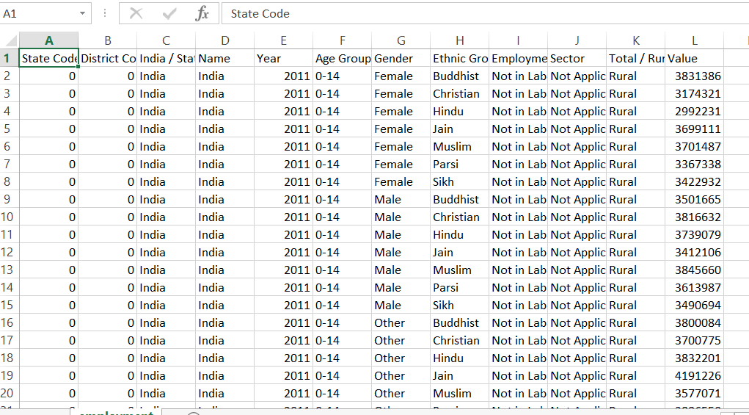
DATASETS DESCRIPTION
Literacy Dataset-240661 Records
Employment Dataset- 312859 Records

Slide 11

Human resources slide 7
PROJECT
ARCHITECTURE
DATA CLEANING AND TRANSFOR-MATION
Silver Layer
DEMOGRA-PHIC ANALYTICS
Gold Layer
DATA
INGESTION
Bronze Layer
WORKFLOW
AUTOMATION
VISUALIZATION

Slide 12
PROJECT ARCHITECTURE
Ingestion: An entry layer that loads raw datasets using Python, ensuring that all incoming data adheres to predefined schemas and regional identifiers.
Transformation & Cleaning: A data-refining process that cleans inconsistent demographic records and standardizes labels to create high-fidelity aggregated metrics.
Data Analytics: A processing layer dedicated to computing complex demographic trends, including population growth, gender distributions, and socio-economic indicators like literacy and employment.
Workflow Automation: The control center powered by Apache Airflow, which manages scheduled ETL pipelines with built-in retries, logging, and performance monitoring.
Visualization Layer: The final consumption stage where refined data is visualized through Power BI dashboards, delivering interactive charts and KPIs tailored for evidence-based policymaking.

Slide 13
Human resources slide 8
THE MEDALLION ARCHITECTURE
1. Bronze Layer:
Immutable Data Capture: It acts as a first target landing area where the census data (CSV/JSON files) is loaded into delta tables with no changes.
Auditability & Lineage: It keeps a record of all the source data so that all such data could be traced for audits and even re-computed if the logic changed.
Schema On Read: Employs Spark to read large data sets quickly and capture naive region identifiers and demographic variables for validation purposes.
Bronze
Silver
Gold

Slide 14
Human resources slide 8
THE MEDALLION ARCHITECTURE
2. Silver Layer:
Data Quality Enforcement: Enforces strong cleaning rules to deal with missing values, eliminate duplicates, and normalize faulty demographic data.
Geographic Standardization: This involves the verification of the state and district codes of each area to ensure consistent comparisons.
Intermediate Aggregation: It generates refined conformed Silver Aggregation Tables, by considering Year, Literature, and Employment for grouping.
3. Gold Layer:
KPI Calculation: Implements complex business logic to determine key policy indicators including Gender Ratios, Urbanization percentages, and correlations between Literacy and Employment.
Performance Optimization: Builds denormalized, high-speed tables optimized for direct query connectivity with Power BI.
Decision Ready Insights: Provides the final single source of truth, that policymakers rely upon to inform
Bronze
Silver
Gold

Slide 15
WORKFLOW ORCHESTRATION
Sequential Task Execution: Uses a Directed Acyclic Graph (DAG) to ensure a strict logical flow, preventing downstream transformations from starting until upstream data is validated.
Dockerized Deployment: Orchestration is hosted within a Docker container, providing a portable and consistent environment that isolates the Airflow scheduler from local OS dependencies.
Hybrid Cloud Integration: Leverages the DatabricksRunNowOperator to bridge the local Airflow environment with the Azure Databricks cloud, triggering Spark jobs via secure API calls.
Automated Dependency Management: Eliminates manual intervention by automatically triggering the Bronze -> Silver -> Gold layers sequence based on successful completion signals.
Pipeline Resilience: Features built-in retry logic and error logging, which automatically handles transient network issues and provides detailed audit trails for troubleshooting.
Real-Time Monitoring: Utilizes the Airflow Web UI to provide stakeholders with a visual dashboard of pipeline health, task duration, and execution status.

Slide 16
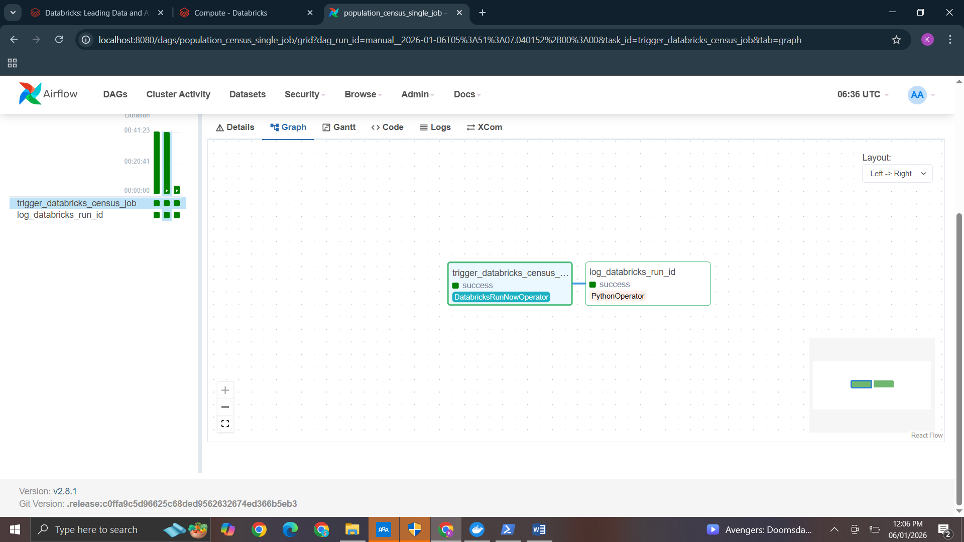
WORKFLOW ORCHESTRATION
Outputs

Slide 17
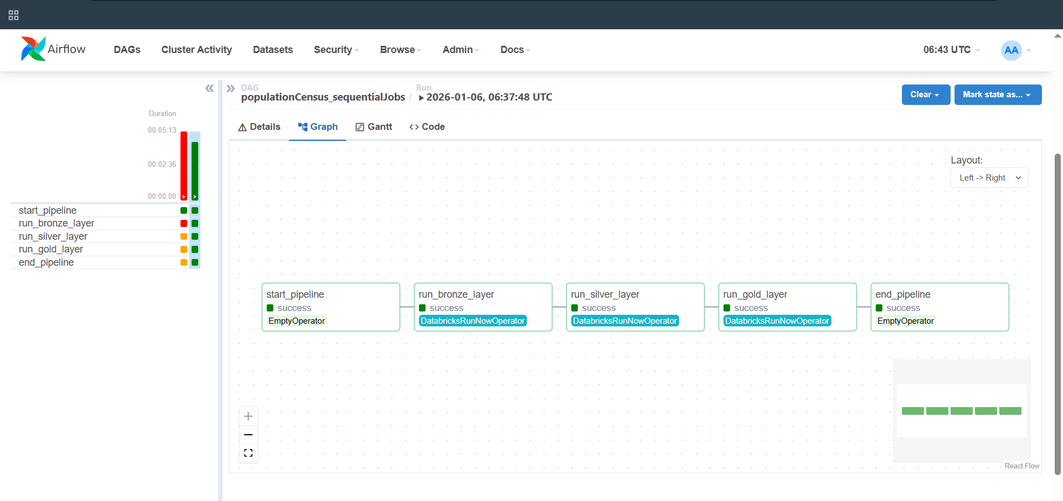
WORKFLOW ORCHESTRATION
Outputs

Slide 18
VISUALIZATIONS
Real-time Integration to Databricks: To provide live access to processed Gold-layer census data directly without the need for data duplication, a Databricks Power BI Connector is utilized with the DirectQuery mode.
State-Level Strategic Insights: Uses treemaps to show the population distribution of a state and donut charts to depict sectorwise proportions of workers. It will be useful for high level executives' decision-making.
Granular District Drill-Downs: Includes a District Slicer and local bar charts, which enable administrators to quickly compare a selection of placed regional metrics on urban population and literacy rates.
Demographic Profile Analysis: The 100% Stacked Bar Chart allows for a comparison across population age groups and gender to observe workforce trends and regional social needs.
Benchmarking operational: Through Funnel Charts and sorted tables, w can track the Top 10 and Bottom 10 districts to show urgent gaps in literacy and gender parity.
Silver Layer Data Validation: The visualizations include a specific Silver Aggregates dashboard to monitor the quality of created aggregates.

Slide 19
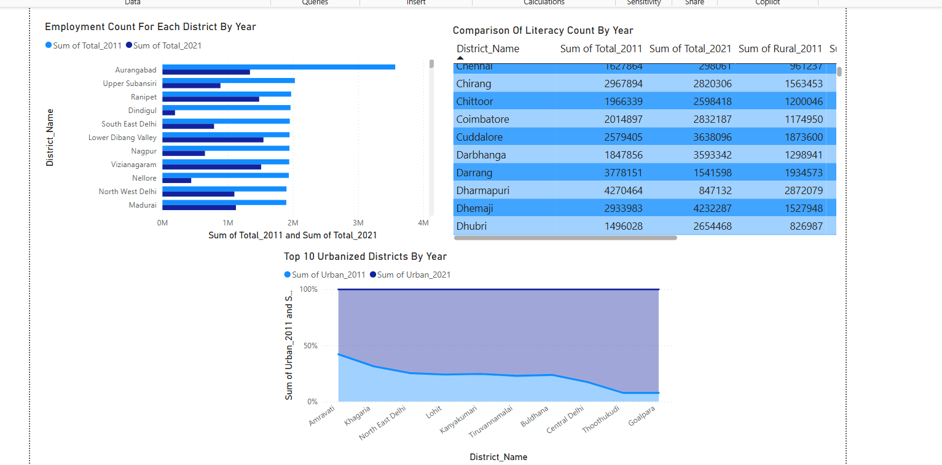
VISUALIZATIONS
District-Wise Visualizations

Slide 20
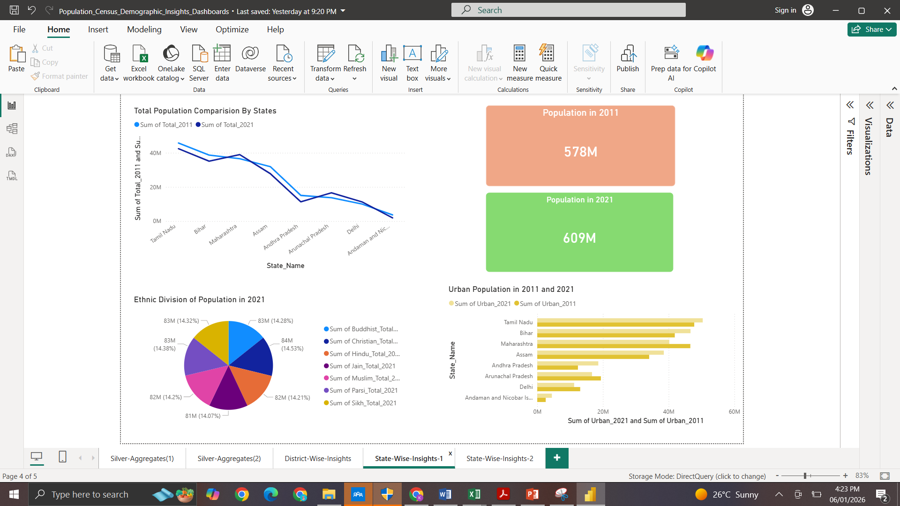
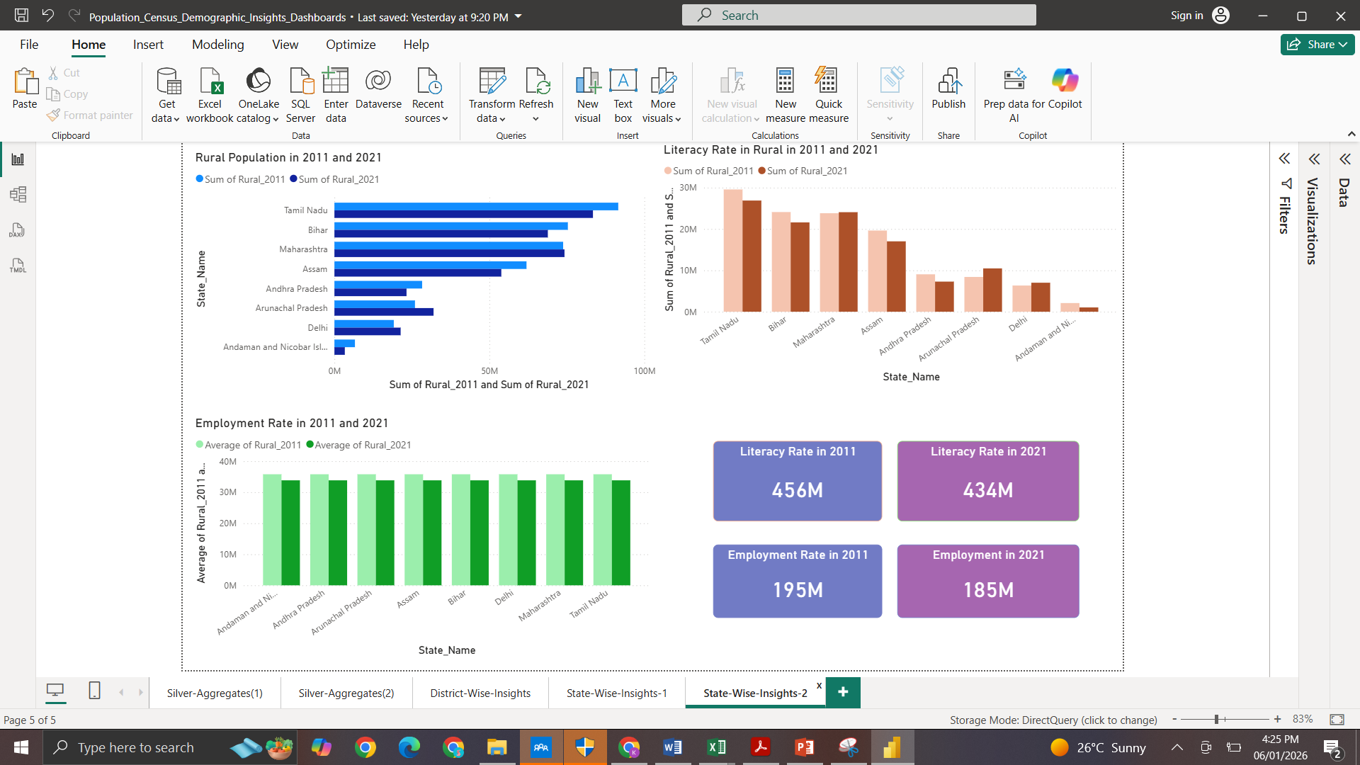
VISUALIZATIONS
State-Wise Visualizations

Slide 21
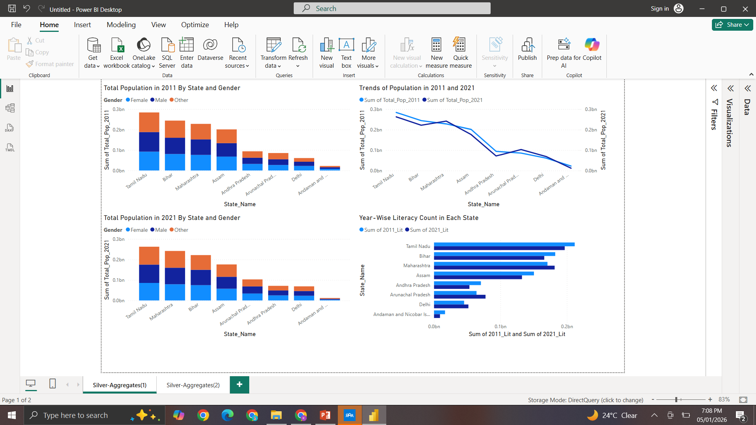
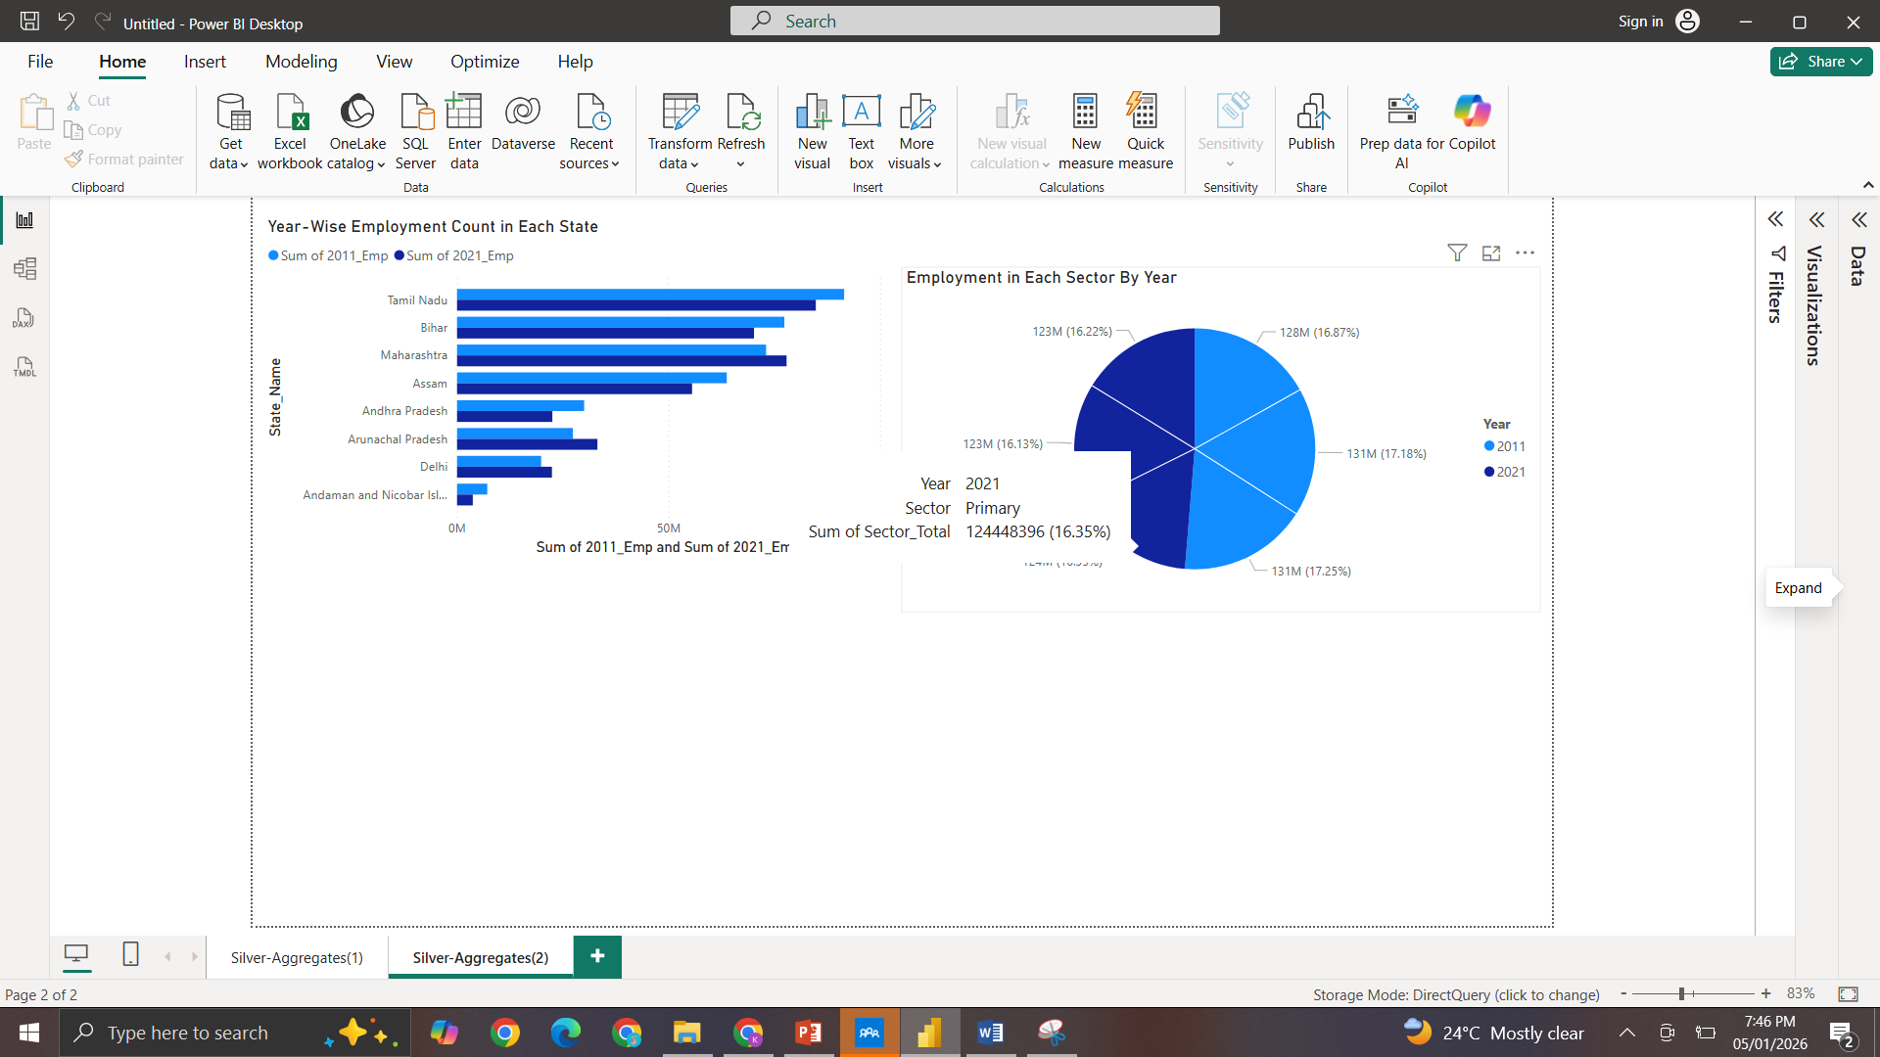
VISUALIZATIONS
Silver Aggregates

Slide 22
USECASES
Evidence-Based Governance: Enables policymakers to identify literacy gaps and gender imbalances using Treemaps for targeted funding and social welfare programs.
Infrastructure Optimization: Analyzes population density and age-group distributions to strategically locate hospitals, schools, and public transport routes.
Data Integrity & Scalability: Provides an automated, audit-ready pipeline that can be rapidly adapted for other large-scale data needs, such as economic forecasting or crisis management.

Slide 23
LIMITATIONS
Real-Time Processing: The pipeline is currently batch-oriented; implementing Structured Streaming would allow for real-time administrative data ingestion.
Automated Alerting: Integrating Slack or Email notifications into the Airflow DAG would proactively alert stakeholders when KPIs cross critical thresholds.
Data Integration: Expanding the model to include climate and infrastructure spending data would provide a more comprehensive socio-economic view.

Slide 24
CONCLUSION
End-to-End Automation: Successfully engineered a production-grade pipeline that automates the journey of raw census data from ingestion to interactive visualization with zero manual intervention.
Architecture Integrity: Implemented a robust Medallion Architecture using Delta Lake, ensuring that data is cleaned, standardized, and validated through three distinct hops for maximum reliability.
Unified Intelligence: Developed a suite of high-performance dashboards that bridge the gap between complex big data engineering and actionable policy insights for national and local stakeholders.

Slide 25
Human resources slide 10
Thank You

