Slide 1
REACT JS

Slide 2
BASICS OF
REACT DEVELOPMENT
By Cibi Nandan Kannan

Slide 3
SUMMARY
Before React JS.
What, Why, When React JS?
Inside React JS.
Environment Needed.
Node CLI commands.
React Project structure.
Components.
Life Cycle of Components.
Data flow.
Connect with services.
State Management.
CSS styling.
Routing.
Build and Deploy.

Slide 4
Before React JS
What is HTML?
A markup language that is used to structure the visible part of the website. Need to Know Basics.
What is CSS?
A Styling language to style HTML structure/elements in the website. Need to know Basics.
(border box)
What is Java script?
A scripting language to make HTML structure interactive to user. Need to know Basics.
(objects, scope, state, arrow functions, composition pattern)
What is JSX?
A extension of Java Script, that helps in writing JS-in-HTML-in-JS
How Browser works?
Process HTML markup and build the DOM tree.
Process CSS markup and build the CSSOM tree.
Combine the DOM and CSSOM into a render tree.
Run layout on the render tree to compute geometry of each node.
Paint the individual nodes to the screen.

Slide 5
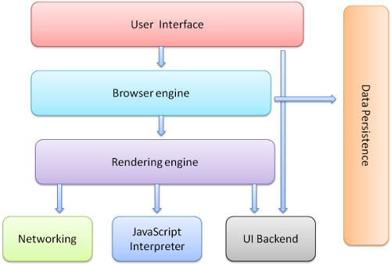

Slide 6
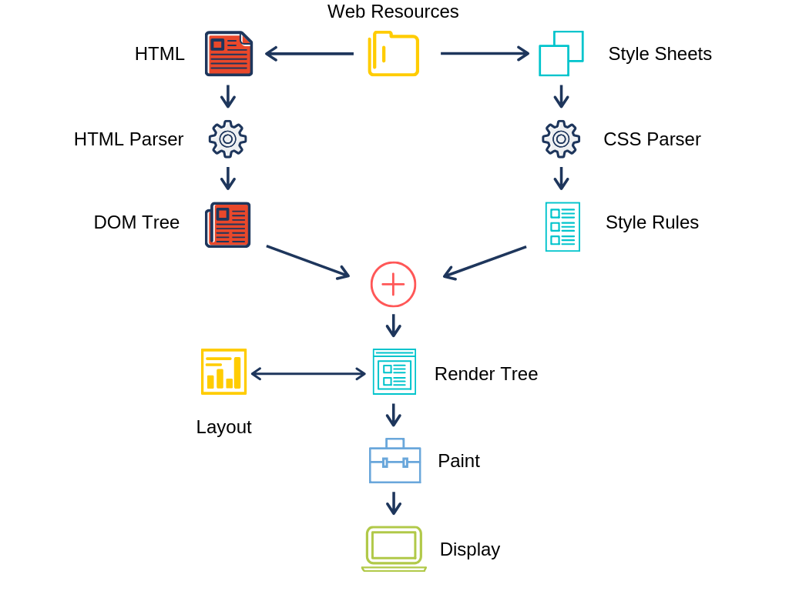

Slide 7
Before React JS
What is DOM?
Document Object Model - It maps the entire Document into an hierarchy of parent and child tree. Each node can hold number of children element or can inherit to other parent element in some or the other way. JavaScript can control the changes happening in DOM by making it interactive to user inputs.
What is Node.JS?
Its a JavaScript runtime based on chrome's V8 engine for development purpose.
Its used to create server side JavaScript applications that are asynchronous and Non blocking.
What is NPM?
Its a default built in tool to manage JavaScript packages.

Slide 8
What, Why, When React JS?
What
It is a JavaScript library created by Facebook for the main purpose of SPA.
Why
It is very fast and uses JSX which is similar to JavaScript and has single.
React allows adding JavaScript library to the source code which helps in rapid development of UI.
Code Stability with One-directional data binding.
When
You need an app with multiple events.
When your application development team has expertise in HTML, CSS, and JavaScript.
You should use React when your requirement demands a personalized app solution.
You want to create shareable components in your app project.

Slide 9
Inside React JS
RECONCILIATION
At its very core, React basically maintains a tree for you. This tree is able to do efficient diff computations on the nodes.
React allows you to effectively re-construct your DOM in JavaScript and push only those changes to the DOM which have actually occurred.
document.getElementById('some-id').innerValue = 'updated value';
When writing the above code in the console or in the JavaScript file, these things happen:
The browser parses the HTML to find the node with this id.
It removes the child element of this specific element.
Updates the element(DOM) with the ‘updated value’.
Recalculates the CSS for the parent and child nodes.
Update the layout.
Finally, traverse the tree and paint it on the screen(browser) display.
React has a different approach to dealing with this, as it makes use of something known as Virtual DOM.
.

Slide 10
Inside React JS
VIRTUAL DOM - In React, Virtual DOM exists which is like a lightweight copy of the actual DOM. So for every object that exists in the original DOM, there is an object for that in React Virtual DOM. It is exactly the same, but it does not have the power to directly change the layout of the document.
DIFFING - React maintains two Virtual DOM at each time, one contains the updated Virtual DOM and one which is just the pre-update version of this updated Virtual DOM. Now it compares the pre-update version with the updated Virtual DOM and figures out what exactly has changed in the DOM. Once React finds out what exactly has changed then it updated those objects only, on real DOM

Slide 11
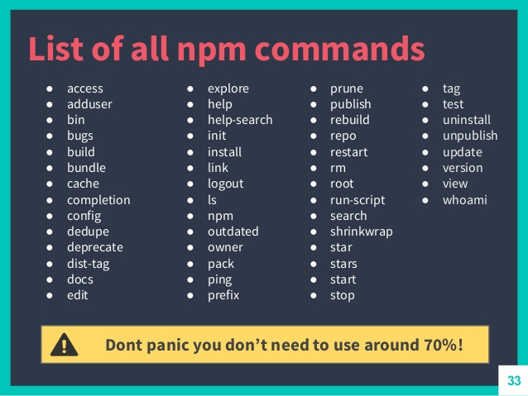
NODE CLI COMMANDS
Need to prefix with the keyword npm “command ”

Slide 12
LETS START BUILDING YOUR APP

Slide 13
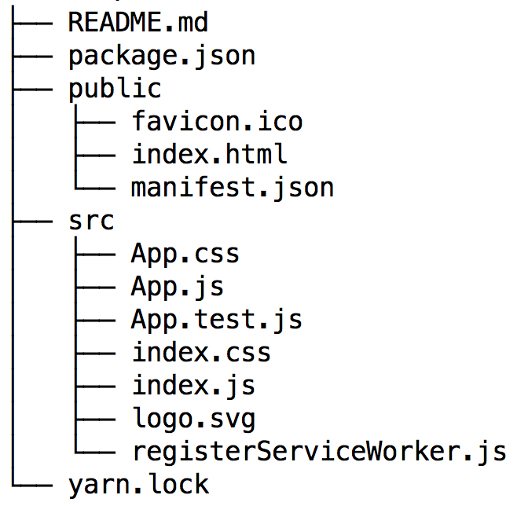
React Project structure
Open a empty directory and open command prompt.
Type npx create-react-app “App name”.
When you first run create-react-app, you’ll end up with a folder like this.
Inside src folder following are the common pattern followed while creating a react app.
src/api.js - You’ll probably need to make calls to a backend API at some point. Put all that code here. If it gets too unwieldy in one file, make a src/api directory and put the area-specific API files under there – like userApi.js, productApi.js, etc.
src/components - All your Presentational (aka Dumb) components go here. These are the simple stateless ones that just take props.

Slide 14
React Project structure
7. src/containers - The Container components go here. These are the stateful ones, and the ones that make the API calls. If you’re using Redux, these are the ones that are connected to the store. Notice that CSS and tests are in the same folder as their respective components.
8. src/index.js - This is where you initialize the app and call ReactDOM.render, so it makes sense to keep this at the top level.
9.src/utils - You’ll probably end up with miscellaneous utility functions – error handlers, formatters, and the like. I usually put them in a file inside utils so I can access them easily.
10. src/images - Put the images in one place to start with.
Now run “npm start” in the same command prompt and your app will be launched in http://localhost:3000 this url.

Slide 15
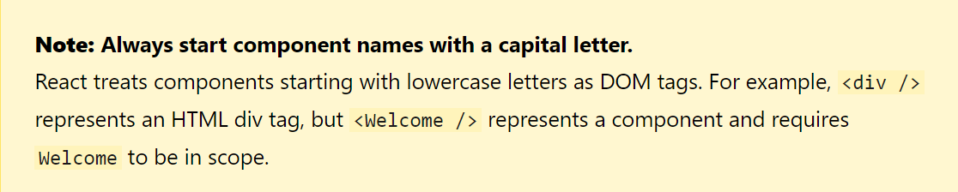
Components - Its Types
Components are the building blocks of any React app and a typical React app will have many of these. Simply put, a component is a JavaScript class or function that optionally accepts inputs i.e. properties(props) and returns a React element that describes how a section of the UI (User Interface) should appear.
Two types of components are there in react.
FUNCTIONAL COMPONENT.
CLASS COMPONENT.

Slide 16
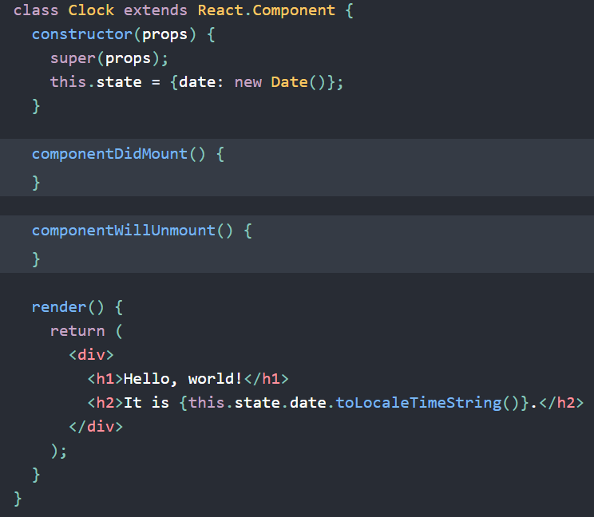

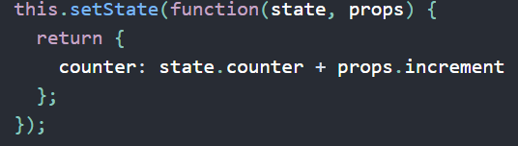
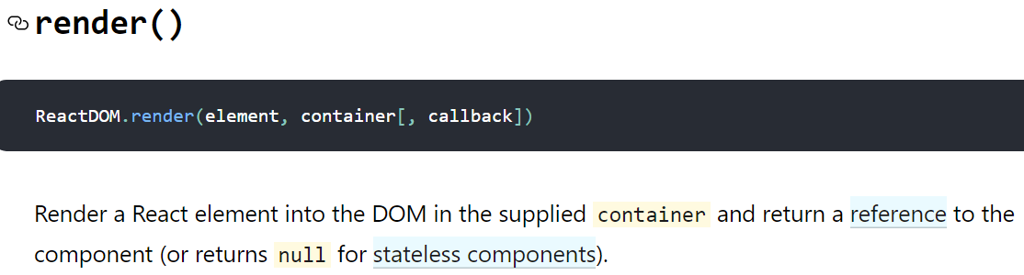
Components – Class
Class syntax is one of the most common ways to define a React component.
While more verbose than the functional syntax, it offers more control in the form of lifecycle methods.
It has internal state and accepts props.
“this” keyword is used to access the class Properties.
To Modify state
setState accepts a function which takes previous state
and props as parameters.

Slide 17
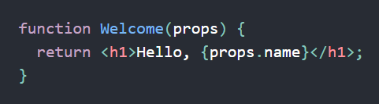
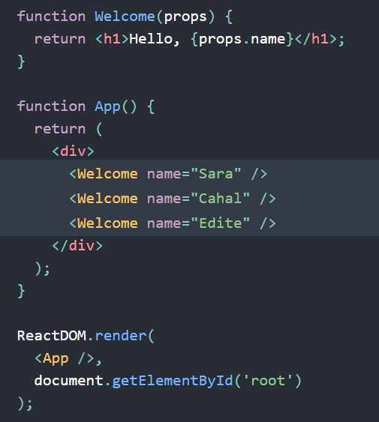
Components – Function
Functions are easy way to create a component which doesn’t have a render method so it basically doesn’t change the DOM. It accepts Props and are stateless.
React is pretty flexible but it has a single strict rule:
All React components must act like pure functions with respect to their props.
Composing Components
Components can refer to other components in their output. This lets us use the same component abstraction for any level of detail.
Extracting Components
Components can be split into few smaller components which can be reused through out our App.

Slide 18
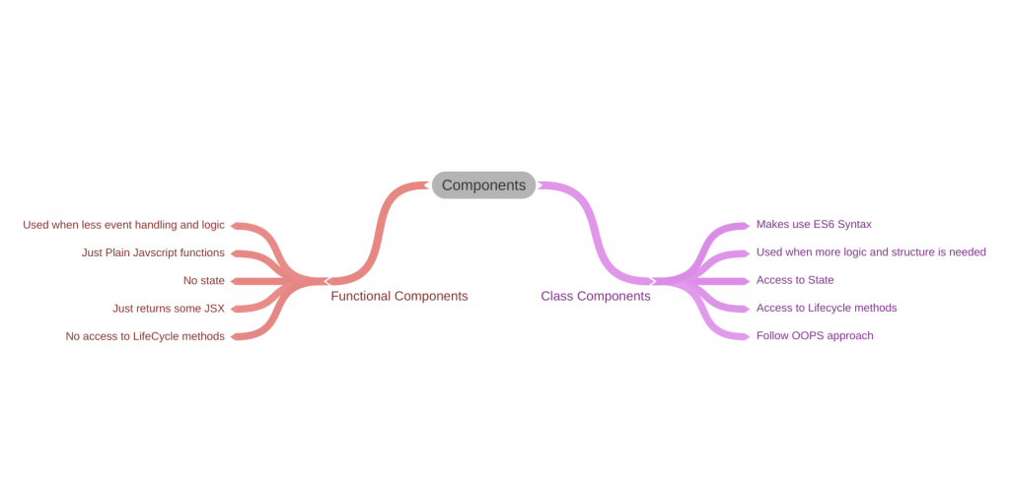
Components – Difference

Slide 19
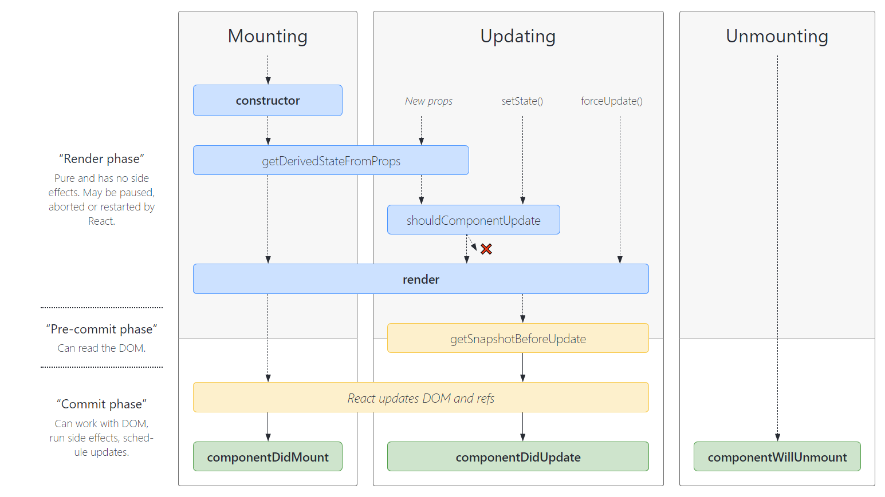
Lifecycle Methods – Class
Each component has several “lifecycle methods” that you can override to run code at particular times in the process.
https://projects.wojtekmaj.pl/react-lifecycle-methods-diagram/

Slide 20
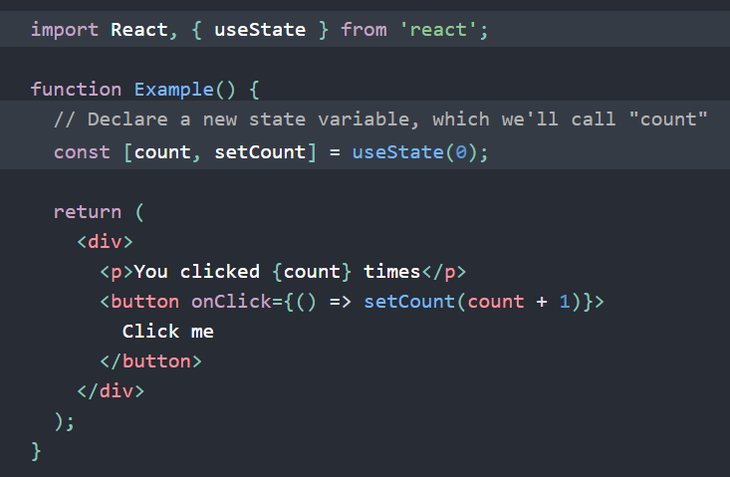
Lifecycle Methods – Functions (HOOKS)
Functions are basically stateless when introduced first. But then React org introduced Lifecycle hooks to make functional Component statefull like class.
Hooks are functions that let you “hook into” React state and lifecycle features from function components. Hooks don’t work inside classes
TYPES OF HOOKS:
1.UseState:
Here, useState is a Hook . We call it inside a
function component to add some local state.
React will preserve this state between re-renders.
useState returns a pair: the current state value
and a function that lets you update it.
You can call this function from an event handler
or somewhere else. It’s similar to this.setState
in a class, except it doesn’t merge the old
and new state together

Slide 21
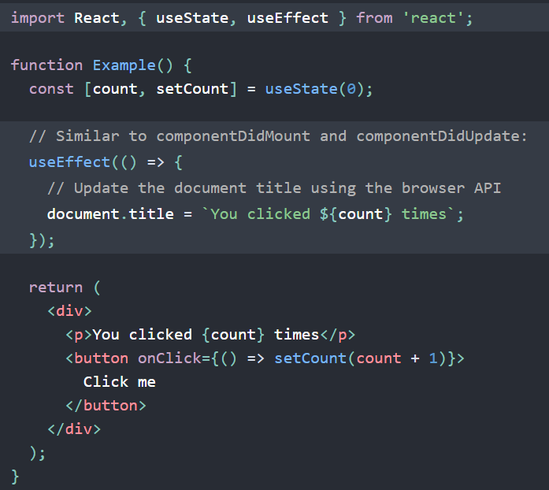

Lifecycle Methods – Functions (HOOKS)
2.UseEffect:
The Effect Hook, useEffect, adds the ability to
perform side effects from a function component.
It serves the same purpose as
componentDidMount, componentDidUpdate,
and componentWillUnmount in React classes,
but unified into a single API.
3.UseContext:
Accepts a context object and returns the current
context value for that context. The current context
value is determined by the value prop of the nearest
<MyContext.Provider> above the calling component
in the tree.
Additional Hooks:
useReducer, useCallback, useMemo, useRef.

Slide 22
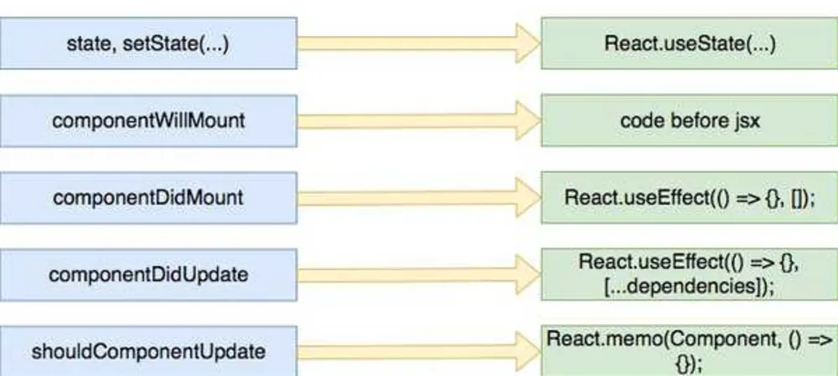
Lifecycle Methods – Class vs Functions

Slide 23
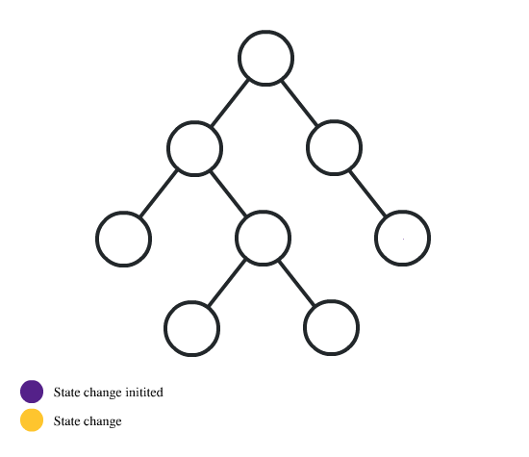
DATAFLOW
In React JS, data flows in one direction, from Parent to Child. This helps components to be simple and predictable.

Slide 24
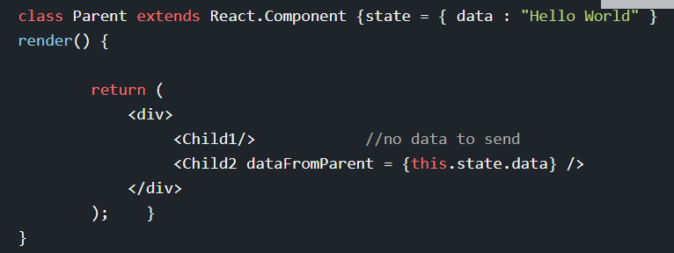
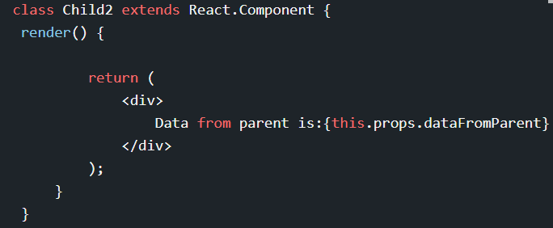
DATAFLOW – From Parent to Child Using Props
Try to imagine the directory structure of the app as follows:
the parent component actually renders the child components in the app
Use the variable this.props.dataFromParent to obtain the data passed from parent to child.

Slide 25
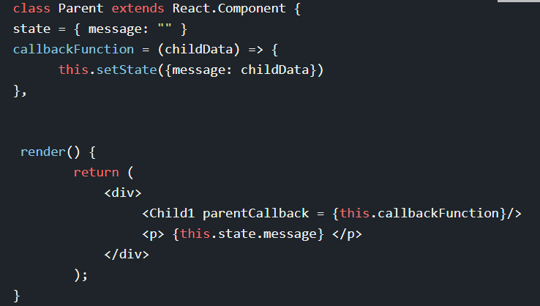
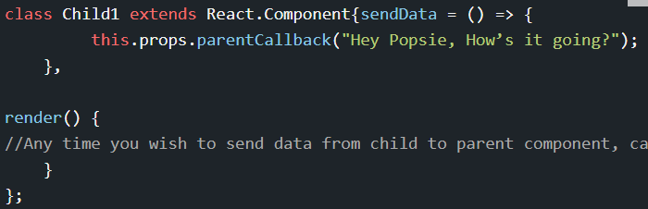
DATAFLOW – From Child to Parent Using Callbacks
In the Parent.js, set a callback function to take in the parameter that you have accessed from the child.
Send the callback function to the child1.js as a prop.
Pass your data using this.props.callback(dataToParent) in the child1.js.

Slide 26
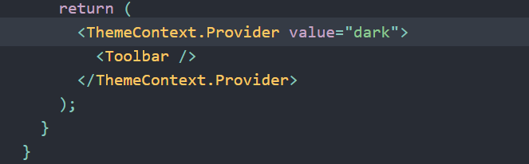
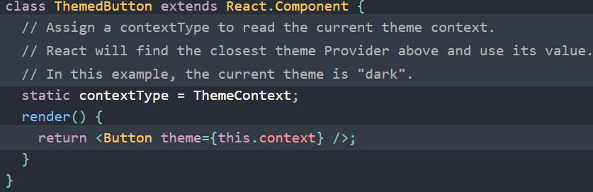
DATAFLOW – React's Context API.
Context provides a way to pass data through the component tree without having to pass props down manually at every level.

Slide 27
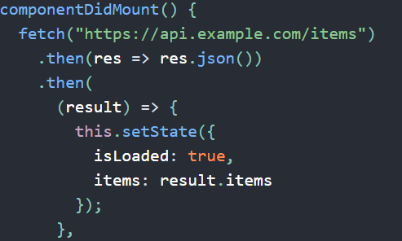
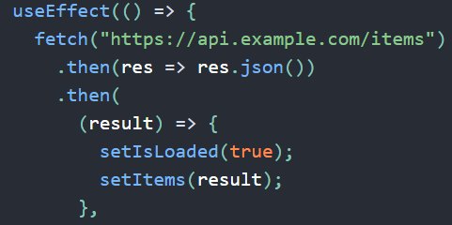
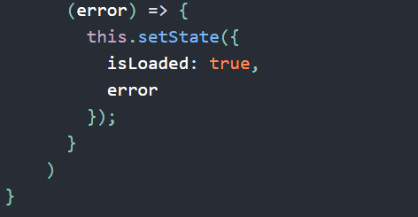
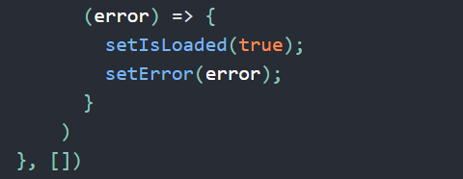
Connect with services
We can use any AJAX library you like with React. Some popular ones are Axios, jQuery AJAX, and the browser built-in window.fetch.
We should populate data with AJAX calls in the componentDidMount lifecycle method. This is so you can use setState to update your component when the data is retrieved.

Slide 28
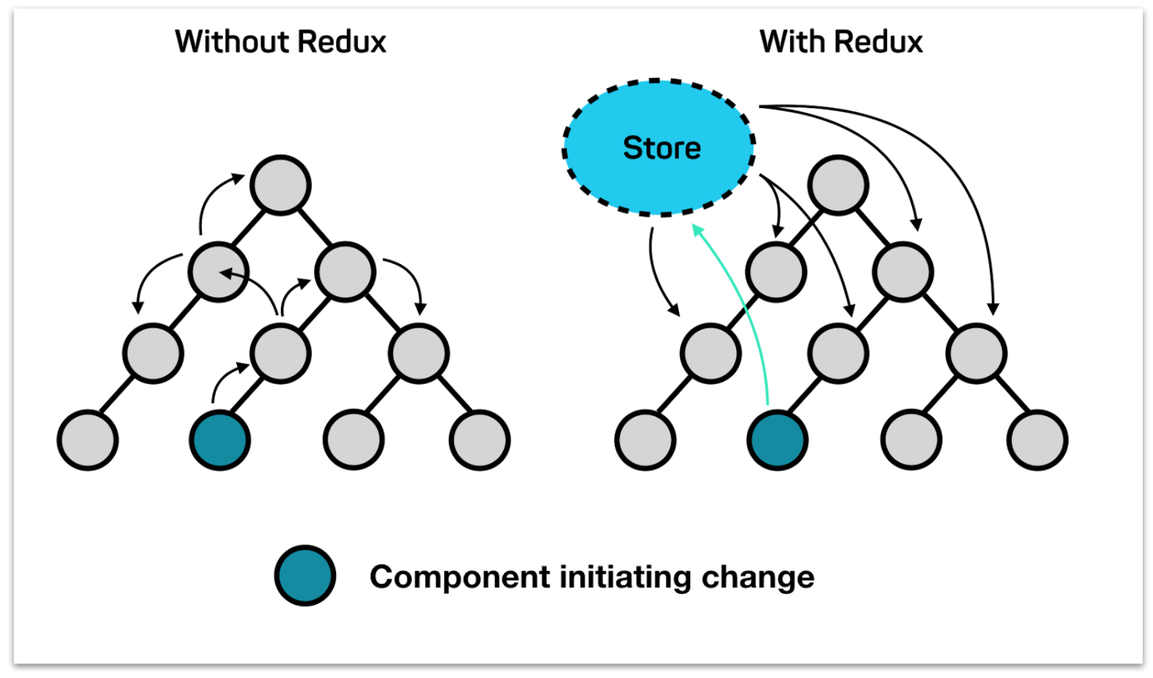
State Management
There are currently two types of State Management.
REDUX
FLUX
Lets discuss about redux:
Redux is an open-source JavaScript library for managing application state.
npm install redux
Components of Redux:
1.Store.
2.Actions.
3.Reducers.
4.Middleware.
5.Providers.

Slide 29
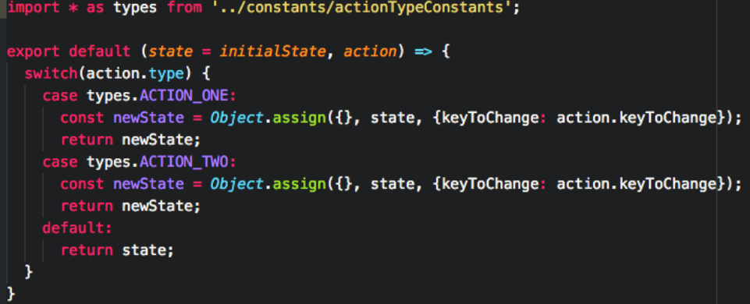
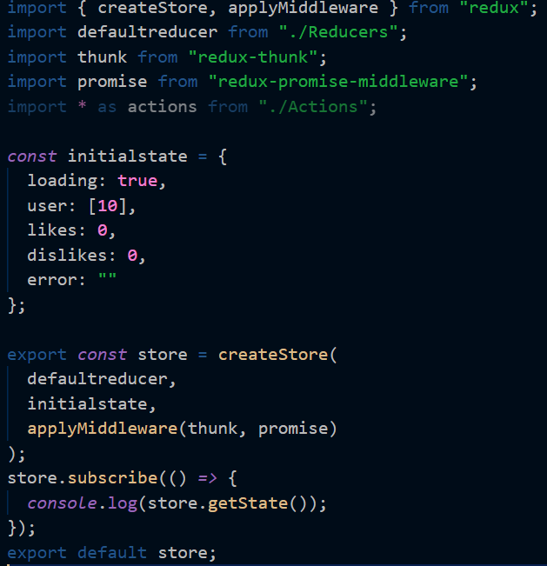
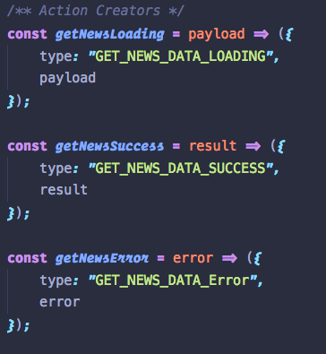
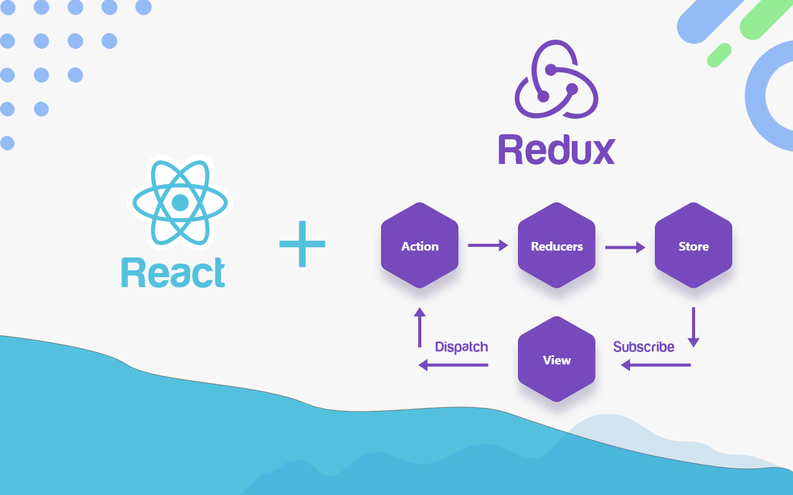
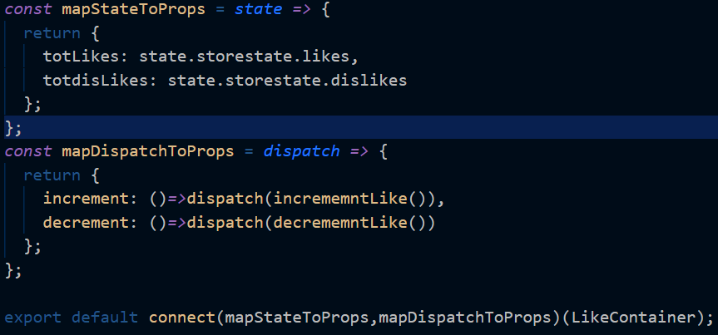
State Management - Redux

Slide 30
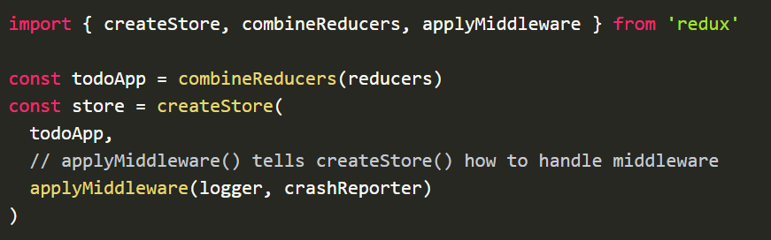
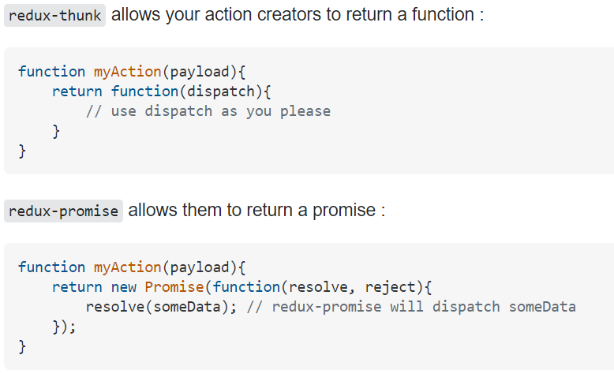
State Management – Redux - Middleware
npm install “middleware name”
Middleware: It provides a third-party extension point between dispatching an action, and the moment it reaches the reducer.

Slide 31
CSS styling
CSS and SCSS Stylesheets
This involves using separate stylesheets like our conventional way of styling our HTML websites either with CSS or a CSS preprocessor called SASS.
CSS Modules
A CSS Module is a CSS file in which all class names and animation names are scoped locally by default.
styled-components
Styled-components is a library for React and React Native that allows you to use component-level styles in your application that are written with a mixture of JavaScript and CSS using a technique called CSS-in-JS.
JSS
JSS is an authoring tool for CSS which allows you to use JavaScript to describe styles in a declarative, conflict-free and reusable way. It can compile in the browser, server-side or at build time in Node.

Slide 32
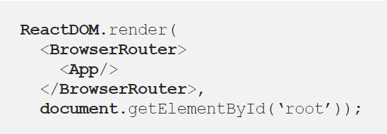
ROUTING
npm install react-router-dom
=> react-router: the core library
=> react-router-dom: a variant of the core library meant to be used for web applications
The react-router package includes a number of routers that we can take advantage of depending on the
platform we are targeting.
These include BrowserRouter, HashRouter, and MemoryRouter.
The BrowserRouter is used for applications which have a dynamic server that knows how to handle any type of URL whereas the HashRouter is used for static websites with a server that only responds to requests for files that it knows about.
Each router creates a history object that it uses to keep track of the current location and re-renders the application whenever this location changes

Slide 33
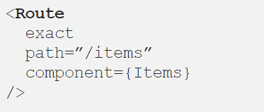
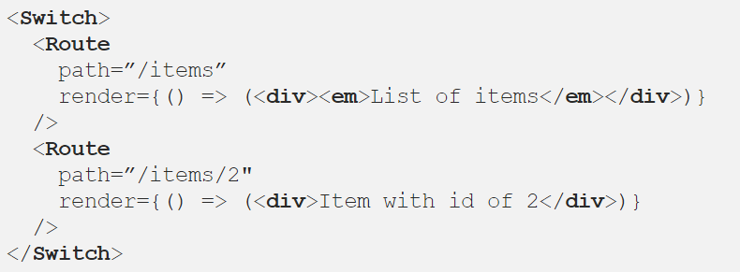
ROUTING
Routes:
The <Route/> component is one of the most important building blocks in the React Router package. It renders the appropriate user interface when the current location matches the route’s path
The <Route/> component provides three props that can be used to determine which component to render:
Switch:
The react-router library also contains a <Switch/> component that is used to wrap multiple
<Route/> components. The Switch component only picks the first matching route among all its
children routes.

Slide 34
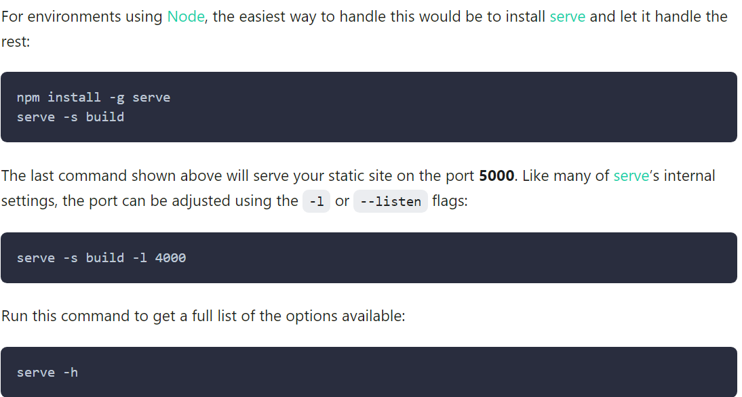
Build and Deploy.
npm run build
creates a build directory with a production build of your app. Set up your favorite HTTP server so that a visitor to your site is served index.html

