Slide 1


TATA NEUSKILL DATA ANALYTICS HACKATHON
CASE STUDY AND ANALYSIS
ON STUDENT DATA
NAME : Krishnaraj V
EMAIL ID : krishnarajgogulan@gmail.com

Slide 2
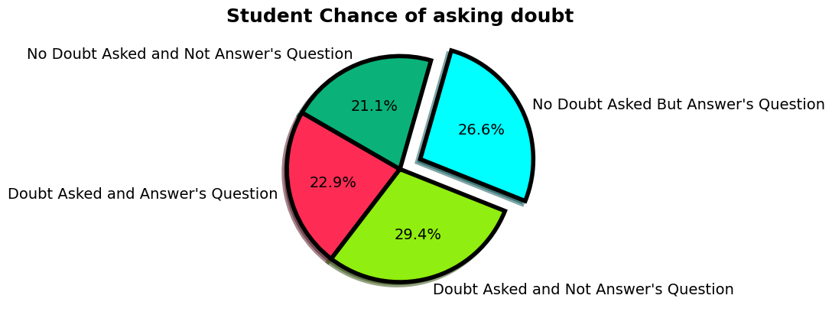
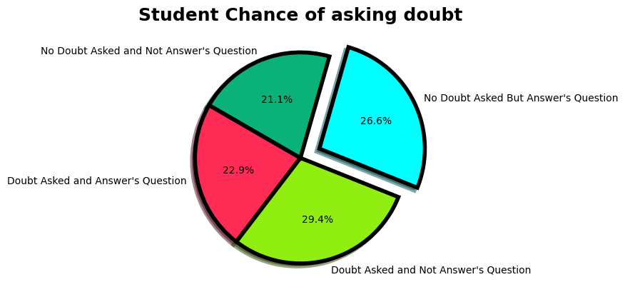
Question 1: What are the chances that a student will answer a question in online class if they have participated in poll but not asked a doubt?
Question 2: Find top 3 students in each stream – Define your own parameters and justify why these parameters are a good indicator of performance
There is 26.6 percentage chance for a Student to answer a question without asking doubt.
Which is comparatively greater to Students who ask doubts and not answers question
Categories | Students Count
Doubt Asked and Answered Question | 25
Doubt Asked and Not Answered Question | 32
No Doubt Asked But Answered Question | 29
No Doubt Asked and Not Answered Question | 23
RollNo | Stream | MaxMarks | Sum | Mean
10050028 | Commerce | 100 | 829 | 82.9
10050026 | Commerce | 100 | 789 | 78.9
10050024 | Commerce | 100 | 781 | 78.1
Here is Top 3 Students from each stream
They have been chosen in top because of their best total and average scores in all their 10 tests
Sum and mean indicates the total, average score and Performance of each student as it is the best measure of central tendency
RollNo | Stream | MaxMarks | Sum | Mean
10050015 | Science | 100 | 835 | 83.5
10050018 | Science | 100 | 812 | 81.2
10050005 | Science | 100 | 798 | 79.8
and question

Slide 3
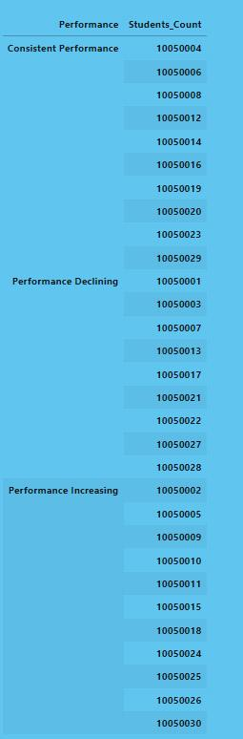
Question 3: Categorize students into 3 buckets - consistent performance, performance declining, performance improving (Define your own parameters)
Question 4: The principal wants to know the best days of the week and time to conduct online classes, help them with this based on past attendance
Here is the student count categorized into 3 given buckets.
Calculated based on average mean of differences in their tests.
From the table it can be clearly understood that weekends(Sunday and Saturday) are the best days to conduct online class.
And between 9:00 to 10:30 is ideal timing in these days for online class
Day of the week | Count Of Students
Saturday | 50
Sunday | 50
Friday | 34
Tuesday | 30
Wednesday | 30
Monday | 28
Thursday | 18
Performance | Students Count
Performance Declining | 9
Consistent Performance | 10
Performance Increasing | 11
Jointime | Leavetime | Count Of Students
09:00:00 | 10:30:00 | 65
 | 10:15:00 | 17
09:15:00 | 10:30:00 | 9
09:00:00 | 10:45:00 | 8
09:15:00 | 10:15:00 | 1

Slide 4
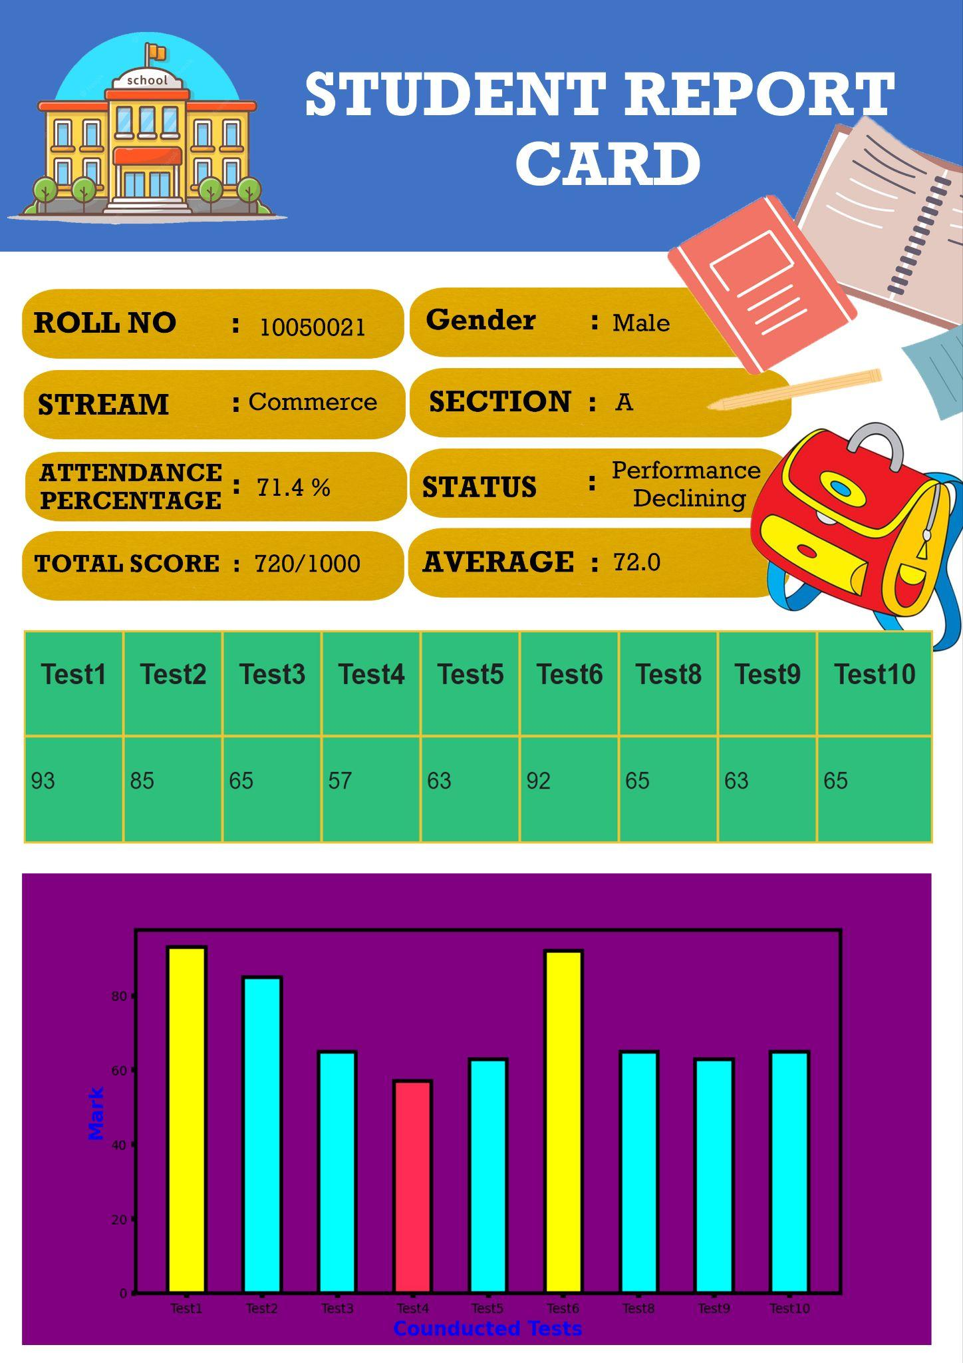
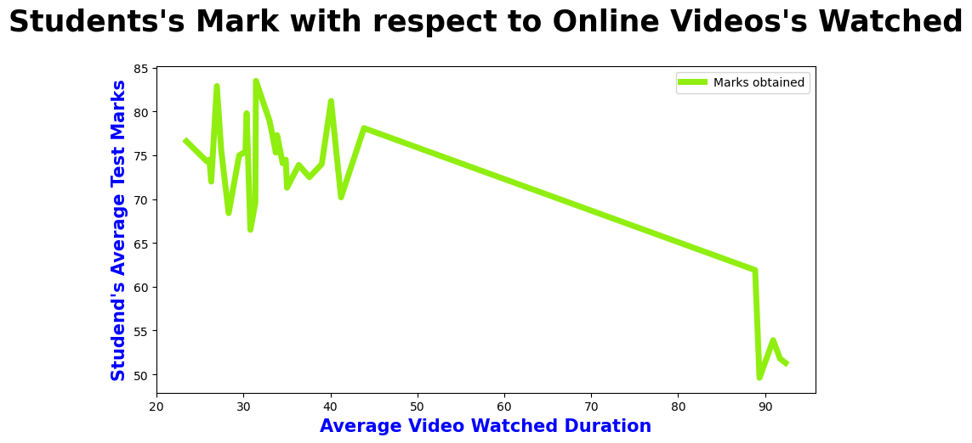
Question 5: Which mode of learning is better suited for students based on grades?
Question 6: Design a student report card
From the above plotted graph we can say that Students with good percentage have low video watched percentage which concludes that offline classes are better than online
And also correlation between this two field is a negative value
 | Video_mean
Video_mean | 1.000000
Marks_mean | -0.866494

Slide 5

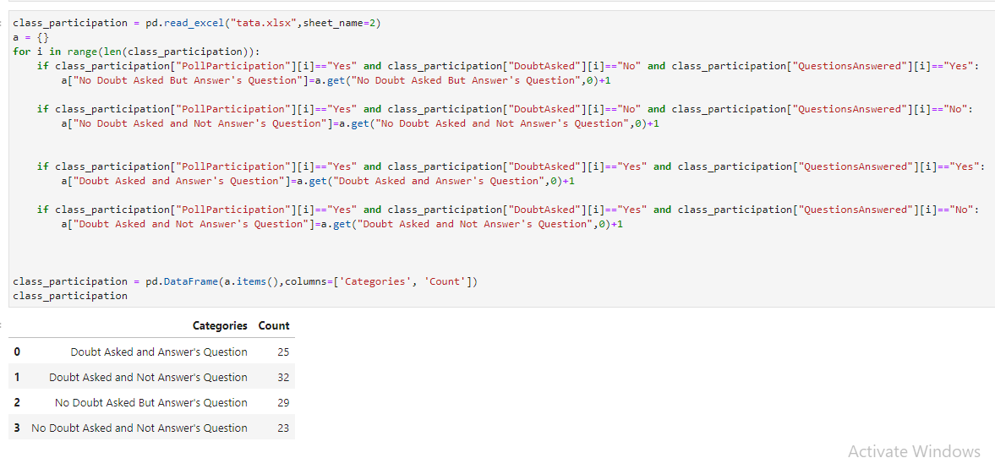
Rough Part #jupyter

Slide 6
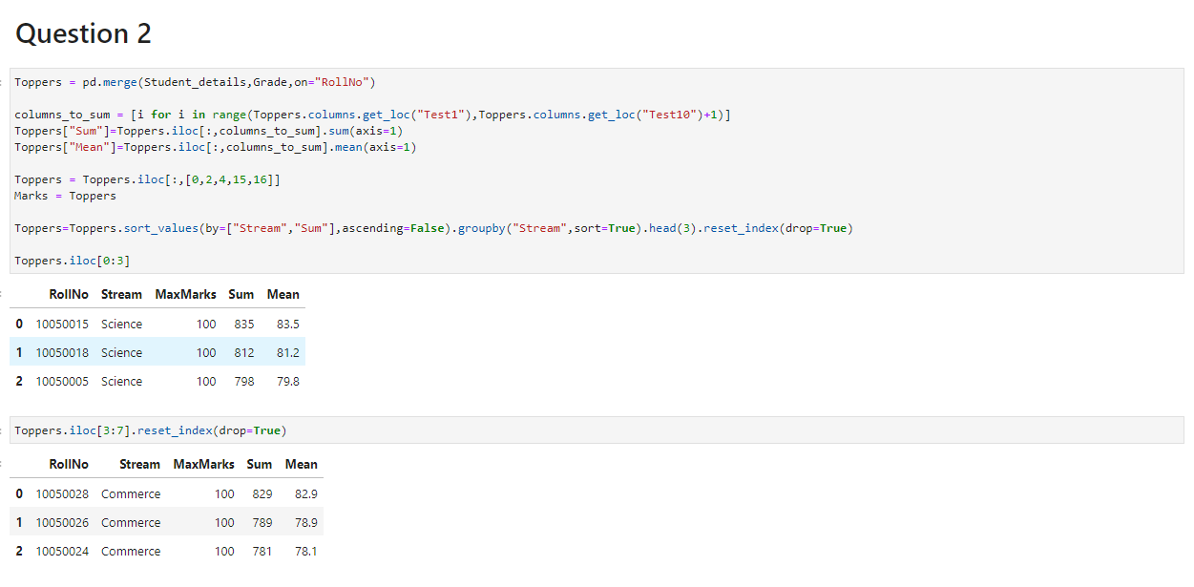

Slide 7
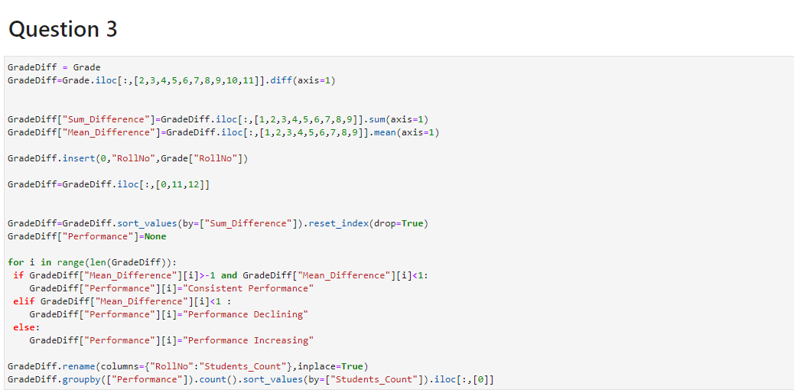

Slide 8
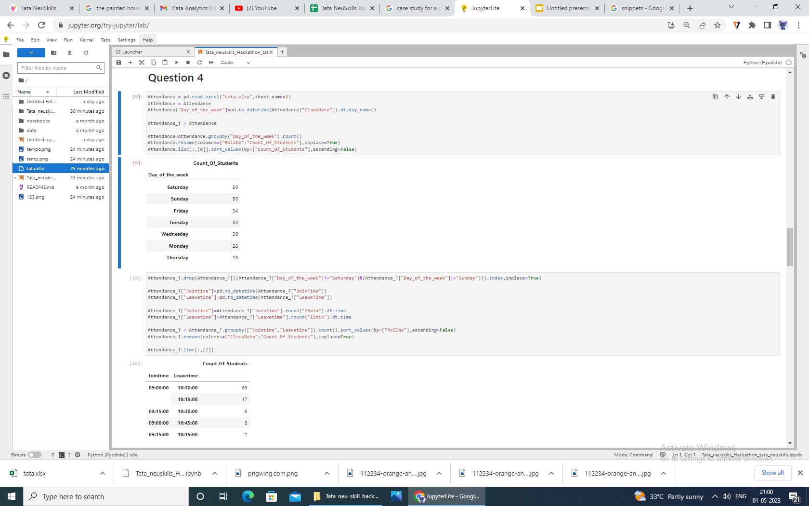

Slide 9
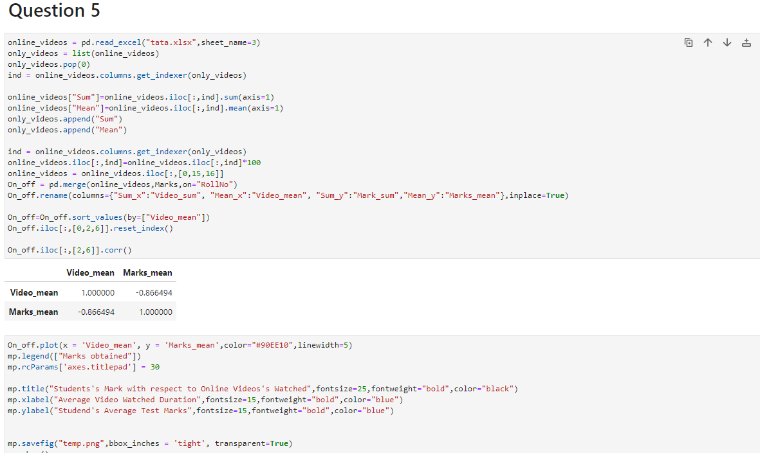

Slide 10
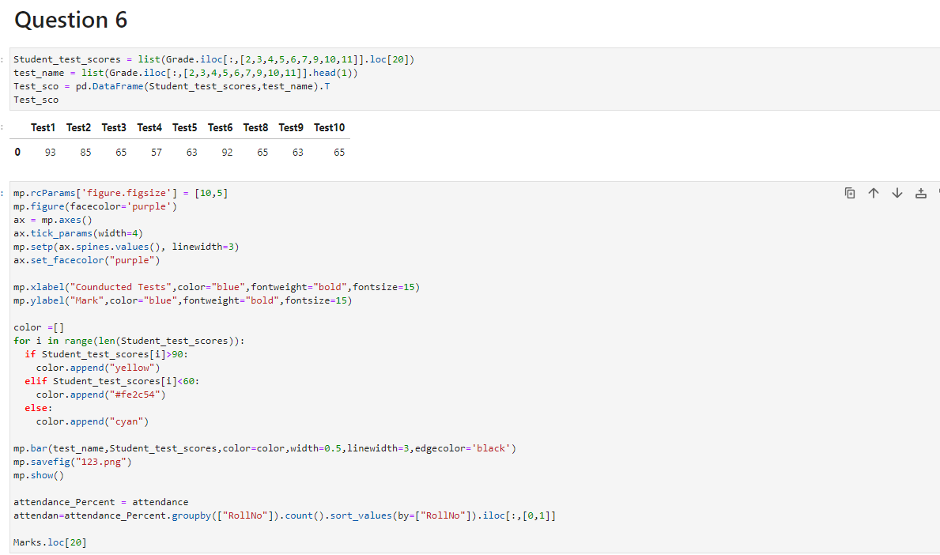

Slide 11
THANK YOU
Data Brings Magic

