Slide 1

EGS PILLAY ENGINEERING COLLEGE, NAGAPATTINAM
DEPARTMENT OF COMPUTER SCIENCE AND
ENGINEERING
First Review
PERMISO
A COMPREHENSIVE PLATFORM FOR MANAGING ON-DUTY AND LEAVE REQUEST
Presented by
RAJ RATHINAM.S (8208E22CSR082)
SHATHIS KUMAR.S (8208E22CSR096)
SYED MOHAMED YOUSUF BADURUDEEN.S (8208E22CSR108)

Slide 2

CONTENT:
Introduction.
Literature Review.
Methodology.
Technical Details & Concepts.
Project Progress.
Future Work.
Questions.

Slide 3
INTRODUCTION:
Objective :
The objective of this project is to develop a Sign Language Recognition (SLR) system using Python that can recognize and interpret hand gestures into text or speech. This system aims to bridge the communication gap between individuals with hearing or speech impairments and the general public by leveraging computer vision and machine learning techniques.

Slide 4
Scope:
Real-time Gesture Recognition : The system will use a webcam to detect and classify hand gestures dynamically.
Machine Learning Approach : Implementation of CNN for image feature extraction and LSTM for recognizing sequential gesture patterns.
Support for Multiple Sign Languages: Initially trained for American Sign Language (ASL), with the potential to extend to Indian Sign Language (ISL) and others.

Slide 5
Problem Statement : - Deaf and mute individuals face challenges in interacting with non-sign language users.
- A computer vision-based system can provide a real-time, cost-effective, and accessible solution.
Significance & Impact : - Bridges the communication gap between the deaf and hearing communities, promoting inclusivity.
- Leverages deep learning and computer vision to create an efficient, scalable recognition system.

Slide 6
Literature Review:
Existing Systems & Their Limitations: - Image Processing Approaches: Early systems used color segmentation and edge detection to identify gestures, but they lacked scalability
- Machine Learning Methods: Traditional classifiers like SVM and KNN were used but required manual feature extraction.
Challenges Identification
Changes in lighting, background, and hand positions affect accuracy.

Slide 7
Methodology:
Overall Approach: - Collect Data: Gather images of different sign language gestures.
- Preprocess Data: Resize, enhance, and prepare images for training
- Build Model: Use deep learning (CNN + LSTM) to recognize gestures.
- Train & Test: Train the model with labeled data and test accuracy.

Slide 8
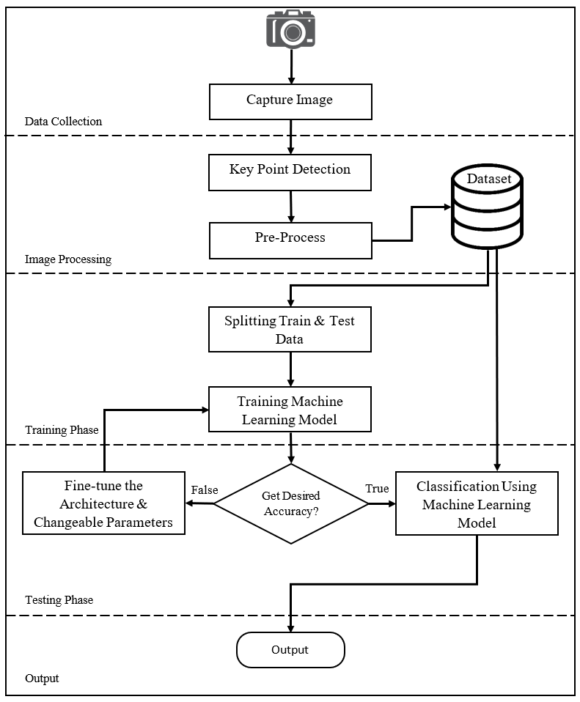
WORKFLOW DIAGRAM

Slide 9
Tools & Technologies Used: - Programming Language: Python - Libraries & Frameworks: OpenCV, TensorFlow/Keras, MediaPipe, NumPy. -
- Model Architecture: CNN + LSTM for gesture recognition
- Development Tools: VS Code with Extensions.

Slide 10
Technical Details :
Core Concepts :
Python Libraries Used: OpenCV for image processing, TensorFlow/Keras for model training, and MediaPipe for hand tracking.
Gesture Recognition Model: Uses CNN to extract features and LSTM to recognize gesture sequences.
Real-time Processing: Webcam captures gestures, which are analyzed frame-by-frame for instant recognition.
Text Conversion: Detected gestures are converted into readable text for communicatio

Slide 11
Technical Challenges : - Lighting & Background Issues → Used adaptive thresholding.
- Hand Occlusion → Trained model to detect hand landmarks.
- Slow Processing → Optimized model and used GPU.
Solutions & Innovations :
- Deep Learning for Better Accuracy.
- Real-time Gesture Recognition.
- Future Integration with Speech Output.

Slide 12
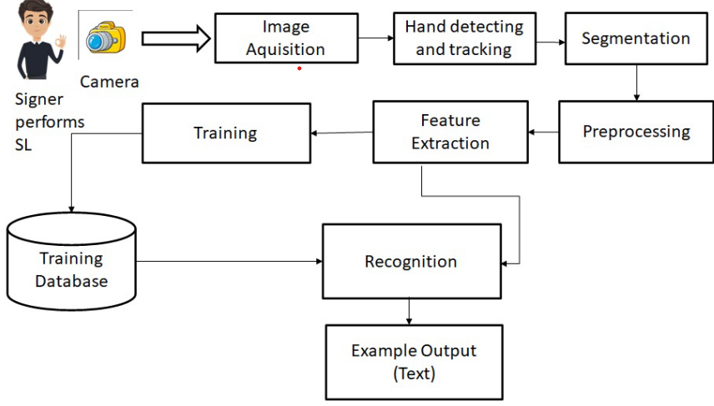
ARCHITECTURE DIAGRAM

Slide 13
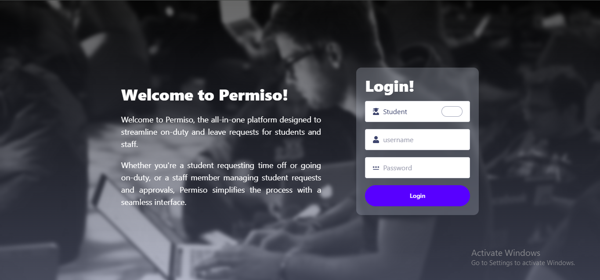
Preliminary Results & Screenshots :
Login Page

Slide 14
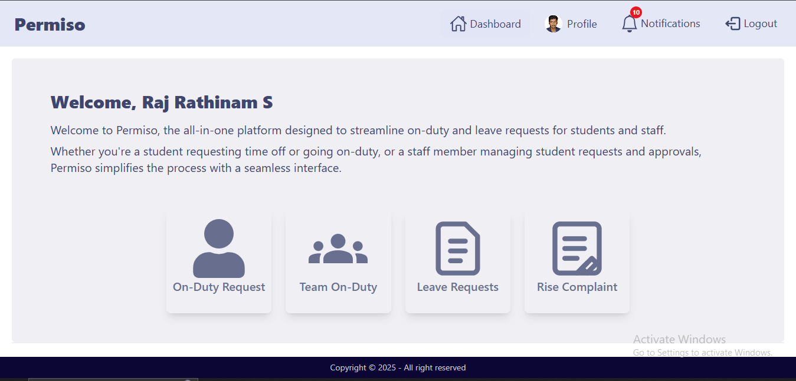
Student Dashboard

Slide 15
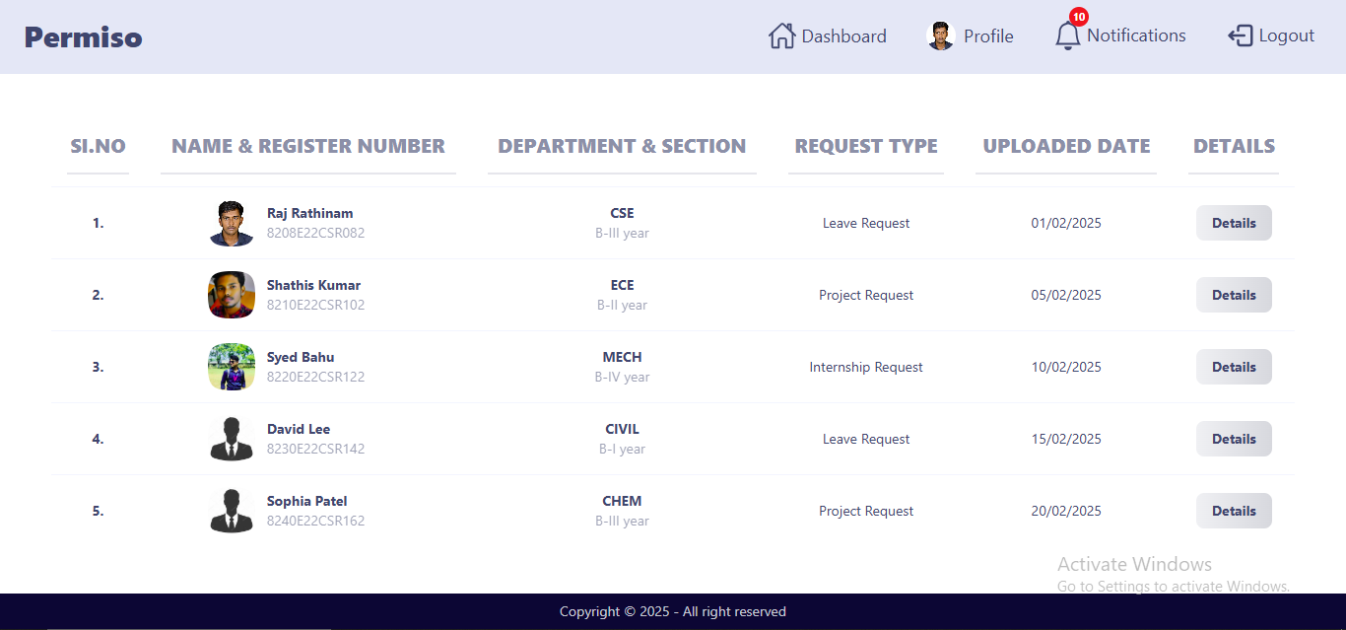
Staff Dashboard

Slide 16
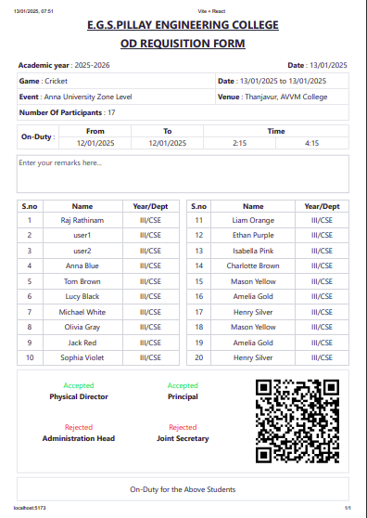
Sample Letter Format

Slide 17
Future Work :
Complete request approval workflow with real-time notifications.
Enhance security with better authentication.
Optimize UI/UX for a better user experience.
Fully deploy and test on Render.

Slide 18
ANY Questions ?

Slide 19
THANK YOU !

