Slide 1

PERSONAL PORTFOLIO WEBSITE
A Multi-Page HTML Project
Krishnasai Doddapuneni
Aspiring Python Full Stack Developer
B.Tech, Computer Science | Hyderabad, India | 2026
Built with HTML5

Slide 2

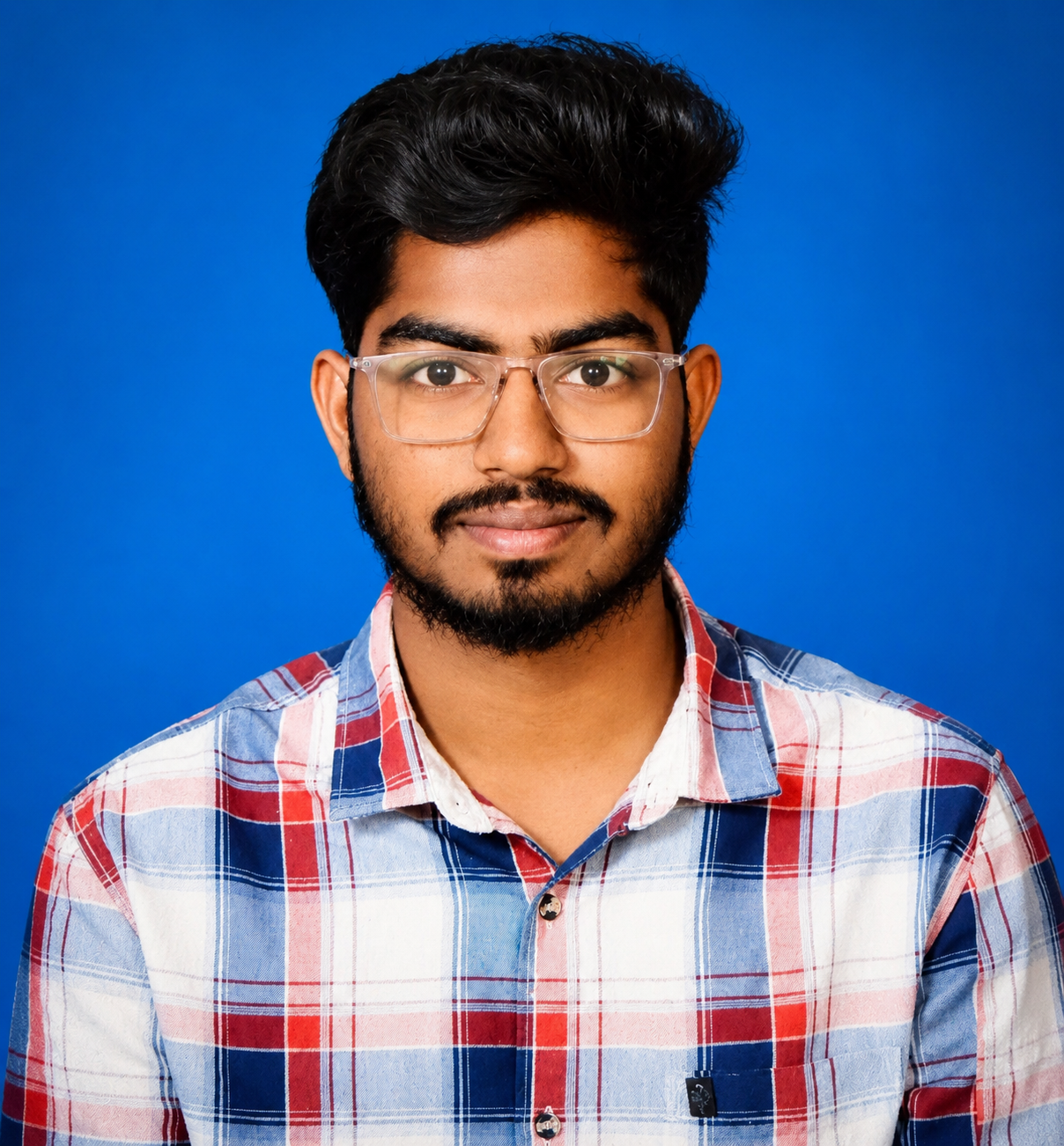
Introduction
Personal Portfolio Website • HTML Project
A personal portfolio website built entirely with core HTML5 to present a clean professional profile online.
Showcases education, technical skills, projects, achievements, and contact details across linked pages.
Created by a fresher aspiring to work as a Python Full Stack Developer, to stand out to recruiters.
Built without any external framework or CSS file — every page is hand-written, semantic HTML.
8
Pages
100%
Hand-coded HTML
1
Single shareable site
2

Slide 3

Project Objective
Personal Portfolio Website • HTML Project
1
Create a clean, organized, multi-page personal portfolio website.
2
Practice and apply core HTML elements — text, lists, tables, media, forms, and navigation.
3
Present academic background, technical skills, and project work in one place.
4
Build a foundation that can later be enhanced with CSS, JavaScript, and Bootstrap.
5
Support a fresher's job search with a single, shareable professional link.
3

Slide 4

HTML Tags Used
Personal Portfolio Website • HTML Project
Structure
Headings & Text
<html> <head> <title> <meta> <body>
<h1>–<h3> <p> <b> <i> <u> <em> <font>
Lists
Tables
<ul> <ol> <li> <dl> <dt> <dd>
<table> <tr> <th> <td>
Navigation & Links
Media
<a> <nav>
<img> <marquee> <iframe>
Forms
Layout
<form> <fieldset> <legend> <label> <input> <textarea>
<hr> <br> <center>
4

Slide 5





Features — Site-Wide
Personal Portfolio Website • HTML Project
Consistent 8-page navigation
Home, About, Education, Skills, Projects, Achievements, Gallery and Contact, linked from every page.
Anchor-linked “Page Bookmarks”
In-page jump links let visitors skip straight to a section using id-based anchors.
Table-based skill meters
Visual progress bars for HTML, CSS, JavaScript and Python built using coloured table cells.
Quick Info & resume download
A summary table of contact/role details plus a one-click link to download the resume.
5

Slide 6





Features — Page Content
Personal Portfolio Website • HTML Project
Structured personal content
Categorised tech stack
Project showcase cards
Family details via definition lists; hobbies and daily routine via bulleted and numbered lists.
Nested lists group skills under Frontend, Backend, Database and Tools.
Each project lists details, features, tech used, challenges, and GitHub / live demo links.
Visual project gallery
Contact form with validation
Embedded Google Map
A dedicated gallery page displaying screenshots from past project work.
Name, email and message fields use required HTML5 attributes for basic validation.
An iframe embeds a live map pinpointing the contact location.
6

Slide 7

Challenges Faced
Personal Portfolio Website • HTML Project
1
Repeating the same navigation bar consistently across 8 separate pages with no shared template or include system.
2
Building visual progress-bar meters using nested table cell widths instead of CSS, requiring precise percentage values.
3
Keeping multi-column tables — Quick Info, certifications, academic records — aligned and easy to read.
4
Displaying images of different sizes and aspect ratios consistently across every page.
5
Structuring long personal content (family, hobbies, routine) clearly using only semantic HTML, with no stylesheet.
6
Adding basic client-side form validation (required, type="email") without relying on JavaScript.
7

Slide 8


Learnings
Personal Portfolio Website • HTML Project
Gained hands-on command of core and semantic HTML tags well beyond the basics.
Practical experience using tables for both structured data and simple visual elements like progress bars.
Understood why consistent navigation and site structure matter for usability.
Worked with HTML forms and embedding external content through iframes.
Recognised the limits of inline, presentational styling (bgcolor, align, font) — clear motivation to learn CSS next.
Developed a better awareness of accessibility basics, such as meaningful alt text on images.
8

Slide 9

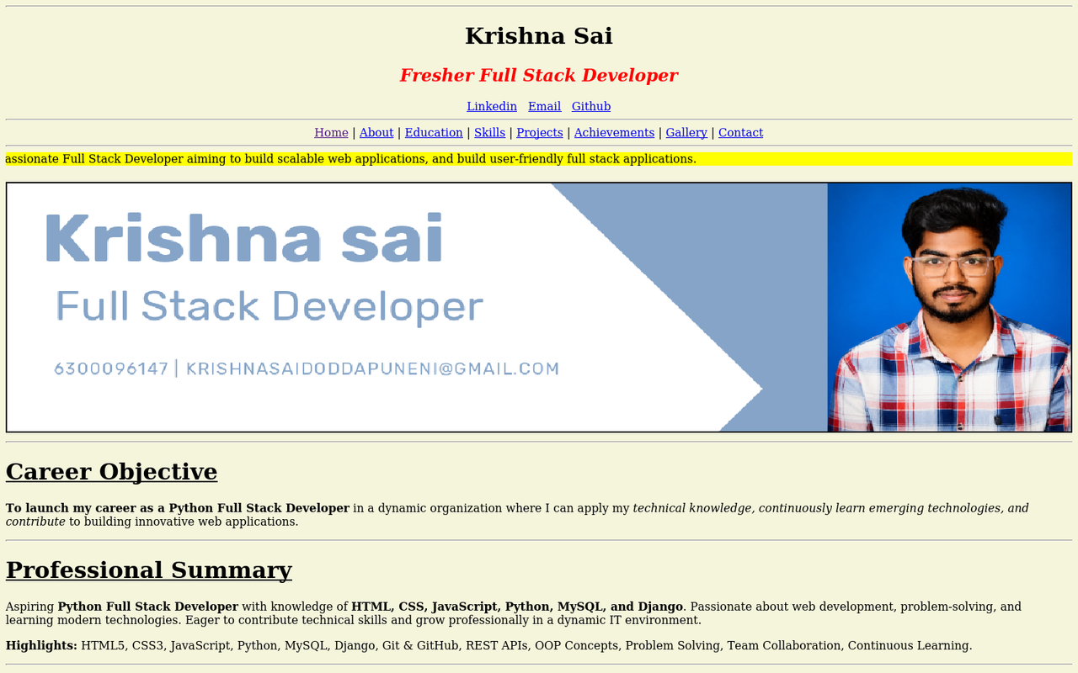
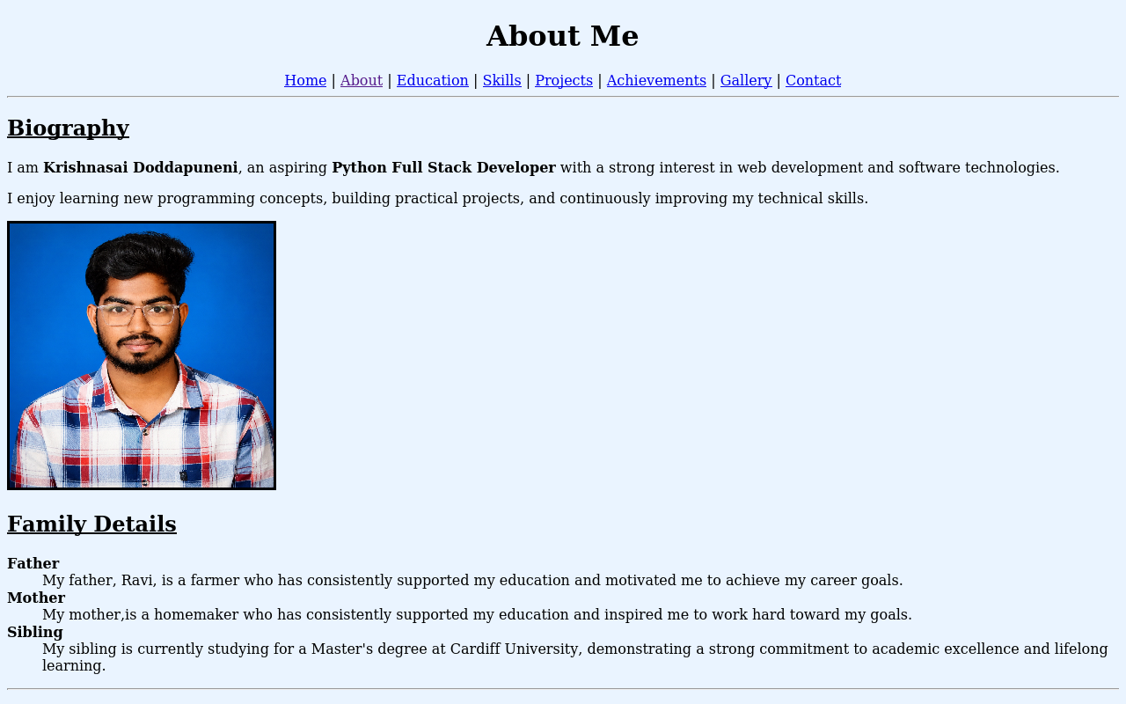
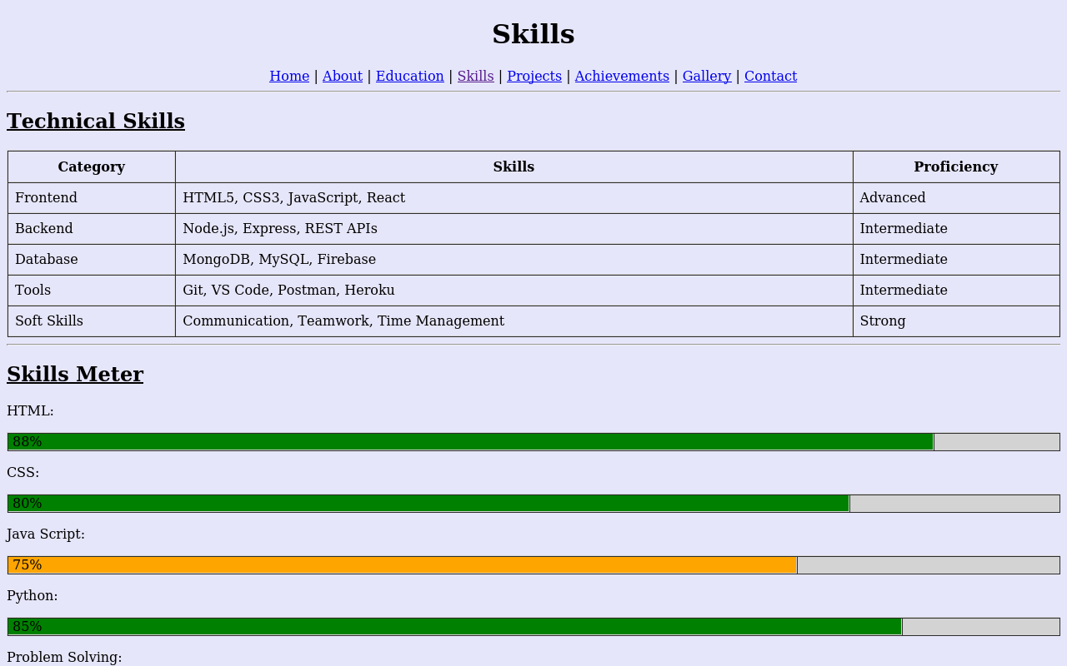
Screenshots — Home, About, Skills
Personal Portfolio Website • HTML Project
Home Page
About Page
Skills Page
9

Slide 10
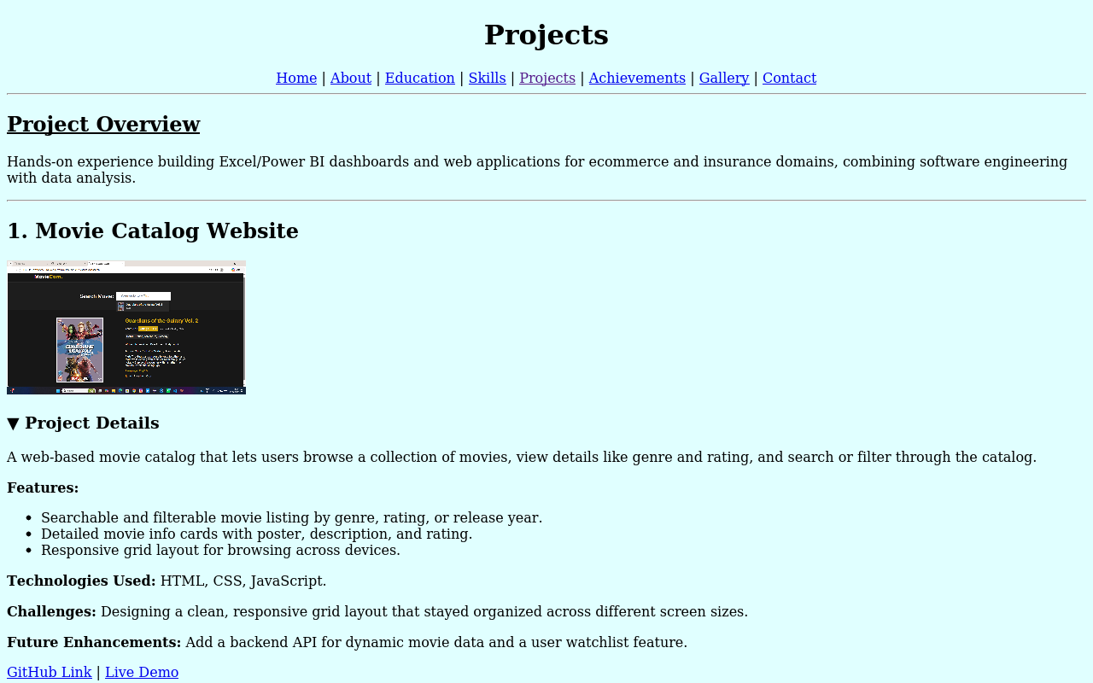
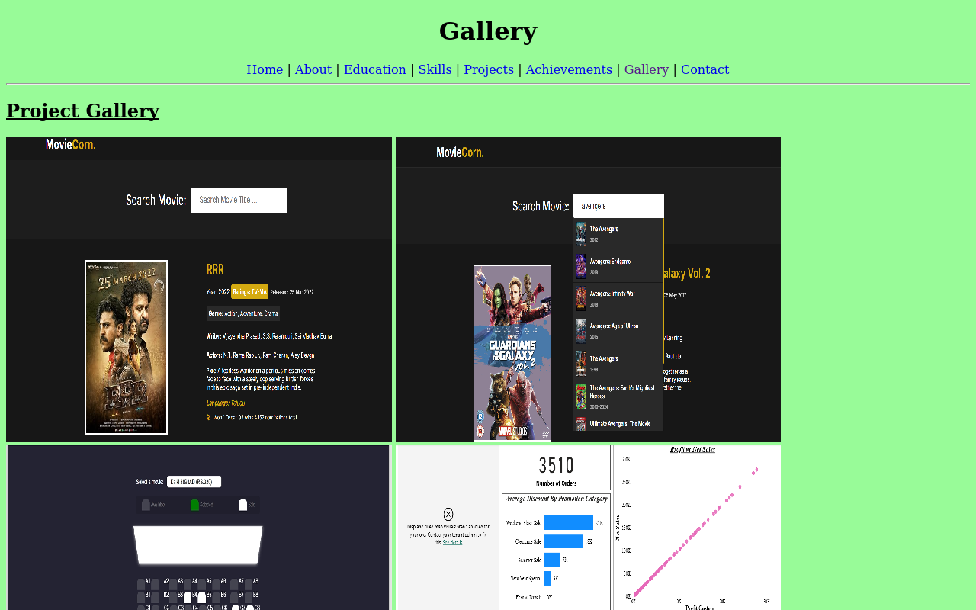
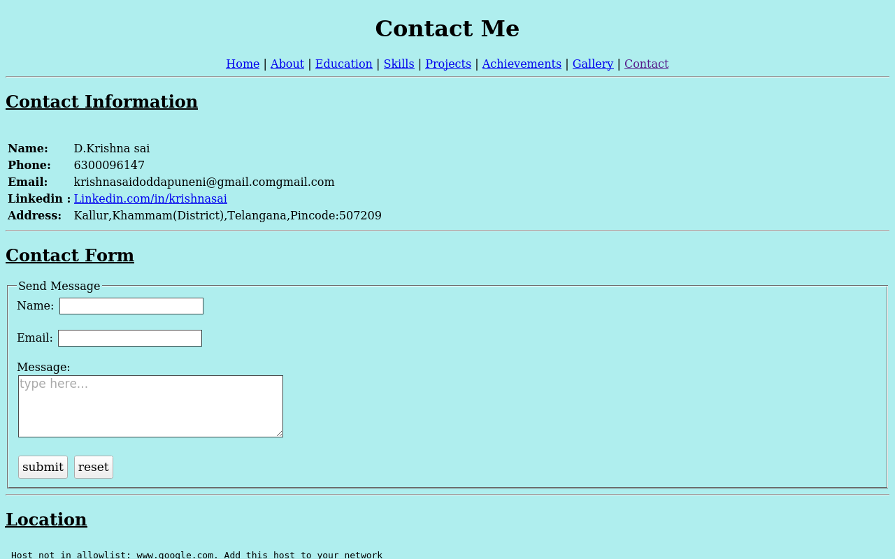
Screenshots — Projects, Gallery, Contact
Personal Portfolio Website • HTML Project
Projects Page
Gallery Page
Contact Page
10

Slide 11

Conclusion
Successfully brings together education, skills, projects and contact details into one organised website.
Achieved the goal of practising and applying a wide range of core HTML elements.
Provides a solid foundation to layer on CSS, JavaScript and Bootstrap next.
A ready, shareable asset to support the search for a Full Stack Developer fresher role.
11

Slide 12
THANK YOU
Krishnasai Doddapuneni
krishnasaidoddapuneni@gmail.com • +91 6300096147

