Slide 1
SAGE KITCHEN
A Restaurant Website Built with CSS3 and HTML5
Krishnasai Doddapuneni
B.Tech CSE (Data Science) | Guru Nanak Institutions, Hyderabad
Built with HTML5 & CSS3

Slide 2

Introduction
Sage Kitchen Website • CSS Project
A fully responsive restaurant website built entirely with HTML5 and CSS3 for Sage Kitchen.
Presents the restaurant's menu, ambience, gallery, and dining story across six linked pages.
Created by a fresher aspiring to work as a Python Full Stack Developer, to build practical front-end styling skills.
Every page is styled with its own dedicated CSS file — no framework, no Bootstrap, pure hand-written CSS3.
6
Pages
100%
Hand-coded CSS
8
Media Query Breakpoints
Sage Kitchen Website • CSS Project
2

Slide 3

Project Objective
Sage Kitchen Website • CSS Project
1
Build a fully responsive, multi-page restaurant website.
2
Apply core CSS3 concepts — Flexbox, Grid, positioning and the box model — to real layouts.
3
Design one consistent visual identity (colour, type, spacing) across every page.
4
Showcase the menu, gallery, and dining experience with clear visual structure.
5
Add interactivity through hover effects, transitions and keyframe animations.
6
Ensure the site adapts cleanly across desktop, tablet and mobile screens.
Sage Kitchen Website • CSS Project
3

Slide 4

CSS3 Techniques Used
Sage Kitchen Website • CSS Project
Layout
Responsive Design
Motion
Flexbox, CSS Grid, Positioning
Media queries (992px, 768px, 480px breakpoints)
Transitions, Keyframe Animations, Hover Effects
Visual Styling
Typography
Structure
Box Shadows, Border Radius, Gradients
Custom Google Fonts, Letter Spacing
Box Model, Semantic Sectioning, Background Overlays
Sage Kitchen Website • CSS Project
4

Slide 5

Features — Site-Wide
Sage Kitchen Website • CSS Project
Consistent 6-page navigation
Home, Menu, Reservations, Gallery, About and Contact, linked from a shared header on every page.
Responsive grid & flex layouts
Menu cards, gallery photos, and feature sections reflow cleanly from desktop down to mobile.
Animated hero banners
Full-width banners with background overlays, custom fonts, and call-to-action buttons on every page.
Reusable footer component
A consistent footer with contact details, opening hours, quick links and social icons across all pages.
Sage Kitchen Website • CSS Project
5

Slide 6
Features — Page Content
Sage Kitchen Website • CSS Project
Categorised menu
Chef & story timeline
Themed photo gallery
Eight menu categories from starters to beverages, each item styled as a priced card.
About page journey timeline plus a meet-the-chefs team section.
Featured Collection, Signature Dishes, Behind the Kitchen and Moments at Sage grids.
Table booking form
Contact & map section
Animated stat counters
Reservation form capturing date, time, guests and contact details.
Styled contact form alongside restaurant location and opening hours.
Recipes, chefs, customers and years of experience shown as styled stat blocks.
Sage Kitchen Website • CSS Project
6

Slide 7
Challenges Faced
Sage Kitchen Website • CSS Project
Aligning a 6-page nav consistently
Responsive grid breakdowns
Keeping header and footer markup and CSS identical across every page while pages lived in different folders.
Getting the menu, gallery and stats grids to reflow gracefully across three breakpoints without breaking spacing.
Managing image-heavy layouts
Fine-tuning hover & transition timing
Balancing image sizing, object-fit and load performance across hero banners and gallery sections.
Getting card lift effects, button hovers and menu animations to feel smooth rather than abrupt.
Sage Kitchen Website • CSS Project
7

Slide 8
Learnings
Sage Kitchen Website • CSS Project
Gained hands-on command of Flexbox and CSS Grid for real, multi-section page layouts.
Practised writing and organising large CSS files per page, rather than one shared stylesheet.
Understood how media queries and breakpoints keep a design usable on every screen size.
Learned to use transitions, keyframe animations and hover states to add polish without JavaScript.
Built a stronger eye for visual consistency — colour palette, spacing, and typography across pages.
Recognised the limits of pure CSS styling — clear motivation to learn JavaScript next.
Sage Kitchen Website • CSS Project
8

Slide 9
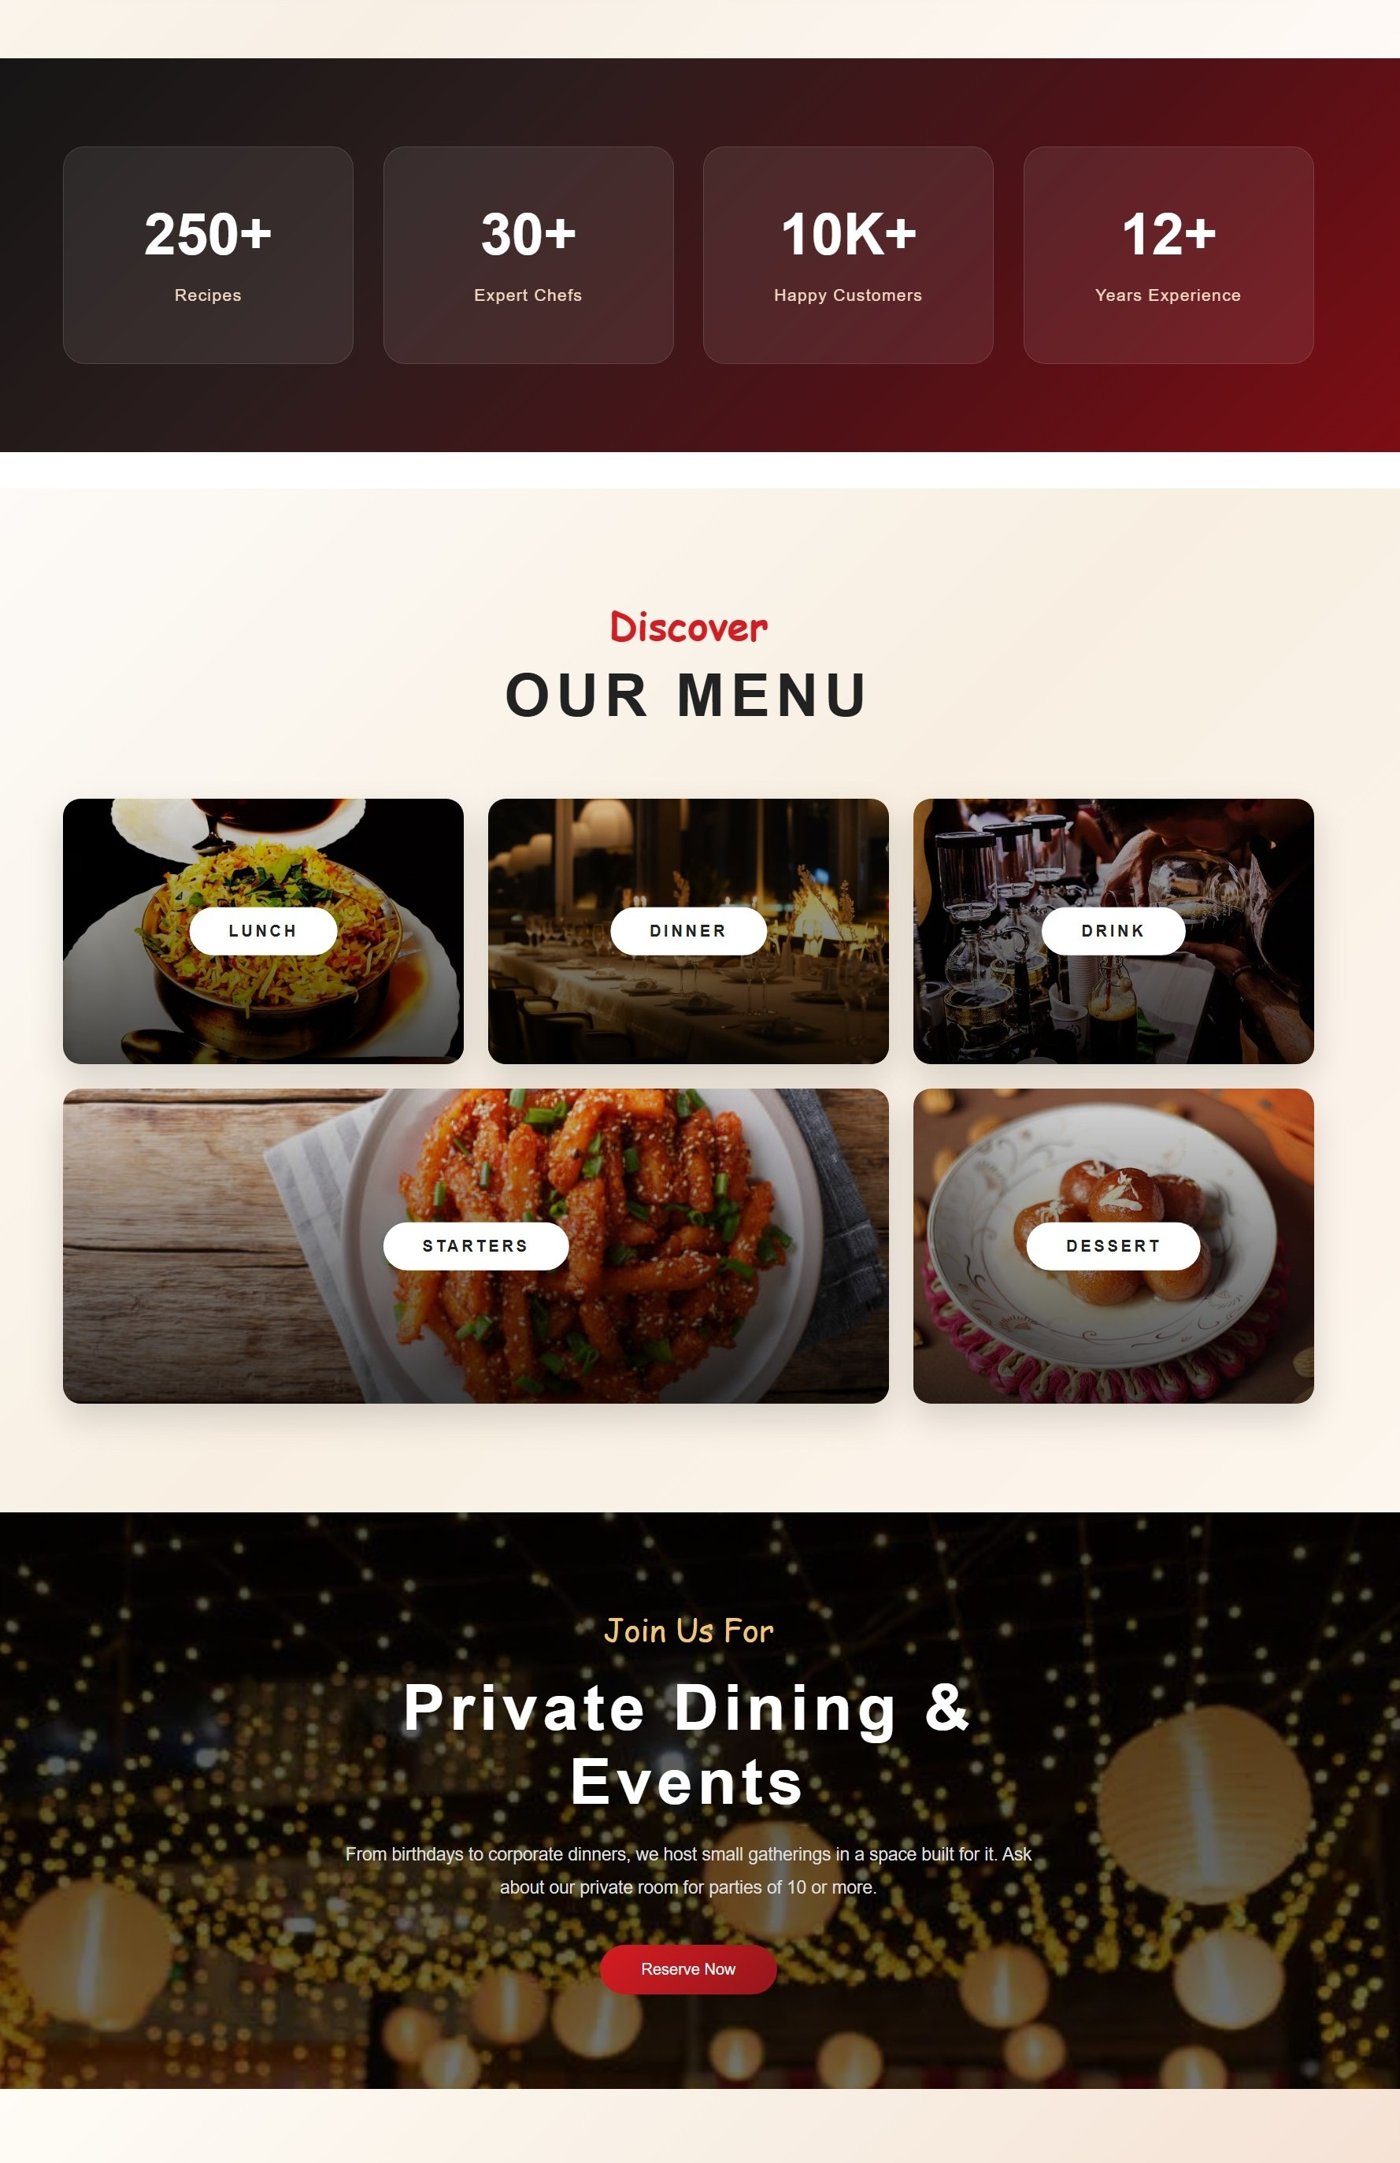
Screenshots — Home
Sage Kitchen Website • CSS Project
Home Page
Sage Kitchen Website • CSS Project
9

Slide 10
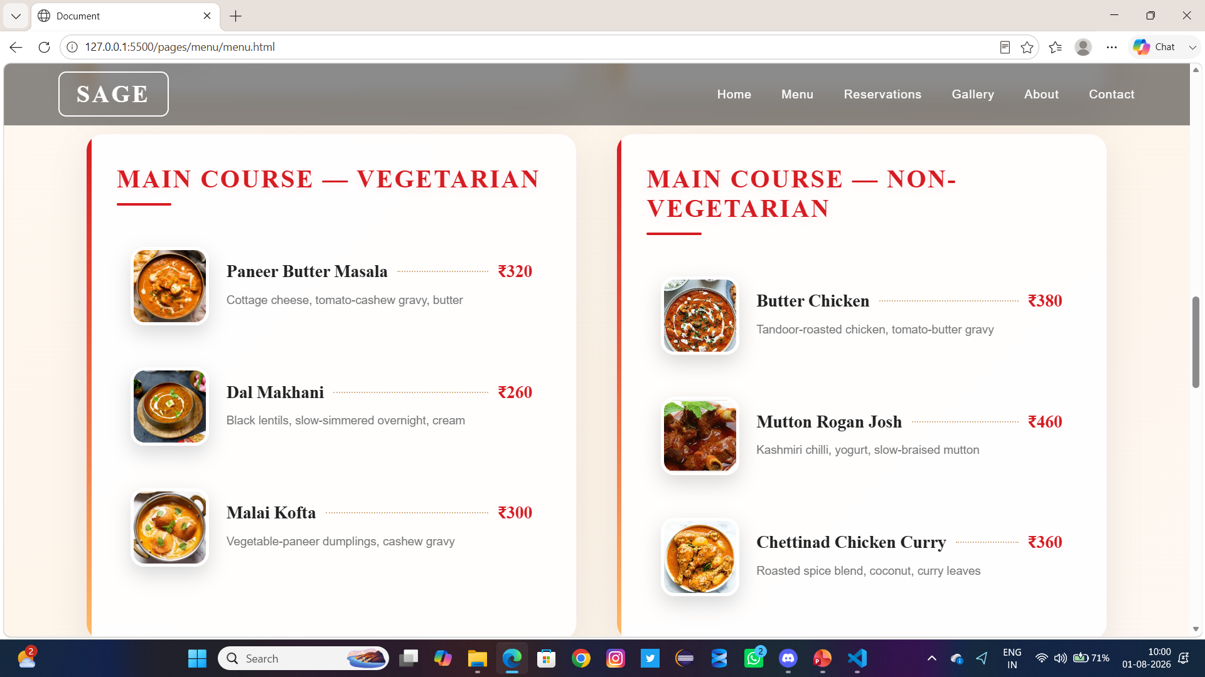
Screenshots —Menu
Sage Kitchen Website • CSS Project
Menu Page
Sage Kitchen Website • CSS Project
9

Slide 11
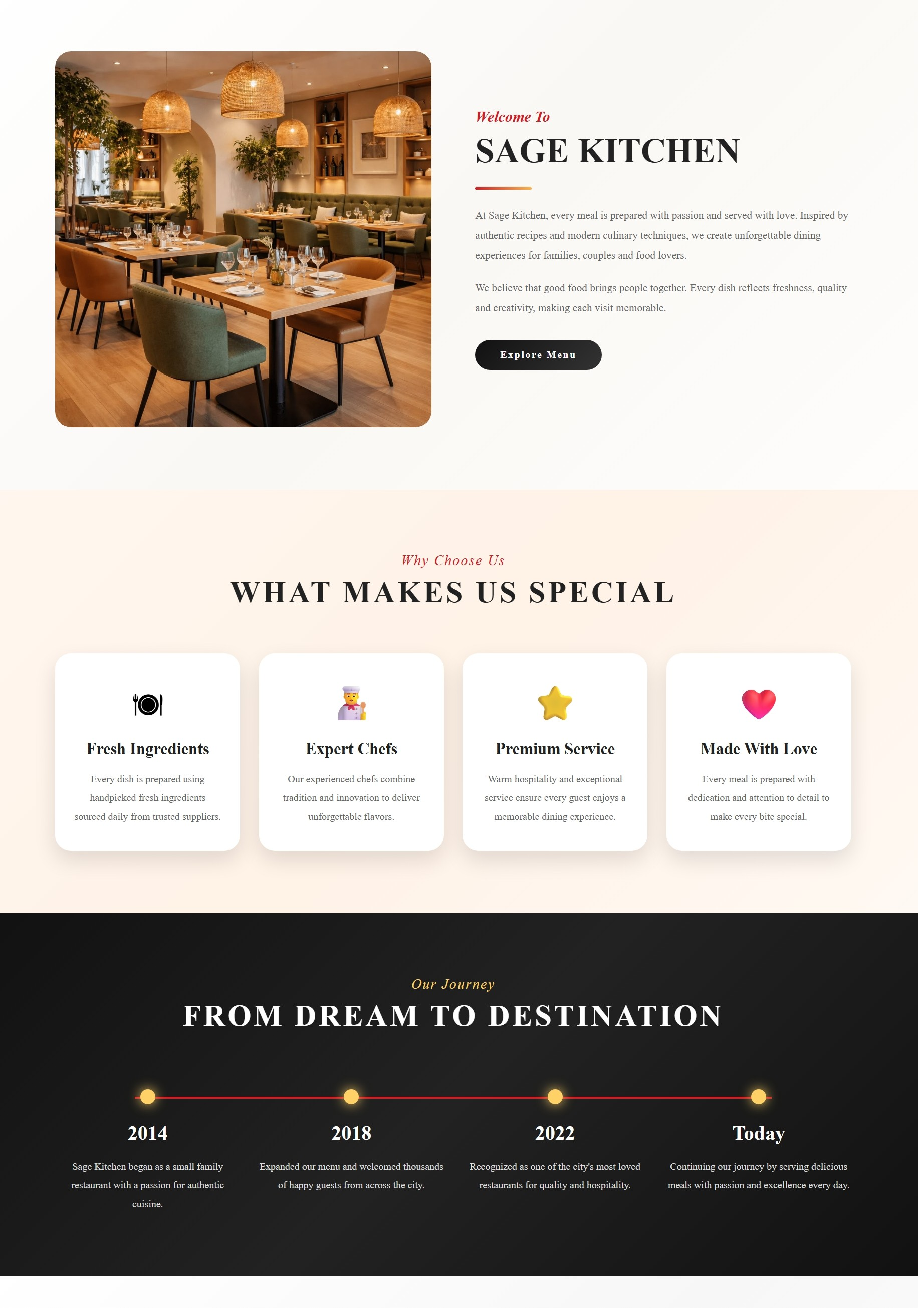
Screenshots —About
Sage Kitchen Website • CSS Project
About Page
Sage Kitchen Website • CSS Project
9

Slide 12

Screenshots — Gallery
Sage Kitchen Website • CSS Project
Gallery Page
Sage Kitchen Website • CSS Project
9

Slide 13
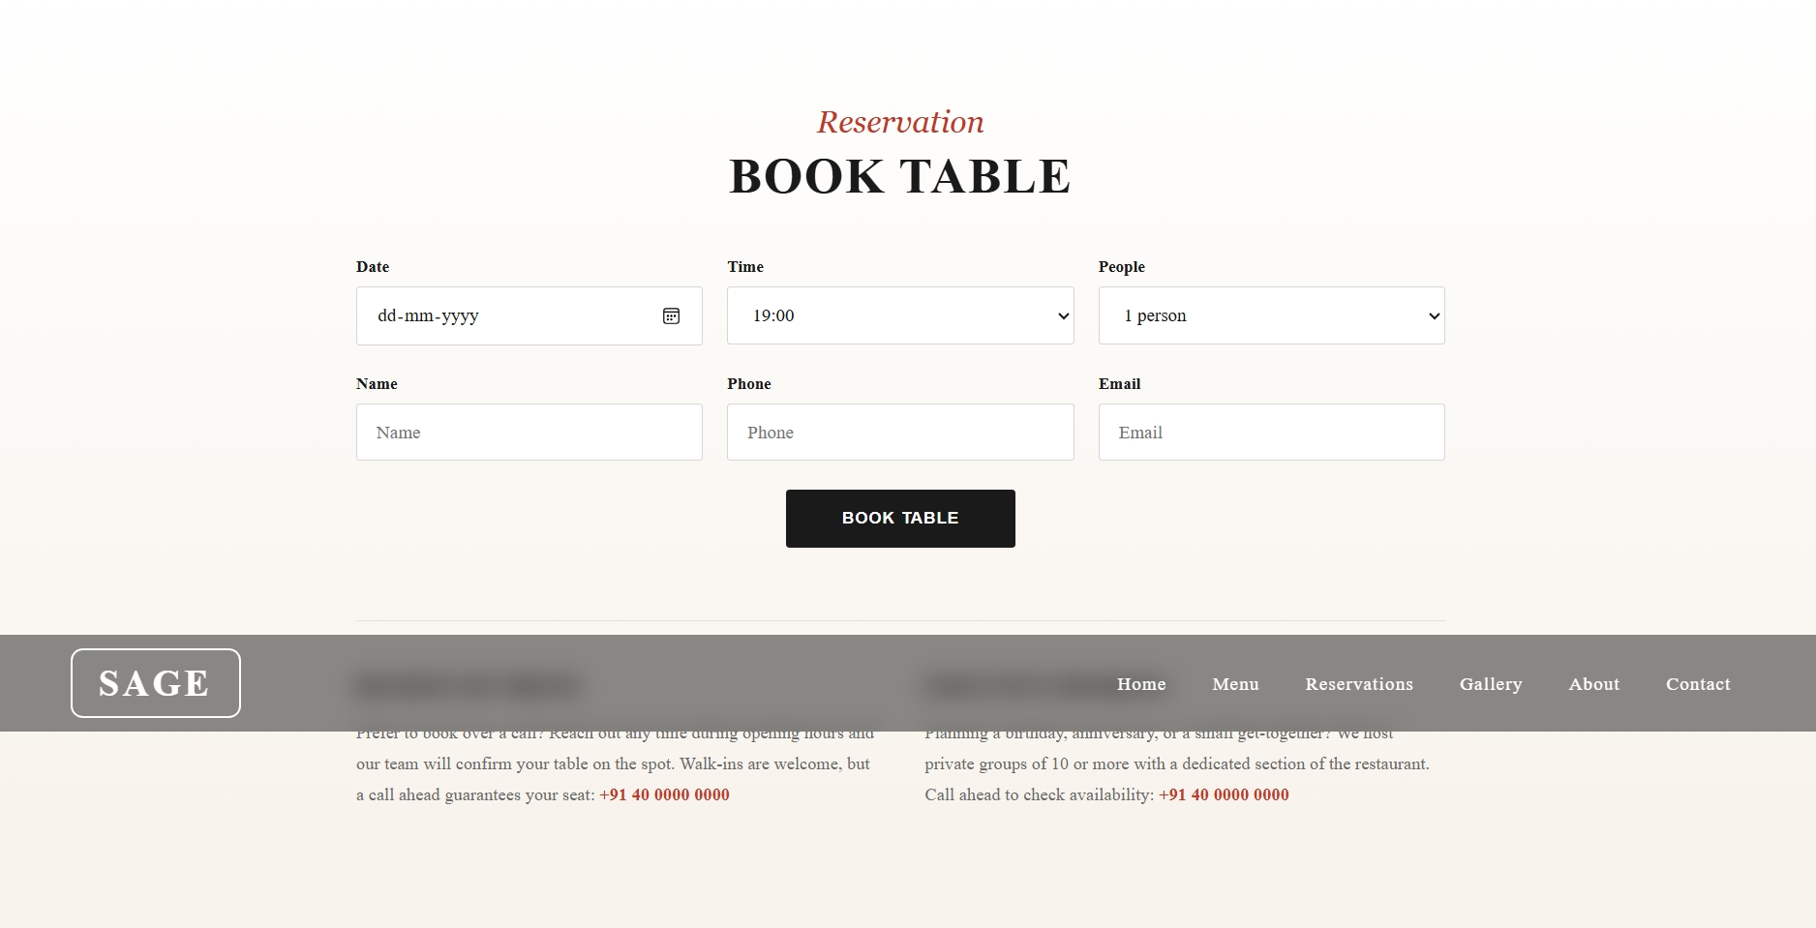
Screenshots — Reservations
Sage Kitchen Website • CSS Project
Reservations Page
Sage Kitchen Website • CSS Project
9

Slide 14
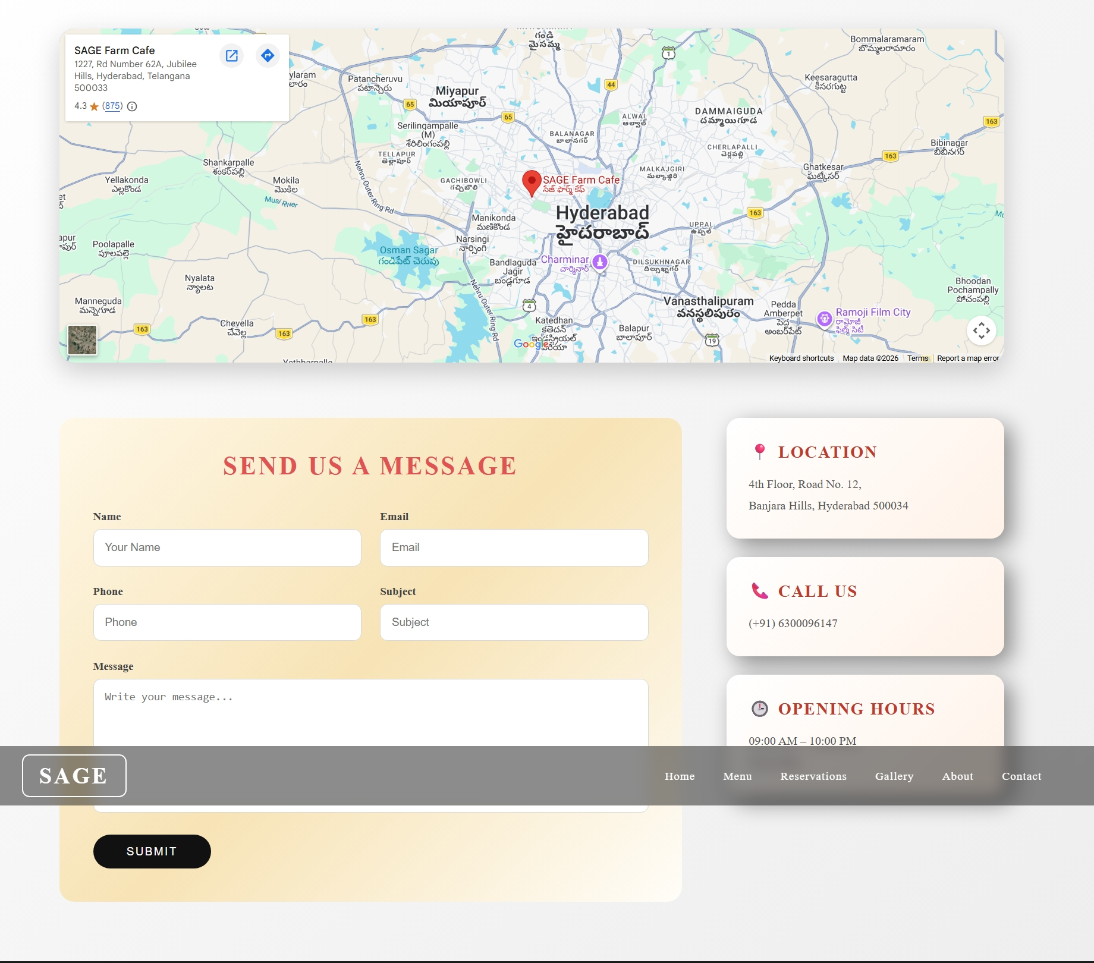
Screenshots —Contact
Sage Kitchen Website • CSS Project
Contact Page
Sage Kitchen Website • CSS Project
9

Slide 15
Conclusion
Successfully built a complete, six-page restaurant website styled entirely with hand-written CSS3.
Achieved the goal of practising and applying Flexbox, Grid, media queries, and CSS animation in one real project.
Delivers a consistent, responsive design across desktop, tablet, and mobile devices.
Provides a solid front-end styling foundation to build on with JavaScript next.
Sage Kitchen Website • CSS Project
11

Slide 16
THANK YOU
Krishnasai Doddapuneni
B.Tech CSE (Data Science) | Guru Nanak Institutions, Hyderabad

