Slide 1
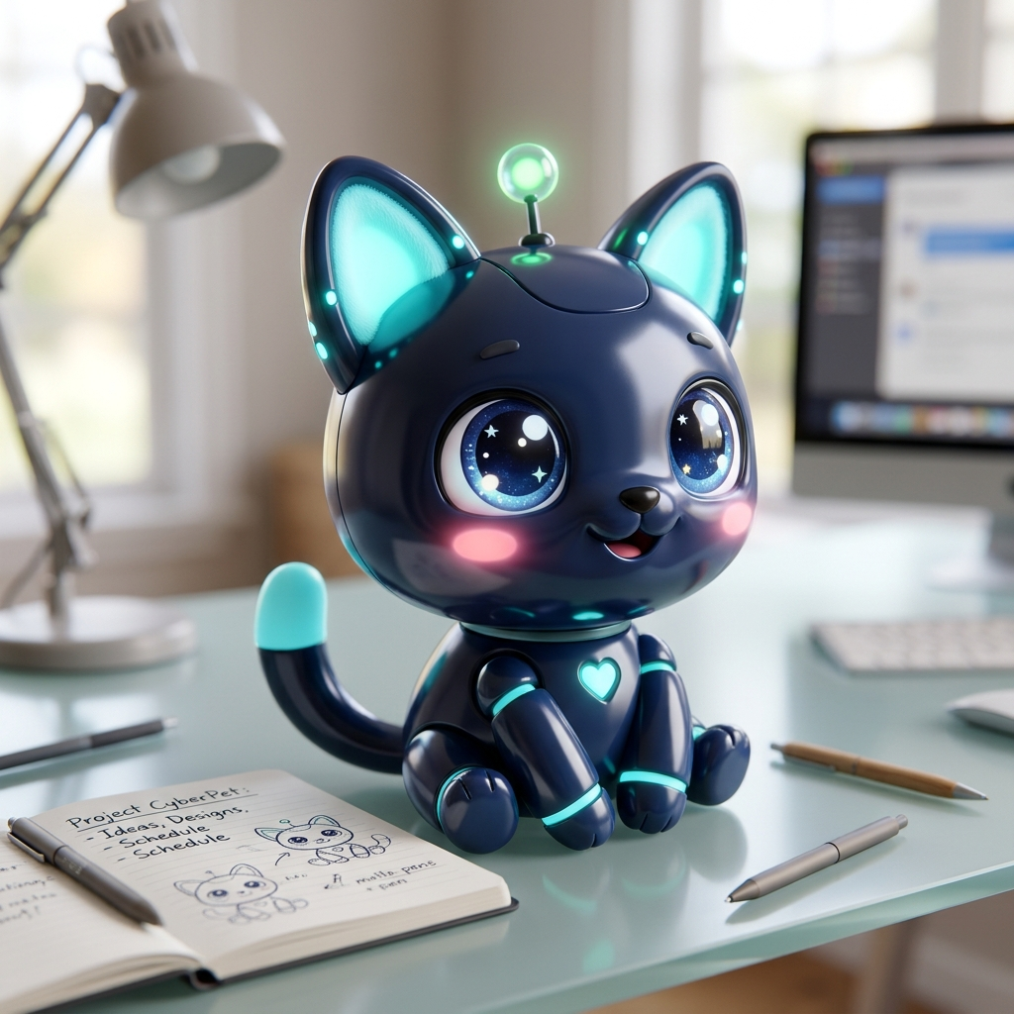
PRIVACY-FIRST GENAI PROJECT
Talk2Tasks AI
Desktop Meeting Intelligence & Live Multilingual AI Companion
• 100% Zero-Bot Architecture — Captures system audio without external bots.
• Real-Time Multilingual Detection — Whisper STT auto-detects 99+ languages.
• Hybrid AI Engine — Custom NVIDIA NIM API + Offline Ollama + Rule Fallback.
• Interactive Desktop Mascot — Transparent floating companion with speech alerts.
Notes:
Welcome everyone. Today I'm excited to present Talk2Tasks AI, a privacy-first desktop meeting intelligence platform. Unlike traditional meeting recorders that require invasive cloud bots to join calls, Talk2Tasks AI runs natively on your desktop. It captures dual audio, transcribes multilingual conversations with Faster-Whisper, and extracts actionable commitments in real time.

Slide 2
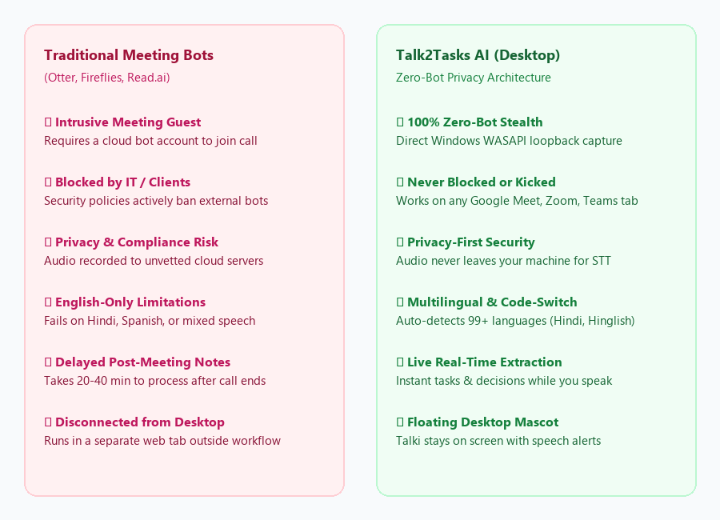
THE PROBLEM
The Meeting Dilemma: Privacy, Security & Language Gaps
⚠️ The Cloud Bot Security Risk
Corporate Google Meet, Zoom, and Teams meetings increasingly ban 3rd-party bots due to data compliance and IP privacy.
⚠️ Post-Meeting Action Item Slip
67% of commitments made in meetings are forgotten or never documented due to note-taking fatigue.
⚠️ Multilingual Communication Breakdown
Global teams speak mixed languages (Hindi, Hinglish, Spanish, French). Traditional English-only tools fail completely.
⚠️ Disconnected Web Tools
Having to open a separate browser tab distracts attendees from active participation in discussions.
Notes:
Here we see why traditional solutions like Otter or Fireflies fail in modern enterprises. They rely on bots that clients and IT security block. Furthermore, global meetings involve multilingual code-switching. Talk2Tasks solves this by capturing system audio directly with zero bots, protecting privacy, and supporting 99+ languages.

Slide 3
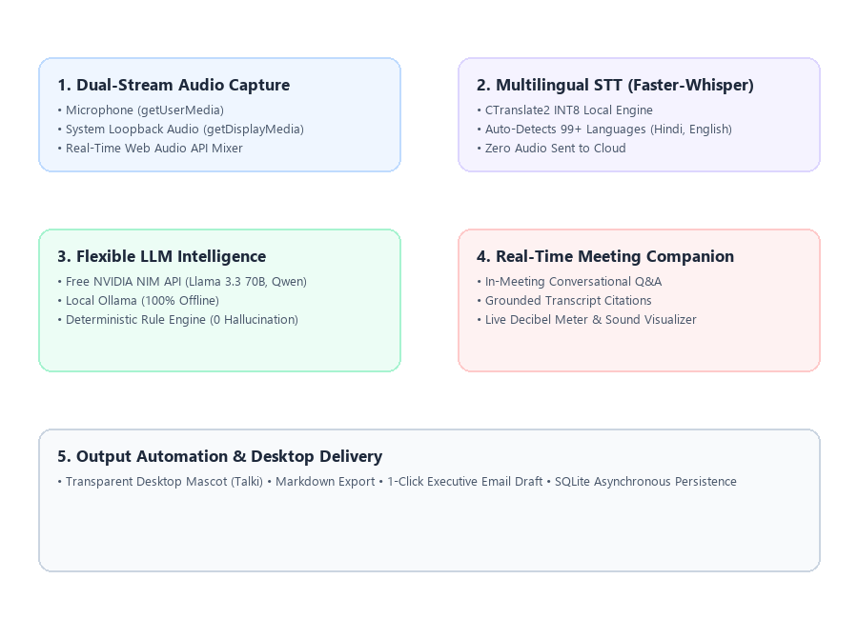
TECHNICAL ARCHITECTURE
Edge & Cloud Architecture: Low Latency, 100% Private
⚙️ Dual-Stream Web Audio Mixer
Captures Windows WASAPI loopback audio (remote participants) and local microphone with real-time volume metering.
⚙️ Faster-Whisper Multilingual STT
CTranslate2-optimized local model runs directly on CPU/GPU. Automatically detects language without sending voice to the cloud.
⚙️ NVIDIA NIM Cloud & Ollama LLMs
Integrates custom user-selected NVIDIA NIM models (Llama 3.3 70B, Qwen 2.5 72B) alongside local offline Ollama.
⚙️ Zero-Hallucination Fallback
Deterministic heuristic engine guarantees structured action items even if completely disconnected from the internet.
Notes:
This slide illustrates our 5-tier architecture. First, the dual-stream mixer captures both system loopback and mic audio. Next, Faster-Whisper transcribes speech locally in 5-second slices with automatic multi-language detection. Finally, our LLM engine parses transcript segments into structured notes, tasks, and follow-up emails.

Slide 4
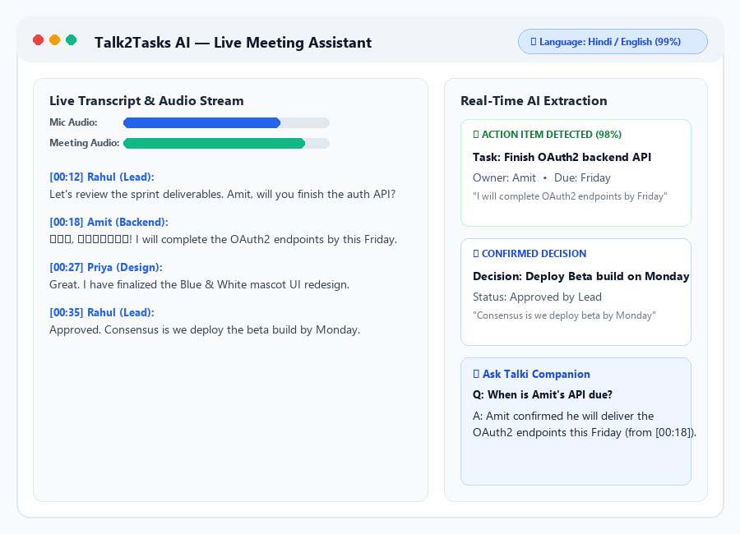
LIVE ASSISTANT
Real-Time Meeting Assistant & Multilingual Detection
🌐 Automatic Multi-Language Detection
Instant badge displays detected language (e.g. Hindi 98%, English 99%), handling code-switched Hinglish effortlessly.
🌐 Real-Time Dual Audio Visualizer
Dynamic decibel meters provide immediate visual feedback that your microphone and speaker loopback are active.
🌐 Instant Task & Decision Notifications
As soon as a participant says 'I will complete the API by Friday', Talk2Tasks extracts owner, task, and deadline.
🌐 In-Meeting Grounded Q&A
Ask questions during the call (e.g. 'What did Rahul say about the budget?'); receives answers strictly grounded in transcript quotes.
Notes:
Here you can see the Live Assistant screen. The dual audio meters confirm that both meeting participants and the user's voice are capturing. Notice the blue language badge confirming automatic multilingual detection. On the right, action items and decisions appear instantly while the meeting is ongoing.

Slide 5
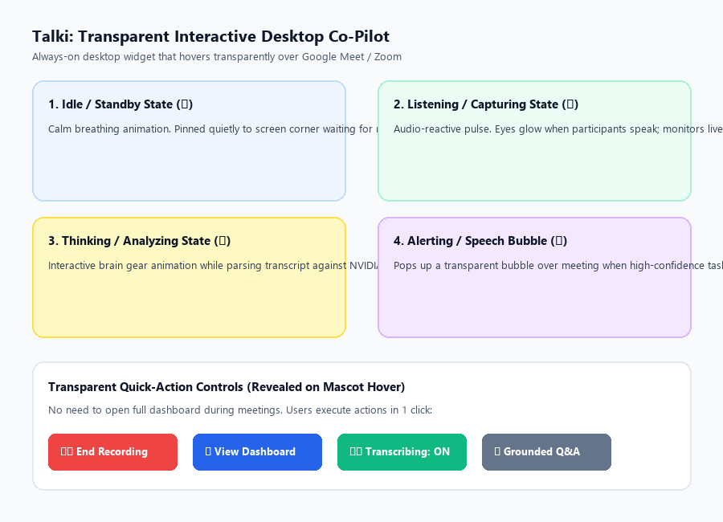
DESKTOP MASCOT
Talki: The Transparent Interactive Desktop Co-Pilot
🐾 Transparent Borderless Desktop Window
Electron window with transparent canvas; only the cute mascot and speech bubbles hover over your screen.
🐾 Dynamic Reactive Animation States
Talki changes states dynamically: Idle breathing, Listening audio pulse, Thinking gear animation, and Alerting speech bubble.
🐾 In-Meeting Speech Bubble Alerts
Whenever an action item or deadline is identified, Talki pops up a notification right over your Google Meet / Zoom window.
🐾 Glassmorphic One-Click Dock
Hovering over Talki reveals quick actions: End Recording, Open Dashboard, View Live Transcripts, or Toggle Mute.
Notes:
Talki is our interactive desktop mascot. Instead of an ugly rectangular app window, Talki is a transparent companion. It reacts to participant voices with a blue listening pulse, and pops up speech bubbles whenever someone commits to a deliverable. Users can control their recording with one-click transparent dock buttons.

Slide 6
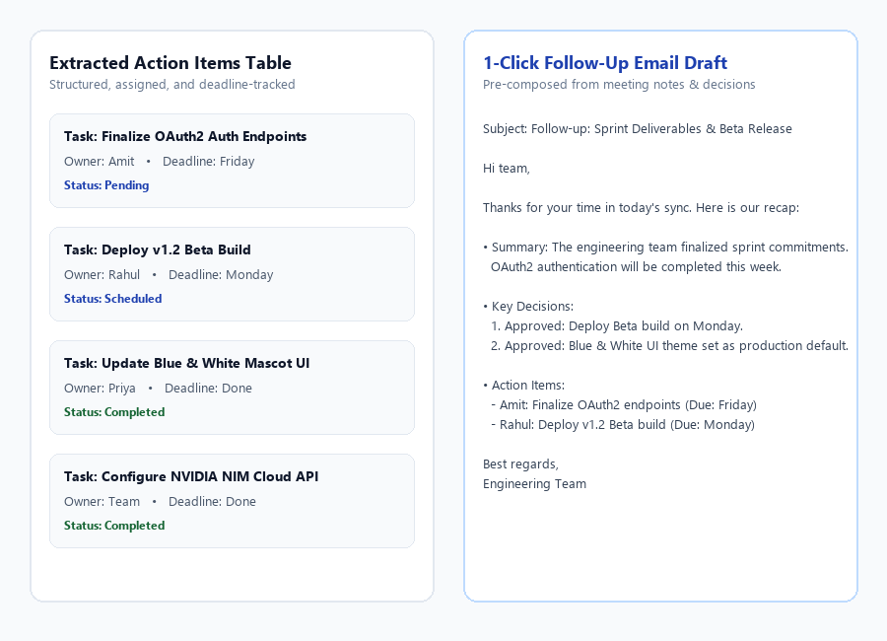
OUTCOMES & VALUE
Deliverables, Enterprise Security & Future Roadmap
🚀 1-Click Follow-Up Email Generation
Pre-composes structured executive recap emails including summary, decisions, and assigned tasks ready to send.
🚀 Action Items Table with Confidence
Categorizes task description, assigned owner, due date, and transcript quote with AI confidence scores.
🚀 Markdown & SQLite Persistence
Full meeting history, audio metadata, and transcript searchable offline anytime.
🚀 Future Roadmap
• Speaker Diarization (Voiceprint)
• Direct Jira/Linear/Slack webhook sync
• Automatic Outlook & Google Calendar listener
Notes:
In conclusion, Talk2Tasks AI delivers actionable outcomes immediately after a meeting ends. Teams save an average of 80% on post-meeting documentation time. With enterprise privacy, zero bots, and multilingual support, Talk2Tasks AI is the future of intelligent desktop collaboration.

