Slide 1

Energy Consumption Analysis

Slide 2
About me
My name is Krishnasree Rajala , and I hold a B.Tech degree in Artificial Intelligence & Machine Learning (AI&ML) from Visvodaya Engineering College Kavali,AP. I am deeply passionate about developing my expertise in Data Science, as it empowers professionals to interpret complex datasets, uncover patterns, and make data-driven decisions that fuel innovation across industries. While I may not yet have formal work experience, my strong technical foundation, analytical thinking, and eagerness to learn drive me to master data science tools and techniques. I am committed to applying these skills to deliver impactful insights and contribute meaningfully to future projects.
Connect With Me
Linkedin : https://www.linkedin.com/in/rajala-krishnasree GitHub : https://github.com/Krishnasree-22 Mail: rajalakrrishnashree@gmail.com

Slide 3
Agenda
Objective of the Project
ER Diagram and schema explanation
Key analysis questions (use cases)
SQL query results with screenshots or summaries
Final business insights and recommendations
Conclusion (Key finding overall)
Q&A Slide
Your Experience/Challenges working on SQL – Data Analysis Project.

Slide 4
Objective of the Project
The objective of the Energy Consumption Analysis SQL project is to analyze worldwide energy consumption using data from the EIA organization, which tracks metrics such as energy consumption, emissions, production, population, and GDP for various countries. The project aims to derive meaningful insights by understanding correlations between economic power, consumption, and emissions. This comprehensive analysis is performed using structured datasets integrated into a MySQL database, enabling comparative, trend-based, and per capita assessments of global energy dynamics.

Slide 5
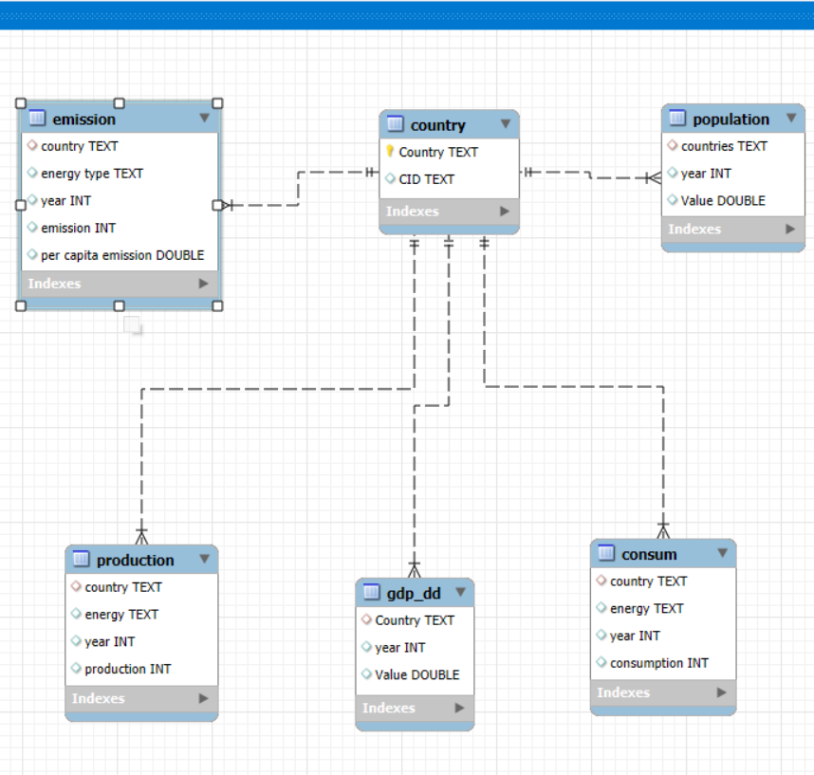
ER Diagram and schema explanation
ER Diagram Explanation
The ER diagram for the SQL project on energy consumption analysis consists of six interconnected tables: country, emission, population, production, GDP, and consum. The central "country" table is linked to all other tables through the country attribute, enabling relational integrity and structured queries across datasets.
Schema Explanation
The country table serves as the reference, containing fields for country name and a unique country ID. All other tables connect to this to maintain data consistency.
The emission table stores emission details, energy type, year, total emission, and per capita emission values for each country.
The population table tracks population values by country and year.
The production table contains data on energy production amounts by country, energy type, and year.
The gdp_dd table records GDP values by country and year.
The consum table keeps track of energy consumption data segmented by country, energy type, and year.

Slide 6
Key analysis questions
What is the total emission per country for the most recent year available?
What are the top 5 countries by GDP in the most recent year?
Which energy types contribute most to emissions across all countries?
How have global emissions, GDP, and population changed over time?
What is the emission-to-GDP and energy consumption per capita for each country?
Which countries have reduced their per capita emissions the most over the last decade?

Slide 7
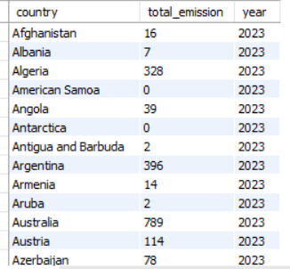
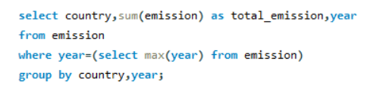
SQL query results with screenshots or summaries
1. What is the total emission per country for the most recent year available?
QUERY
OUTPUT

Slide 8
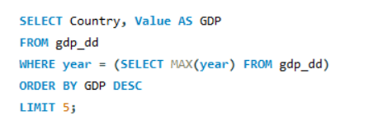
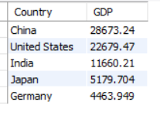
SQL query results with screenshots or summaries
2.What are the top 5 countries by GDP in the most recent year?
QUERY
OUTPUT

Slide 9
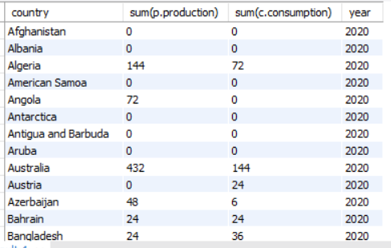
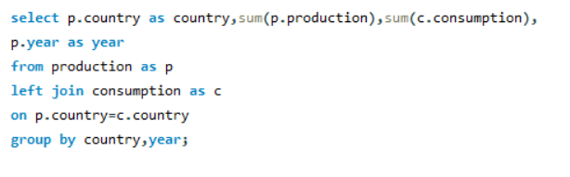
SQL query results with screenshots or summaries
3.Compare energy production and consumption by country and year
QUERY
OUTPUT

Slide 10
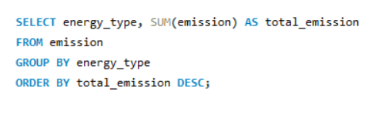
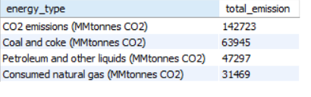
SQL query results with screenshots or summaries
4. Which energy types contribute most to emissions across all countries?
QUERY
OUTPUT

Slide 11
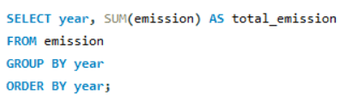
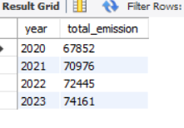
SQL query results with screenshots or summaries
5. How have global emissions changed year over year?
QUERY
OUTPUT

Slide 12
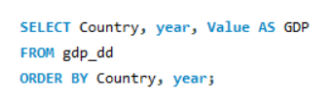
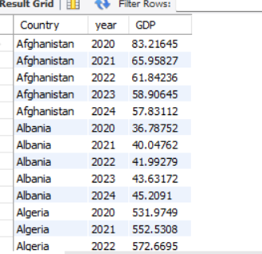
SQL query results with screenshots or summaries
6. What is the trend in GDP for each country over the given years?
QUERY
OUTPUT

Slide 13
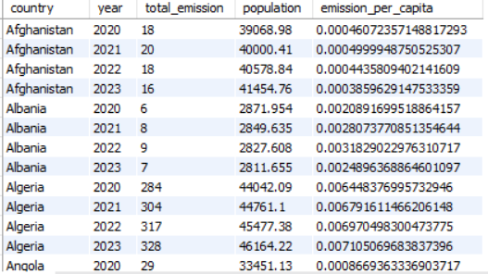
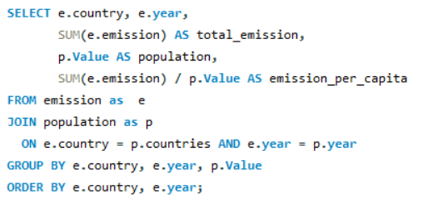
SQL query results with screenshots or summaries
7. How has population growth affected total emissions in each country?
QUERY
OUTPUT

Slide 14
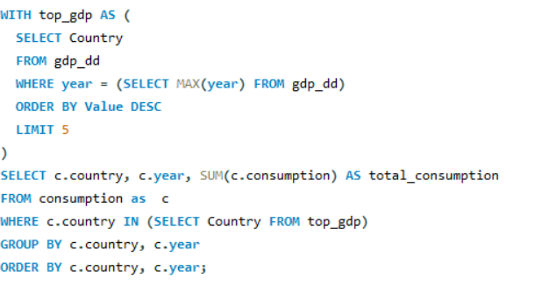
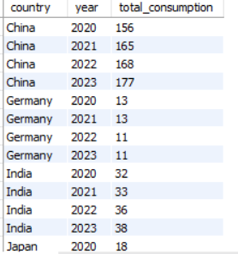
SQL query results with screenshots or summaries
8. Has energy consumption increased or decreased over the years for major economies?
QUERY
OUTPUT

Slide 15
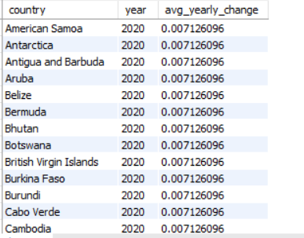
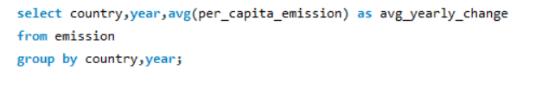
SQL query results with screenshots or summaries
9.What is the average yearly change in emissions per capita for each
country?
QUERY
OUTPUT

Slide 16
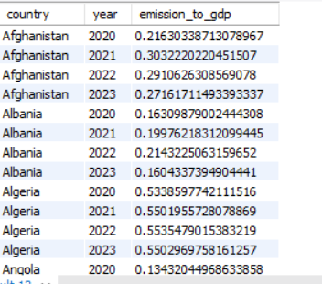
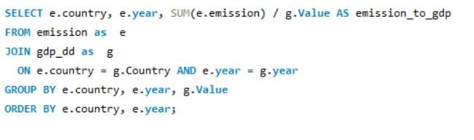
SQL query results with screenshots or summaries
10. What is the emission-to-GDP ratio for each country by year?
QUERY
OUTPUT

Slide 17
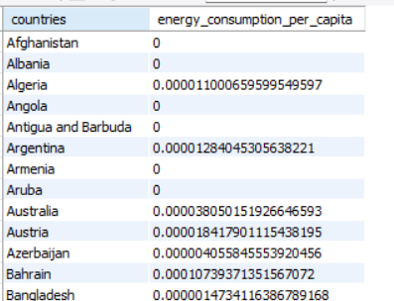
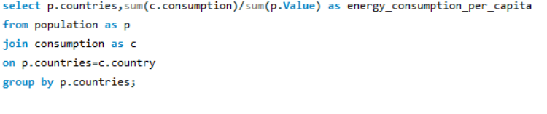
SQL query results with screenshots or summaries
11. What is the energy consumption per capita for each country over the last decade?
QUERY
OUTPUT

Slide 18
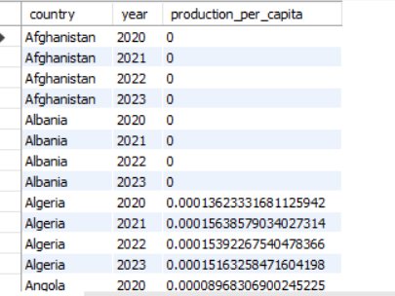
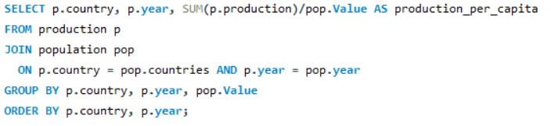
SQL query results with screenshots or summaries
12. How does energy production per capita vary across countries?
QUERY
OUTPUT

Slide 19
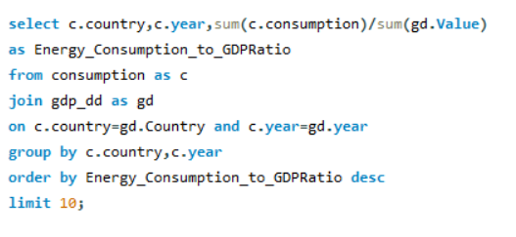
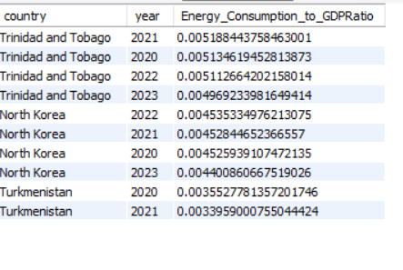
SQL query results with screenshots or summaries
13. Which countries have the highest energy consumption relative to GDP?
QUERY
OUTPUT

Slide 20
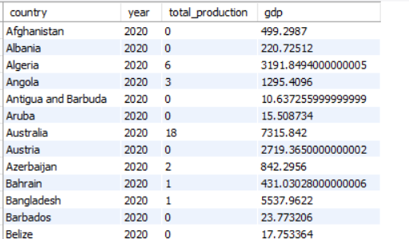
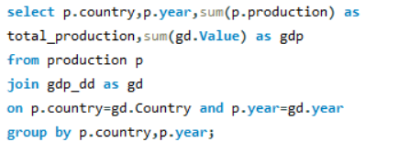
SQL query results with screenshots or summaries
14. What is the correlation between GDP growth and energy production growth?
QUERY
OUTPUT

Slide 21
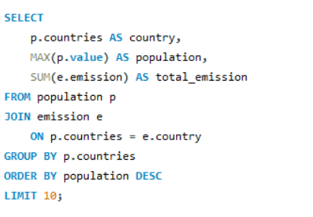
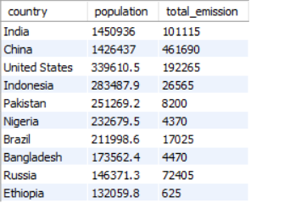
SQL query results with screenshots or summaries
15. What are the top 10 countries by population and how do their emissions compare?
QUERY
OUTPUT

Slide 22
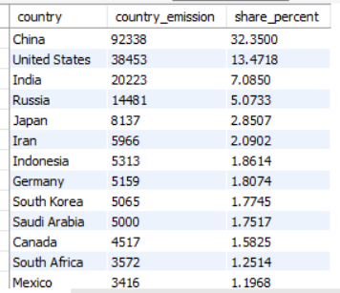
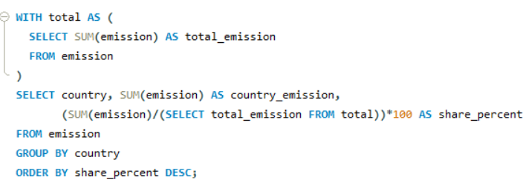
SQL query results with screenshots or summaries
16. What is the global share (%) of emissions by country?
QUERY
OUTPUT

Slide 23
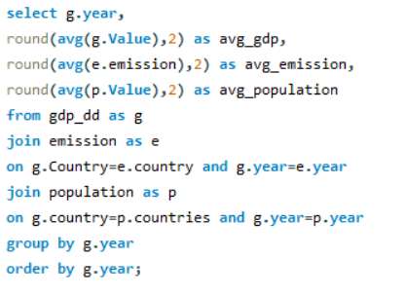
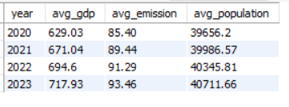
SQL query results with screenshots or summaries
17. What is the global average GDP, emission, and population by year?
QUERY
OUTPUT

Slide 24
Final business insights and recommendations
Countries with higher GDP tend to have increased energy consumption and emissions, indicating economic growth drives energy demand.
Emission-to-GDP ratios reveal efficiency levels; countries with lower ratios manage economic growth with less environmental impact.
Population growth correlates with rising emissions, highlighting the need for sustainable energy policies as populations increase.
Energy consumption and production trends over time suggest opportunities for investment in cleaner and more efficient energy sources.
Top energy-consuming countries should focus on reducing per capita emissions through renewable energy adoption and efficiency improvements.
Continuous monitoring of energy consumption per capita and emission trends can guide policy decisions to balance growth and sustainability.

Slide 25
Conclusion
This project helped analyze how different countries use energy and produce emissions.
It showed that countries usually use more energy as their economy grows.
The results highlight the need to use energy more efficiently and adopt cleaner sources.
Data analysis supports making better decisions to protect the environment while supporting growth.
Overall, this study shows how data can help plan for a sustainable and energy-efficient future.

Slide 26
Your Experience/Challenges working on SQL
Experience
Gained practical skills in writing complex SQL queries to analyze large datasets.
Learned how to work with multiple related tables and perform joins for meaningful insights.
Understood real-world relationships between energy consumption, emissions, GDP, and population.
Challenges
Managing and integrating multiple tables with different attributes required careful schema design.
Ensuring data consistency and avoiding errors during SQL querying was sometimes difficult.
Interpreting results to draw clear business insights from raw data demanded critical thinking and domain understanding.

Slide 27

THANK YOU

