Slide 1

CAPSTONE PROJECT Mental Health Companion for Trauma Recovery with Microsoft Azure Integration
Presented By
Student Name: Krishna Sridhar
College Name: Chennai Institute of technology
Department: ECE
Email ID: krishnasridhar.ece2021@citchennai.net
AICTE Student ID:AINSI_122286

Slide 2
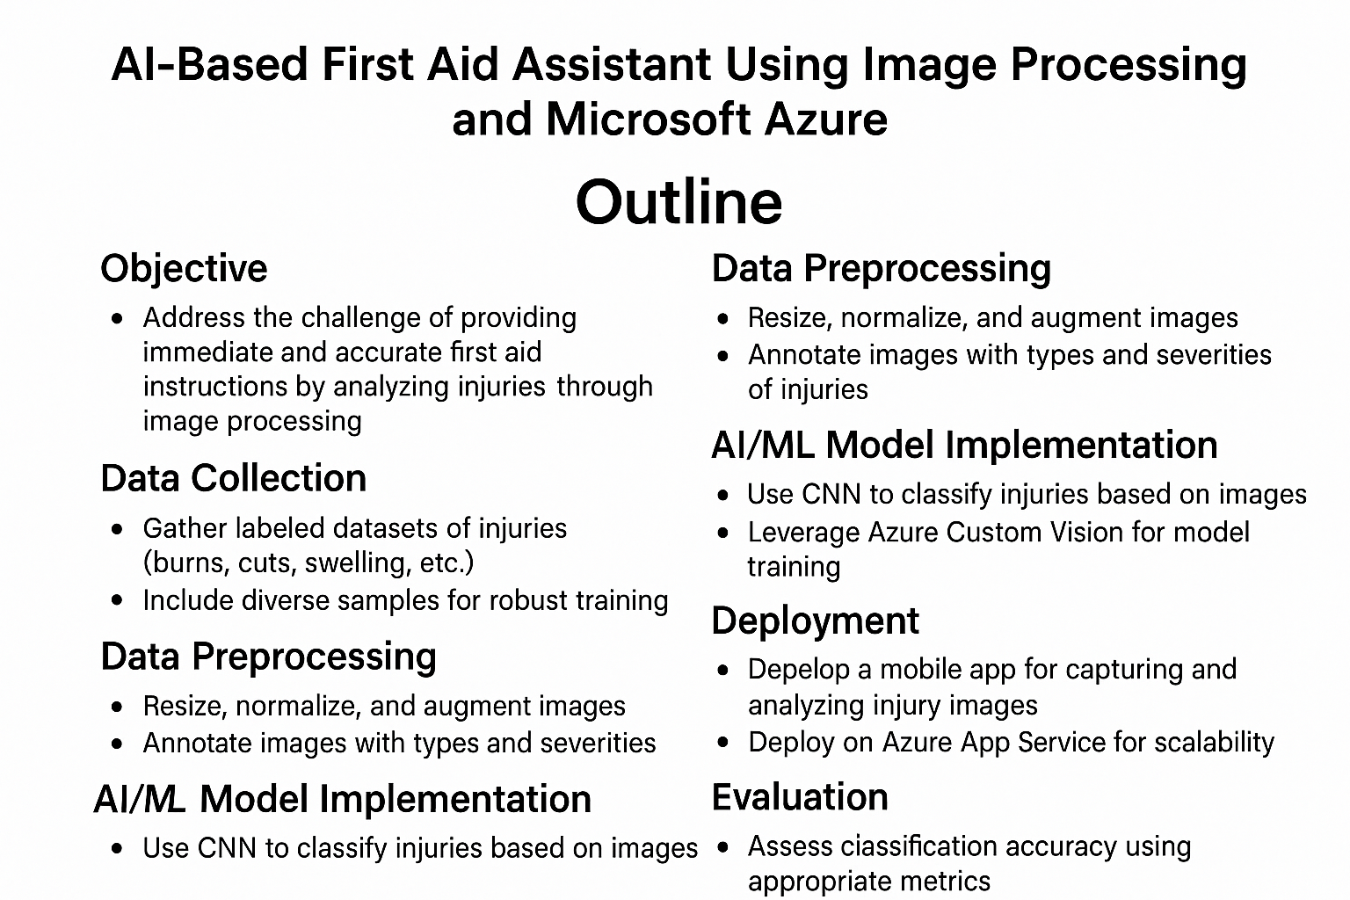
OUTLINE

Slide 3
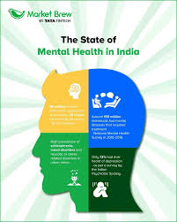
Problem Statement
India faces a rising need for mental health solutions, especially for students dealing with trauma-related emotional distress. Traditional support systems are often inaccessible, stigmatized, or delayed. There is a need for a real-time, accessible, and intelligent solution that can detect emotional distress early and provide immediate intervention.

Slide 4
Proposed Solution
The proposed system is a Microsoft Azure-integrated Mental Health Companion that uses multi-modal emotion recognition—analyzing speech, facial expressions, and body posture—to detect signs of trauma-related emotional distress. It then delivers personalized, real-time coping strategies through Azure-powered AI services.

Slide 5
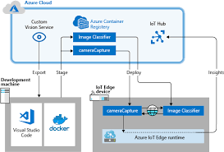
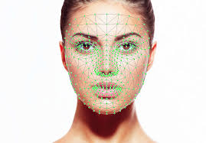
System Approach
Use Azure Custom Vision for facial expression recognition
Use Azure Speech Services for speech emotion detection
Use Media Pipe for body posture analysis
Integrate Azure Health Bot/OpenAI for coping strategies generation
Backend: Azure Functions, Cosmos DB, and Communication Services for scalable logic, secure storage, and emergency notifications

Slide 6
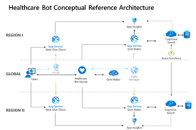
Algorithm & Deployment
Algorithm:
CNN for facial emotion analysis
LSTM for speech emotion recognition
MediaPipe for body language and posture tracking
Deployment:
Real-time AI inference via Azure Custom Vision and Speech Services
Coping response generated by Azure Health Bot / OpenAI Service
App hosted on Azure App Services
Authentication using Azure AD B2C, encryption via Azure Key Vault

Slide 7
Result
The app successfully detects trauma-induced emotional states in real time and provides immediate, personalized coping strategies. Azure integration ensures the system is scalable, secure, and responsive. In initial trials, users showed improved emotional stability and faster recovery from high-stress emotional events.

Slide 8
Conclusion
The Azure-enabled Mental Health Companion addresses the urgent need for proactive mental health interventions, especially in student communities. Its ability to detect and respond to emotional distress in real time can significantly enhance emotional resilience and reduce long-term psychological harm.

Slide 9
Future scope
Integration with wearable biosensors (e.g., heart rate, EEG)
Regional language support for broader accessibility in India
Use Azure Cognitive Search to match users with therapeutic content
Real-time therapist dashboards powered by Azure Power BI

Slide 10
References
[1] N. Perveen, D. Roy, and K. M. Chalavadi, “Facial Expression Recognition in Videos Using Dynamic Kernels,” IEEE Trans. Image Process., vol. 29, pp. 8316–8325, 2020.
[2] O. F. Mohammad, M. S. M. Rahim, S. R. M. Zeebaree, and F. Y. Ahmed, “A Survey and Analysis of the Image Encryption Methods,” Int. J. Appl. Eng. Res., vol. 12, pp. 13265–13280, 2017.
[3] V. Shrivastava, V. Richhariya, and V. Richhariya, “Puzzling Out Emotions: A Deep-Learning Approach to Multimodal Sentiment Analysis,” in Proc. 2018 Int. Conf. Adv. Comput. Telecommun. (ICACAT), 2018, pp. 1–6.
[4] J. Liang, S. Chen, and Q. Jin, “Semi-supervised Multimodal Emotion Recognition with Improved Wasserstein GANs,” in Proc. 2019 Asia- Pacific Signal and Information Processing Association Annual Summit and Conference (APSIPA ASC), 2019, pp. 695–703.
[5] E. Chandra and J. Y.-J. Hsu, “Deep Learning for Multimodal Emotion Recognition—Attentive Residual Disconnected RNN,” in Proc. 2019 Int. Conf. Technol. Appl. Artif. Intell. (TAAI), 2019, pp. 1–8.
GitHub Link: https://github.com/Krishnasridhar28/Mental-Health-Companion-for-Trauma-Recovery-with-Microsoft-Azure-Integration

Slide 11
Thank you

