Slide 1
IT SERVICES
KrishnaSrikanth Donthineni
Team ID: 1=IT
Folder: b-f19-03
“E-business” class, Prof. Hanh Pham, Fall 2019

Slide 2
Outline :
Business Model
  1.1 Business Context and Goals
  1.2 Technical Requirements & Technologies
Architecture
Protocols
Database (with data examples)
Schedule

Slide 3
Business Model:
1.1 Business Context and Goals
The business is going to offer IT services like hardware parts, connection errors complaints, Data Visualization .
The business is targeting customers who needs help with the hardware parts, Storage services ,Data Visualization etc..

Slide 4
Products Going To be Featured:
Hardware parts for back-up.
Security devices or software for different type of electronics like Computers, Phones etc..
Data visualization on the cloud in which the data should be sent through sockets.
Data visualization on our side only by downloading the plug-in and attach to our software.

Slide 5
Business Model:
  1.2 Technical Technologies & Requirements:
It is going to be built and run on wyvern Linux school server.
Front End: HTML ,CSS , BootStrap and JavaScript.
Programming Language: PHP
Socket Programming: Java
For now I am not going to use any framework going forward if it is necessary will include one.
Softwares: Putty , WinSCP.

Slide 6
Business Model:
  1.2 Technical Technologies & Requirements
a) Website: Different Pages for the Front-End user
Registration Page, Login Page, Catalog Page, Shopping cart Page, Payment Page, Shipping Page , Visualization Page.
b) API:
The Linux server with minimum requirements.
Sockets connections using java socket programming. Where client and server both will be able send and receive the data.

Slide 7
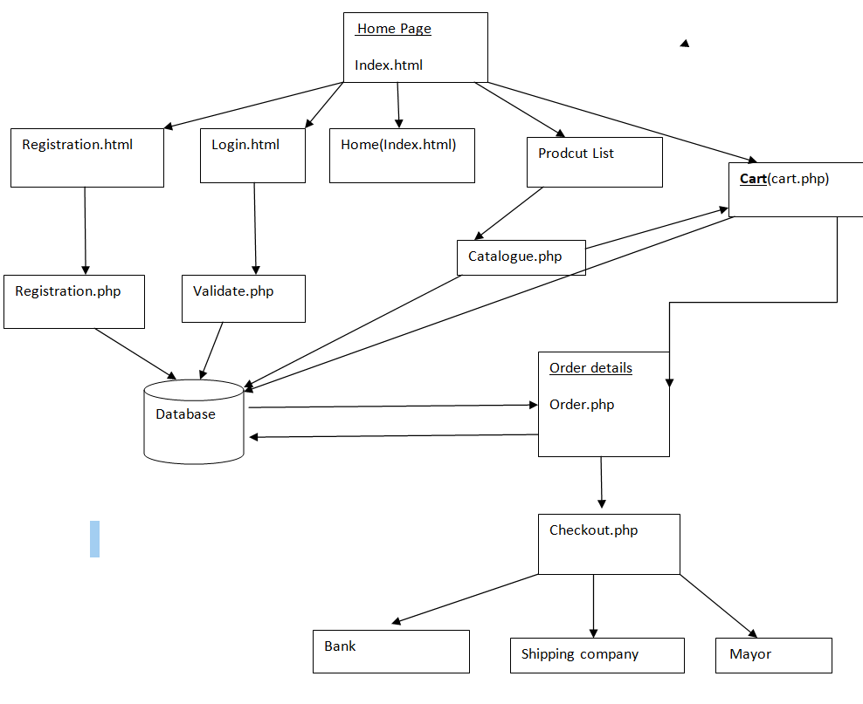
Architecture Web Site:

Slide 8
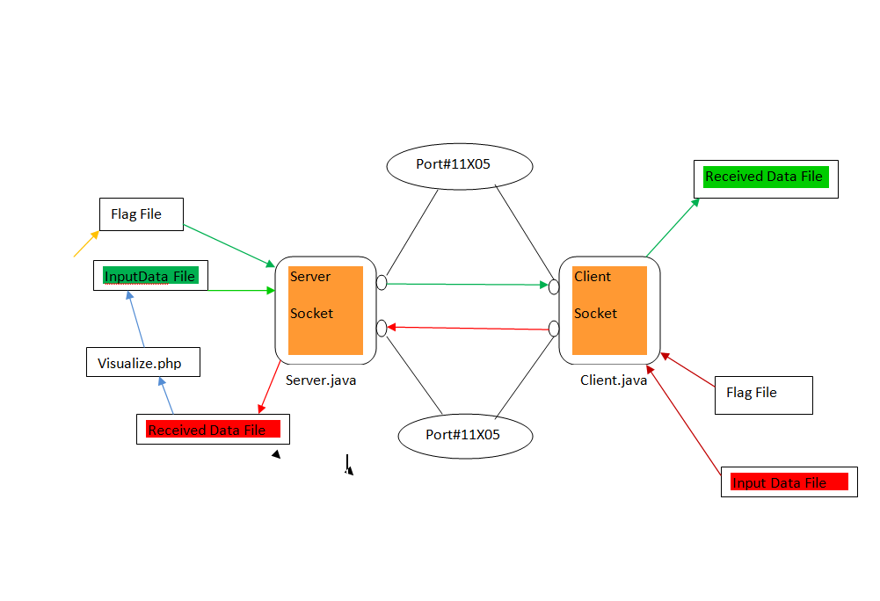
API Architecture:

Slide 9
PROTOCOLS:
  3.1 TRANSACTIONS
T1: REGISTRATION
--
T2: LOGIN
---
T3: Adding product to the cart.
----
T4,T5:Check Out , Confirm Order.
-----
T6:Visualization

Slide 10
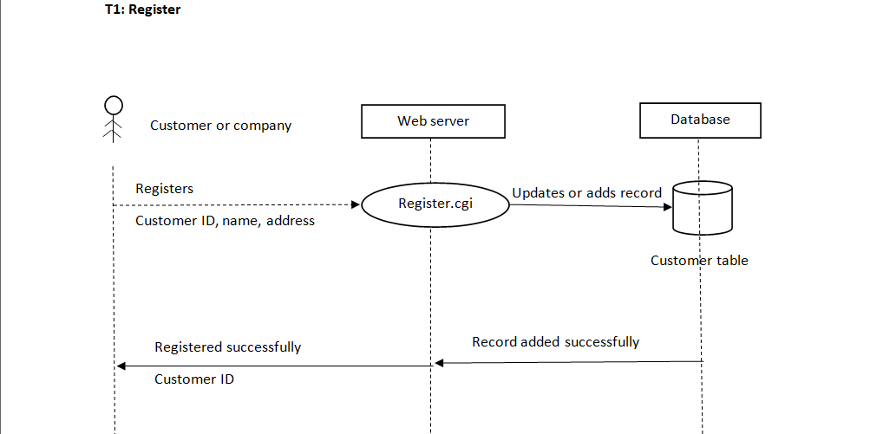
T1: REGISTRATION:

Slide 11
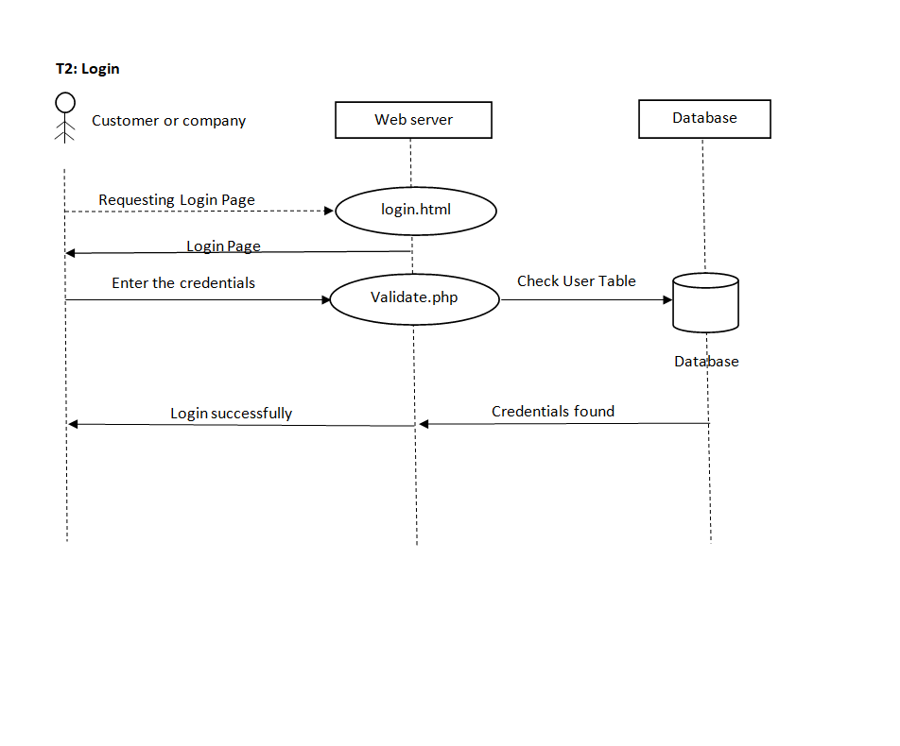
T2: LOGIN:

Slide 12
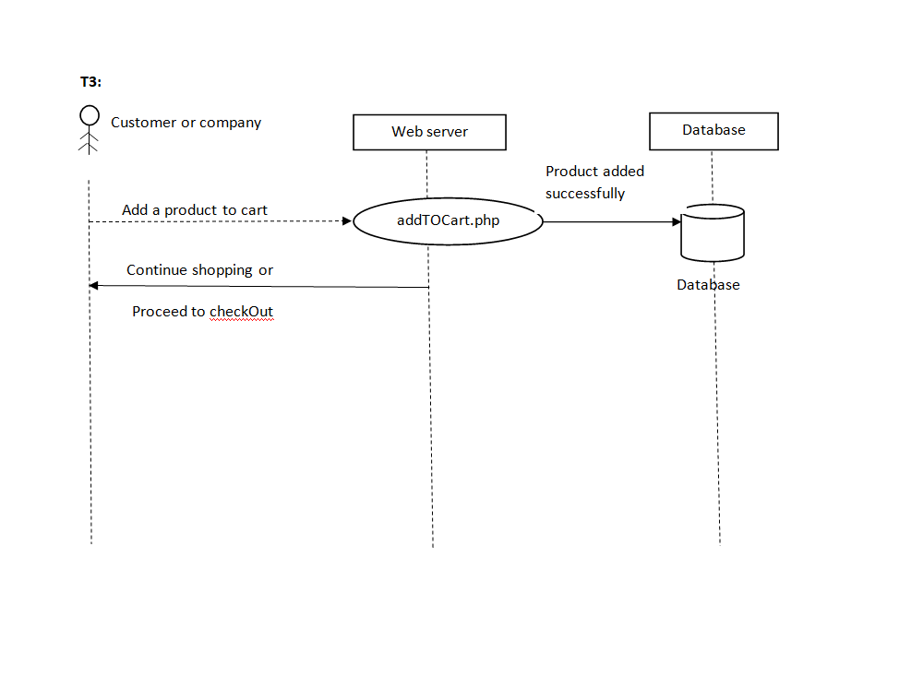
T3: Adding product to the cart:

Slide 13
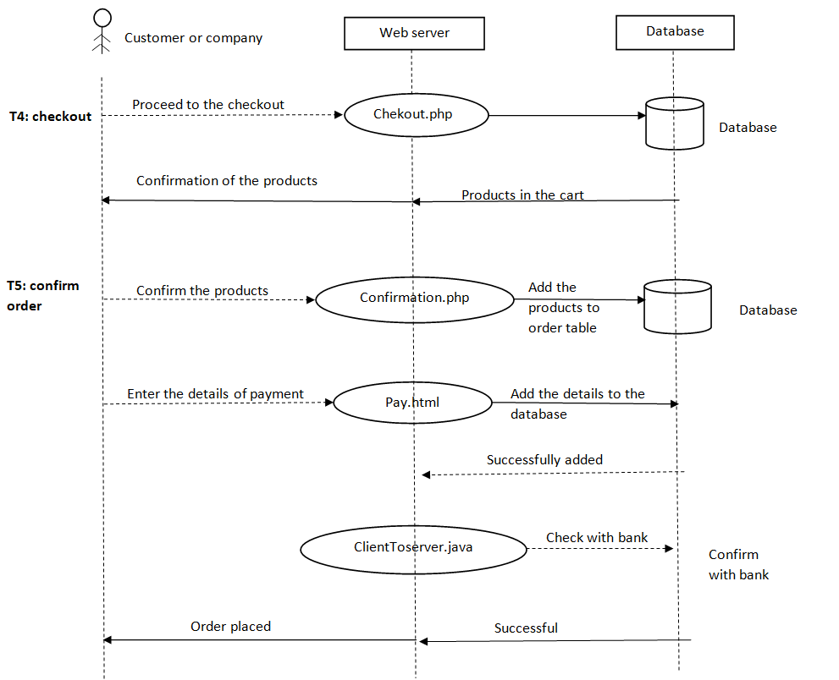
T4,T5:

Slide 14
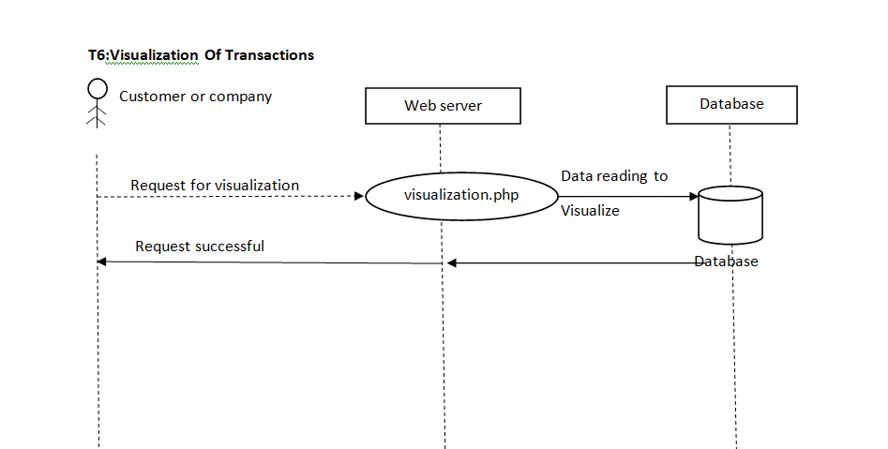
T6:

Slide 15
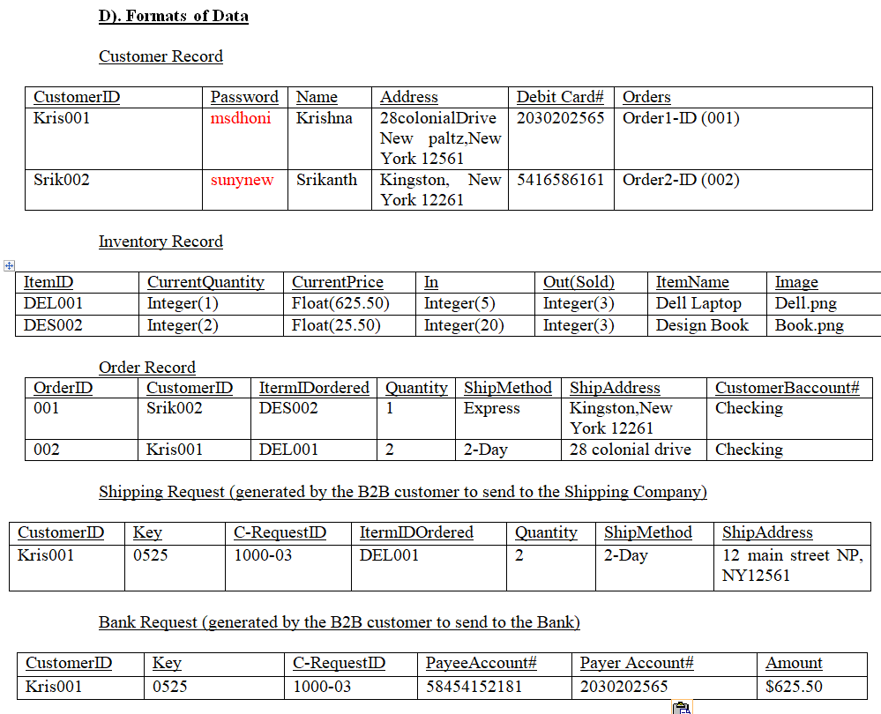
DATABASE:

Slide 16
Database:
Visualization Record For customers:
Customer Id | Customer Name | Product Id | Products Name | Total Products | Total Price
Krish001 | Krishna | DEL001 | Dell Hardware parts | 2 | 40
Srik002 | Srikanth | VIS001 | Simple visualization | 1 | 100

Slide 17
SCHEDULE:
Date | Work to done
Nov 5 | Proposal Presentation
…
Nov 6 | Updating the requirments and ideas according to the suggestions during Proposal presentation.
Nov 6 – Nov 12 | Working on FRONT-END
 | Login, registration, product lists and cart
… | Database design
… | Connecting Database to front end
… | Testing
… | Test Login , Registration , Cart and Order pages.
Nov 13 – Nov 20 | connecting socket programming to web site.
 | Testing data flowing between client and server.
Nov 21 – Nov 24 | Testing whole project and making improvisation.
Nov 25 | Make the slides for poster & write Final report
Dec 1 | Make the poster Prepare the Oral presentation
Dec 4 | Final presentation (Job Fair, poster and equipment)

