Slide 1
Metabolic Network Prediction with Directed Graph Methods

Slide 2
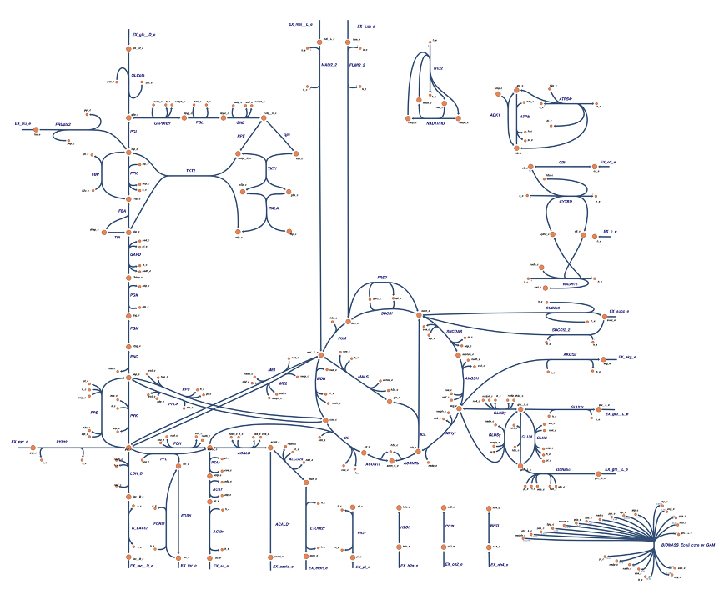
Directed Graphs from Metabolic Networks
R2
M2
R4
M4
R7
M1
R1
M5
M1
M3
R5
M5
R3
R7
Gene Expression
(Mapped from Gene to Reaction)

Slide 3
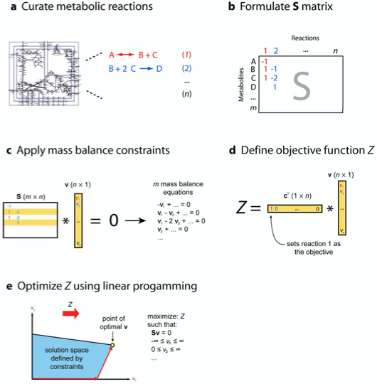
Classic Computational Strategy: Flux Balance Analysis
Reactions are compartmentalized (cytosol, extracellular, mitochondrial, etc.) and include transport reactions
Uptake and Excretion limits are set using transport reactions (somewhat arbitrary)
Determination of objective function introduces large bias, particularly in complex organisms

Slide 4
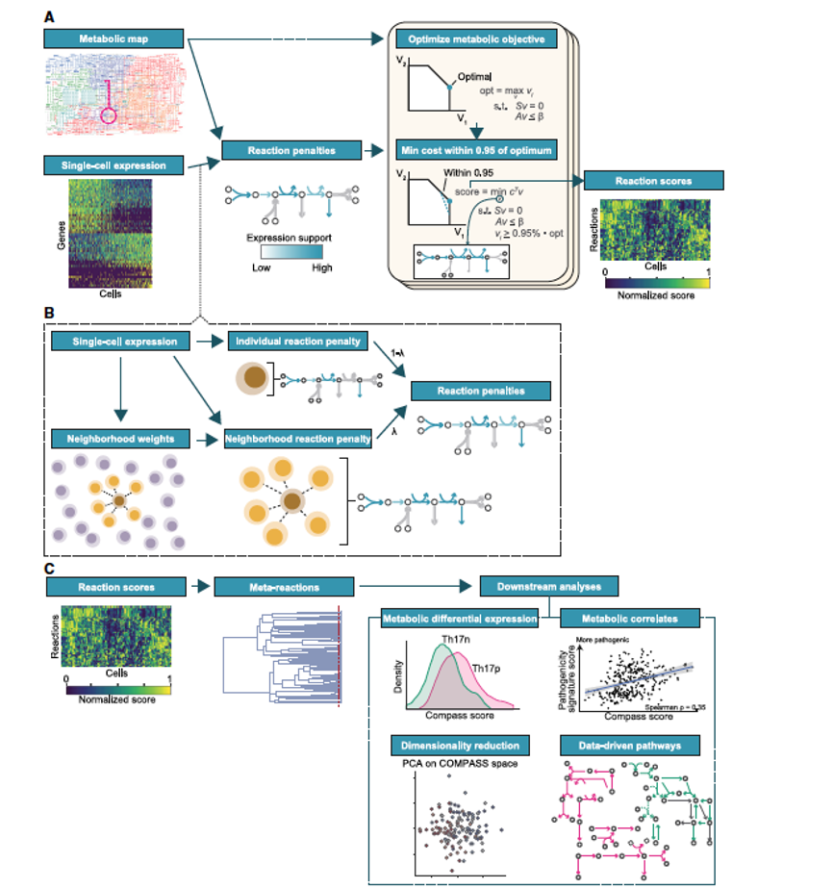
Adaptation for Single Cell Transcriptomics: Compass Algorithm
Calculate maximal fluxes for each reaction
Calculate maximal fluxes for each cell constrained by gene expression
Group and scale to obtain Compass scores representing predicted maximal flux through metabolic pathways
Extremely slow
Does not leverage inherent graph structure of biochemistry

Slide 5
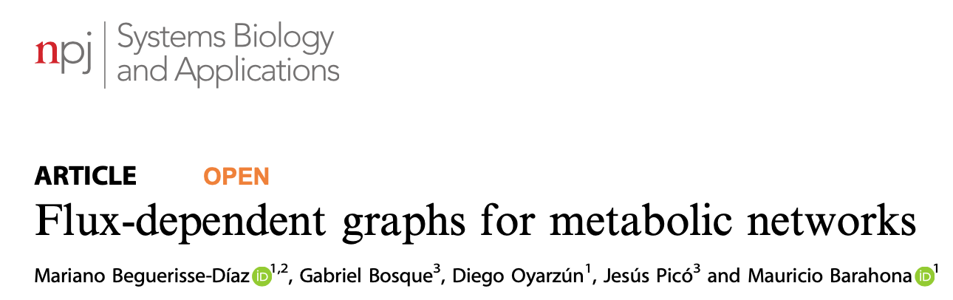
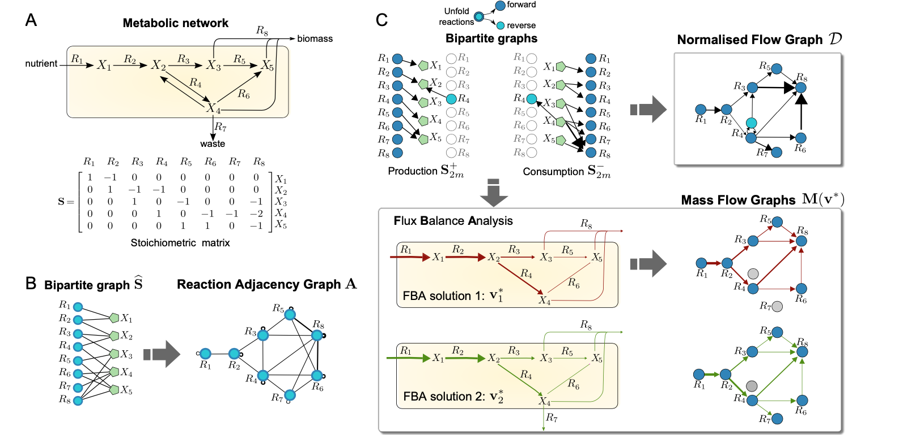

Slide 6
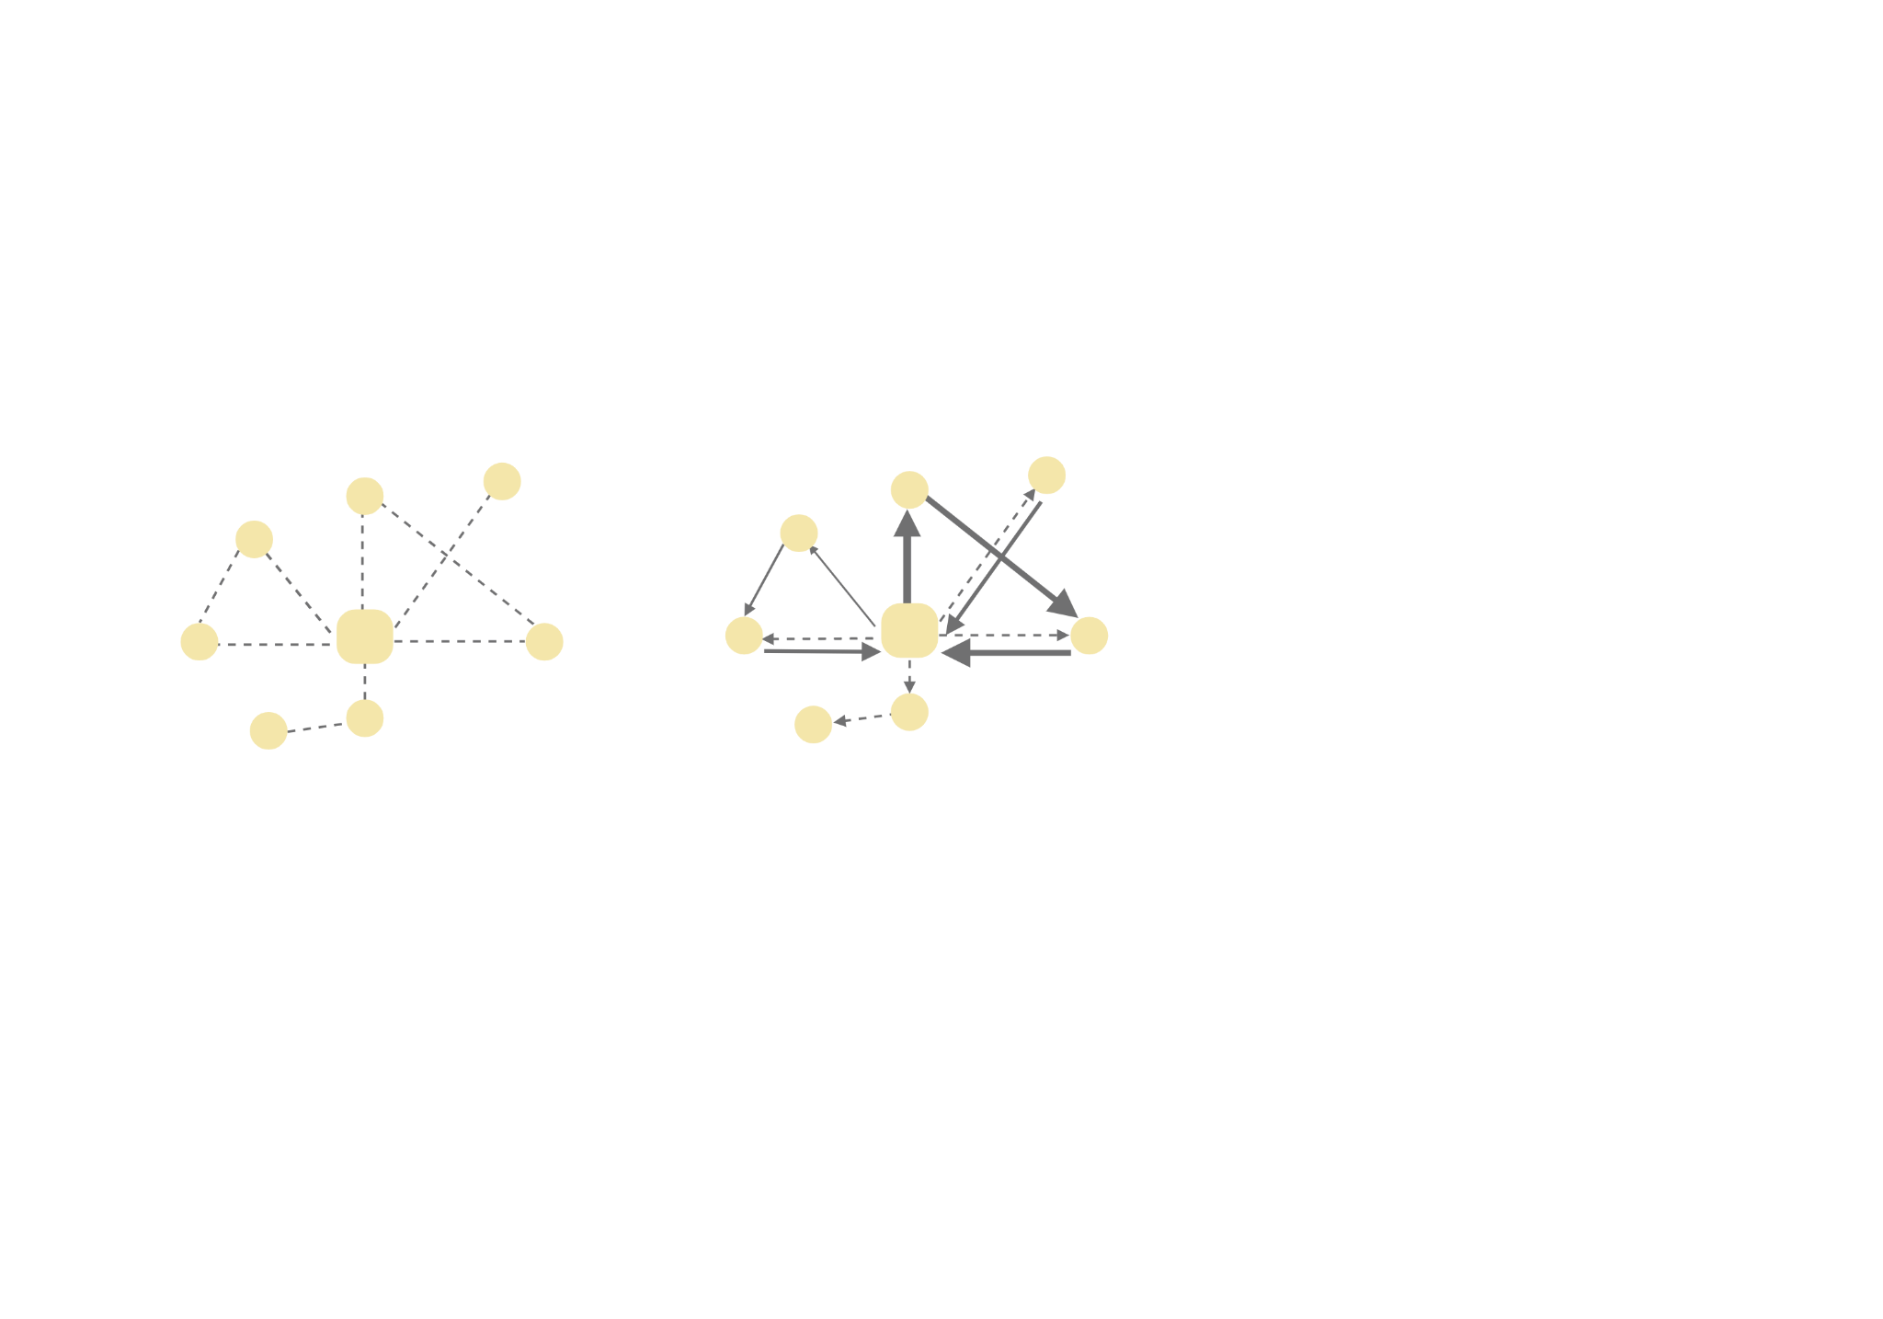
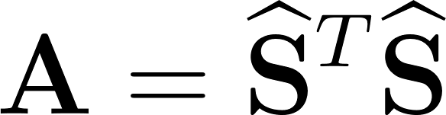

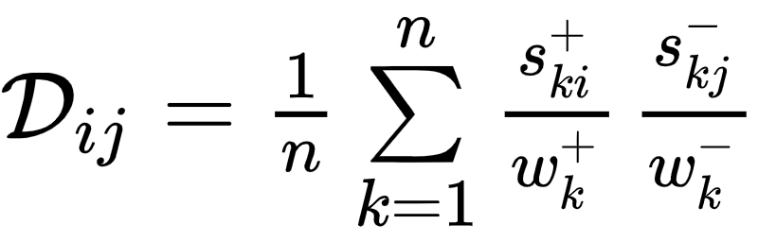
Reaction Adjacency Graph (RAG)
Mass Flow Graphs are Weighted, Directed
Two reactions (nodes) are connected if they share metabolites
Undirected, unweighted
Structure dominated by ‘pool metabolites’
(H₂O, NAD+/H, ATP, ions)
= boolean version of S
Unfold each reaction into Forward & Reverse reactions (representing producer, consumer relationships)
Normalized Adjacency Matrix: Edge Weights are Probabilistic (based on stoichiometry, flux solutions)

Slide 10
If c is known: (toy, e.coli)
Sv=0
optimize:v*c.T
Where c = [000001]
If c is unknown: (mouse, human, worms, etc.)
V_maximal = []
For reaction in n_reactions:
c = zeroes[]
c[reaction] = 1
Constraint: Sv=0
Constraint: each reaction- gene expression (upper/lower bounds)
Maximize v[reaction] by maximizing: v*c.T
v*c.T[reaction] == maximum flux for reaction_i
V_maximal[reaction] = v*c.T[reaction]
V_maximal*S !== 0
Notes:
Add in pseudocode

Slide 11
R2
M2
R4
M4
R7
M1
R1
M5
M1
M3
R5
M5
R3
R7
V_maximal*S !== 0

