Slide 1
Input Representation
Dataset: ZINC12K
Node Features: 16
Atom Types (8):
C (Carbon)
O (Oxygen)
N (Nitrogen)
S (Sulfur)
F (Fluorine)
Cl (Chlorine)
Br (Bromine)
I (Iodine)

Slide 2
Input Representation
Dataset: ZINC12K
Node Features: 16
Pair Encodings (8):
C-O
C-N
C-S
N-O
O-S
N-S
C-F
C-Cl

Slide 3
Predicted Properties
• qed
• HeavyAtomMolWt
• MolWt
• BalabanJ
• BertzCT
• Ipc
• TPSA
• NumHAcceptors
• NumHDonors
• RingCount
• MolLogP
• SAscore
• FSP3

Slide 4
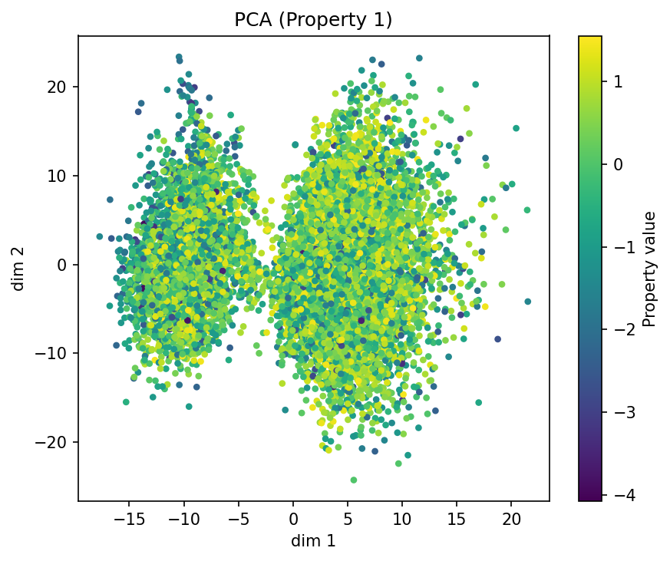
Alpha: 0.01 | PCA of qed
qed MAE: 0.7494
Overall Model MAE: 0.6900 • Overall Model STD: ±0.6503

Slide 5
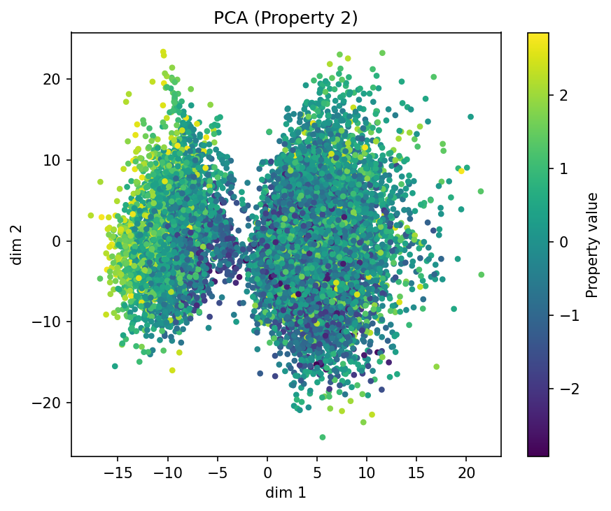
Alpha: 0.01 | PCA of HeavyAtomMolWt
HeavyAtomMolWt MAE: 0.7450
Overall Model MAE: 0.6900 • Overall Model STD: ±0.6503

Slide 6
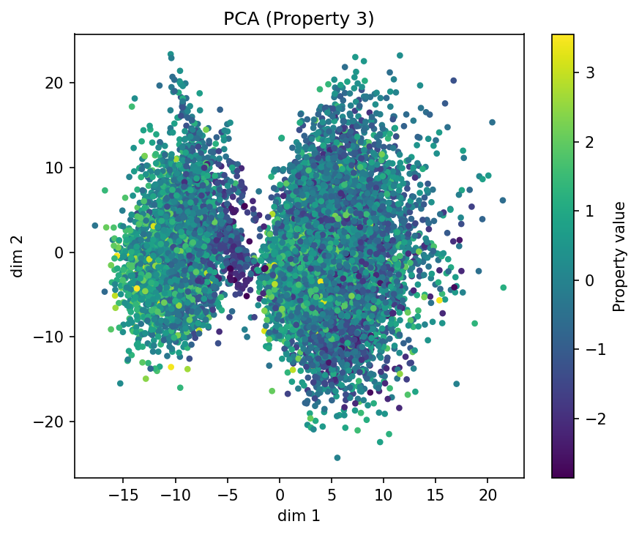
Alpha: 0.01 | PCA of MolWt
MolWt MAE: 0.7526
Overall Model MAE: 0.6900 • Overall Model STD: ±0.6503

Slide 7
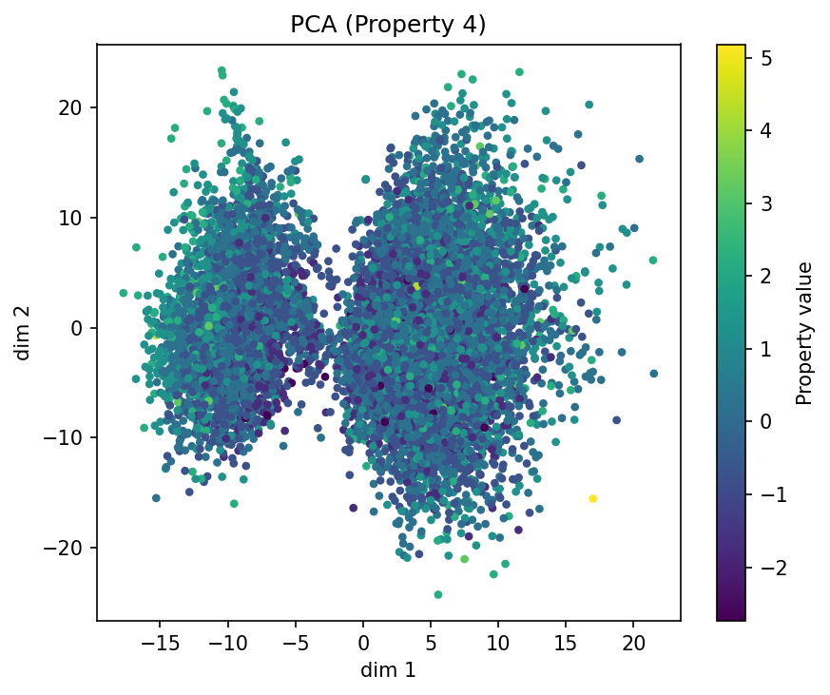
Alpha: 0.01 | PCA of BalabanJ
BalabanJ MAE: 0.7449
Overall Model MAE: 0.6900 • Overall Model STD: ±0.6503

Slide 8
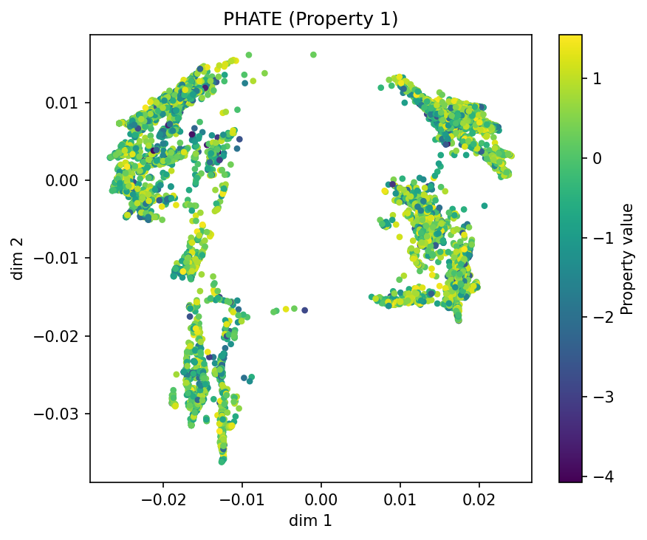
Alpha: 0.01 | PHATE of qed
qed MAE: 0.7494
Overall Model MAE: 0.6900 • Overall Model STD: ±0.6503

Slide 9
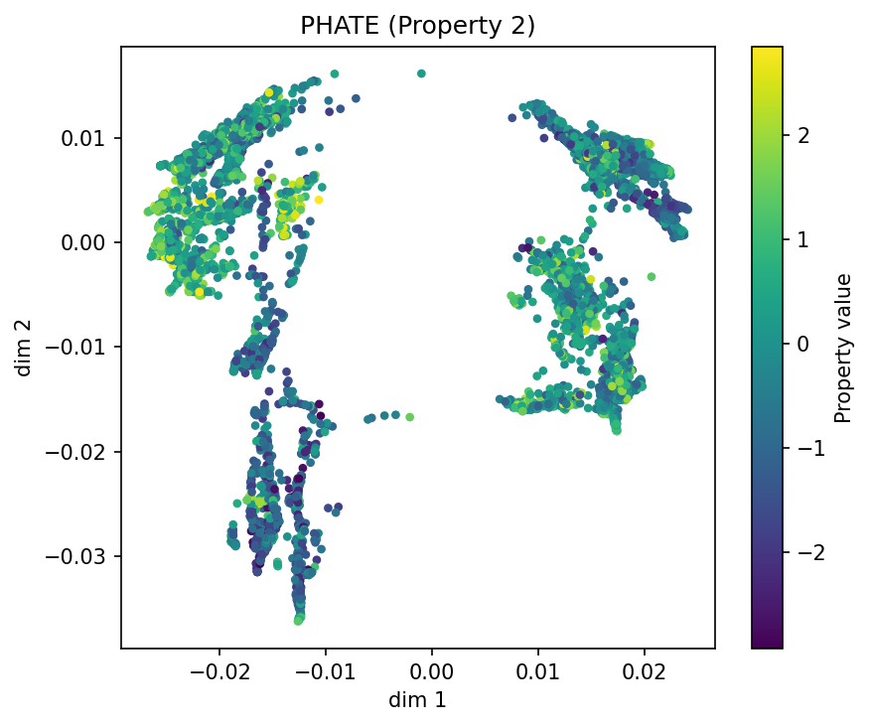
Alpha: 0.01 | PHATE of HeavyAtomMolWt
HeavyAtomMolWt MAE: 0.7450
Overall Model MAE: 0.6900 • Overall Model STD: ±0.6503

Slide 10
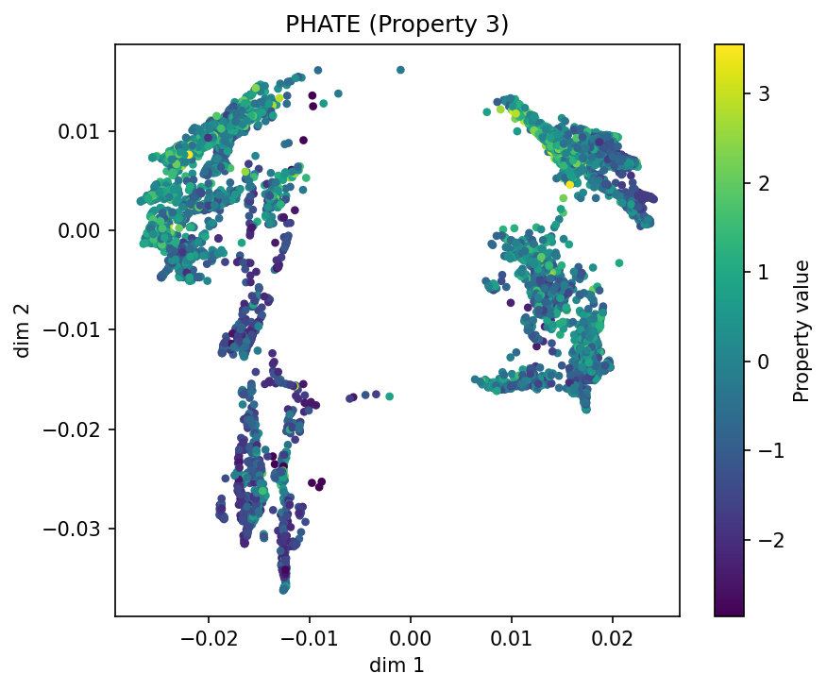
Alpha: 0.01 | PHATE of MolWt
MolWt MAE: 0.7526
Overall Model MAE: 0.6900 • Overall Model STD: ±0.6503

Slide 11
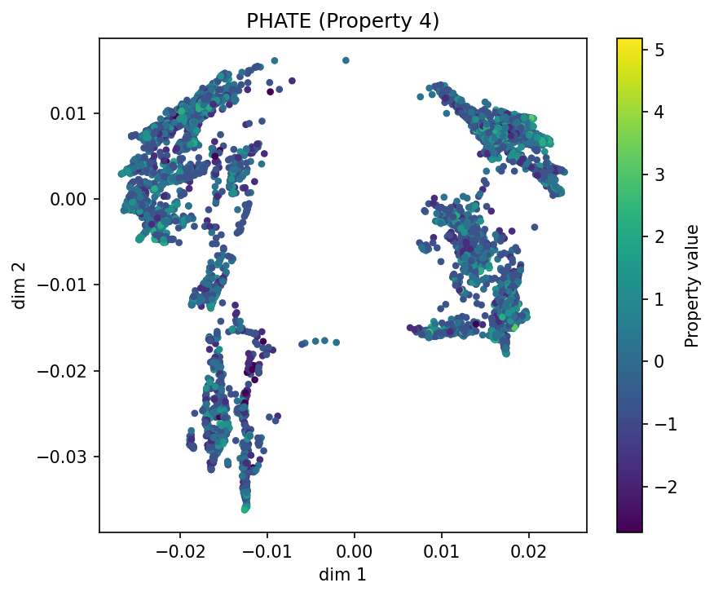
Alpha: 0.01 | PHATE of BalabanJ
BalabanJ MAE: 0.7449
Overall Model MAE: 0.6900 • Overall Model STD: ±0.6503

Slide 12
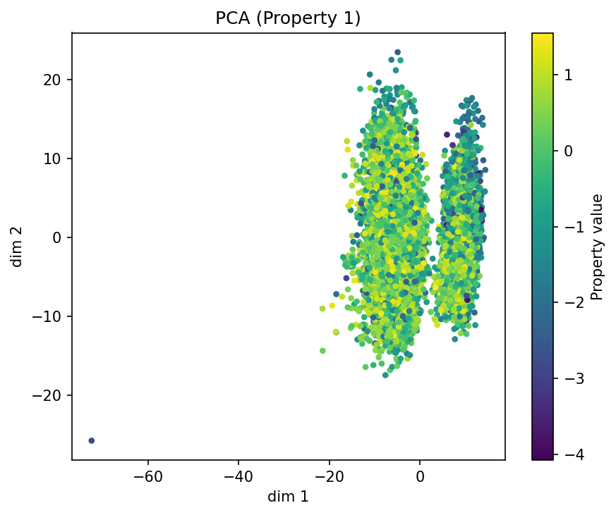
Alpha: 0.3 | PCA of qed
qed MAE: 0.7953
Overall Model MAE: 0.7082 • Overall Model STD: ±0.6826

Slide 13
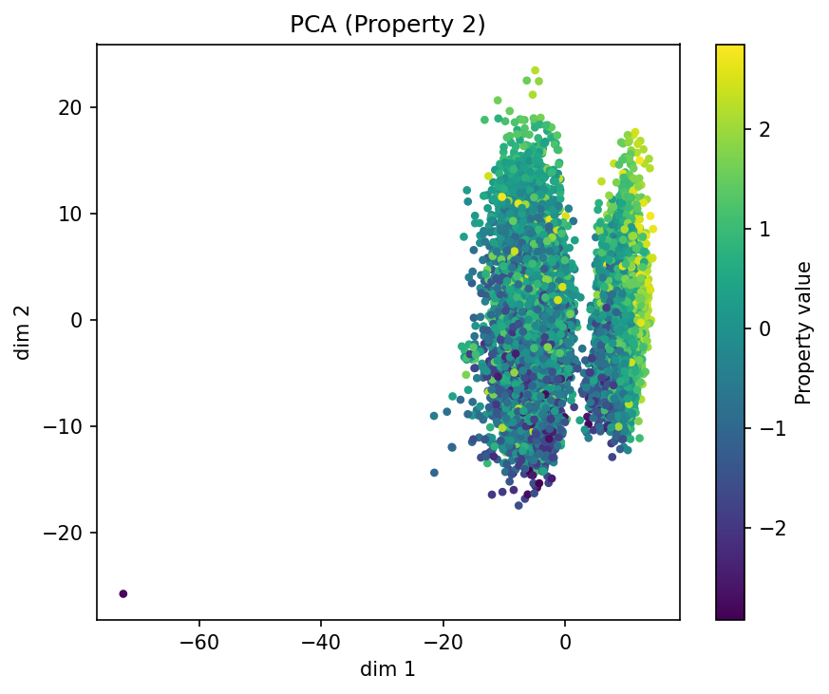
Alpha: 0.3 | PCA of HeavyAtomMolWt
HeavyAtomMolWt MAE: 0.7701
Overall Model MAE: 0.7082 • Overall Model STD: ±0.6826

Slide 14
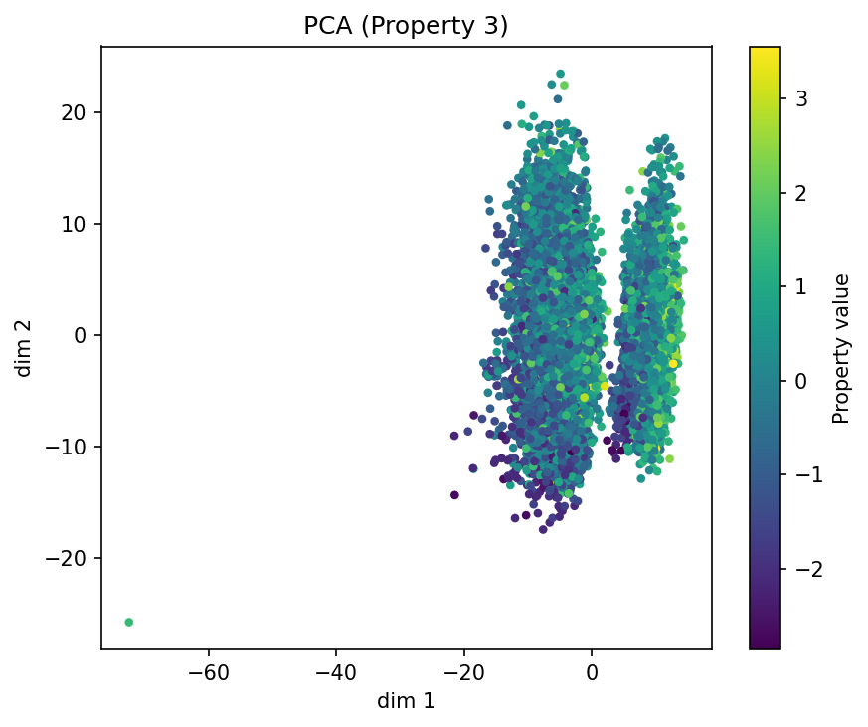
Alpha: 0.3 | PCA of MolWt
MolWt MAE: 0.7862
Overall Model MAE: 0.7082 • Overall Model STD: ±0.6826

Slide 15
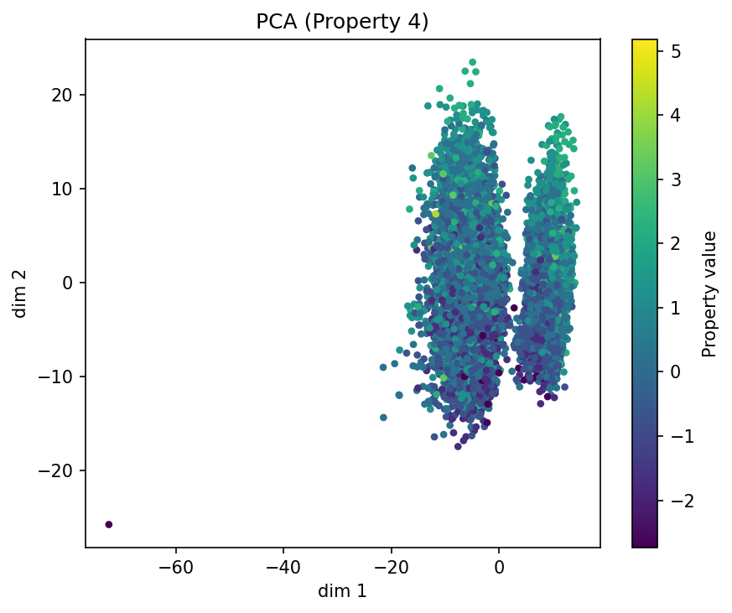
Alpha: 0.3 | PCA of BalabanJ
BalabanJ MAE: 0.7785
Overall Model MAE: 0.7082 • Overall Model STD: ±0.6826

Slide 16
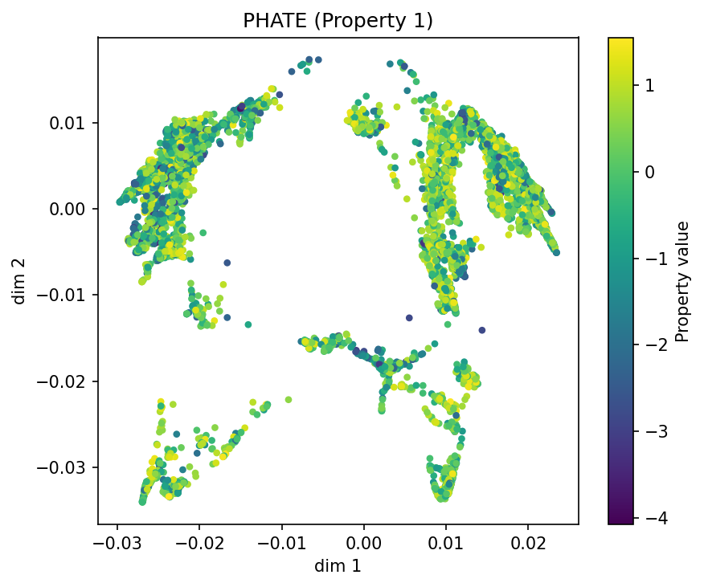
Alpha: 0.3 | PHATE of qed
qed MAE: 0.7953
Overall Model MAE: 0.7082 • Overall Model STD: ±0.6826

Slide 17
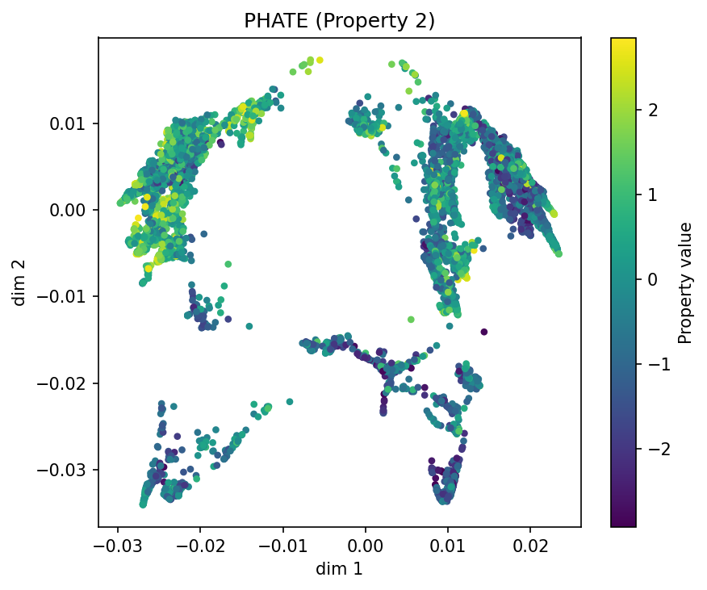
Alpha: 0.3 | PHATE of HeavyAtomMolWt
HeavyAtomMolWt MAE: 0.7701
Overall Model MAE: 0.7082 • Overall Model STD: ±0.6826

Slide 18
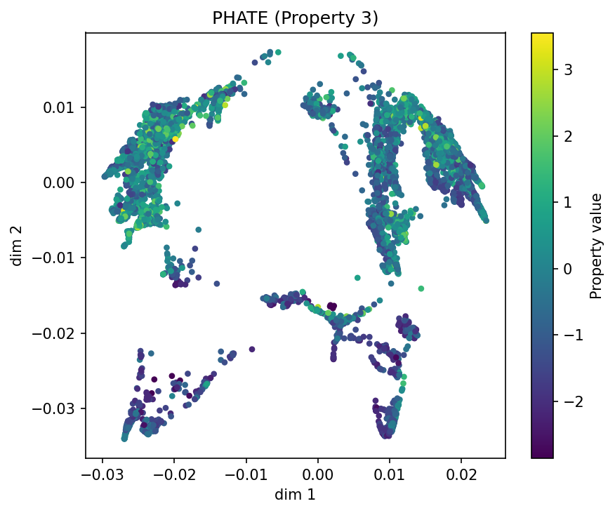
Alpha: 0.3 | PHATE of MolWt
MolWt MAE: 0.7862
Overall Model MAE: 0.7082 • Overall Model STD: ±0.6826

Slide 19
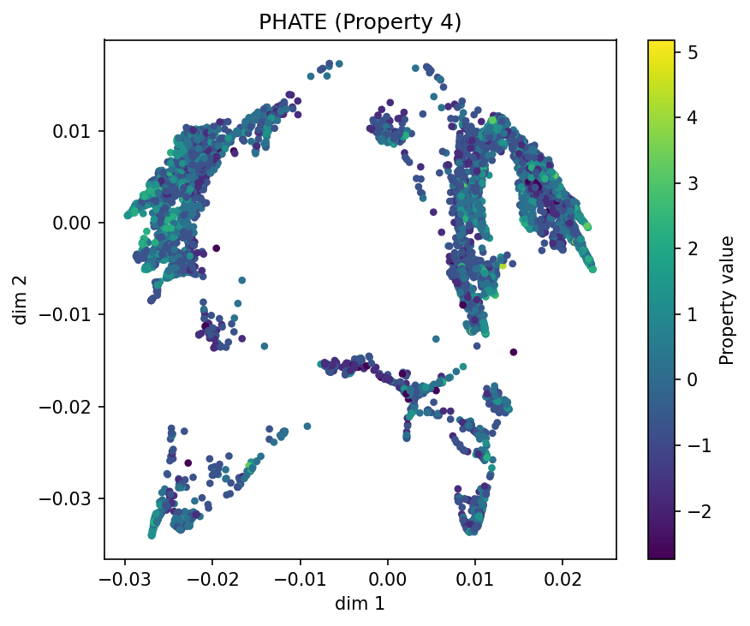
Alpha: 0.3 | PHATE of BalabanJ
BalabanJ MAE: 0.7785
Overall Model MAE: 0.7082 • Overall Model STD: ±0.6826

Slide 20
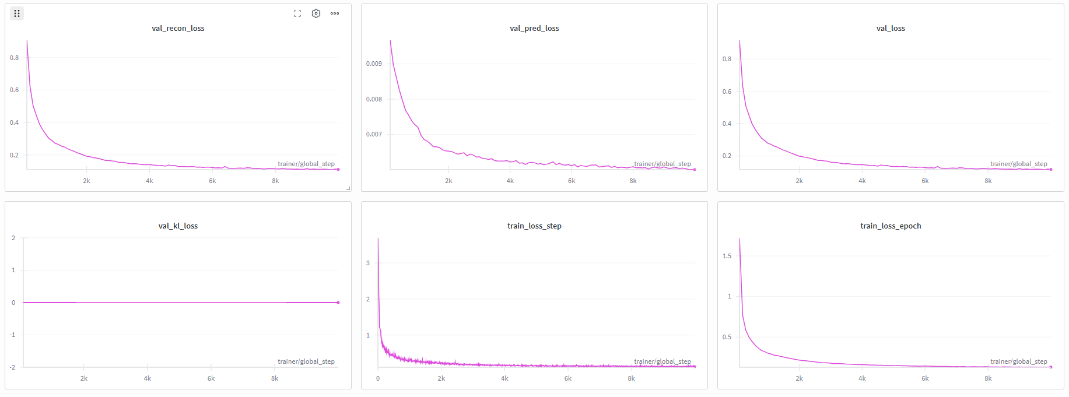
Training Curves: Alpha 0.01

Slide 21
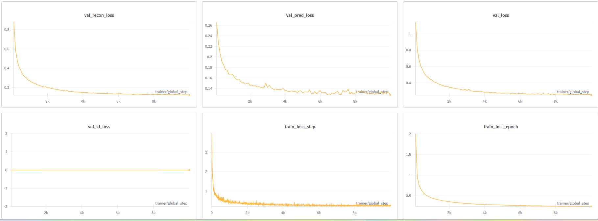
Training Curves: Alpha 0.3

