Slide 1
NAVAAYU
AI-Powered Central Telemetry Monitoring System for Neonatal ICUs
Build For Good Hackathon 2026 Submission

Slide 2
The Critical Gaps in Neonatal Care
• Alarm Fatigue desensitization:
Bedside monitors sound thousands of alerts daily, leading to warning desensitization among clinical staff and delayed responses.
• Lack of Integrated Telemetry:
Clinicians must be physically at the bedside to check vital histories, breathing motion waveforms, and classification states.
• Sudden Infant Death (SIDS) & Apnea Risk:
Infant sleep posture (e.g. stomach sleeping) and silent breathing arrests require active, integrated visual-telemetry tracking to detect on time.
• Security Identification Errors:
Newborn babies do not have names yet. Standard dashboards lack secure bed-location mapping, introducing clinical ID risk.
THE MANDATE
NICUs require an integrated edge intelligence dashboard that sifts through noise, removes alarm fatigue, maps secure coordinates, and alerts only when clinically significant risk is present.

Slide 3
NAVAAYU - Unified Edge AI Solution
Central Telemetry Grid
Beds location-coordinate grid mapping displaying real-time micro-vitals (HR, SpO₂, Temp, Resp Rate) and active condition scores for all beds simultaneously without names.
Biological Wave Sweep
Integrated real-time simulated continuous ECG waveforms featuring physiological QRS complexes, respiratory baseline sways, and lead noise matching live pulse rates.
Edge AI Warning Engine
A Random Forest classifier evaluating vitals at 1s intervals. Triggers visual flashing alerts and audible apnea sirens immediately upon detecting dangerous stillness.

Slide 4
3-PC Distributed System Architecture
PC 1: Bedside Telemetry Simulator (Local Client)
Simulates real-time vital sign sensors of neonatal beds and streams inputs dynamically via HTTP POST to the cloud Edge AI server.
PC 2: Edge AI Processing Server (Render Cloud)
Hosts FastAPI endpoints, parses inputs, feeds data to the Random Forest model for classification, and records patient states.
PC 3: Clinician Central Dashboard (Vercel Cloud)
A high-performance React/TypeScript application polling PC 2 at 1s intervals to render waveforms, vitals, and warnings.

Slide 5
Technology Stack & Production Deployment
• Clinician Frontend:
React 18, TypeScript, Vite, Recharts, Lucide Icons
• Edge AI Backend:
Python, FastAPI, Scikit-learn (Random Forest Classifier), Joblib, OpenCV
• Cloud Infrastructure:
Vercel (UI Hosting), Render (Backend AI API hosting)
Clinician Dashboard Portal (Live):
https://neonatal-ui-frontend.vercel.app
Secure Passcode to Access Portal:
1234
Edge AI Server URL (Render):
https://neonatal-pc2-api.onrender.com
GitHub Source Code Repository:
https://github.com/Krishnav1310/BABY-MONITOR-PROTOTYPE

Slide 6
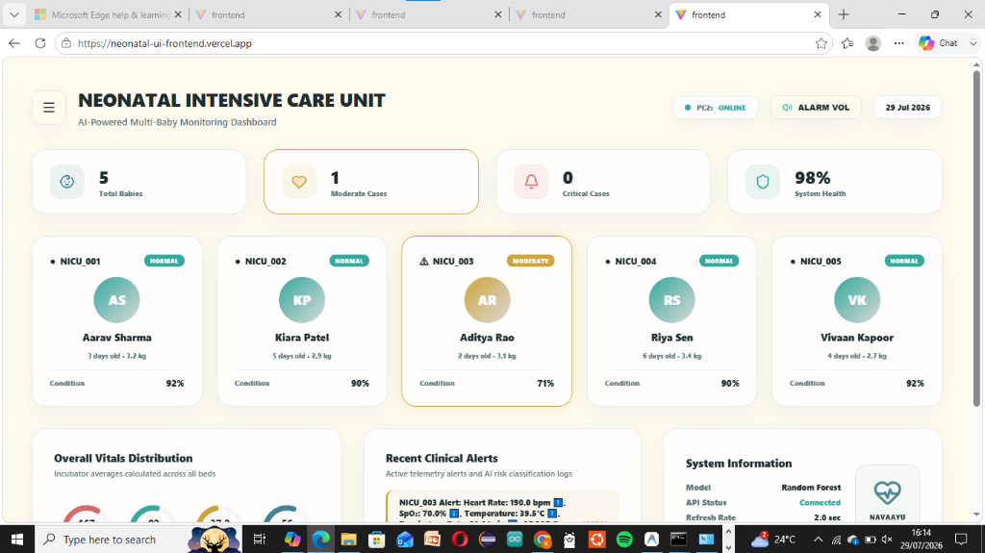
Clinical Dashboard Product Preview

