Slide 1

M.TECH THESIS PRESENTATION - DISSERTATION 2
Latency Characterisation and Small-Packet Batching in a PCIe-AXI DMA Streaming Pipeline
A cycle-accurate SystemVerilog RTL study of PCIe + AXI-Stream DMA latency, validated against a closed-form analytical model
Name: Krishna Vardhan Chathurajupalle
Roll No. 2024OVL1079
Electrical Engineering Department, Indian Institute of Technology Jammu
Supervisor: Dr Ankit Dubey, Assistant Professor

Slide 2
CHAPTER 1
Introduction
▸ PCIe is the standard interconnect for attaching high-performance peripherals (NICs, SSD controllers, accelerators, FPGA devices) to a host processor.
▸ Bulk data movement uses DMA engines rather than processor-driven I/O, so large transfers don't consume CPU cycles per word moved.
▸ On the FPGA/SoC fabric side, DMA engines are built around AMBA AXI, specifically AXI4-Stream for back-pressure-aware data streams to downstream logic.
▸ A host ↔ device transfer crosses two protocol domains:
– PCIe side: data in Transaction Layer Packets (TLPs) — fixed header, credit-based flow control, link-level ACK round trip
– AXI side: a DMA engine translates memory-mapped bursts ↔ AXI4-Stream beats, after fetching a descriptor (source, destination, length)
▸ Both TLP framing and descriptor fetch impose a processing cost largely independent of transfer size is negligible for large transfers, but dominant for small ones.
PCIe-AXI DMA Latency Characterisation & Small-Packet Batching
2 / 15

Slide 3
CHAPTER 1
Motivation
▸ Vendor IP documentation specifies functional behaviour and peak bandwidth, but rarely quantifies latency as a function of packet size.
▸ Architects are left to over-provision buffering or discover the fixed-overhead penalty only after silicon/FPGA bring-up.
▸ Neugebauer et al. (SIGCOMM 2018) confirm empirically that small-transfer PCIe performance is dominated by per-descriptor / per-TLP overhead, but as a black-box measurement on commodity NIC/host systems, not an instrumented, re-simulatable RTL model.
▸ Interrupt coalescing (Mogul & Ramakrishnan, 1997) and NIC interrupt-moderation timers show that amortising fixed per-event cost over batches is a proven general technique — but its direct application inside an RTL DMA datapath is unaddressed.
This gap motivates the thesis:
▸ Build a cycle-accurate, parameterised model of a PCIe-AXI DMA pipeline
▸ Measure: how latency & per-byte efficiency vary with packet size
▸ Design, implement & evaluate a packet-batching mitigation
▸ ...all within a synthesizable, re-runnable RTL testbed
PCIe-AXI DMA Latency Characterisation & Small-Packet Batching
3 / 15

Slide 4
CHAPTER 2
Literature Review
PCIe Performance
AXI-Based DMA IP
Overhead Amortisation
Latency Modeling
Budruk et al. detail TLP header/credit-flow overheads. Neugebauer et al. (2018) show small-DMA throughput is dominated by transaction count but as a black-box host measurement.
AMBA AXI4 / AXI4-Stream specs (Arm) define the fabric-side protocol. AMD-Xilinx AXI DMA & UltraScale+ PCIe IP guides document descriptor-ring operation but treat fetch latency as an implementation detail. Gu et al. [1] and Kavianipour [7] fix this at the driver level, not the datapath.
Mogul & Ramakrishnan (1997): interrupt coalescing avoids receive livelock. Intel NIC interrupt-moderation timers apply the same idea in hardware at the interrupt level, not the RTL transfer level. Park et al. [4] apply the same amortisation idea to MB-scale PIM transfers via peer-to-peer DMA.
Kleinrock's queueing theory formalises fixed-plus-proportional service time but doesn't validate whether a real RTL implementation actually behaves this way.
Research Gap
▸ No open, per-stage, packet-size-parameterised latency model • No RTL-level application of batching to PCIe-AXI DMA transfers • No validated link between the analytical queueing model and cycle-accurate hardware measurement • Gu et al. [1] is the closest attempt, but reports only aggregate GB/s/µs -- adopted here as the baseline (Ch. 7)
PCIe-AXI DMA Latency Characterisation & Small-Packet Batching
4 / 15

Slide 5
CHAPTER 1
Objectives of the Thesis
1
Develop an analytical latency model for a PCIe transaction layer and a descriptor-based DMA engine (fixed base term + size-proportional term).
2
Design & implement, in synthesizable SystemVerilog, a 7-stage behavioural pipeline that reproduces this latency behaviour cycle-accurately.
3
Build a directed testbench exercising the pipeline across 64 B–4 KB packet sizes and validate hardware-measured latency against the analytical model.
4
Design a small-packet batching mechanism that coalesces packets into one larger AXI-Stream frame, and quantify its latency/efficiency improvement.
5
Characterise AXI-Stream FIFO depth's effect on buffering headroom and back-pressure, distinguishing it from steady-state throughput.
PCIe-AXI DMA Latency Characterisation & Small-Packet Batching
5 / 15

Slide 6
CHAPTER 3
Methodology — Analytical Latency Model
Every packet pays a fixed, size-independent cost plus a term proportional to its size, at each stage:
PCIe delay
L_PCIe(S) = T_base + ⌈S/4⌉ · T_dw
TLP header assembly + credit round trip, plus per-DWORD transfer time
DMA delay
L_DMA(S) = T_setup + ⌈S/W⌉
Descriptor fetch/parse overhead, plus payload / datapath-width beats
Total latency
L_tot(S) = L_PCIe(S) + L_DMA(S) + L_other
L_other = small fixed residual from pass-through pipeline stages
Efficiency η(S) = S / L_tot(S) rises monotonically with S — fixed overheads are amortised over more bytes. → Coalescing N packets into one frame of size N·S pays T_base and T_setup once instead of N times: L_tot(N·S) < N·L_tot(S).
PCIe-AXI DMA Latency Characterisation & Small-Packet Batching
6 / 15

Slide 7
CHAPTER 4
Methodology — Pipeline Architecture
Seven AXI4-Stream-connected stages; every stage independently implements tvalid/tready so back-pressure propagates correctly end to end.
Packet Generator (TB)
pcie_model
dma_model
axi_mm2s _adapter
axis_fifo
batching _unit
stream _sink
A hardware latency_monitor observes packet-injection and stream_sink completion events directly, timestamping in RTL.
pcie_model / dma_model
3-state FSMs (recv → delay/setup → send); buffer full packet, hold for computed delay, replay beats
axis_fifo
FWFT circular buffer, configurable depth; combinational read → zero latency when empty
batching_unit
Zero-buffering pass-through; suppresses inner tlast, merges N packets into 1 frame (BATCH_COUNT / timeout)
latency_monitor
In-design hardware perf-counter; tags injection → completion, reports latency/efficiency/throughput
PCIe-AXI DMA Latency Characterisation & Small-Packet Batching
7 / 15

Slide 8
CHAPTER 5
Work Done — Design & Implementation
▸ Incremental, stage-by-stage build against stub modules are kept the design always elaborating, and made each stage's latency independently attributable.
▸ pcie_model / dma_model FSMs implement Eq. (1)/(2) exactly: S_RECV → S_DELAY/S_SETUP → S_SEND.
▸ Batching algorithm: per-beat decision logic pass tdata/tkeep through unchanged, accumulate byte count, merge tlast on BATCH_COUNT or timeout.
▸ Single enable bit (BATCHING_EN) switches between bypass and active which is on same RTL/testbench, clean A/B comparison.
GitHub Repository: Code Repository
System Architecture Block Diagram
Packet
Generator (TB)
gen.*
pcie_model
pcie_m.*
dma_model
dma_m.*
axi_mm2s
_adapter
pkt_inject
mm2s_m.*
latency
_monitor
pkt_done
stream
_sink
batch_m.*
batching
_unit
fifo_m.*
axis_fifo
PCIe-AXI DMA Latency Characterisation & Small-Packet Batching
8 / 15

Slide 9
CHAPTER 5
Work Done — Algorithm
Per-Beat Batching Decision
Executed every cycle a beat is accepted, i.e., s_tvalid && m_tready
Pass tdata/tkeep through unchanged (zero-latency wiring).
If this is the first beat of a new batch, latch first_id &larr; s_tid.
If s_tlast is asserted (an inner packet boundary):
a. Accumulate pkt_cnt &larr; pkt_cnt + 1 and batch_bytes &larr; batch_bytes + s_tuser.
b. If pkt_cnt has now reached BATCH_COUNT, or a timeout flush is pending: assert m_tlast, drive m_tuser = accumulated batch_bytes, drive m_tid = first_id, and reset all batch state.
c. Otherwise, suppress m_tlast (the inner boundary is invisible downstream) and continue accumulating.
If no beat is accepted for BATCH_TIMEOUT consecutive cycles while a batch is in progress, set flush_pending, causing the next tlast to close the batch regardless of pkt_cnt (prevents an indefinite hang on a short final batch).
PCIe-AXI DMA Latency Characterisation & Small-Packet Batching
8 / 15

Slide 10
CHAPTER 6
Work Done — Experimental Setup & Verification
All RTL compiled, elaborated & simulated with AMD-Xilinx Vivado xsim, driven via a reproducible Makefile flow.
# | Scenario | Description
0 | Baseline | Batching disabled; 6 packet sizes (64B–4KB) injected in turn, latency measured
1 | Batching | BATCH_COUNT (4) × 64B packets injected back-to-back → latency of coalesced frame
2 | FIFO sweep | Baseline loop re-run at FIFO_DEPTH ∈ {16,64,256}, with/without rate-limited sink
Verification milestones (selected)
▸ send_packet handshake bug: tready polled in the wrong simulation region, causing false hangs on the final beat is fixed with a do...while construct.
▸ stream_sink stall-model bug: pkt_done qualified only on (tvalid && tlast), quadrupling reported pkt_count under back-pressure is fixed by gating on (tvalid && tready && tlast).
▸ fifo_occupancy width bug: port sized from package default instead of instance parameter, silently truncating occupancy for FIFO_DEPTH=256 is also fixed.
▸ 8 regression runs completed with zero timeouts, assertion failures, or watchdog firings.
PCIe-AXI DMA Latency Characterisation & Small-Packet Batching
9 / 15

Slide 11
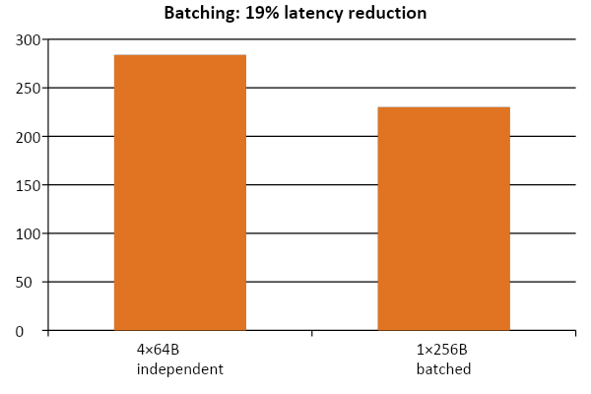
CHAPTER 7
Research Outcome — Performance
Baseline Latency (cycles)
Baseline Efficiency (B/cyc)
Peak FIFO Occupancy (beats)
2K
1K
0
1.6
1.2
0.8
250
125
0
641282565121K4K
641282565121K4K
641282565121K4K
Packet size (bytes)
Packet size (bytes)
Packet size (bytes)
Measured baseline end-to-end latency (cycles) and effective efficiency (bytes/cycle) versus packet size plotted on a log-scale x-axis.
Peak FIFO occupancy versus packet size under rate-limited sink. Shallower FIFOs saturate and trigger back-pressure earlier.
Depth-16 Depth-64 Depth-256
230 = 71 (first packet) + 3×53 (inter-packet gaps). Fixed PCIe/DMA overhead paid once per 256B frame instead of 4× → 1.25× efficiency improvement, using the same RTL/testbench with a single enable bit.
PCIe-AXI DMA Latency Characterisation & Small-Packet Batching
10 / 15

Slide 12
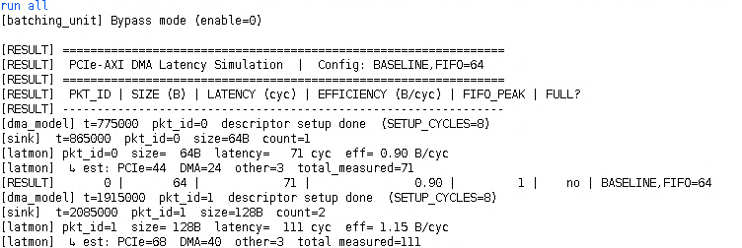
CHAPTER 7
Research Outcome — Hardware Metrics
Packet Size (B) | Latency (cycles) | Efficiency (B/cyc)
64 | 71 | 0.90
128 | 111 | 1.15
256 | 191 | 1.34
512 | 351 | 1.46
1024 | 671 | 1.53
4096 | 2591 | 1.58
Size (B) | PCIe | DMA | Other | Total
64 | 44 | 24 | 3 | 71
128 | 68 | 40 | 3 | 111
256 | 116 | 72 | 3 | 191
512 | 212 | 136 | 3 | 351
1024 | 404 | 264 | 3 | 671
4096 | 1556 | 1032 | 3 | 2591
Configuration | Latency (cyc) | Eff (B/cyc)
4 x 64 B sent independently (baseline) | 284 | 0.90
1 x 256 B batched frame (Scenario 1) | 230 | 1.11
Improvement | 19.0% reduction | 1.25x eff
PCIe-AXI DMA Latency Characterisation & Small-Packet Batching
11 / 15

Slide 13
CHAPTER 7
Research Outcome — Comparison with Prior Work
Study | Approach & where it's applied | Result & attributability
Gu et al. [1] (2025) | Linux driver descriptor prefetch + PCIe config-space extended tag + multicore host dispatch, on real VC709/XDMA hardware | 123-136% bandwidth, 15-24% latency gain (randomised mix). Three mechanisms enabled together -- one combined GB/s / µs figure, no per-mechanism split
Kavianipour & Böhm [7] (2012) | Host-side buffer merging before the DMA call, bus-master scatter/gather DMA | Up to 1080 MB/s for merged writes vs. much lower for small (12 B) un-merged buffers. Throughput only, no latency breakdown
This thesis | batching_unit — a single RTL block on the AXI4-Stream side, upstream of pcie_model / dma_model. No driver or host changes | 19.0% latency reduction, 1.25x efficiency (4x64B to 1x256B). Fully attributable: it is the only block that differs between baseline and batched runs
The part of this thesis's architecture responsible for the improvement is the batching_unit stage: it is the only block that changes between the baseline and batched configurations, so the full 19% reduction is attributable to it alone. Gu et al.'s comparable improvement is the joint effect of three separate changes, and cannot be attributed to any one of them.
PCIe-AXI DMA Latency Characterisation & Small-Packet Batching
11 / 15

Slide 14
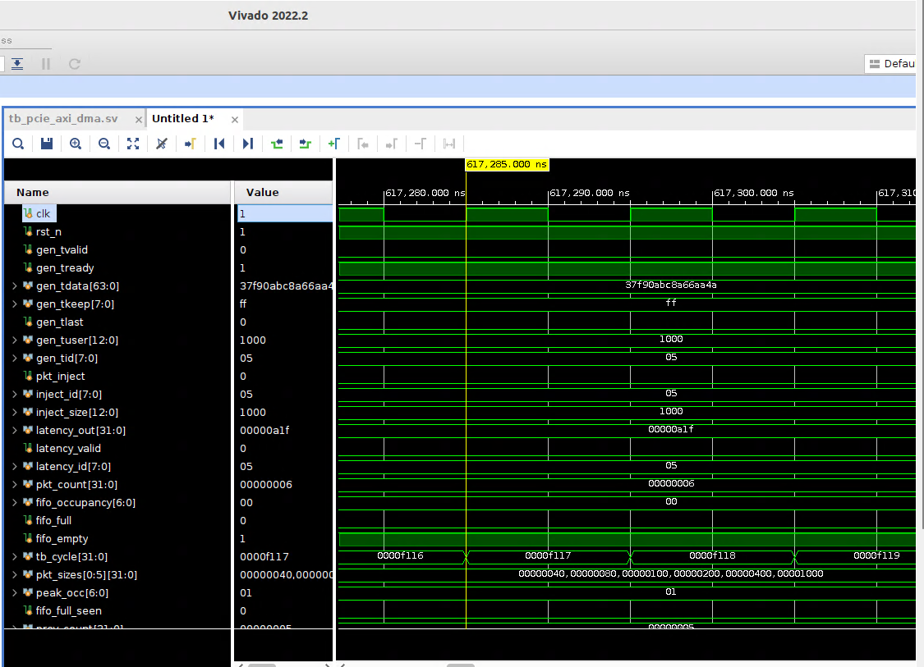
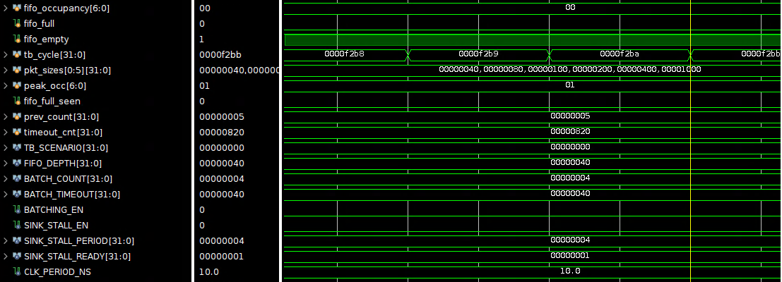
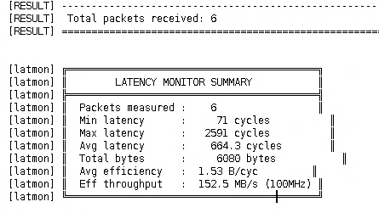
CHAPTER 7
Research Outcome — Simulation Results
PCIe-AXI DMA Latency Characterisation & Small-Packet Batching
11 / 15

Slide 15
CHAPTER 8
Research Contributions
Validated Analytical Model
Closed-form, packet-size-parameterised PCIe+DMA latency model, matched to cycle-accurate HW measurement within a constant residual across a 64× size range.
Open RTL Pipeline
Synthesisable 7-stage SystemVerilog PCIe-AXI DMA model with a directed, self-checking testbench — re-parameterisable for further study.
In-Design Latency Monitor
Hardware performance-counter block timestamping injection/completion directly in RTL — avoids software-side reference-point misalignment.
Small-Packet Batching Unit
Zero-buffering pass-through coalescer: 19% latency reduction, 1.25× efficiency, isolated via a single enable-bit A/B comparison. Comparable order of improvement to Gu et al. [1], but attributable to one block instead of three combined changes.
Buffering vs. Throughput Study
Always-ready vs. rate-limited sink experiments cleanly separate FIFO buffering headroom from steady-state completion latency.
PCIe-AXI DMA Latency Characterisation & Small-Packet Batching
12 / 15

Slide 16
CHAPTER 8
Conclusion
▸ Baseline efficiency rises from 0.90 B/cycle (64B) to 1.58 B/cycle (4KB) is explained, to within a constant 3-cycle residual, by the closed-form PCIe+DMA latency model.
▸ The batching unit reduces the latency of transferring four 64B packets from 284 to 230 cycles (19% reduction) by paying fixed overhead once instead of four times.
▸ FIFO depth governs buffering headroom, not steady-state single-flow latency, once a fixed-rate consumer is the bottleneck with an easily overlooked distinction when sizing DMA buffers from bandwidth specs alone.
Limitations & Future Work
▸ Single packet in flight (no pipelined/overlapping transactions); behavioural, not synthesised, PCIe/DMA IP; no physical FPGA validation.
▸ Future: multi-packet-in-flight modelling, bursty-workload FIFO study, adaptive batching, validation against commercial IP, hardware bring-up.
PCIe-AXI DMA Latency Characterisation & Small-Packet Batching
13 / 15

Slide 17
References
[1] X. Gu, L. Shao, N. Bai, G. Zhang, and X. Zhang, "A co-optimization of software and hardware for pcie-based small packet dma transfer," IEEE Embedded Systems Letters, vol. 17, no. 1, pp. 6–9, 2025.
[2] C. Snmez, M. Shahawy, C. C. Belentepe, and P. Ienne, "Fleximem: Flexible shared virtual memory for pcie-attached fpgas," in 2024 34th International Conference on Field-Programmable Logic and Applications (FPL), pp. 78–86, IEEE, 2024.
[3] S. Bandara, A. Sanaullah, Z. Tahir, U. Drepper, and M. C. Herbordt, "Performance evaluation of virtio device drivers for host-fpga pcie communication," in 2024 IEEE International Parallel and Distributed Processing Symposium Workshops (IPDPSW), pp. 169–176, IEEE, 2024.
[4] M. S. Park, S. Y. Kim, and S. W. Kim, "Low overhead pim-to-pim communication on pcie-based multi-pim platforms for executing large-scale ai models," in 2024 International Conference on Electronics, Information, and Communication (ICEIC), pp. 1–4, IEEE, 2024.
[5] J. Zhang, H. Huang, X. Chen, X. Li, J. Zhao, M. Liu, and Z. Wang, "Rpcnic: Enabling efficient datacenter rpc offloading on pcie-attached smartnics," in 2025 IEEE International Symposium on High-Performance Computer Architecture (HPCA), pp. 1379–1394, IEEE, 2025.
[6] D. Gupta, A. Purohit, and R. Naresh, "Fpga for high-frequency trading: Reducing latency in financial systems," in 2024 3rd International Conference on Automation, Computing and Renewable Systems (ICACRS), pp. 19–25, IEEE, 2024.
[7] H. Kavianipour and C. Bohm, "High performance fpga-based scatter/gather dma interface for pcie," in 2012 IEEE Nuclear Science Symposium and Medical Imaging Conference (NSS/MIC), pp. 1517–1520, IEEE, 2012.
PCIe-AXI DMA Latency Characterisation & Small-Packet Batching
15 / 15

