Slide 1


Indian Motorcycle Market Analysis

Slide 2

About me:
NAME : Chekuri Krishna Varma
EDUCATION: B.TECH (CSE)
PROFILE:
LINKEDIN :
Github : https://github.com/Krishnavarma1234
www.linkedin.com/in/krishna-varma-chekuri-a78470303

Slide 3
Objective
Collect motorcycle data from BikeWale
Analyze different motorcycle brands and models
Clean and preprocess the dataset
Handle missing values and duplicates
Identify important patterns
Create meaningful visualizations

Slide 4
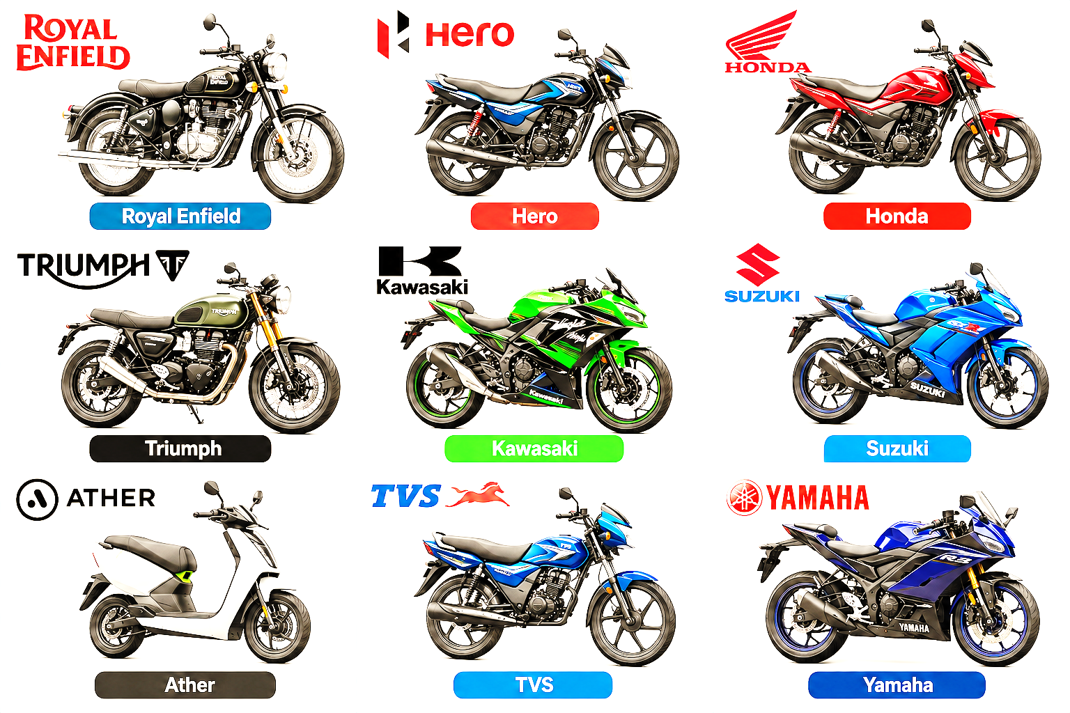
Data Source & Brands
Data Source
Website: BikeWale
Brands Scraped
Royal Enfield
Hero
Honda
Triumph
Kawasaki
Suzuki
Ather
TVS
Yamaha

Slide 5
Technologies Used
Technology | Purpose
Python | Programming
Requests | Web requests
BeautifulSoup | Web scraping
Pandas | Data analysis
NumPy | Numerical operations
Matplotlib | Visualization
Seaborn | Statistical visualization

Slide 6
Web Scraping Workflow
BikeWale Website
↓
Send HTTP Request
↓
BeautifulSoup
↓
Extract Bike Details
↓
Create DataFrame
↓
Save as CSV
Data Collected
Brand
Model
Engine Capacity
Mileage
Horsepower
Weight
Price
Rating

Slide 7
Dataset Structure
Dataset Columns
Brand
Model
Engine Capacity in CC
Mileage
Break Horse Power in BHP
Weight in KG
Ex-Showroom Price
Rating

Slide 8
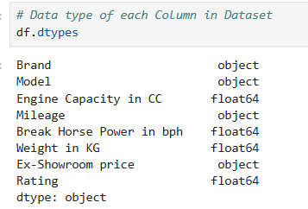
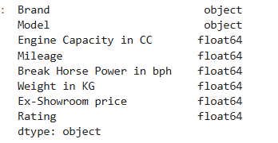
Data Cleaning
Converted price into numeric format
Converted mileage into numeric format
Removed rows without price
Checked missing values
Checked duplicate records
Treated missing numerical values

Slide 9
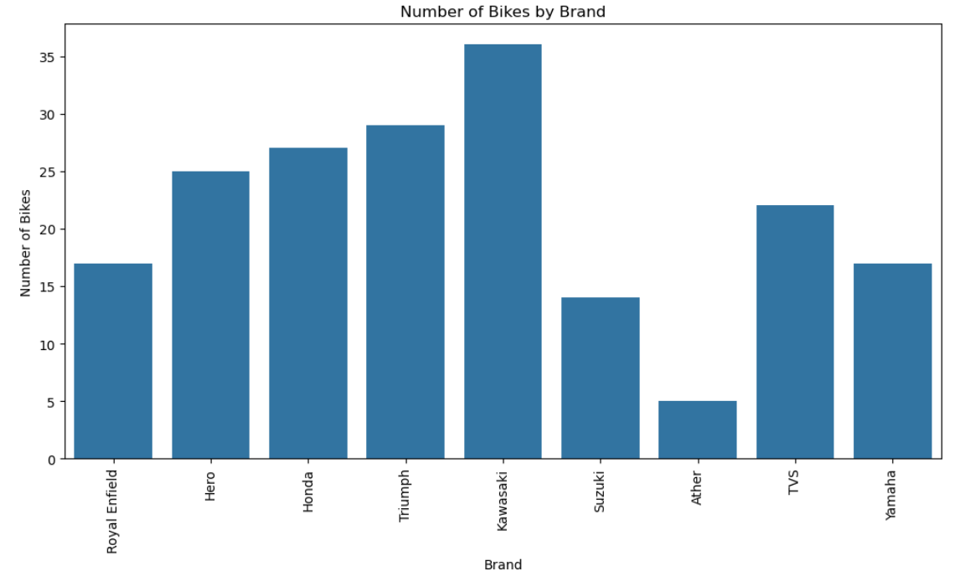
Univariate Analysis
How many bikes are available from each motorcycle brand in the dataset?

Slide 10
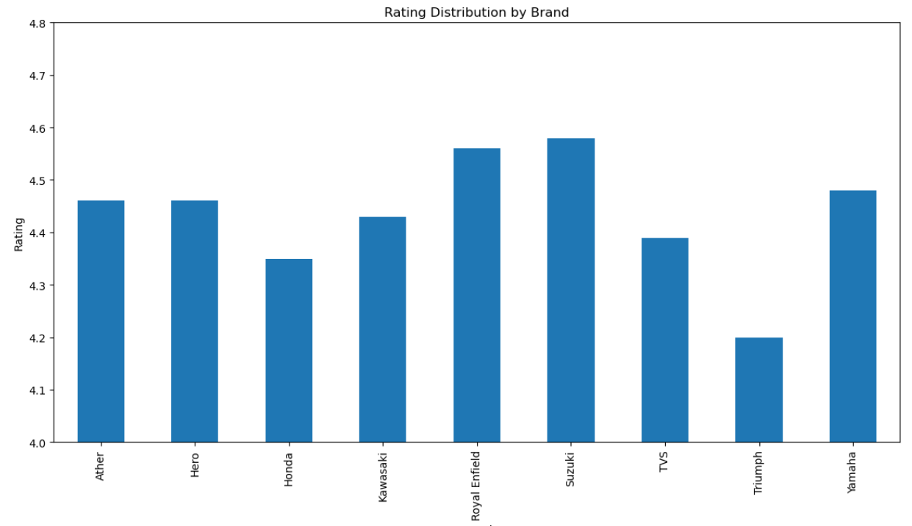
How does the average rating vary across different motorcycle brands?

Slide 11
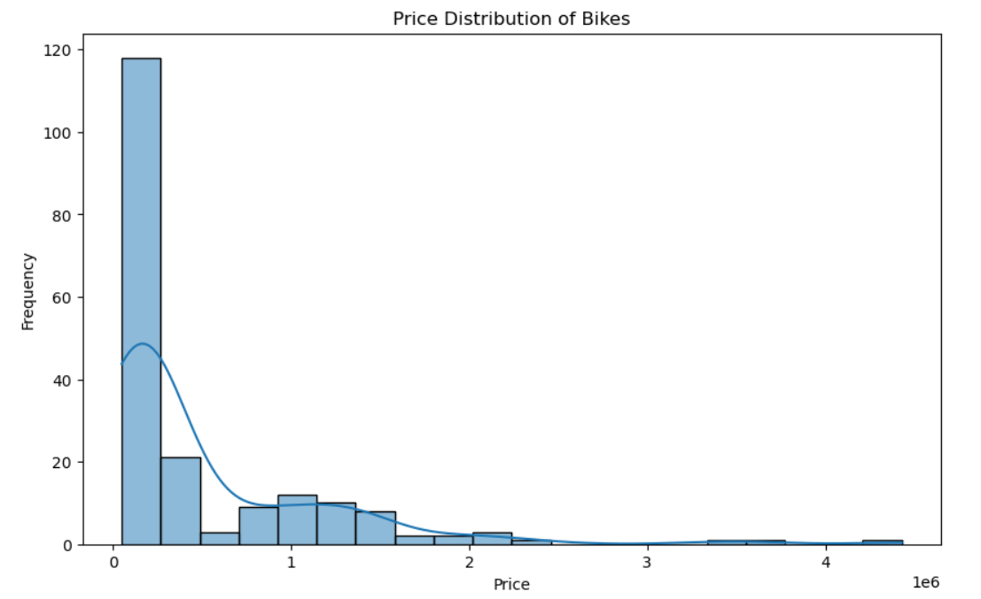
How are motorcycle prices distributed across the dataset?

Slide 12
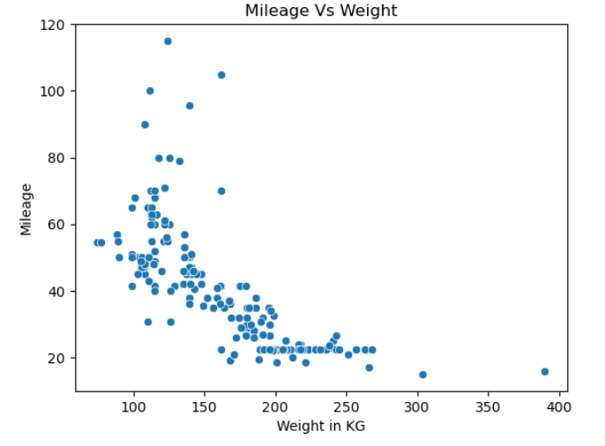
Bivariate Analysis
How does motorcycle mileage vary with increasing weight?

Slide 13
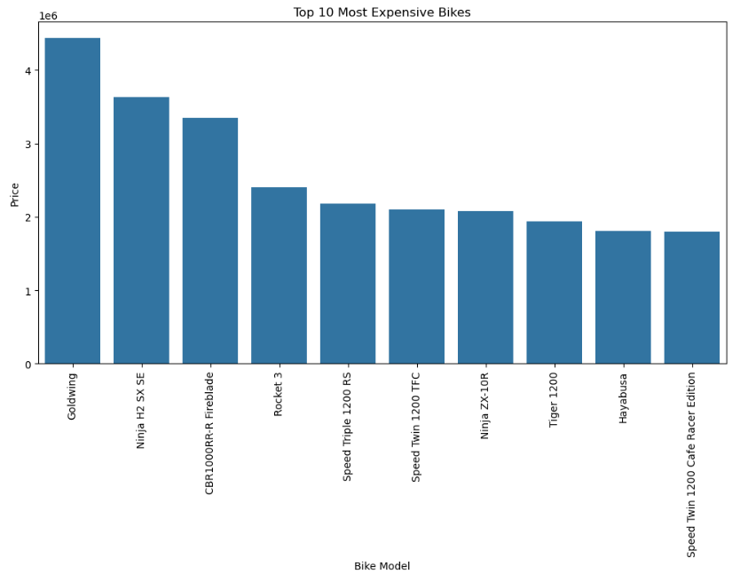
What are the top 10 most expensive motorcycle models based on price?

Slide 14
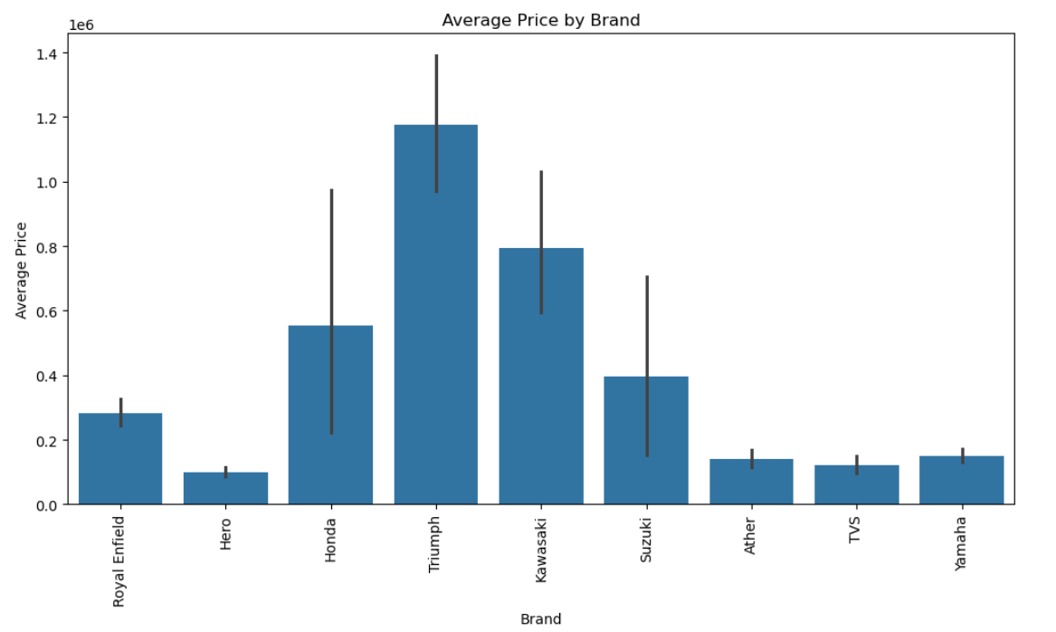
Which motorcycle brands have higher or lower average prices

Slide 15
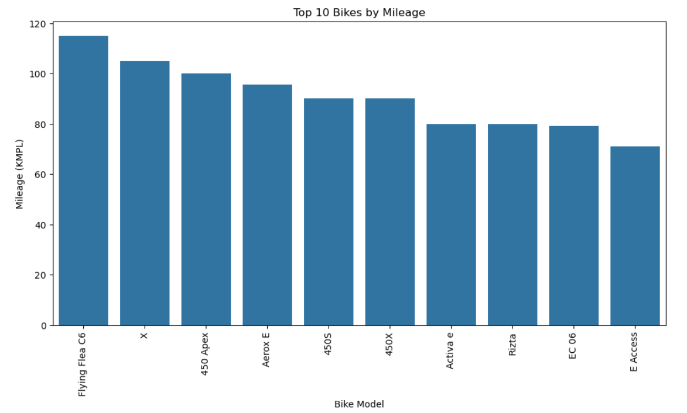
What are the top 10 motorcycle models based on mileage

Slide 16
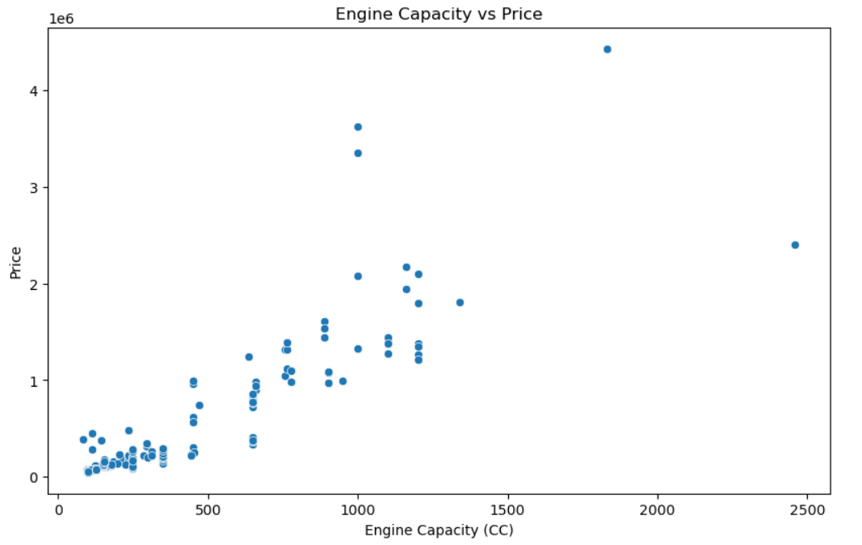
How does motorcycle price vary with increasing engine capacity?

Slide 17
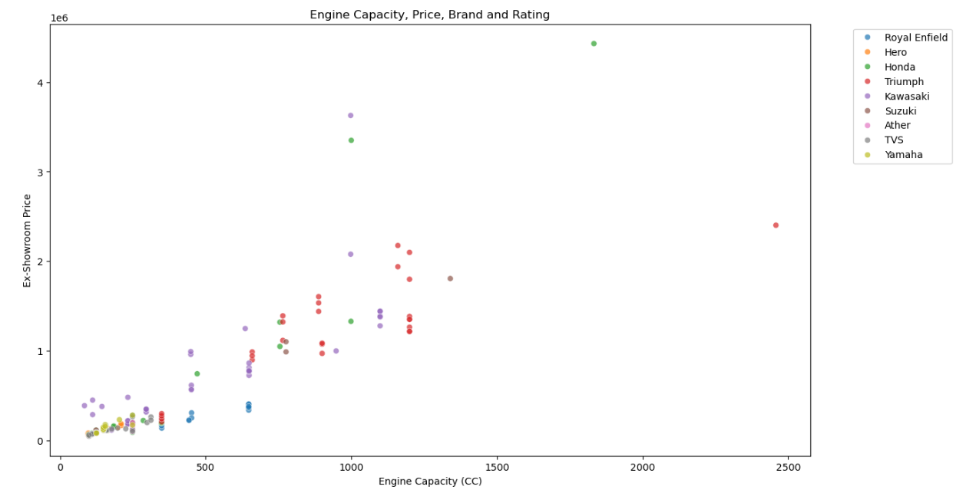
Multivariate Analysis
How do engine capacity and price vary across different motorcycle brands and ratings?

Slide 18
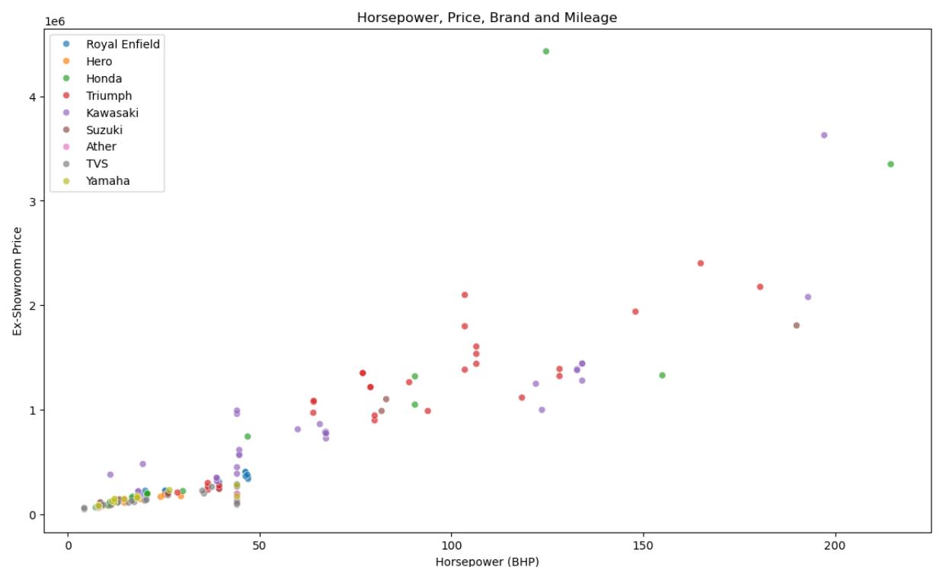
How do horsepower and price vary across different motorcycle brands and mileage levels?

Slide 19
Key Findings
Bike prices show a wide variation
Engine capacity and price can be compared using scatter plots
Mileage varies across different motorcycles
Motorcycle specifications differ across brands
Brand-wise averages provide useful comparisons
Top expensive and high-mileage models can be identified

Slide 20
Recommendations
Develop products for different price segments.
Consider engine capacity while setting prices.
Improve mileage through weight and efficiency optimization.
Balance horsepower, performance, and price.
Benchmark pricing across competing brands.
Monitor ratings and customer feedback.
Include more variables in future analysis.

Slide 21
Challenges Faced
Web Scraping – Extracting data consistently from different BikeWale brand pages was challenging.
Missing Values – Some motorcycle specifications contained missing data.
Data Cleaning – Price, mileage, engine capacity, and other fields required cleaning and conversion.
Data Imputation – Suitable methods were needed to handle missing values without affecting the analysis.
Visualization & Outliers – Different data ranges and extreme values made some graphs difficult to interpret.

Slide 22
Conclusion
BikeWale → Web Scraping → Data Cleaning → Analysis → Visualization
Project Outcome
Automated data collection
Structured motorcycle dataset
Cleaned data
Statistical analysis
Visual insights

Slide 23


