Slide 1
Boosting Algorithm
Krishnaveni raghunathan

Slide 2
Boosting Algorithm
The term ‘Boosting’ refers to a family of algorithms which converts weak learner to strong learner.
Types of Boosting algorithms
There are many boosting algorithms.
We will see about below boosting algorithms.
AdaBoost(Adaptive Boosting)
XGBoost
LightGBM

Slide 3




Boosting vs Bagging
Boosting
Bagging
In Boosting we combine predictions that belong to different types
The main aim of boosting is to decrease bias, not variance
At every successive layer Models are weighted according to their performance.
New Models are influenced by the accuracy of previous Models
Bagging is a method of combining the same type of prediction
The main aim of bagging is to decrease variance not bias
All the models have the same weightage
All the models are independent of each other

Slide 4
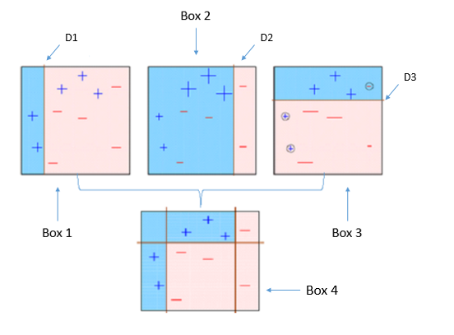
AdaBoost (Adaptive Boosting)
AdaBoost fits a sequence of weak learners on different weighted training data.
It starts by predicting original data set and gives equal weight to each observation.
If prediction is incorrect using the first learner, then it gives higher weight to observation which have been predicted incorrectly.
Being an iterative process, it continues to add learner(s) until a limit is reached in the number of models or accuracy.

Slide 5
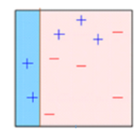
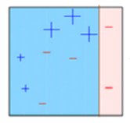
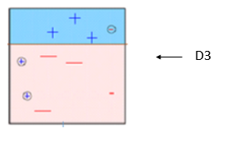
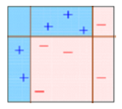
Explanation of the Diagram
Box 1: You can see that we have assigned equal weights to each data point and applied a decision stump to classify them as + (plus) or – (minus). The decision stump (D1) has generated vertical line at left side to classify the data points. We see that, this vertical line has incorrectly predicted three + (plus) as – (minus). In such case, we’ll assign higher weights to these three + (plus) and apply another decision stump.
Box 2: Here, you can see that the size of three incorrectly predicted + (plus) is bigger as compared to rest of the data points. In this case, the second decision stump (D2) will try to predict them correctly. Now, a vertical line (D2) at right side of this box has classified three mis-classified + (plus) correctly. But again, it has caused mis-classification errors. This time with three -(minus). Again, we will assign higher weight to three – (minus) and apply another decision stump.
Box 3: Here, three – (minus) are given higher weights. A decision stump (D3) is applied to predict these mis-classified observation correctly. This time a horizontal line is generated to classify + (plus) and – (minus) based on higher weight of mis-classified observation.
Box 4: Here, we have combined D1, D2 and D3 to form a strong prediction having complex rule as compared to individual weak learner. You can see that this algorithm has classified these observation quite well as compared to any of individual weak learner.

Slide 6
AdaBoost Python Code
from sklearn.ensemble import AdaBoostRegressor
regressor = AdaBoostRegressor(n_estimators=100, base_estimator=dt,learning_rate=1)
regressor.fit(x_train,y_train)

Slide 7
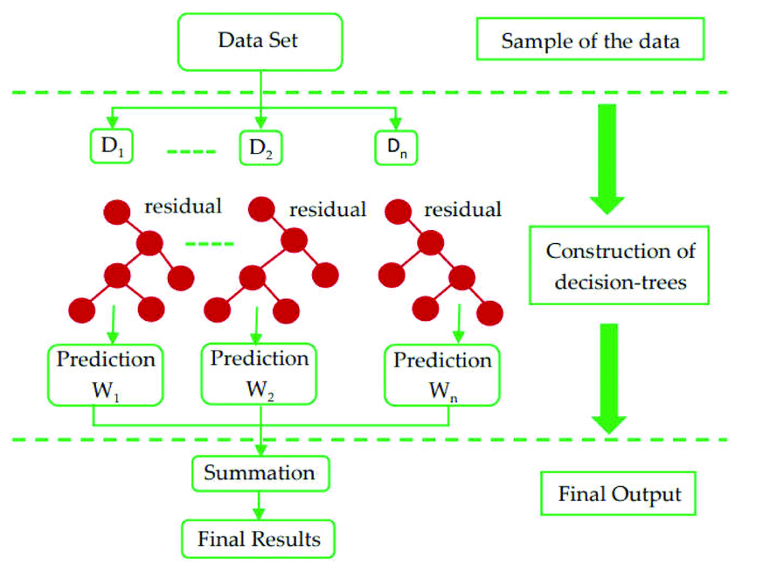
XG Boost
XGBoost also known as Extreme Gradient Boosting, is a supervised learning technique that uses an ensemble approach based on the Gradient Boosting algorithm.
XGBoost is a machine learning algorithm that uses an ensemble of decision trees and gradient boosting to make predictions.
XGBoost is a versatile algorithm that can be used for both classification and regression problems.

Slide 8
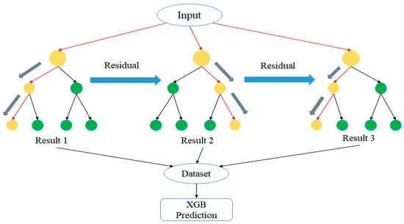
XGBoost expects to have the base learners which are uniformly bad at the remainder so that when all the predictions are combined, bad predictions cancels out and better one sums up to form final good predictions

Slide 9
XGBoost Python Code
Import xgboost as xg
#Instantiation
Regressor = xg.XGBRegressor( objective = ‘reg:linear’, n_estimators = 10, seed = 123)
#Fitting the model
Regressor.fit(X_train, Y_train)

Slide 10
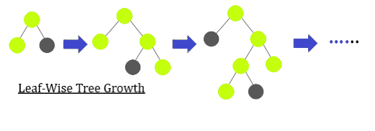
LGBM Algorithm
LightGBM is a powerful and efficient open-source gradient boosting framework for machine learning.
It’s specifically designed to handle large datasets and perform well in terms of speed and memory usage.
LightGBM uses a technique called gradient boosting, which combines multiple weak learners (usually decision trees) to create a strong predictive model.

Slide 11
LightGBM - Light Gradient Boosting Machine Algorithm
LightGBM is a gradient-boosting framework based on decision trees to increase the efficiency of the model and reduces memory usage. It uses two novel techniques:
Gradient-based One Side Sampling(GOSS)
Exclusive Feature Bundling (EFB)
These techniques fulfill the limitations of the histogram-based algorithm that is primarily used in all GBDT (Gradient Boosting Decision Tree) frameworks. The two techniques of GOSS and EFB described below form the characteristics of the LightGBM Algorithm. They comprise together to make the model work efficiently and provide it a cutting edge over other GBDT frameworks
LightGBM splits the tree leaf-wise as opposed to other boosting algorithms that grow tree level-wise. It chooses the leaf with the maximum delta loss to grow. Since the leaf is fixed, the leaf-wise algorithm has a lower loss compared to the level-wise algorithm. Leaf-wise tree growth might increase the complexity of the model and may lead to overfitting in small datasets.

Slide 12
LGBM Python Code
#install lightgbm library
Pip install lightgbm
#download lightgbm library
Import lightgbm as lgb
#download only LGBMRegressor functionality from the lightgbm library
From lightgbm import LGBMRegressor
#Instantiation
Regressor = LGBMRegressor()
#Fitting the model
Regressor.fit(X_train, Y_train)

Slide 13
Comparison of LightGBM and XGBoost
LightGBM
XGBoost
LightGBM is known for its speed and memory efficiency, making it suitable for large datasets
If speed and memory efficiency are critical, LightGBM may be better
XGBoost offers extensive features and tuning options. The choice depends on your specific needs.
If you need more tuning flexibility and interpretability, XGBoost might be preferred

