Slide 1

P227
APPLE Stock
Price Prediction
Welcome
Done By:
Team-2
Guided By:
Neha Gupta

Slide 2


BUSINESS PROBLEM
To predict the price of Apple stock for next 30 days on the basis of given data.
BUSINESS OBJECTIVE
Build a model to predict the Stock price for the said period by splitting the data into train and test set.
Find trends in short term and long term.
Methodologies
ARIMA
SARIMA

Slide 3

PROJECT WORK FLOW
Data Processing
EDA & Visualization
Feature Selection
Stationary Test
Data Splitting
Training Data
Test Data
Train Model
Predict Model
Performance Measure
Deployment

Slide 4
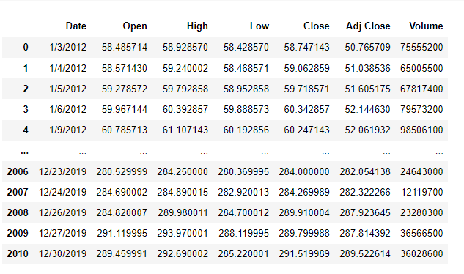
DATASET & Pre-Processing
The data used in this project consists of the historical stock prices of AAPL.
Dataset contains the following variables; Date (January 2012 - December 2019), Open, High, Low, Close, Adjusted Close and Volume.
Dataset contains 2011 rows and 7 columns.
It has float and integer values and Date column is in Object type.
There are no null values in the data.
There are no duplicates in the data.
Data is highly correlated.

Slide 5

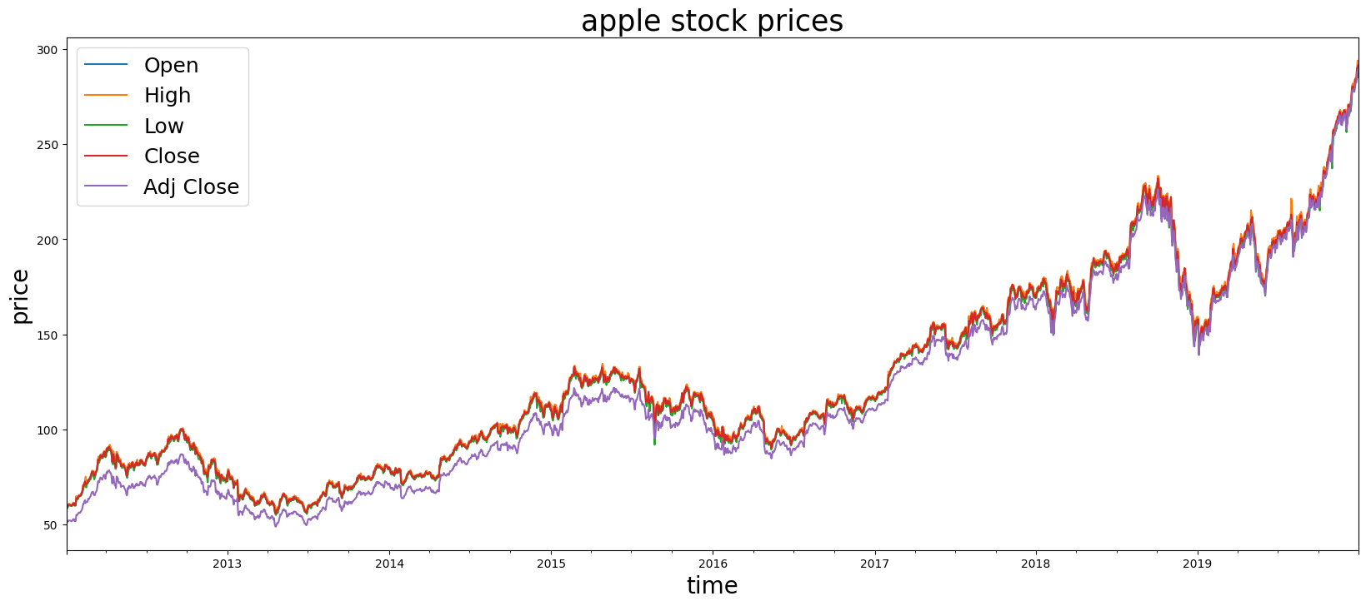
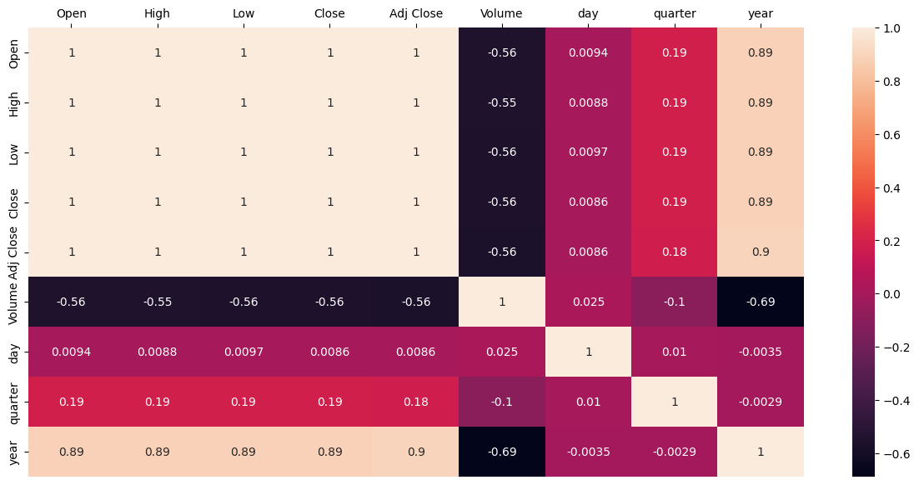
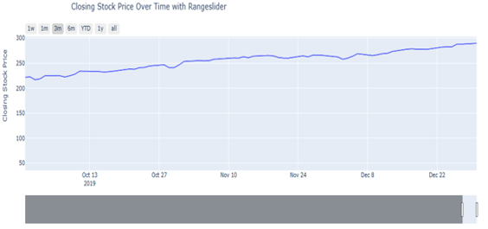
EDA & Visualization
Changing data type of date feature from object type to date.
Adding year, quarter, month and weekday features to the data
Visualizing datapoints with using plots like box plot, line plot ,bar plots and Heat map etc.,

Slide 6
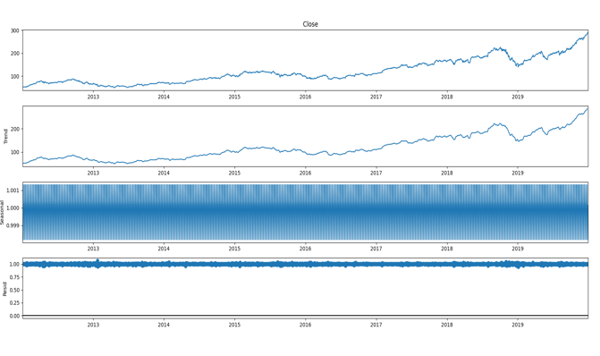
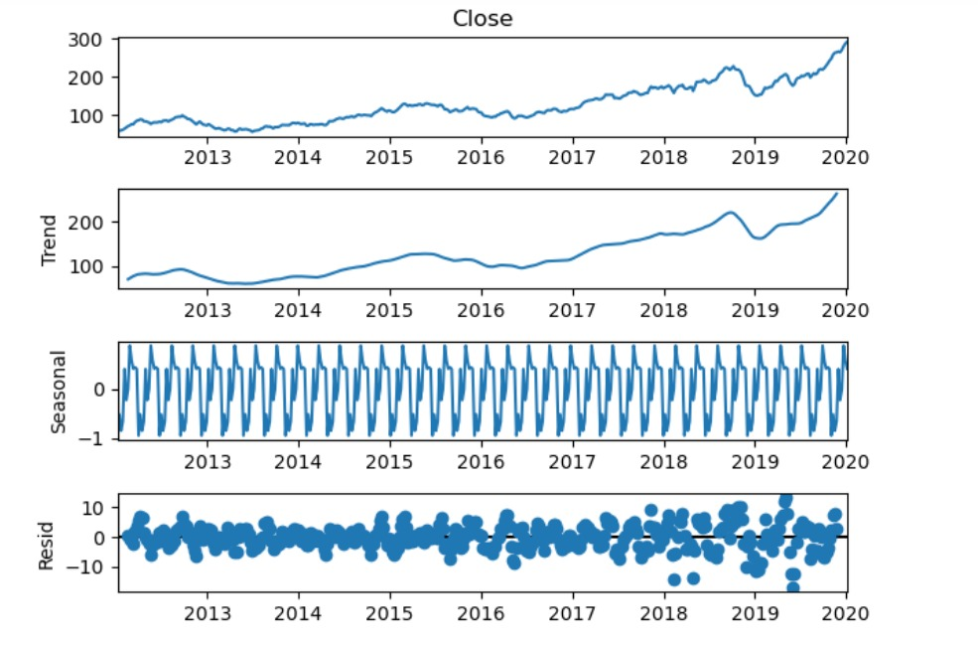
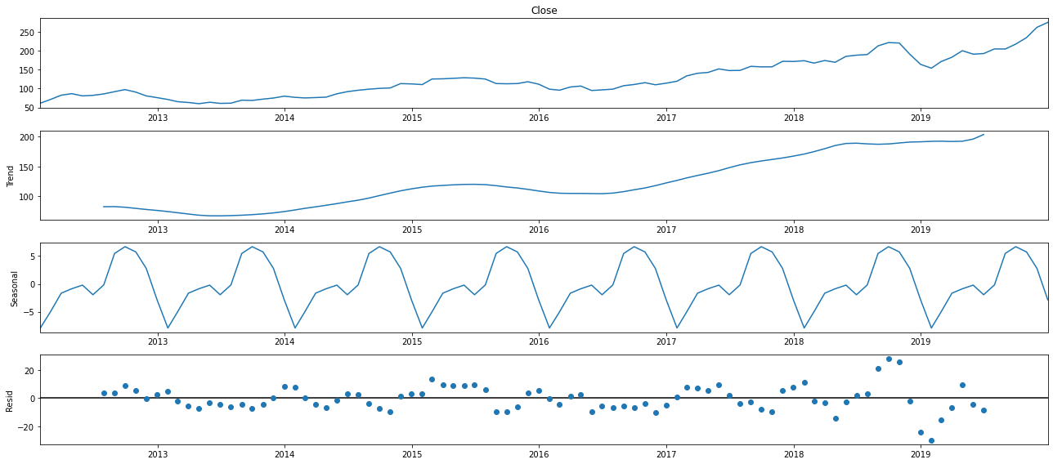
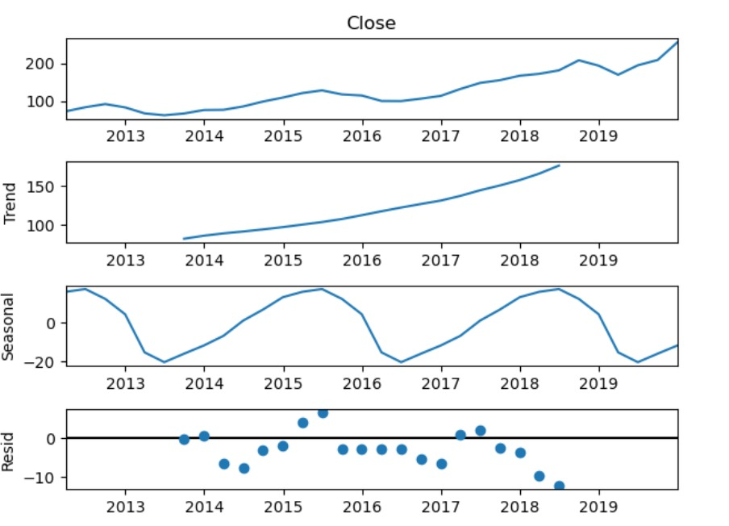
Decomposition of time series
Original
Weekly
Monthly
Quarterly

Slide 7
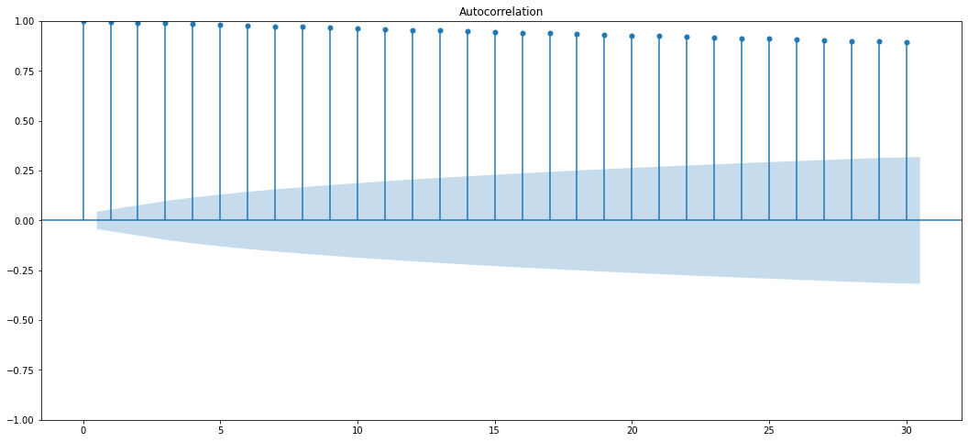
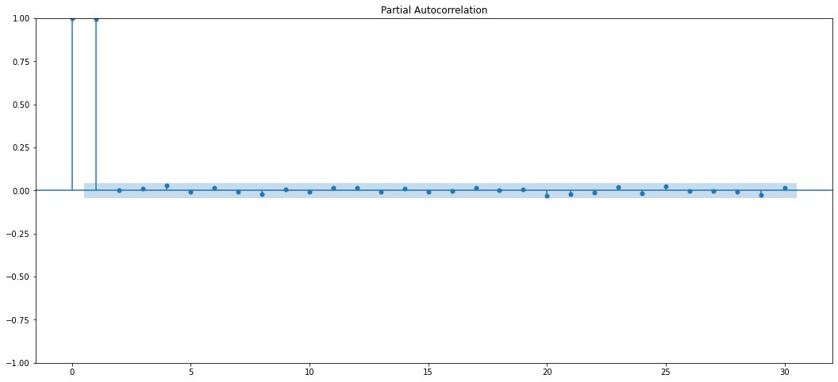
ACF plots and PACF plots (Before Differencing)
ACF PLOT
PACF PLOT
ADF TEST
ADF Test Statistic : 1.2193479467002406
p-value : 0.9961168706935021
#Lags Used : 9
Number of Observations used : 2001
Accept Null Hypothesis. Data is Non – Stationary

Slide 8
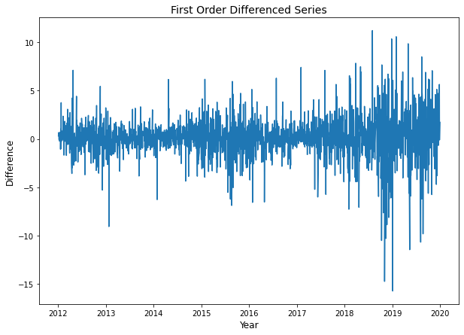
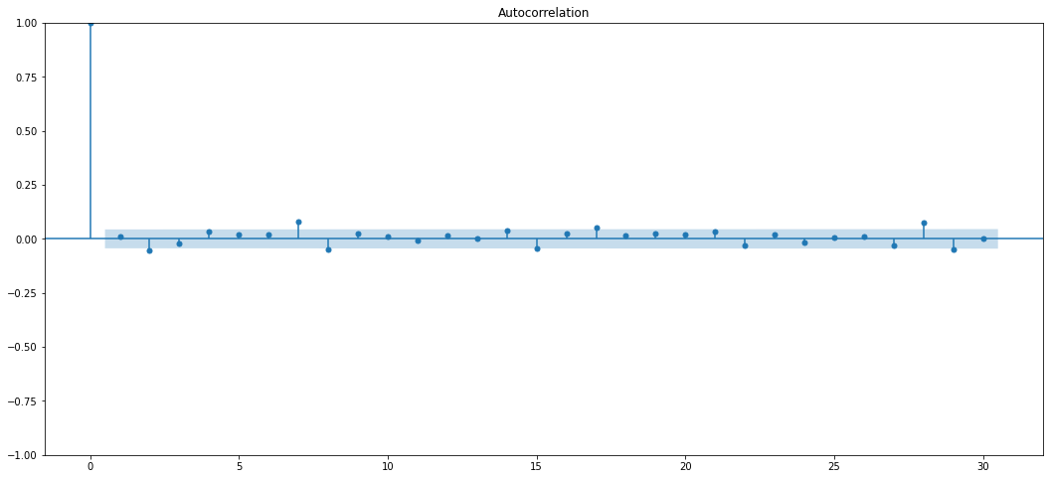
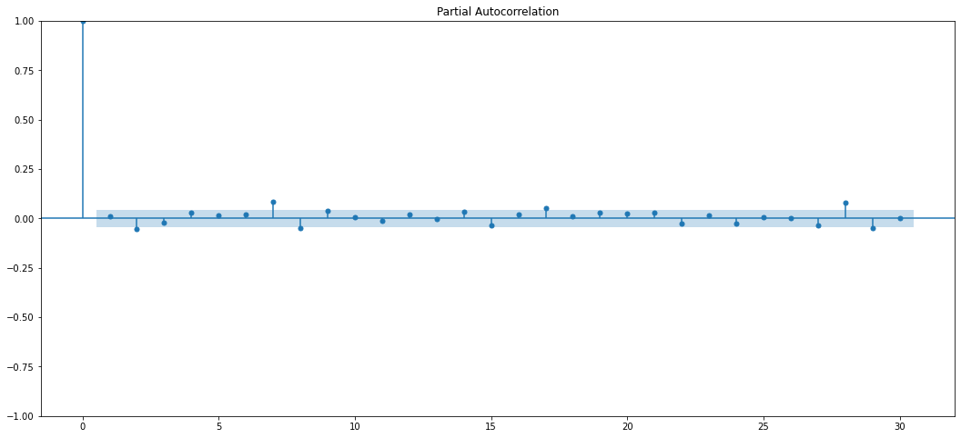
ACF plots and PACF plots (After Differencing)
Differencing
ACF Plot
PACF Plot
ADF Test Statistic : -13.62553837607382
p-value : 1.7630934279439484e-25
#Lags Used : 8
Number of Observations used : 2001
Reject Null Hypothesis. Data is Stationary

Slide 9
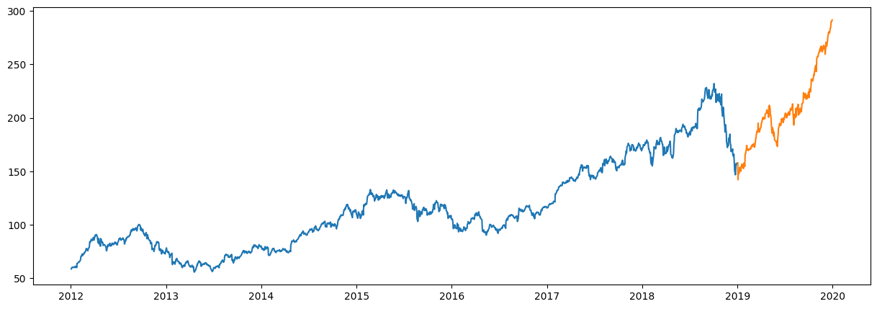
Data Splitting
Dataset has been divided into two parts
Train Data – 2012-02-03 to 2018-12-30
Test Data – 2019-01-01 to 2019-12-30

Slide 10
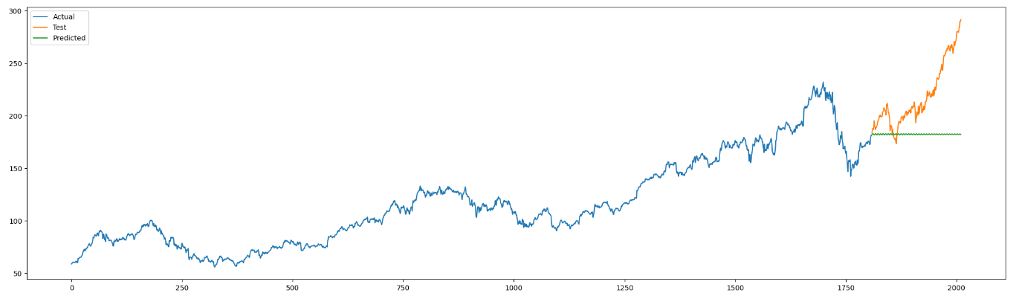
ARIMA
ARIMA – Auto Regression Integrated Moving Average Model.
It goes through differencing steps to eliminate the non-stationary part.
ARIMA Models are specified by three order parameters: (p, d, q),
where,
p is the order of the AR term
q is the order of the MA term
d is the number of differencing required to make the time series stationary
An ARIMA model is one where the time series was differenced at least once to make it stationary and we combine the AR and the MA terms.

Slide 11
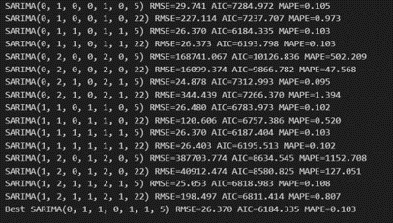
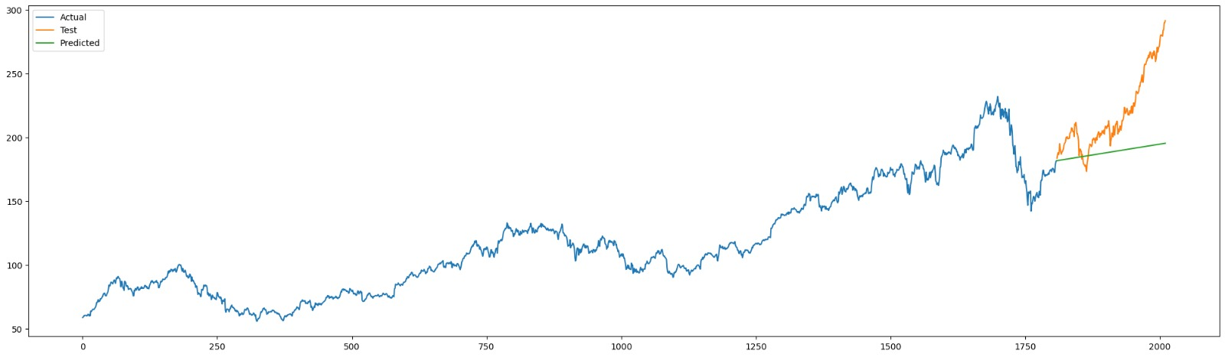
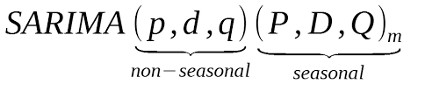
SARIMA
An extension to ARIMA that supports the direct modeling of the seasonal component of the series is called SARIMA - Seasonal Autoregressive Integrated Moving Average.
There are four seasonal elements that are not part of ARIMA that must be configured; they are:
P: Seasonal autoregressive order.
D: Seasonal difference order.
Q: Seasonal moving average order.
m: The number of time steps for a single seasonal period.
(0,1,1)X(0,1,1,5)

Slide 12
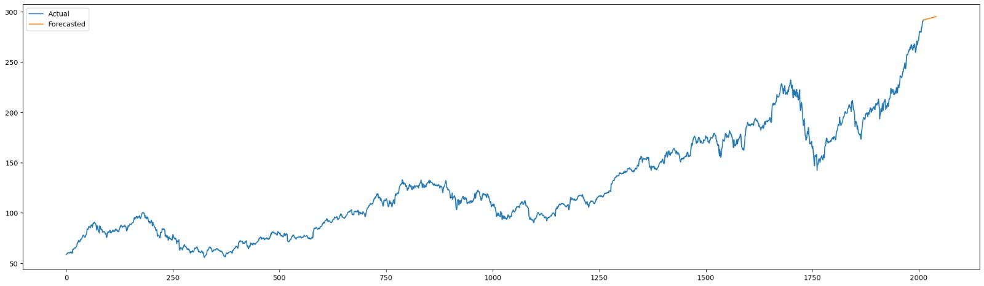
Conclusion
We have selected the SARIMA model because our data is seasonal.
The SARIMA model is accurate for short-period forecasting but less accurate for long-period forecasting.
We took this as the final model forecasted for the next 30 days, and that is showing a meaningful idea for investing in apple stocks.

Slide 13

P227
APPLE Stock
Price Prediction
Done By:
Team-2
Guided By:
Neha Gupta
Thank You

