Slide 1
Online Retail Sales Performance Analysis
Data Analyst Assessment — Management View
Business problem: understand revenue drivers, customer concentration, market opportunities and cancellation exposure.
Dataset: UCI Online Retail — 541,909 raw transaction rows.
Analysis period: 01-Dec-2010 to 09-Dec-2011; December 2011 is partial.
Method: Python + Pandas, descriptive analysis and business-oriented segmentation.

Slide 2
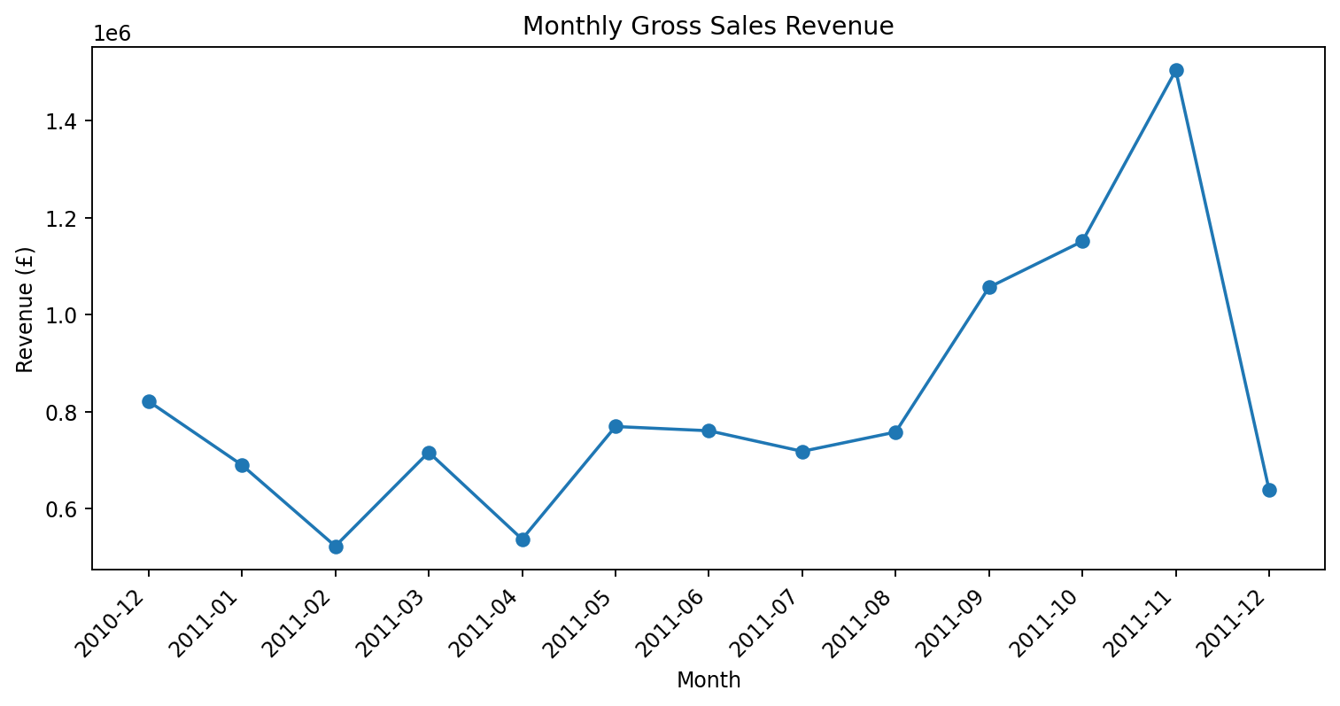
Data & Methodology
Removed exact duplicates and standardized text fields.
Calculated Revenue = Quantity × UnitPrice.
Separated cancellation invoices from normal positive sales.
Customer analysis uses only records with a known CustomerID.
Created monthly, country, product and customer summaries.
No profit/margin analysis: the dataset contains no cost field.

Slide 3
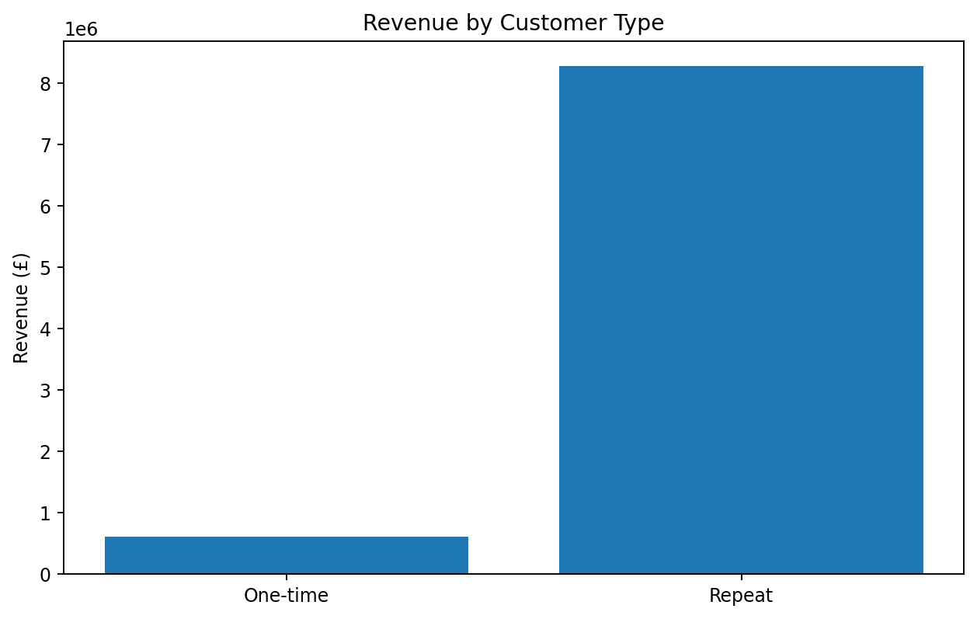
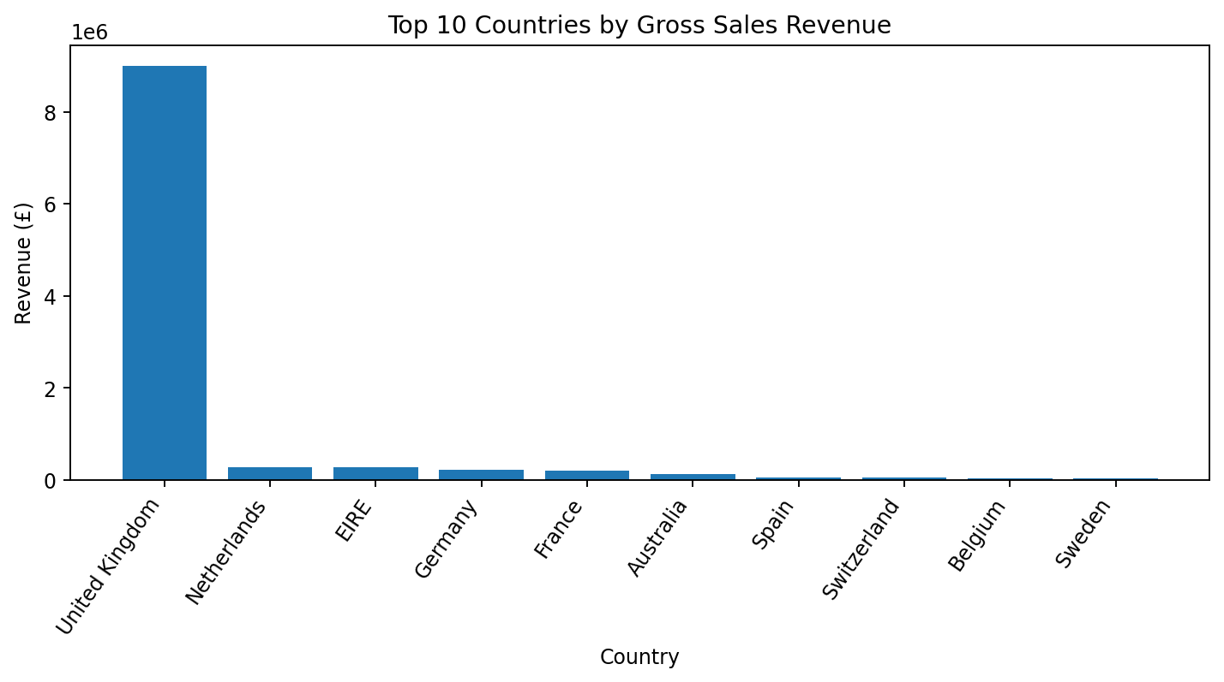
Key Findings
Repeat customers contribute 93.1% of identified-customer revenue.
UK contributes 84.6% of gross sales.
International AOV is 69.3% higher than UK AOV.
Sep–Nov contributes 34.9% of gross sales.

Slide 4
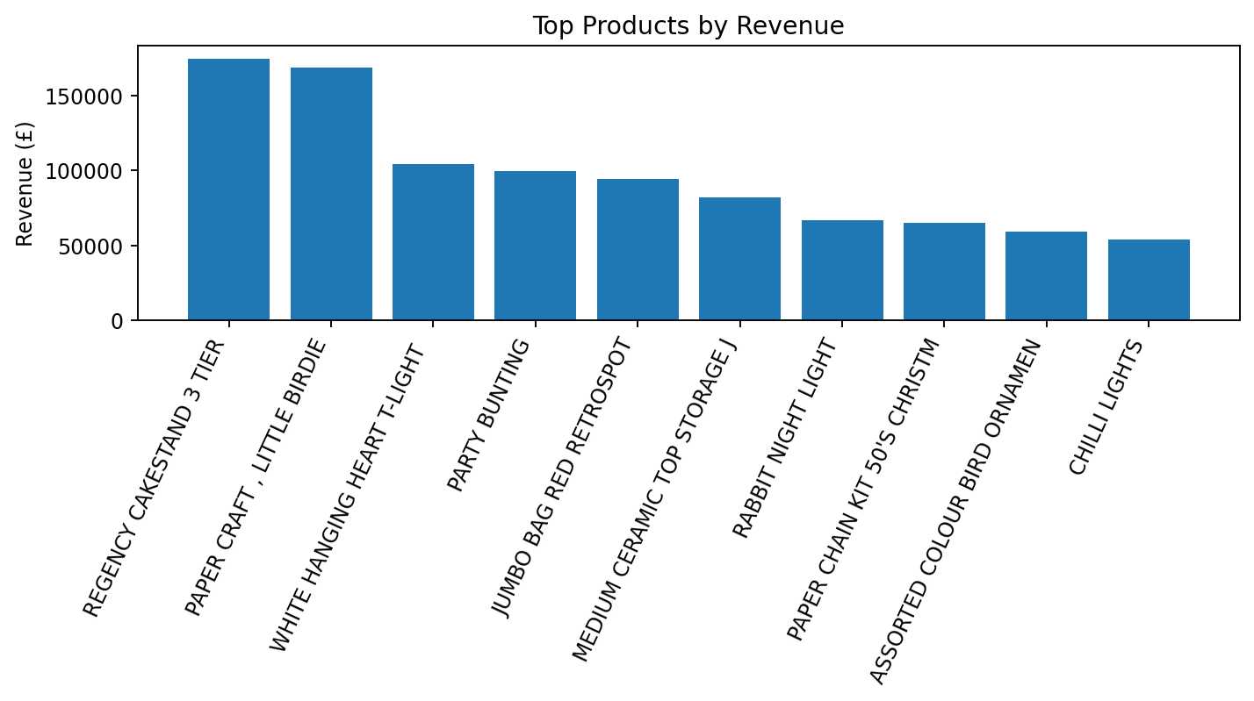
Deep-Dive: Seasonality + Transaction Concentration
November is the peak month at £1.50M, 30.6% above October.
Invoice 581483 is a major outlier: £168,469.60 and 80,995 units.
The outlier is plausible for a wholesale-oriented retailer and should be investigated, not automatically deleted.
Peak-period planning and outlier-aware reporting are important for management.

Slide 5
Recommendations
1. RETAIN — Strengthen repeat-customer retention with reorder reminders, loyalty/VIP treatment and targeted follow-up.
2. REDUCE LEAKAGE — Analyze cancellation reasons and prioritize the products/customers/orders with the largest cancellation value.
3. EXPAND SELECTIVELY — Target high-AOV international markets with focused acquisition and retention programs.
Prioritization: protect the existing high-value base first, reduce avoidable leakage second, then scale attractive international segments.

Slide 6
Expected Business Impact & Measurement
Retention: increase repeat purchase rate and repeat-customer revenue.
Cancellation reduction: lower cancellation value rate and recover revenue from preventable reversals.
International growth: increase non-UK revenue and maintain/improve AOV by target market.
Operational readiness: improve inventory/fulfillment capacity ahead of the Sep–Nov demand peak.
Dashboard KPIs: revenue, orders, AOV, repeat revenue share, cancellation value/rate, country mix.

Slide 7
Limitations & Next Steps
CustomerID is missing for 135,080 raw rows; customer-level conclusions cover identifiable customers only.
December 2011 is partial through 09-Dec-2011.
No product cost/margin data — profitability cannot be concluded.
Next: obtain cost/margin, cancellation reason, marketing campaign and customer channel data.
Next: build an interactive Looker Studio dashboard with month/country/product filters.
AI was used for analysis support and documentation; final figures were recalculated and verified against the supplied dataset.

