Slide 1

PRESIDENCY UNIVERSITY
PYTHON PROJECT
ON
BLOOD BANK MANAGEMENT SYSTEM

Slide 2
PROJECT
BY
CHEKRAPANI-2016CSE085
JOYCE MARY B-2016CSE095
KRISHNA VYAS-2016CSE099
YASHASWINI-2016CSE107

Slide 3
CONTENTS
ABSTRACT
INTRODUCTION
DESCRIPTION
DATA FLOW DIAGRAM
SYSTEM DIAGRAM
APPLICATION
DRAWBCAKS
FUTURE ENHANCEMENT
CONCLUSION

Slide 4
ABSTRACT
As we being living in the contemporary world should keenly give approach to the Health issues typically. The number of persons who are in need of blood are increasing in large number day by day. In order to help people who are in need of blood, Online Blood Bank Management can be used effectively for getting the details of blood donors having the same blood group.

Slide 5
INTRODUCTION
The process of building systems has always been complex with system becoming larger, the costs and complexities get multiplied. So the need for better methods for developing systems is widely recognized to be effective and the applied model should meet a few basic requirements. The model should be structured and cover the entire system development process from feasibility study to programming, testing and implementation.

Slide 6
DESCRIPTION
The Donor and the Recipient plays the major role.
There are types of blood that we have to notice when the recipient indulges in it. The emphasis is given more on the Blood Group.

Slide 7
TYPES OF BLOOD GROUP
Abpositive
Abnegative
Opositive
Onegative
Apositive
Anegative
Bpositive
Bnegative

Slide 8
WORKING ENVIRONMENT
Software Configuration:
Operating System : Windows 10
Web server : Personal Web Server
Web Browser : Internet Explorer
Designing Tool : Python
Server Side Scripting : Python 3.6
Backend : Spyder

Slide 9
PACKAGES USED
xlrd
openpyxl
datetime

Slide 10
DATA FLOW DIAGRAM
Blood
Bank
Blood Donors
Receiving Services
Blood Seekers
Donating Blood

Slide 11
SYSTEM FLOW MODEL
Blood
Bank
Blood
Donors
Blood
Seekers
Registration
Donor
Search
General
Information
FAQ’s
Terms Of
Service

Slide 12
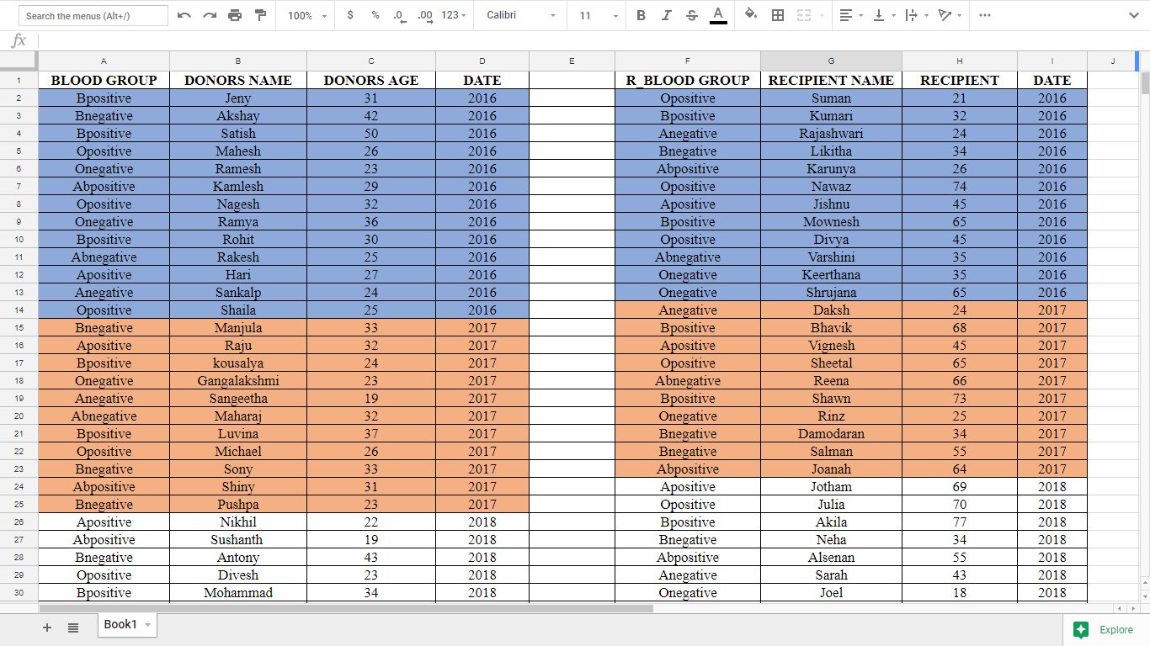
DATABASE

Slide 13
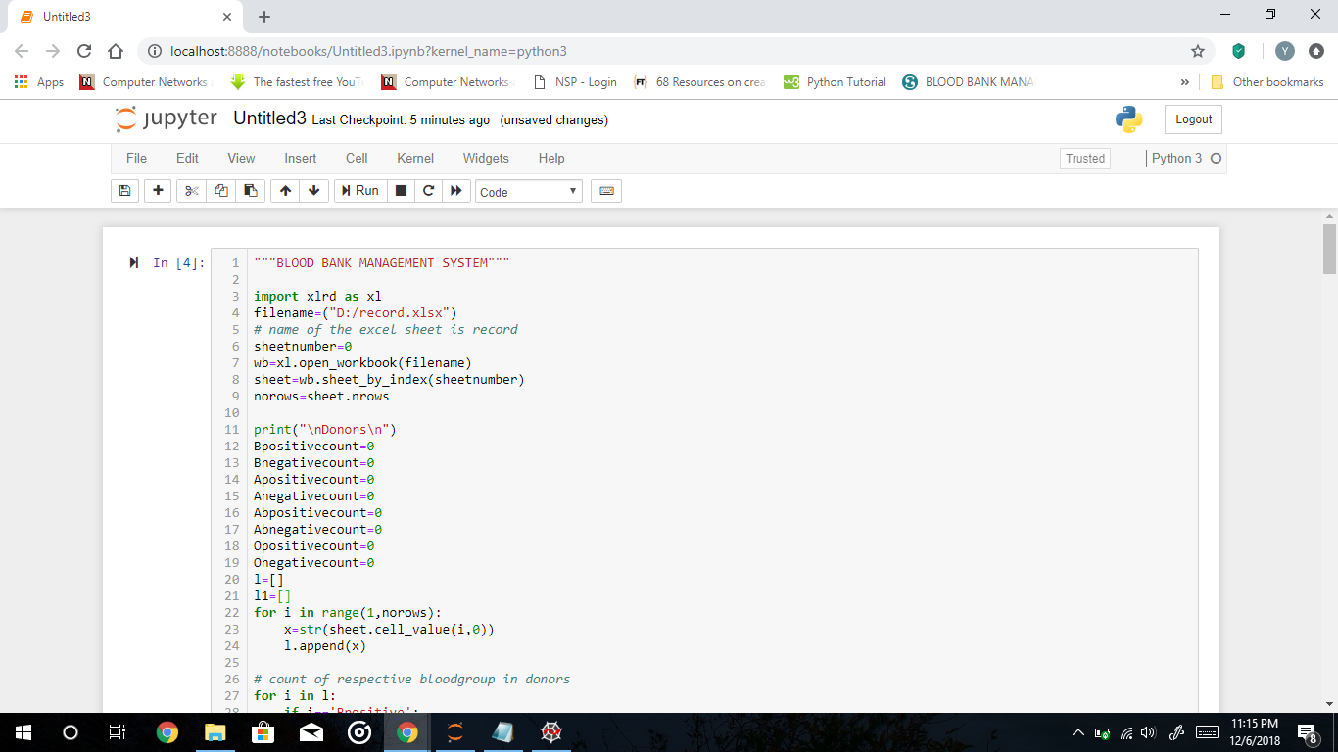
SCREENS OF THE WORK(CODE)

Slide 14
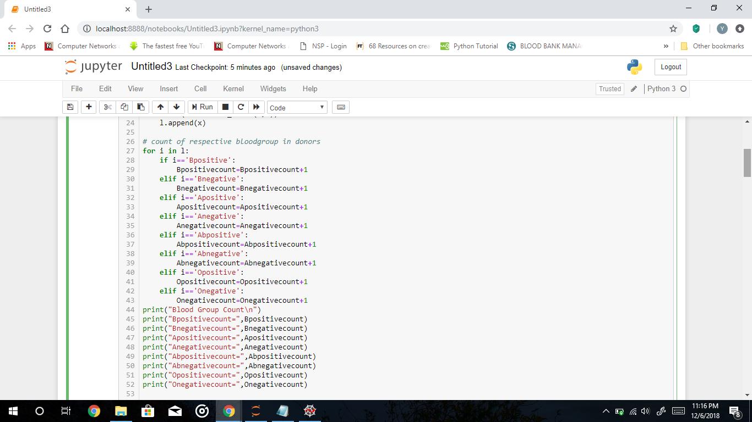
SCREENS OF THE WORK(CODE)

Slide 15
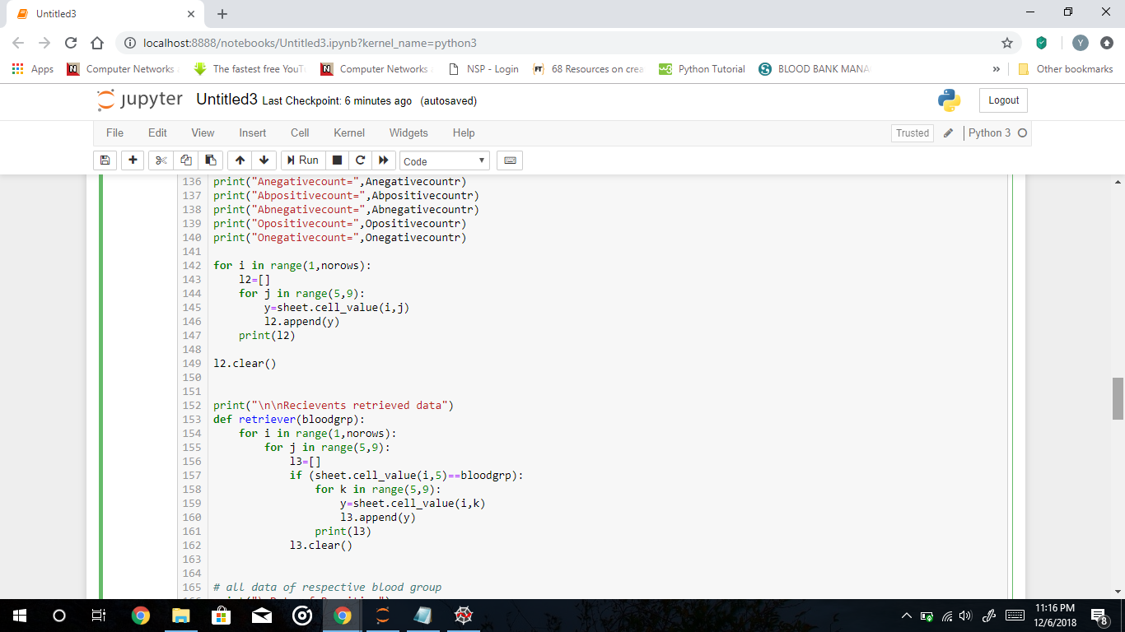
SCREENS OF THE WORK(CODE)

Slide 16
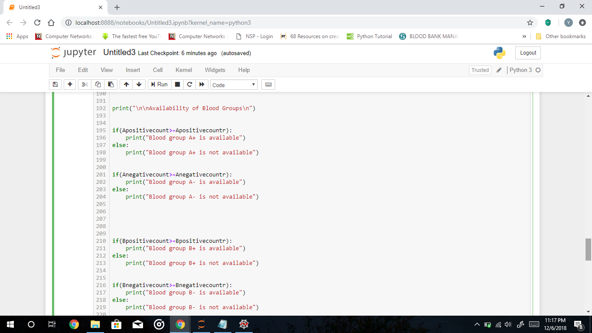
SCREENS OF THE WORK(CODE)

Slide 17
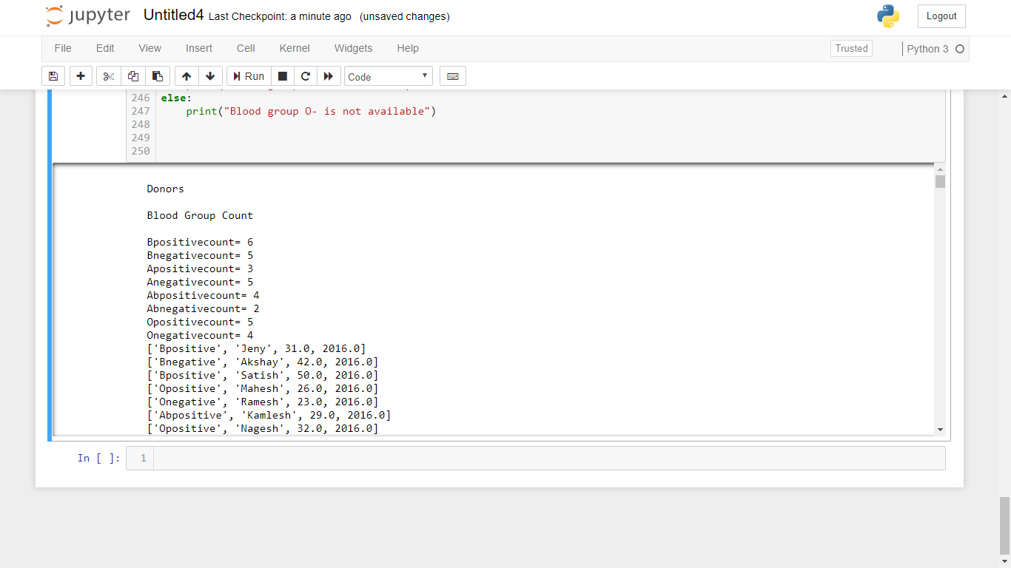
SCREENS OF THE WORK(OUTPUT)

Slide 18
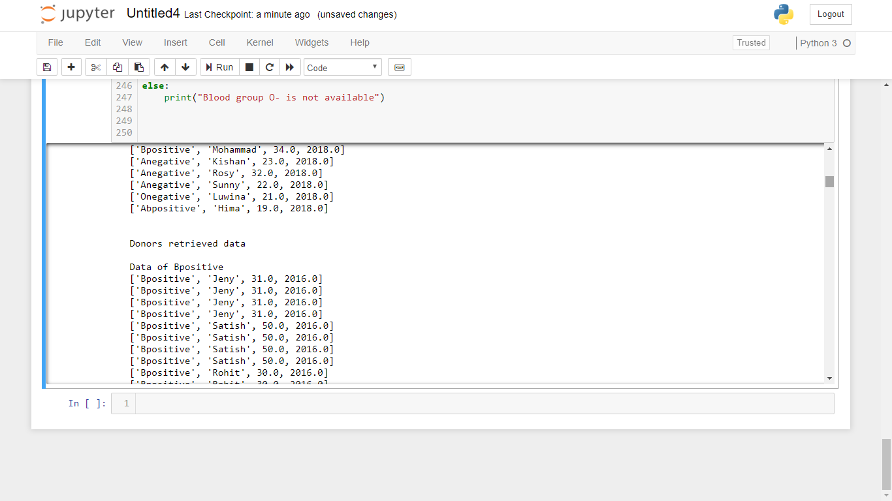
SCREENS OF THE WORK(OUTPUT)

Slide 19
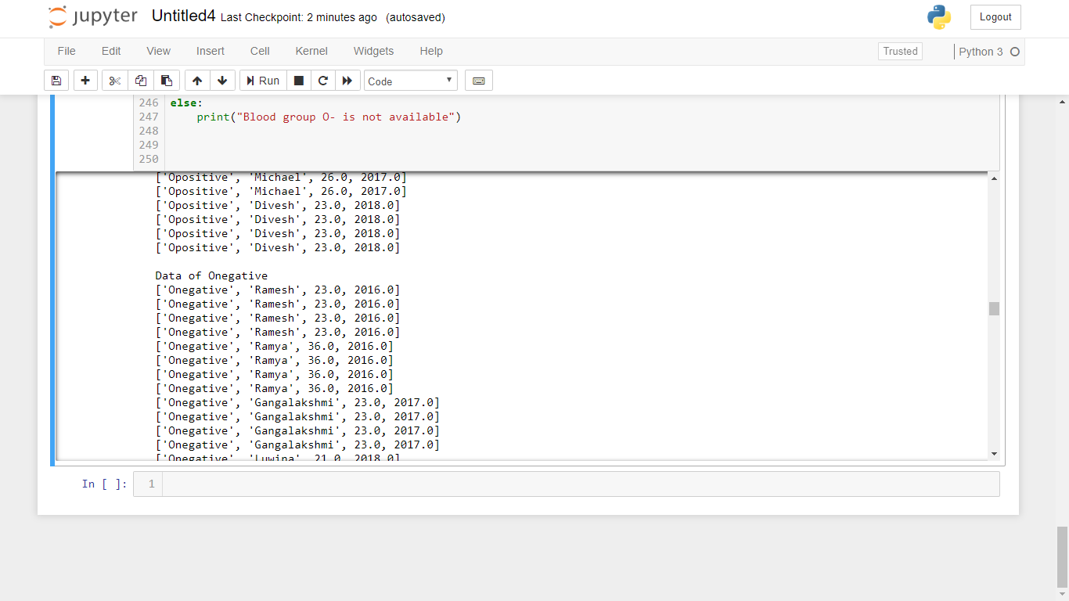
SCREENS OF THE WORK(OUTPUT)

Slide 20
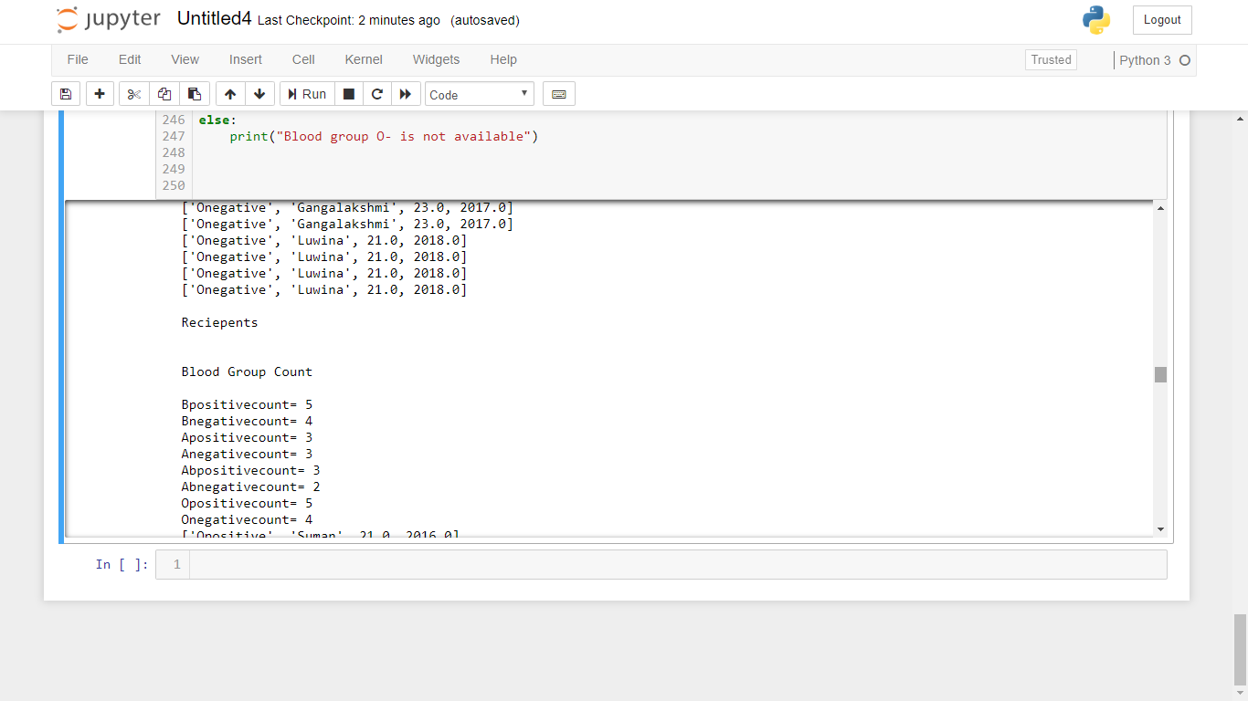
SCREENS OF THE WORK(OUTPUT)

Slide 21
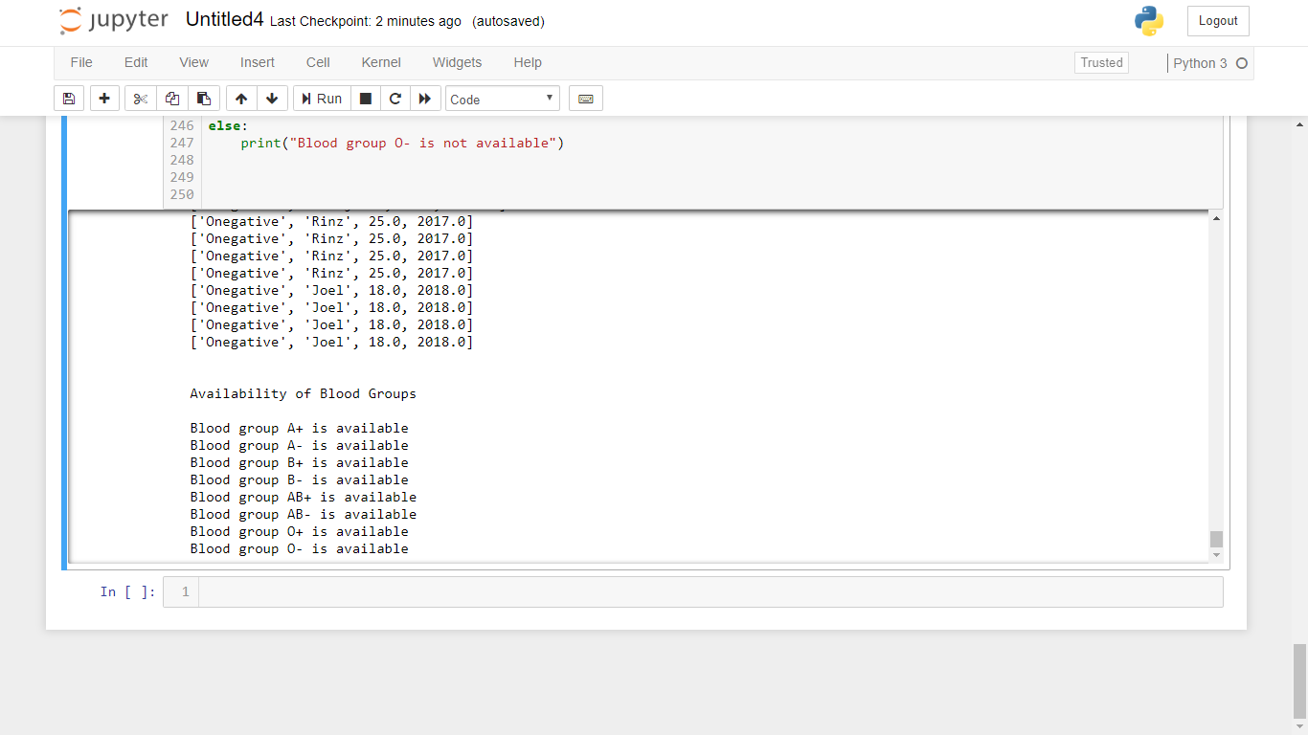
SCREENS OF THE WORK(OUTPUT)

Slide 22
APPLICATIONS AND DRAWBACKS
With the help of Online Blood Bank Management, people who are having the thought of donating blood gets registered in Online Blood Bank giving his details. Online Blood Bank Management site is available to everyone easily. It preserves the documents and updates the value when ever the donor or recipient enhances.
The optimization of the code is slow and to implement this to the large group of people is in fact very difficult.

Slide 23
FUTURE ENHANCEMENT
To optimize the code and use SQL Database and implement in the large scale and synchronize to the very best of the enhancement.
To be able to reach even to the very end of the city. As there was a little number of contact person’s information given, some people may face difficulty in getting blood fast. So i like to gather more information regarding the contact persons in other cities as well as villages and will provide much more services for the people and help everyone with humanity.

Slide 24
CONCLUSION
This project has given us an ample opportunity to design, code, test and implements an application. This has helped in putting into practice of various Software Engineering principles and Database Management concepts like maintaining integrity and consistency of data.

Slide 25
THANK YOU

