Slide 1
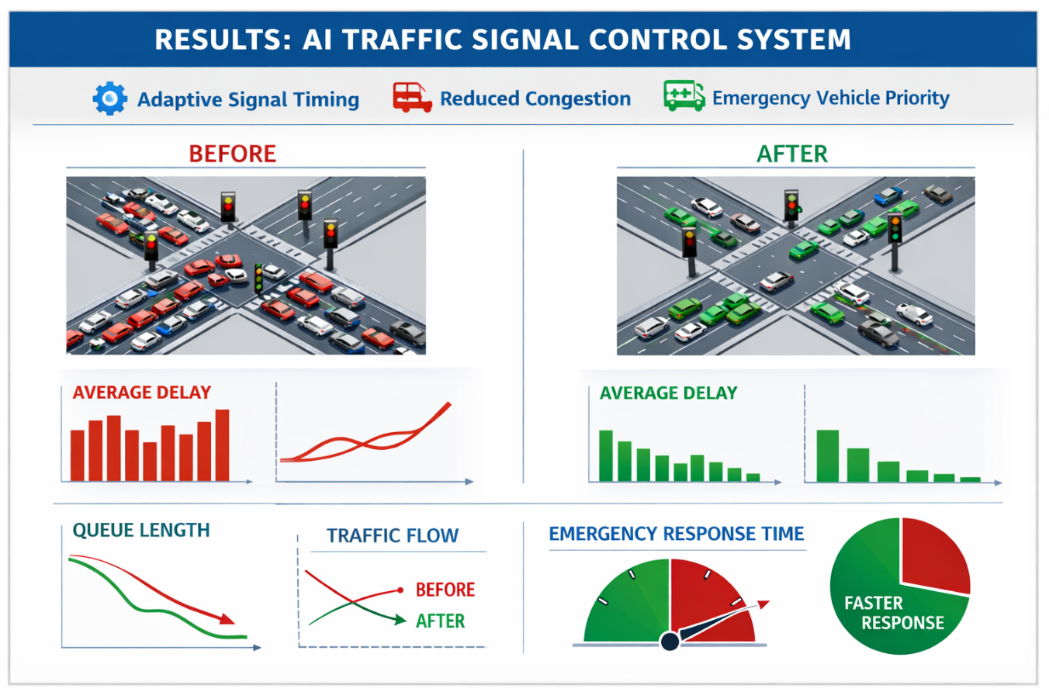
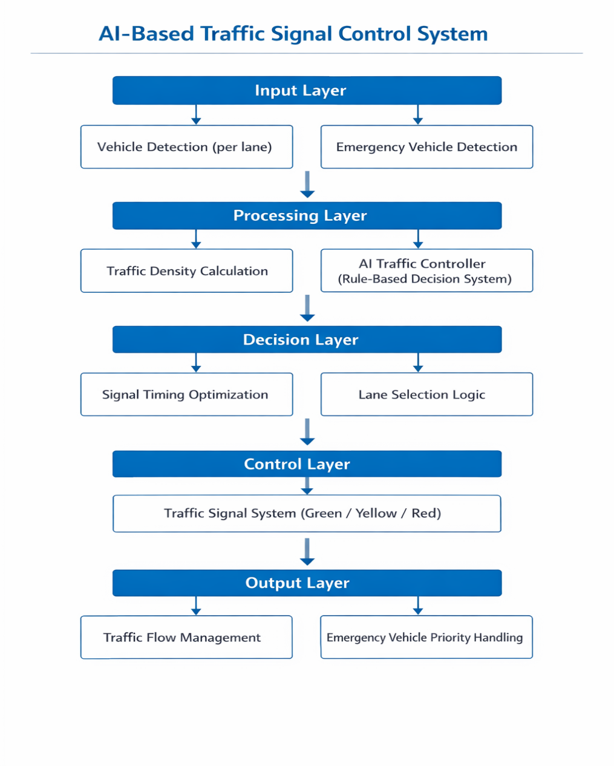
St.Francis Institute of Technology (Engineering College) AnAutonomous Institute, Affiliated to University of Mumbai
Departmentof ComputerEngineering
Academic
Year: 2025 - 26
Title of the Project :AI-Based Adaptive Traffic Signal Control System with Emergency Handling
Manas Dave(CMPN), Krish Desai(CMPN),Rianna Rodriguez(CMPN)
Abstract
Review of Literature
Results
This project presents an AI-based traffic signal control system designed to optimize traffic flow at a four-way intersection. The system dynamically adjusts signal timings based on real-time vehicle density using a rule-based intelligent controller. Additionally, it incorporates an emergency vehicle detection mechanism that prioritizes critical lanes while maintaining safe signal transitions. The simulation is implemented using Python and Pygame, providing a visual representation of traffic behavior. The proposed system improves traffic efficiency, reduces congestion, and enhances emergency response handling.
Title of Paper / Ref No. | Methodology | Discussion of Results | Drawback
[1] Traffic Signal Timing via Deep Reinforcement Learning (IEEE, 2020) | Used Deep Q-Network (DQN) to optimize signal timing based on real-time traffic states and rewards. | Achieved significant reduction in vehicle waiting time and improved traffic flow efficiency compared to fixed-time systems. | Requires high computational power and large training dataset; complex to implement.
[2] Smart Traffic Light Control System Using IoT and Machine Learning (IEEE, 2021) | Integrated IoT sensors with ML models to detect traffic density and dynamically adjust signals. | Improved adaptability in real-world conditions with better congestion management. | Dependent on hardware sensors and network reliability; higher cost.
[3] Adaptive Traffic Signal Control Using Fuzzy Logic (IEEE, 2022) | Applied fuzzy logic rules to determine signal timing based on traffic density levels. | Provided smooth and flexible control without strict thresholds; easy to implement. | Less accurate compared to AI/learning-based approaches; limited scalability.
Problem Statement
Traditional traffic signals operate on fixed timers, leading to inefficient traffic flow and increased congestion. There is a need for an intelligent system that dynamically adjusts signal timing based on real-time traffic density and handles emergency vehicles eff6iciently.
Figure 2: Comparative Analysis of Traffic Conditions Before and After Implementation of AI-Based Adaptive Traffic Signal Control System
Proposed Methodology
The proposed system uses a rule-based AI controller with the following components:
Vehicle Detection: Counts vehicles in each lane
Density Calculation: Classifies traffic as LOW, MEDIUM, HIGH Dynamic Timing:Signal time = MIN + (vehicle_count × factor) Round-Robin Scheduling: Ensures fairness among lanes Emergency Handling:
Detects emergency vehicles Prioritizes lane at next safe transition State Machine Model:
GREEN → YELLOW → GREEN
Conclusion and future directions
The system successfully demonstrates an intelligent traffic control mechanism using
adaptive signal timing and emergency handling. It improves traffic efficiency compared to traditional systems.
Future Scope:Integration with real-time sensors (IoT) Machine learning-based prediction models
Experimental setup
Platform: Python Library: Pygame
Simulation Size: 4-way intersection (800x800 grid)
Inputs:
Vehicle density per lane Emergency vehicle presence Output:
Dynamic signal timing
Traffic movement visualization
References
[1] Li, L., Lv, Y., & Wang, F. Y., “Traffic Signal Timing via Deep Reinforcement Learning,” IEEE Transactions on Intelligent Transportation Systems, 2020.
[2] Sharma, S., & Kaur, P., “Smart Traffic Light Control System Using IoT and Machine Learning,” IEEE Access, 2021.
[3] Kumar, R., & Singh, A., “Adaptive Traffic Signal Control Using Fuzzy Logic,” IEEE International Conference on Smart Systems, 2022.
Figure 1:Block Diagram of AI-Based Traffic Signal Control System Showing Input, Processing, Decision, Control, and Output Layers

