Slide 1
REFERENCE TEMPLATE
Project Presentation
An editorial layout for a considered, elegant project review.
Guide · Prof. Vishal Acharya

Slide 2
SECTION 01
Contents
01
Objective
02
System Architecture
Goal & problem the project solves
How components fit together
03
Workflow Diagram
04
Class Diagram
Step-by-step process flow
Objects & relationships
05
Database Diagram
06
Pipeline Diagram
Tables & relationships (ER)
Data / processing pipeline
07
Charts / Results
08
Future Scope
Outcomes & metrics
What comes next

Slide 3
SECTION 02
Objective
State clearly what the project aims to achieve
Problem: what real issue does it solve?
Goal: what will the system do (one line)?
Scope: key features / modules included.
Users: who benefits from it?
Outcome: the measurable end result.
A WELL-FORMED OBJECTIVE
"To design and develop a [type] system that [does what] for [target users], improving [benefit] and reducing [pain point]."

Slide 4
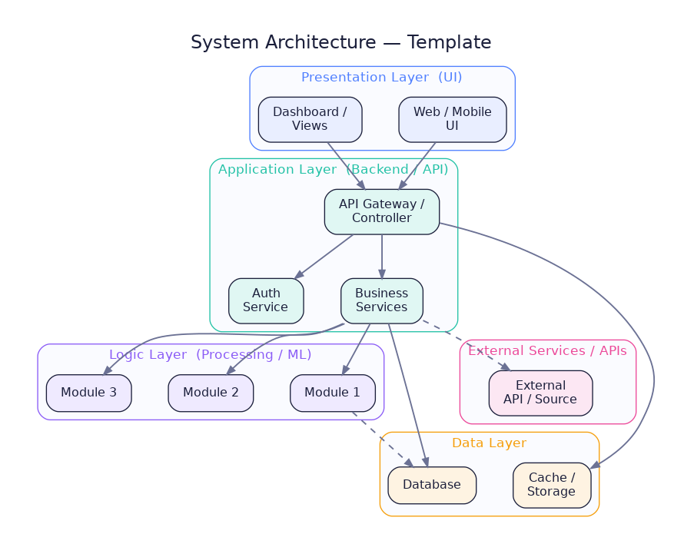
SECTION 03
System Architecture
How the layers & components connect
Show the project as layers: UI → Backend → Logic → Data.
Name each real component (framework, service, DB).
Add arrows for data flow.
Include external APIs if any.

Slide 5
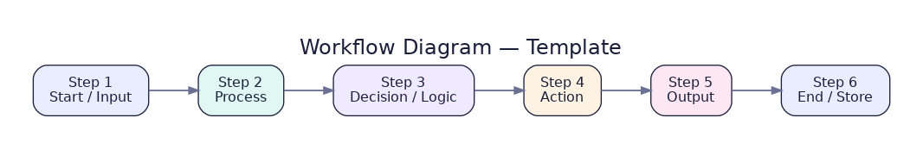
SECTION 04
Workflow Diagram
The step-by-step process a user/data follows
Flow from start (input) to end (output).
Each box = one action or stage.
Add decision points where the flow branches.
Keep it left-to-right, easy to follow.

Slide 6
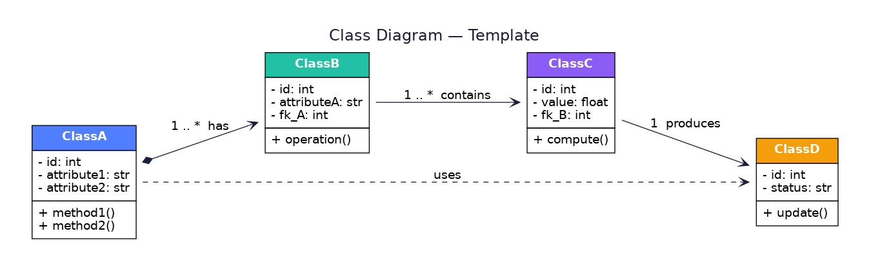
SECTION 05
Class Diagram
Core objects, attributes & relationships
Each box = a class: attributes (top), methods (bottom).
Lines show relationships (has, contains, uses).
Add cardinality (1, 1..*).
Use for the OO design of the app.

Slide 7
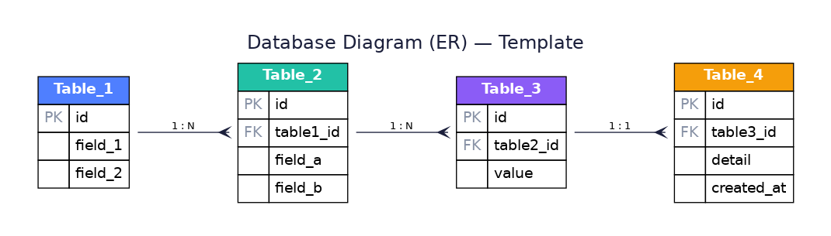
SECTION 06
Database Diagram (ER)
Tables, keys & relationships
Each box = a table with PK & FK.
Lines show relationships: 1:1, 1:N, N:M.
List the important columns.
Mirrors the real database schema.

Slide 8
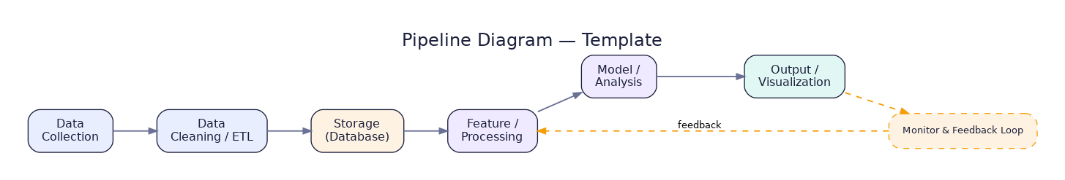
SECTION 07
Pipeline Diagram
How data moves & is processed end-to-end
Stages: collect → clean → store → process → output.
Useful for ML / data / ETL projects.
Add a feedback/monitoring loop.
Each stage maps to a real project step.

Slide 9
SECTION 08
Charts / Results
Show outcomes with clear, editable charts

Slide 10
SECTION 09
Project Screenshots
Add your final project screenshots here
+
+
Screenshot 1
Screenshot 2
Main screen / dashboard
Key feature in action
+
+
Screenshot 3
Screenshot 4
Result / report view
Another highlight

Slide 11
SECTION 10
Future Scope
How the project can grow beyond this version
01
02
03
Scale & Cloud
More AI/ML
Mobile App
Deploy on cloud, handle more users & data
Add models, improve accuracy, real-time predictions
Native Android / iOS companion app
04
05
06
Integrations
Analytics
Security
Connect external APIs, payments, notifications
Richer dashboards & reporting
Role-based access, auditing, compliance

Slide 12
Thank You
Guide · Prof. Vishal Acharya

