Slide 1

Unit-4 Memory Management CO4 - use memory management strategies and allocation techniques
Operating System (OS)
DU #2302CS401
Prof. Asha A. Gondaliya
Department of Computer Engineering
asha.gondaliya@​darshan.ac.in

Slide 2

Looping
Topics
Memory Management: Concept
Logical and Physical address
Basic Memory Management Techniques
Contiguous Memory Allocation
Fixed/Static partition
dynamic / variable partition
Swapping
Non-Contiguous Memory Allocation
Paging
Segmentation
The concept of virtual memory

Slide 3

Looping
Topics
Concept of a Page Fault
Memory Allocation Strategies (First Fit, Best Fit, and Worst Fit)
Page Replacement Algorithmes: FIFO, LRU, OPT

Slide 4
Memory Management: Concept
Section - 1

Slide 5
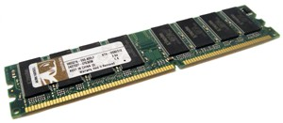
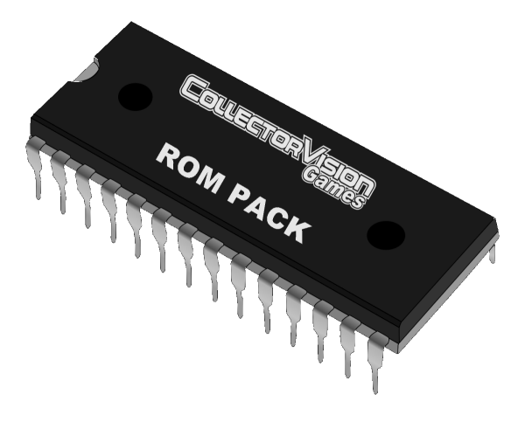
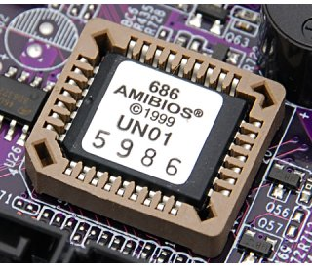
What is Memory?
Memory is a collection of data in specific format.
It used to store instruction and processed data.
Types of memory
Random Access Memory (RAM), is a volatile memory that loses its contents when the computer or hardware device loses power.
Read Only Memory (ROM), is a non-volatile memory, that keeps its contents even if the power is lost.
Computer uses special ROM called BIOS (Basic Input Output System) which permanently stores the software needed to access computer hardware such as hard disk and then load an operating system into RAM and start to execute it.

Slide 6
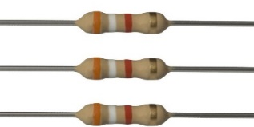

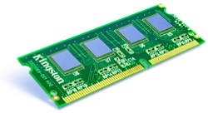
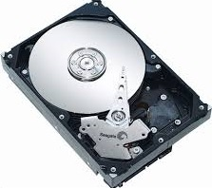
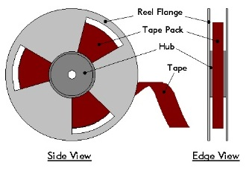
Memory Hierarchy
Arrangement of storage of memory system in computer is memory hierarchy.
Top layer for memory hierarchy
Can be access without delay.
Located inside CPU. Used to reduce main memory access.
Register
Programs can decide what to keep in register
If data available , Cache Hit
If data not available , Cache miss
Cache
Currently used data kept in cache memory. Program need data it searched from cache.
Main Memory
Workhouse of memory system.
Information came from disk before use
Magnetic Disk
Used for Store information permanently in form of file
Used for backup purpose only
Magnetic Tape

Slide 7
Memory Hierarchy
Typical Access Time
Typical Capacity
Faster
Expensive
Register
< 1 KB
1 nsec
Volatile
Cache
1 MB
2 nsec
Main Memory
64 - 512 MB
SPEED
COST
10 nsec
Non Volatile
Magnetic Disk
5 - 50 GB
10 msec
Magnetic Tape
20 - 100 GB
100 sec
Slower
Cheap

Slide 8
Logical and Physical Address
Section - 2

Slide 9
Logical Address and Physical Address
Memory
Relocation Register
Logical Address
346
Physical Address
14346
CPU
1400
MMU

Slide 10
Logical Address and Physical Address
Logical Address | Physical Address
Logical Address is generated by CPU | Physical Address assign in main memory
Set of all logical addresses that can be referenced by a process. | Set of all physical addresses occupied by a process in main memory.
Address starts from zero and goes up to a maximum value based on the size of the process. | Addresses may or may not be contiguous, depending on the memory allocation method.
A process can read and write its own logical address space. | A process can read and write only those physical addresses that belong to its own logical address.
Logical addresses are limited by the address size of the processor. | Physical addresses are limited by the amount of installed memory.

Slide 11
Basic Memory Management Techniques
Section - 3

Slide 12
Memory Allocation
Memory Allocation is an action of assigning physical and virtual memory address space to process.
Goal of Memory allocation
High Utilization
Maximum possible memory should be Utilized
No any Single piece of memory should be wasted.
High Concurrency
Maximum possible process should be in main memory.
As there are many processes in memory, CPU remain busy most of the time in executing one of the process. So throughput is better.

Slide 13
Memory Allocation
MEMORY ALLOCATION
Contiguous
Memory Allocation
Non – Contiguous
Memory Allocation
Fixed
Partitioned
Dynamic
Partitioned
Swapping
Paging
Segmentation
Virtual
Memory

Slide 14
Contiguous Memory Allocation
Section – 3.1

Slide 15
Contiguous Memory Allocation
Simple and Old method of memory allocation. Not used in modern OS.
Each space occupy block of contiguous memory location in main memory.
Entire process kept in Contiguous section of memory.
When Process brought in memory it finds chunk
free memory having enough size to hold process.
When Chunk is found required memory is allocated.
If memory space of required size not available
in main memory then process wait until required
size is available.
Logical address space is not divided into any partition.
Physical address space will be contiguous without any gaps.
000
Logical
Address
Space of
Process P
6000
Physical
Address
Space of
Process P
799
6799

Slide 16
Contiguous Memory Allocation(Conti..)
Advantages
It is easy to implement and understand.
Disadvantages
Having poor memory utilization

Slide 17
Fixed / Static partition
Section – 3.1.1

Slide 18
Fixed /Static Partition
Allow multiple process to execute simultaneously.
Memory shared among OS and processes. It increases CPU utilization.
Memory divided into fixed size partition. Size can be equal or unequal for different partitions.
Each partition can accommodate exactly one process.
Any program need to be loaded in memory , a free partition big enough
to hold program is found. This partition will be allocated to that process.
If there is no free partition available for required size, then that
process need to wait in queue.
Partition 4
Partition 3
Partition 2
Partition 1
OS

Slide 19
Fixed / Static partition(Conti..)
There are two ways to maintain queue :
Using single input queue
Using multiple input queue : Separate queue is maintained, when process comes, it puts in queue for smallest partition large enough to hold.
800k
800k
Partition 4
Partition 4
700k
700k
Multiple Input Queue
Partition 3
Single Input Queue
Partition 3
400k
400k
Partition 2
Partition 2
200k
200k
Partition 1
Partition 1
100k
100k
OS
OS
0
0

Slide 20
Fixed / Static Partitions(Conti..)
Advantages
Implementation is simple
Disadvantages
Degree of multiprogramming is fixed. The number of maximum possible processes that can be executed simultaneously cannot be changed.
Partition are of fixed sized. So, any space in partition not used by process is wasted. This is called internal fragmentation.

Slide 21
Dynamic / Variable Partition
Section – 3.1.2

Slide 22
Dynamic / Variable Partitions(Conti..)
Initially, the entire memory is treated as single fixed partition.
Whenever, any process enters in system, a chunk free memory big enough to fit process is found and allocated. The remaining space is treated as another free partition.
If enough free memory is not available, then process needs to wait until required memory is available.
When process get terminate, it release space occupied. If free space is contiguous to another free partition, both free partition are clubbed together into single free partition.
Figure explains working of method :
Only an OS has been loaded in memory.
If new process comes, it will allocated into memory.
Same if any process terminates, memory is released.

Slide 23
Dynamic / Variable Partitions(Conti..)
Advantages
Better Utilization of memory
No internal Fragmentation
Degree of multiprogramming is not fixed
Disadvantages
Memory is allocated when process enters in system, and released when it terminates. This operation creates holes in memory.
These holes will be so small that no any processes can be loaded in it. But, total size of all holes may be big enough to hold any process. But, as memory is allocated contiguously here, these holes can't be used. This type of memory wastage is called external fragmentation.

Slide 24
Dynamic / Variable Partitions
This method allows multiple process to execute Simultaneously.
The memory is shared among OS and various running process simultaneously.
Memory is not divides in fixed partitions. Process allocated exactly as much memory required.
Operating System
Operating System
Operating System
Operating System
Operating System
8M
Operating System
8M
8M
8M
8M
8M
20M
20M
20M
Process 1
20M
Process 1
Process 1
Process 1
20M
Process 1
56M
14M
Process 4
11M
Process 2
Process 2
14M
Process 2
14M
3M
36M
Process 3
18M
Process 3
18M
Process 3
18M
22M
4M
4M
4M
Initial State
Process 1 - Enters
Process 2 - Enters
Process 3 - Enters
Process 2 - terminates
Process 4 - Enters

Slide 25
Swapping
Section – 3.2.3

Slide 26
Swapping
Consider that system has physical memory of size – 32 MB.
Now suppose, there are 5 processes each having size of 8MB. They all want to be executed simultaneously. These 5 process need total 40 – MB of memory to be resident in memory. By using Swapping, its possible.
Swapping is a technique in which processes are moved between main memory and disk.
Sometimes, there is not enough space in main memory to hold all current active process. So, process must kept on disk and brought into memory to run dynamically.
Process is moved in its entire between memory or disk.
Swapping uses some of portion of secondary storage (disk) as backing storage. This is known as Swap Area.

Slide 27
Swapping(Conti..)
Step -1 : When any process goes in blocked state and there is not enough space in memory to run all process, then that process is moved to swap area
Process will remain until it became ready to run and process will brought in memory
Step – 2 : Operation of moving process from swap area to memory is called Swap In
Step – 3 : Operation of moving process from memory to swap area is called Swap Out
Operating System
1
Swap Out
Process
P1
Swap Area
Step – 4 : When process brought back to memory then it may be loaded on different location rather then original one.
So, there is need of Memory Relocation.
2
Swap In
Process
P2
User space
Main Memory
Backing Store

Slide 28
Non-Contiguous Memory Allocation
Section – 3.2

Slide 29
Non-Contiguous Memory Allocation
This method is used by Modern OS.
Logical address space is divided into partitions. For each partition contiguous chuck of free memory is allocated.
Physical Address space will not be contiguous.
Logical address space of process is divided 3 partition A, B, C.
Each partition is allocated separate chunk of memory in physical memory.
……….
B
A
……….
B
A
C
……….
Logical Address Space
C
……….
Memory

Slide 30
Non-Contiguous Memory Allocation(Conti..)
Advantage
Having better Memory Utilization
Disadvantage
It is complex to implement

Slide 31
Paging
Section – 3.2.1

Slide 32
Paging
The Process of Retrieving processes in the form of pages from secondary storage into the main memory is known as paging.
Logical address space is divided into partitions.
For each partition contiguous memory is allocated in physical memory.
Physical address space of process will not be contiguous.
OS maintain table known as Page Table, for each process. Page table contains page number and frame number.
Frame number indicates actual frame on physical address
Page table Contains page number and frame number
Page number used to search Page table.

Slide 33
Address Translation in Paging
page
L
P
Page no-2
3rd byte
Frame 4
3rd byte
Physical Address
0
Logical Address
Offset
Offset
1
OS
P1(0)
P1(1)
P1(2)
P1(3)
P1(4)
P1(5)
P1(6)
P1(Page Table)
Frame Number
Gives Actual location within Page
2
Page Table
P1
3
0
Frame 2
0
1
2
3
4
5
6
4
+
1
Frame 3
5
2
Frame 4
6
3
Frame 5
7
4
Frame 6
8
5
Frame 7
9
Page Table Base Register
10
Main Memory
6
Frame 8
Page Table P1
Frame 10
Process

Slide 34
Paging
Advantages
Allocation and De-allocation
of memory is very fast. List of free frame need to be maintained.
No external Fragmentation
Each and every frame memory can be allocated.
Disadvantage
Additional memory required
To read information from page table
Every Instruction require two memory : for Page table and for Data
Internal Fragmentation
Process size is may not be exact multiple of page size.
So some Space remain unoccupied.
Size of Page Table
May be too large to keep in main memory.
Page table contains entry for all pages in logical address space.

Slide 35
Segmentation
Section – 3.2.2

Slide 36
Segmentation
The Logical address space of any process is collection of code, stack, data.
The logical address space of a process is divided into blocks of varying size , called segment.
Each segment contains a logical unit of process. Logical unit can be main function, other function or procedure, stack, array, symbol etc.
Operating system maintains a table called, segment table for each process.
The logical address is divided into two parts :
Segment number : Which identifies a segment
Offset : Gives actual location within segment

Slide 37
Segmentation(Conti..)
Segment table describes information such as where segment is loaded in physical memory and what is size of each segment.
0000
Main Function
1200
Code
A table called segment Table, used to implement segmentation.
Each entry of segment table has segment BASE and segment LIMIT
Segment 0
Segment 0
Segment 2
2200
User Define Function
3000
Stack
Segment 2
Limit
Base
3300
0
1000
1200
Segment 3
Segment 1
Segment 3
1
500
4300
4100
2
300
3000
3
800
3300
4300
Logical Address Space
Segment 1
Logical Address Space of process is divided into four segment.
Segment Table
4800
Physical Memory
Base contain physical starting address.
Limit specifies length of segment
Physical memory is shown with four segments

Slide 38
Segmentation(Conti..)
During Process execution CPU generates logical address :
S
Logical Address divided into two parts :
1. Segment number (s)
2. Offset(d)
Limit
Base
Segment Number
Logical Address Space
Segment Table
Segment Number is used as index in segment table.
Offset (d) of logical address must be between 0 and segment limit (length of segment).
s
d
L
200+3000
2
200
200 < 300
d + base
d < limit
<
Yes
+
P
Physical Address Space
If offset is less then segment limit then,
It is added with segment Base
And it produce physical address
No
d > limit
If offset is greater to segment limit then,
It is generate addressing Error.
Addressing Error

Slide 39
Segmentation(Conti..)
Advantages
All segments are independent from each other.
Sharing of data among various process is simple.
No internal Fragmentation. Segment allocated as much memory it required.
Disadvantages
Expensive and difficult to allocate contiguous free memory.
External fragmentation is possible.

Slide 40
The concept of virtual memory
Section – 3.2.3

Slide 41
Virtual Memory
A technique allow a process to execute even though it partially loaded in main memory.
The virtual memory removes requirement that an entire process should be in main memory for its execution.
Main advantage is if process is larger then main memory then also process can be execute in main memory.
Ex : 40-MB process can be execute on 32-MB memory.
Virtual address space can be larger than physical memory.

Slide 42

Virtual Memory(Conti..)
Page is on backing store (disk)
.
When logical address is generated , page table is searched.
If page validity bit is set to invalid, means page required is not available in memory. This is known as Page Fault
3
Operating System
1
Reference
2
Logical Address Space
Trap
6
Restart Instruction
Disk
Page Fault
Operating system request to bring page into memory from disk
Operating system determines location of page on disk
Free Frame
5
Restart Page Table
4
Bring in missing Page

Slide 43
Virtual Memory(Conti..)
That page brought into free frame in memory.
If free frame memory not available then some replacement algorithm is used to replace occupied frame.
Page is on backing store (disk)
.
Operating System
3
1
Reference
2
Logical Address Space
Trap
Free Frame
6
Restart Instruction
Disk
Page Fault
Frame number is entered in page table entry and validity bit is set to valid.
Free Frame
5
Restart Page Table
4
Bring in missing Page
Instruction referenced by logical address is restarted

Slide 44
Virtual Memory(Conti..)
Advantages
There is no need to keep entire memory into process, more process can be accommodated in memory.

Slide 45
Concept of a Page Fault
Section – 5

Slide 46
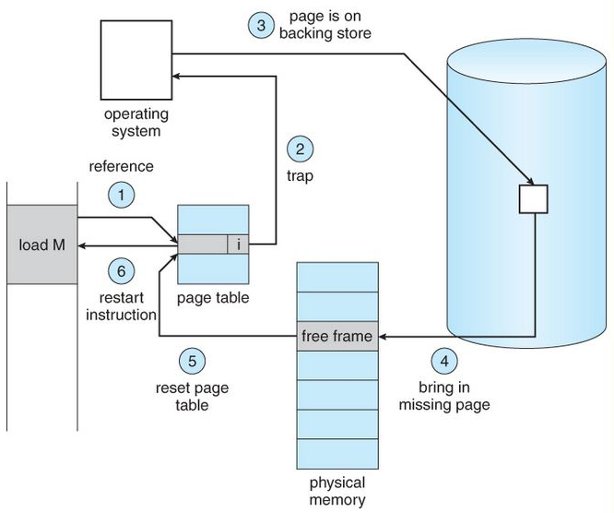
Page Fault
Page Fault: When process needs the page on the memory (RAM), and the page is not already on memory, then it is called a page fault.
The page fault is also called page miss.

Slide 47
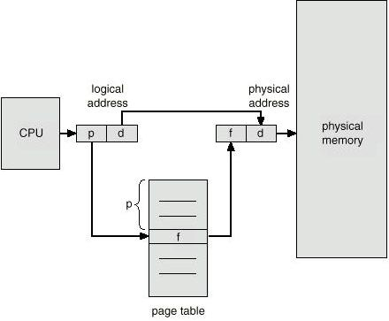
Page Fault
Page Fault: When process needs the page on the memory (RAM), and the page is not already on memory, then it is called a page fault.
The page fault is also called page miss.
Page Hit: When process needs the page on the memory, and the page is already available on memory, then it is called page hit.

Slide 48
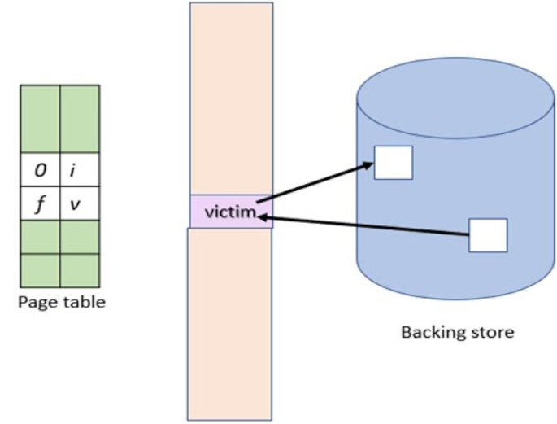
Page Fault
Page Fault: When process needs the page on the memory (RAM), and the page is not already on memory, then it is called a page fault.
The page fault is also called page miss.
Page Hit: When process needs the page on the memory, and the page is already available on memory, then it is called page hit.
Page Replacement: A page from the main memory is replaced with a page from the secondary memory.
Page replacement occurs due to page faut.

Slide 49
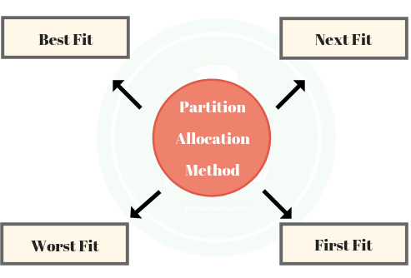
Memory Allocation Strategies (First Fit, Best Fit, and Worst Fit)
Section – 6

Slide 50
Strategies to select partition
When process enter in system, required free memory is allocated for that process.
For this purpose, all free memory is called holes, is searched to find out chunk of free memory.
First Fit :
Search start from starting location of memory.
First available hole , which is large enough to hold process and Selected for allocation.
Search time is less.
Memory loss is higher, as very large hole may be selected for a small process.
Example : Free partition selected for allocation of 10 MB
5
7
15
5
11
8
20
4
3
Search Starts from beginning of memory
5
7
15
5
11
8
20
4
3
5 MB free
5
7
10
5
11
8
20
4
3
15
5
First Fit

Slide 51
Strategies to select partition(Conti..)
Next Fit :
Search start from where previous search ended.
This avoid repeating search of memory which has been already allocated.
This portion will be mostly at front end of memory.
Example : Free partition selected for allocation of 10 MB
5
7
15
5
11
8
20
4
3
Search Start where previous search ended
5 MB free
5
7
10
5
5
11
8
20
4
3
5
7
10
10
5
11
8
20
4
3
5
First Fit
Next Fit
5 MB free
1 MB free
5
10
1
3
5
7
10
5
11
8
20
4

Slide 52
Strategies to select partition(Conti..)
Best Fit :
Entire memory is searched.
Smallest available hole , which is large enough to hold process is Selected for allocation.
Search time is high as it searches entire memory.
Memory loss is less, As it leaves tiny holes into which no process can fit.
Example : Free partition selected for allocation of 10 MB
Search entire memory
Find smallest hole
5
7
15
5
11
8
20
4
3
5 MB free
5
7
10
5
5
11
8
20
4
3
Best Fit
5 MB free
1 MB free
First Fit
Next Fit
5
10
1
3
5
7
10
5
11
8
20
4
First Fit

Slide 53
Strategies to select partition(Conti..)
Worst Fit :
Entire memory is searched.
Largest available hole , which is large enough to hold process is Selected for allocation.
This can be used only for dynamic partition.
This is not used for fixed partitioning.
Example : Free partition selected for allocation of 10 MB
5
7
15
5
11
8
20
4
3
Search entire memory
Find Largest hole
Best Fit
5 MB free
1 MB free
5
10
1
3
5
7
10
5
11
8
20
4
Best Fit
Worst Fit
5 MB free
1 MB free
10 MB free
First Fit
5
10
1
10
10
3
5
7
10
5
11
8
20
4
First Fit
Next Fit

Slide 54
Page Replacement Algorithmes: FIFO, LRU, OPT
Section - 7

Slide 55
Page replacement algorithms
Following are different types of page replacement algorithms
FIFO (First In First Out Page ) Page Replacement Algorithm
LRU (Least Recently Used) Page Replacement Algorithm
OPT (Optimal) Page Replacement Algorithm

Slide 56
Page Replacement Algorithme: FIFO(First In First Out Page )
Section – 7.1

Slide 57
1. FIFO Page Replacement Algorithm
The First In First Out Page replacement algorithm is the simplest page replacement algorithm.
The operating system maintains a list of all pages currently in memory, with the most recently arrived page at the tail and least recent at the head.
On a page fault, the page at head is removed and the new page is added to the tail.
The performance of the FIFO algorithm is not always good because it may happen that the page which is the oldest is frequently referred by OS.
Hence removing the oldest page may create page fault again.

Slide 58
FIFO Page Replacement Algorithm
Page Reference String:
4,7,6,1,7,6,1,2,7,2
Three frames
Page Request | 4 | 7 | 6 | 1 | 7 | 6 | 1 | 2 | 7 | 2
Frame – 1 | 4 | 4 | 4 | 1 | 1 | 1 | 1 | 1 | 1 | 1
Frame – 2 |  | 7 | 7 | 7 | 7 | 7 | 7 | 2 | 2 | 2
Frame – 3 |  |  | 6 | 6 | 6 | 6 | 6 | 6 | 7 | 7
Page Faults (6) | F | F | F | F |  |  |  | F | F

Slide 59
Page Replacement Algorithme: LRU (Least Recently Used)
Section – 7.2

Slide 60
LRU (Least Recently Used) Page Replacement Algorithm
Pages that have been heavily used in last few instructions will probably be heavily used again in next few instructions.
When page fault occurs, throw out the page that has been used for the longest time. This strategy is called LRU (Least Recently Used) paging.
To fully implement LRU, it is necessary to maintain a linked list.
List stores most recently used page at the front and the least recently used page at the rear.
The list must be updated on every memory reference.
Finding a page in the list, deleting it, and then moving it to the front is a very time consuming operations.

Slide 61
LRU (Least Recently Used) Page Replacement Algorithm
Page Reference String:
4,7,6,1,7,6,1,2,7,2
Three frames
Page Request | 4 | 7 | 6 | 1 | 7 | 6 | 1 | 2 | 7 | 2
Frame – 1 | 4 | 4 | 4 | 1 | 1 | 1 | 1 | 1 | 1 | 1
Frame – 2 |  | 7 | 7 | 7 | 7 | 7 | 7 | 2 | 2 | 2
Frame – 3 |  |  | 6 | 6 | 6 | 6 | 6 | 6 | 7 | 7
Page Faults (6) | F | F | F | F |  |  |  | F | F

Slide 62
LRU (Least Recently Used) Page Replacement Algorithm
Page Reference String:
3,1,2,3,4,2,3,0,3,1,3
Three frames
Page Request | 3 | 1 | 2 | 3 | 4 | 2 | 3 | 0 | 3 | 1 | 3
Frame – 1 | 3 | 3 | 3 | 3 | 3 | 3 | 3 | 3 | 3 | 3 | 3
Frame – 2 |  | 1 | 1 | 1 | 4 | 4 | 4 | 0 | 0 | 0 | 0
Frame – 3 |  |  | 2 | 2 | 2 | 2 | 2 | 2 | 2 | 1 | 1
Page Faults (6) | F | F | F |  | F |  |  | F |  | F

Slide 63
Page Replacement Algorithme: OPT (Optimal)
Section – 7.3

Slide 64
Optimal Page Replacement Algorithm
When page fault occurs, some set of pages will be in the memory.
One of these pages will be referenced on the very next instruction.
Other pages may not be referenced until 10, 100, or perhaps 1000 instructions later.
This algorithm will remove the page which reference far away as compare to other pages.
The only problem with this algorithm is that it is unrealizable.
At the time of the page fault, the operating system has no way of knowing when each of the pages will be referenced next.

Slide 65
Optimal Page Replacement Algorithm
Page Reference String:
4,7,6,1,7,6,1,2,7,2
Three frames
Page Request | 4 | 7 | 6 | 1 | 7 | 6 | 1 | 2 | 7 | 2
Frame – 1 | 4 | 4 | 4 | 1 | 1 | 1 | 1 | 2 | 2 | 2
Frame – 2 |  | 7 | 7 | 7 | 7 | 7 | 7 | 7 | 7 | 7
Frame – 3 |  |  | 6 | 6 | 6 | 6 | 6 | 6 | 6 | 6
Page Faults (5) | F | F | F | F |  |  |  | F

Slide 66
Operating System (OS)
DU # 2302CS401
Prof. Asha A. Gondaliya
Computer Engineering Department
asha.gondaliya@​darshan.ac.in

