Slide 1
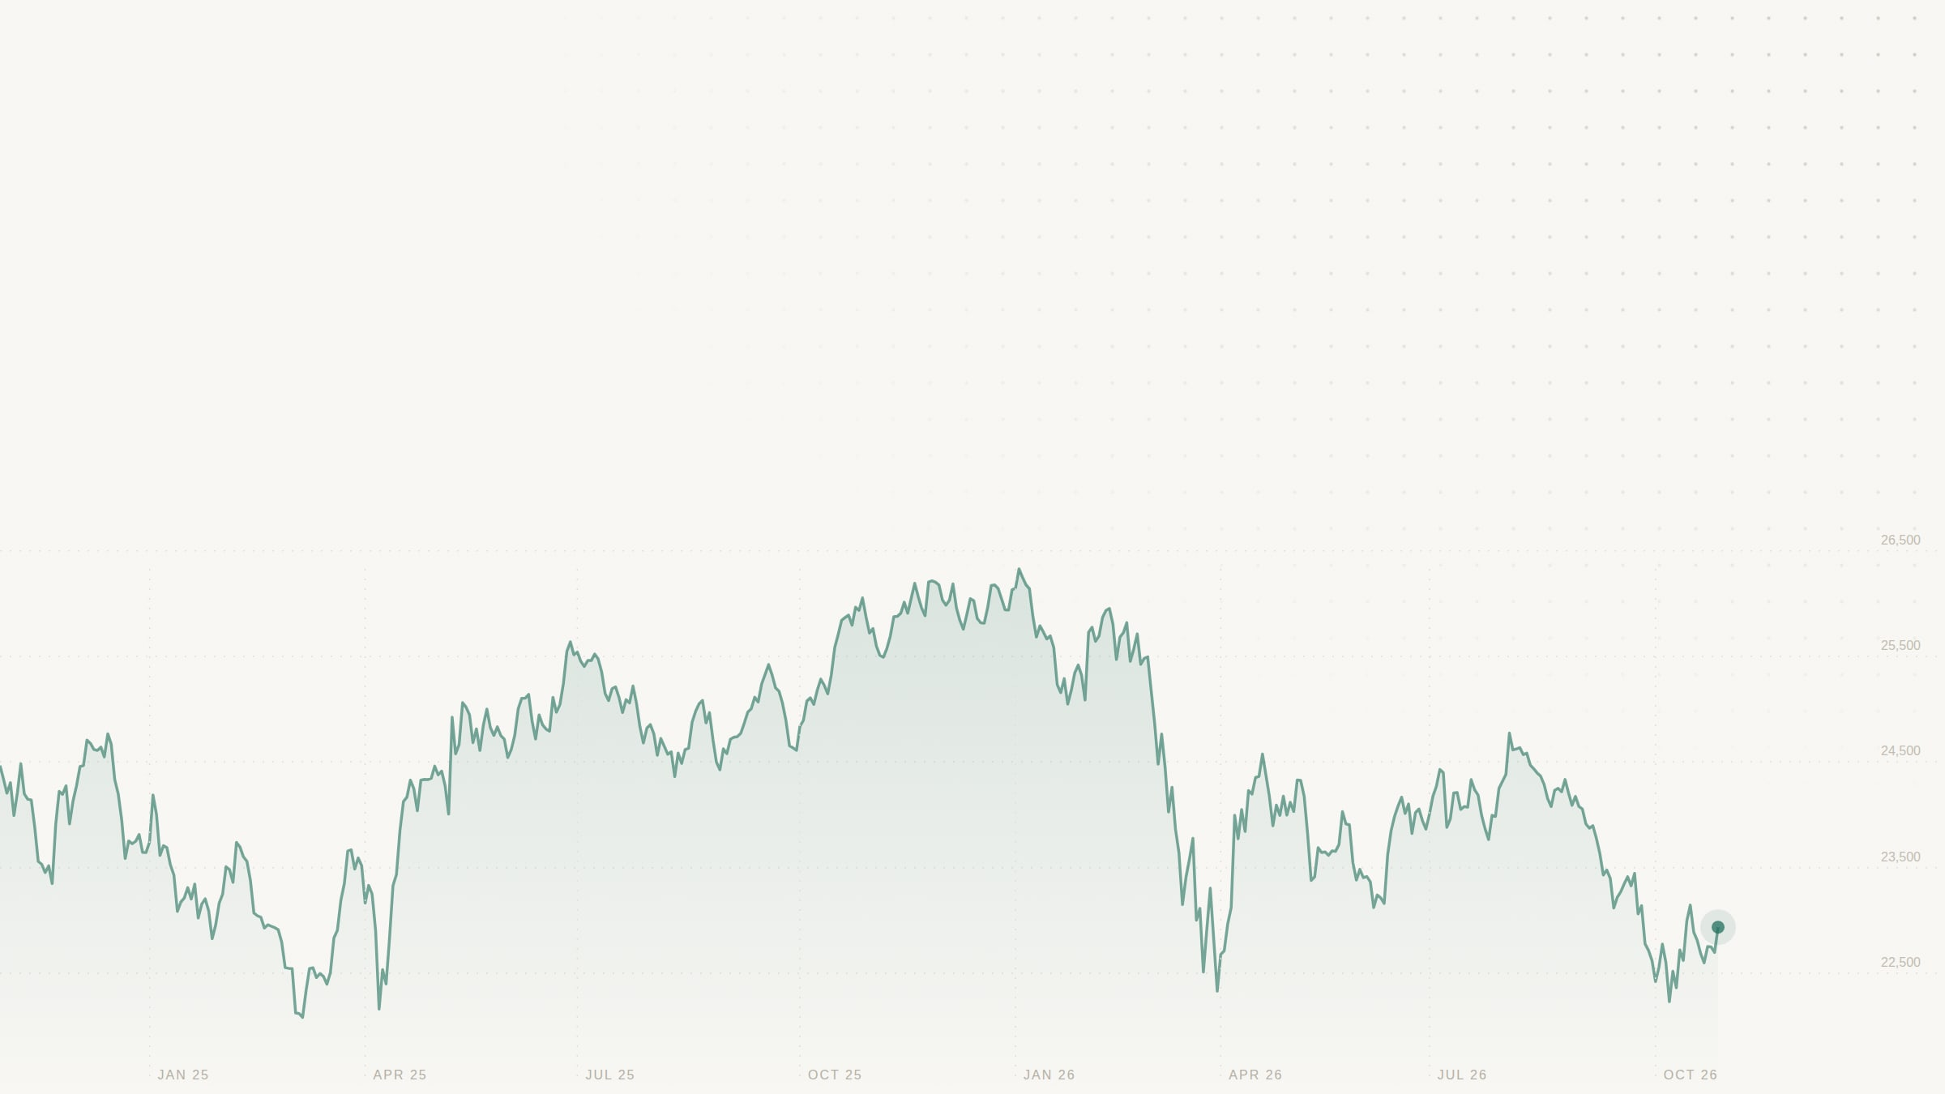
MarketLens
DATA ANALYTICS AND VISUALIZATION · MINI PROJECT · SEMESTER 5
Show the truth
after costs.
PRESENTED BY
Shreya Sharma
Roll 14 · Batch B1
Krish Potanwar
Roll 21 · Batch B2
Dhanashree Sainis
A research workstation and paper-trading platform for Indian stocks: live prices, every rupee of cost itemised, and a dash where data is missing.
Roll 28 · Batch B2
NIFTY 22,936.75
The line through these slides is the NIFTY 50 at daily close, 29 Oct 2024 to 29 Oct 2026. Source: Yahoo Finance.
LIVE DEMO market-lens-kappa.vercel.app
Notes:
DHANASHREE SAINIS · about 40 s
Good morning, everyone. We are Shreya Sharma, Krish Potanwar, and I am Dhanashree Sainis. Our Data Analytics and Visualization mini project is MarketLens, a research workstation and paper-trading platform for Indian stocks, built around one idea: show the truth after costs. The faint line running through these slides is the real NIFTY 50 over the last two years. I will introduce the project, the problem and our objectives. Shreya will cover the existing and proposed systems, the architecture, the technologies and our method. Krish will show the implementation, the results, the advantages and our conclusion.

Slide 2
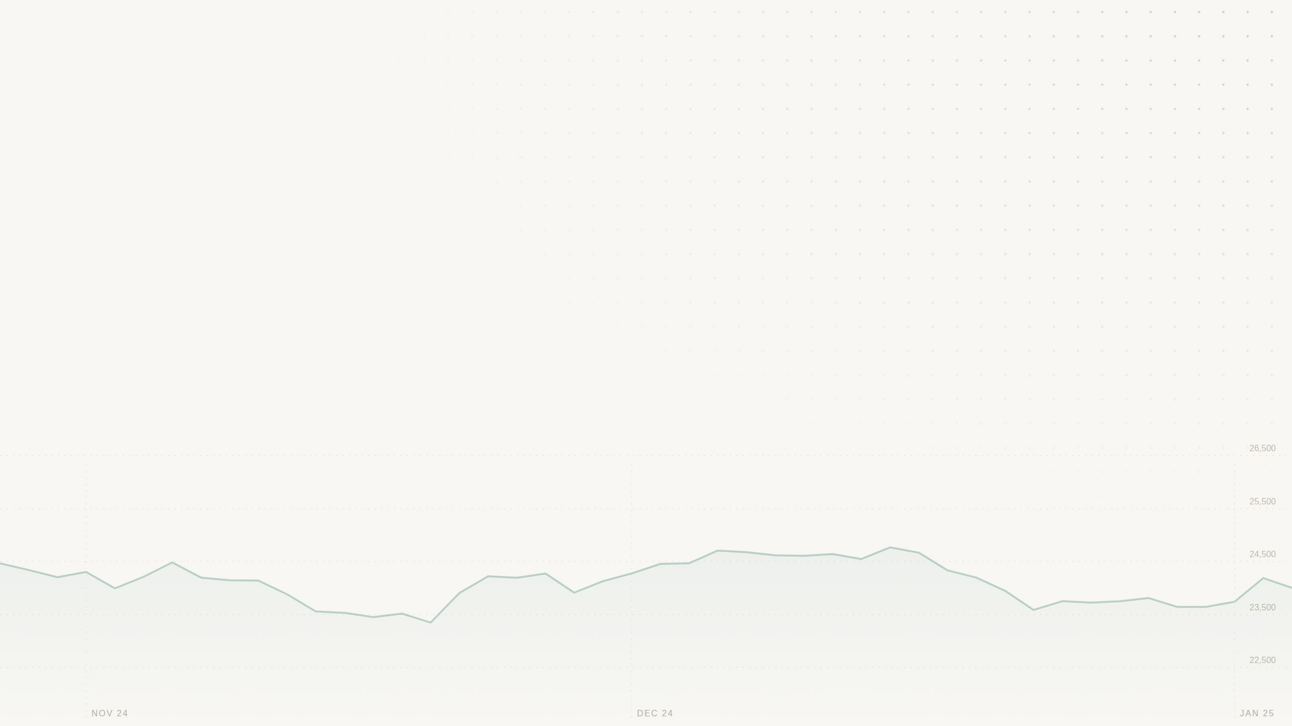
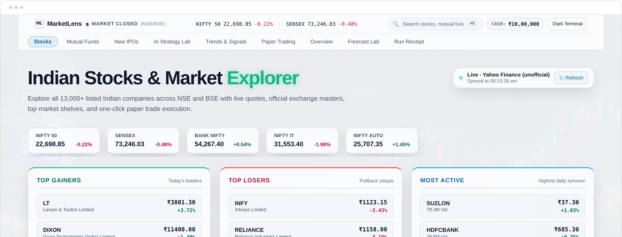
No. 01 INTRODUCTION
One workstation for Indian stocks.
MarketLens is a web application for researching and paper-trading Indian stocks. It puts live NSE and BSE data, technical analysis, scenario modelling and a rule-faithful trading simulator in one place, and shows every rupee a trade really costs.
13,109
9
0
Fig. 1 Stocks Explorer on live Yahoo Finance data.
NSE and BSE listings, searchable
modules in one interface
paid data feeds or API keys
MARKET
INTELLIGENCE
EXECUTION
RESEARCH
Stocks Explorer
Mutual Funds
New IPOs
AI Strategy Lab
Trends and Signals
Paper Trading
Overview
Forecast Lab
Run Receipt
MarketLens
02 / 12
Notes:
DHANASHREE SAINIS · about 40 s
MarketLens is a web application for researching and paper-trading Indian stocks. It brings live market data, technical analysis, scenario modelling and a trading simulator that follows Indian market rules into one place. You can search all 13,109 NSE and BSE listings, study a stock's chart and indicators, generate scenarios, and place a paper trade, and every order shows exactly what it would cost. There are nine modules in four groups: Market, Intelligence, Execution and Research. It needs no paid data feed and no API key. The screenshot is the running app on live data, not a mock-up.

Slide 3
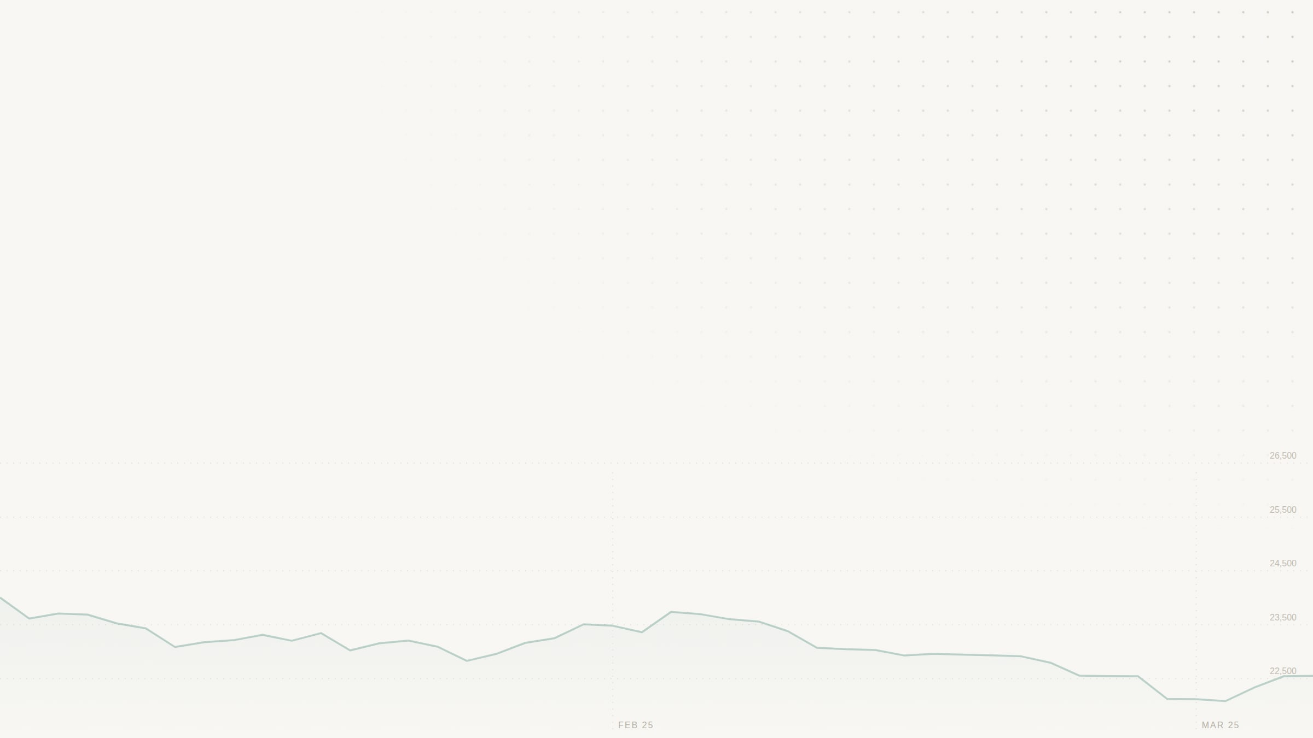
No. 02 PROBLEM STATEMENT
0.18%
Most paper trading hides what trading costs.
1
Statutory charges are left out: STT, GST, stamp duty, exchange fees.
The price has to move this far, in your favour, just for a ₹1,00,000 intraday round trip to break even.
2
Orders fill instantly at any hour, as if the market never closed.
3
Student data projects stop at a notebook and a stale CSV file.
Statutory charges and brokerage
₹82.44
Slippage, 0.05% each way
₹100.00
PROBLEM STATEMENT
Cost of the round trip
₹182.44
Build a platform where a learner can research and paper-trade Indian stocks on live data, under real market rules, with every cost applied and every result open to audit.
Rates from the MarketLens fee schedule. It mirrors published broker schedules and is not yet verified against NSE circulars.
MarketLens
03 / 12
Notes:
DHANASHREE SAINIS · about 55 s
Most paper-trading apps are flattering. They leave out statutory charges: STT, GST, stamp duty and exchange fees. They fill your order instantly at any hour, as if the market never closed. And most student data projects stop at a notebook and a stale CSV file. Here is what that hides. On a one-lakh-rupee intraday round trip, our engine charges 82 rupees 44 in brokerage and statutory fees, plus 100 rupees of slippage. That is 182 rupees, or 0.18 percent. The stock has to move that far in your favour just to break even. So our problem statement is: build a platform where a learner can research and paper-trade Indian stocks on live data, under real market rules, with every cost applied and every result open to audit.

Slide 4
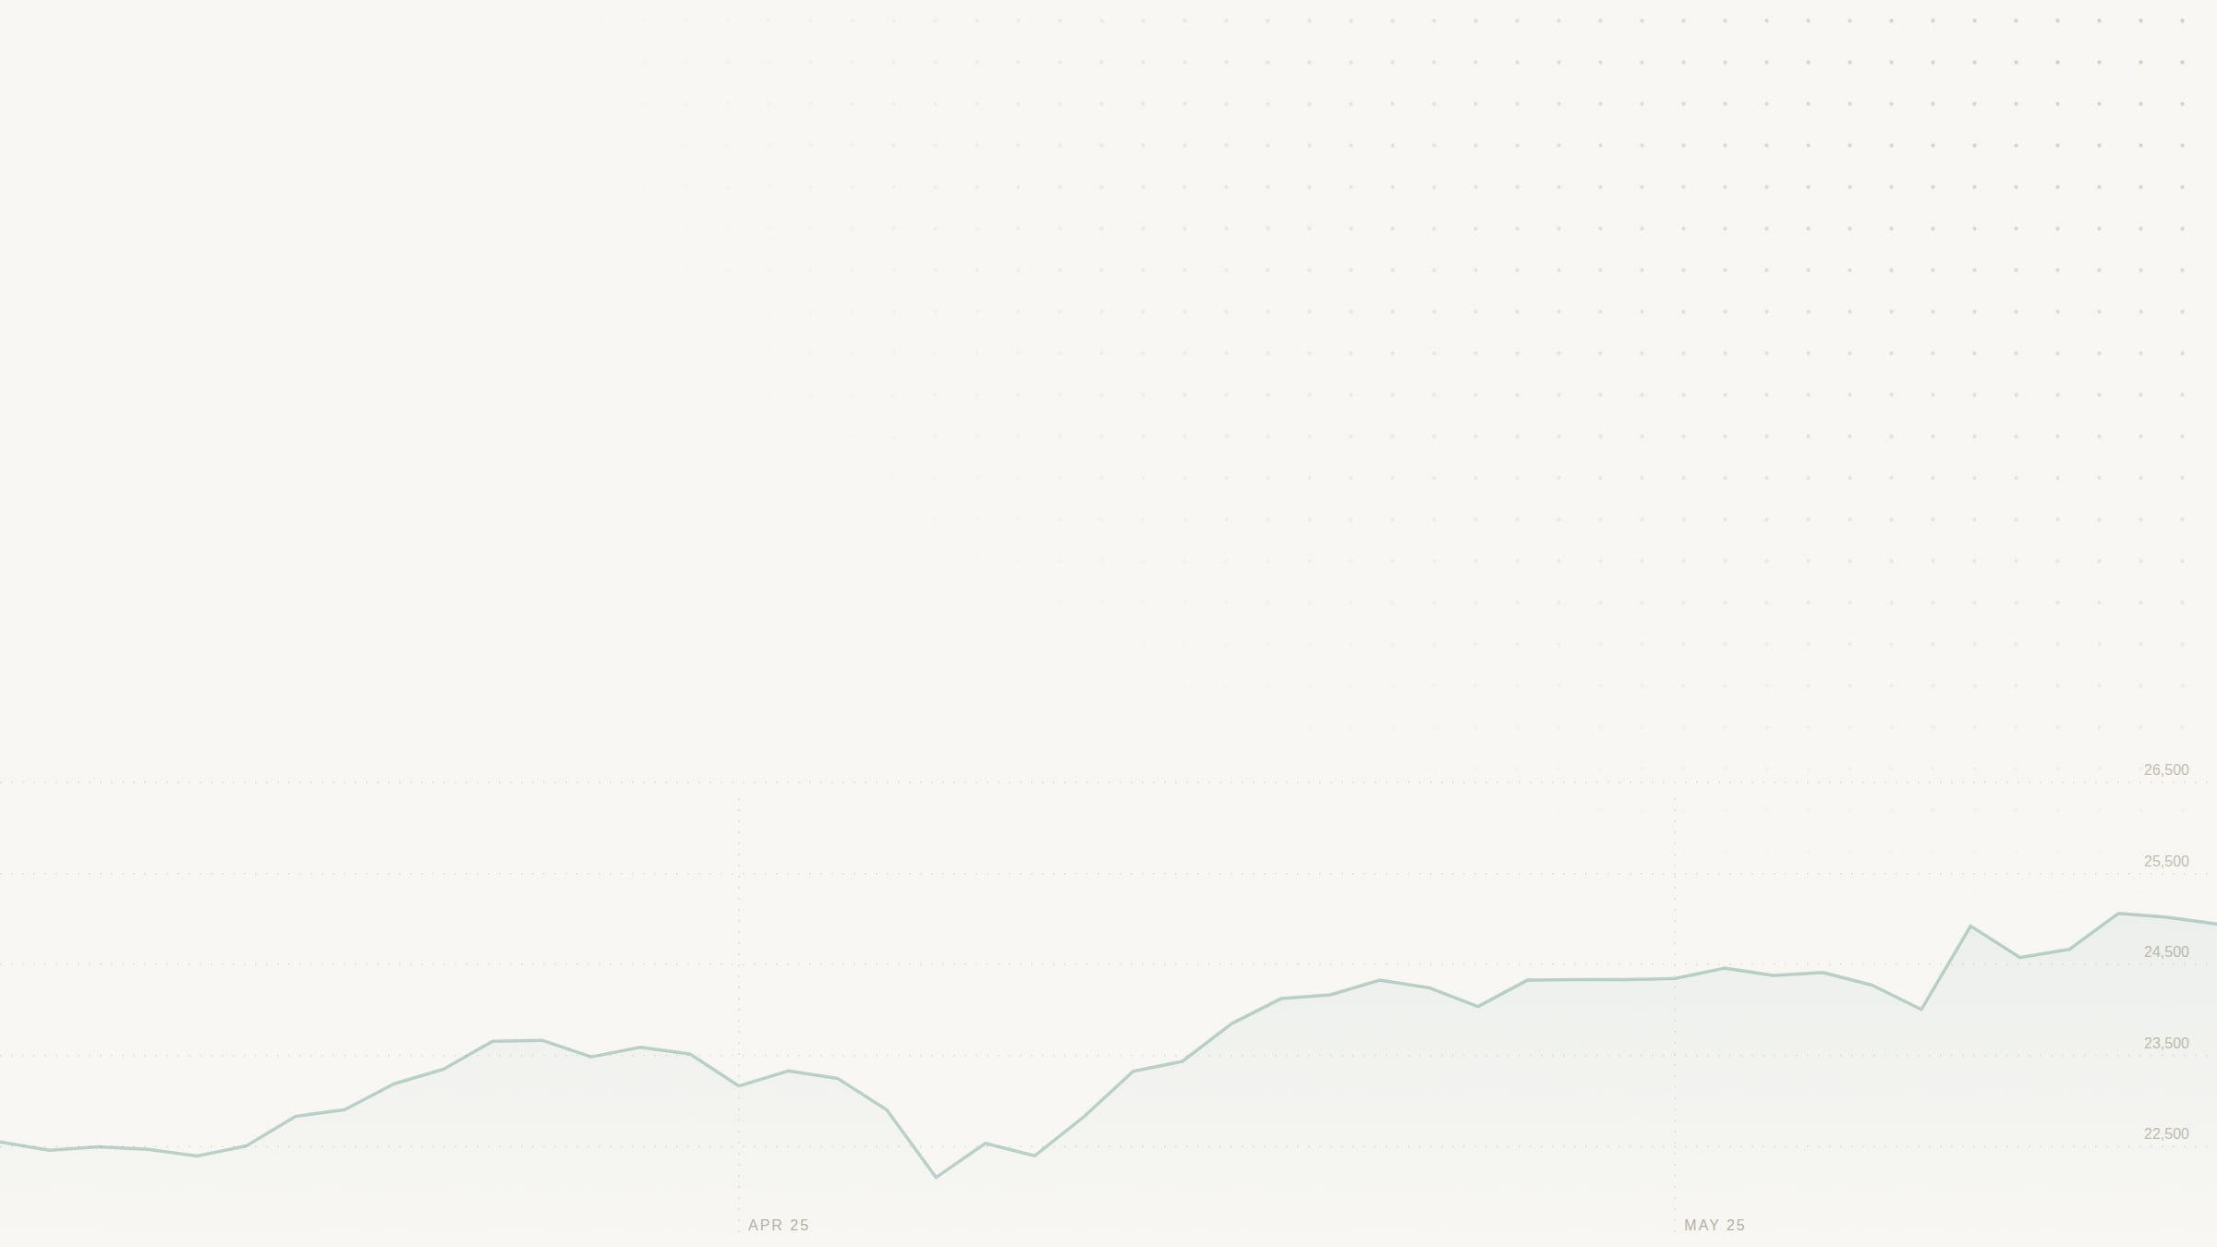
No. 03 OBJECTIVES
What MarketLens set out to do.
01
02
03
04
05
Show live, honest data
Follow Indian market rules
Itemise every cost
Make research auditable
Turn data into decisions
Live NSE and BSE quotes, charts, IPOs, fund NAVs and news. A dash, never an invented number, when a feed fails.
Sessions from 9:15 to 3:30 IST, weekends and holidays closed, intraday positions squared off at 3:15 PM.
Brokerage, STT, exchange fee, SEBI fee, stamp duty, GST and slippage on every paper order.
A backtest and forecast with no look-ahead, published as fingerprinted runs nobody can edit.
Indicators, four scenarios and a Monte Carlo risk fan, in an interface that works from phone to desktop.
AIM
Make the cost of trading visible, and make every number on screen traceable to its source.
MarketLens
04 / 12
Notes:
DHANASHREE SAINIS · about 40 s
That gave us five objectives. One: show live, honest data, and when a feed fails, show a dash instead of an invented number. Two: follow Indian market rules, with sessions from 9:15 to 3:30, weekends and holidays closed, and intraday positions squared off at 3:15. Three: itemise every cost on every order. Four: make the research auditable, with no look-ahead, and results that cannot be edited once published. Five: turn the data into decisions, with indicators, scenarios and a risk simulation, in an interface that works from phone to desktop.
HAND-OFF: Shreya will now compare this with existing systems.

Slide 5
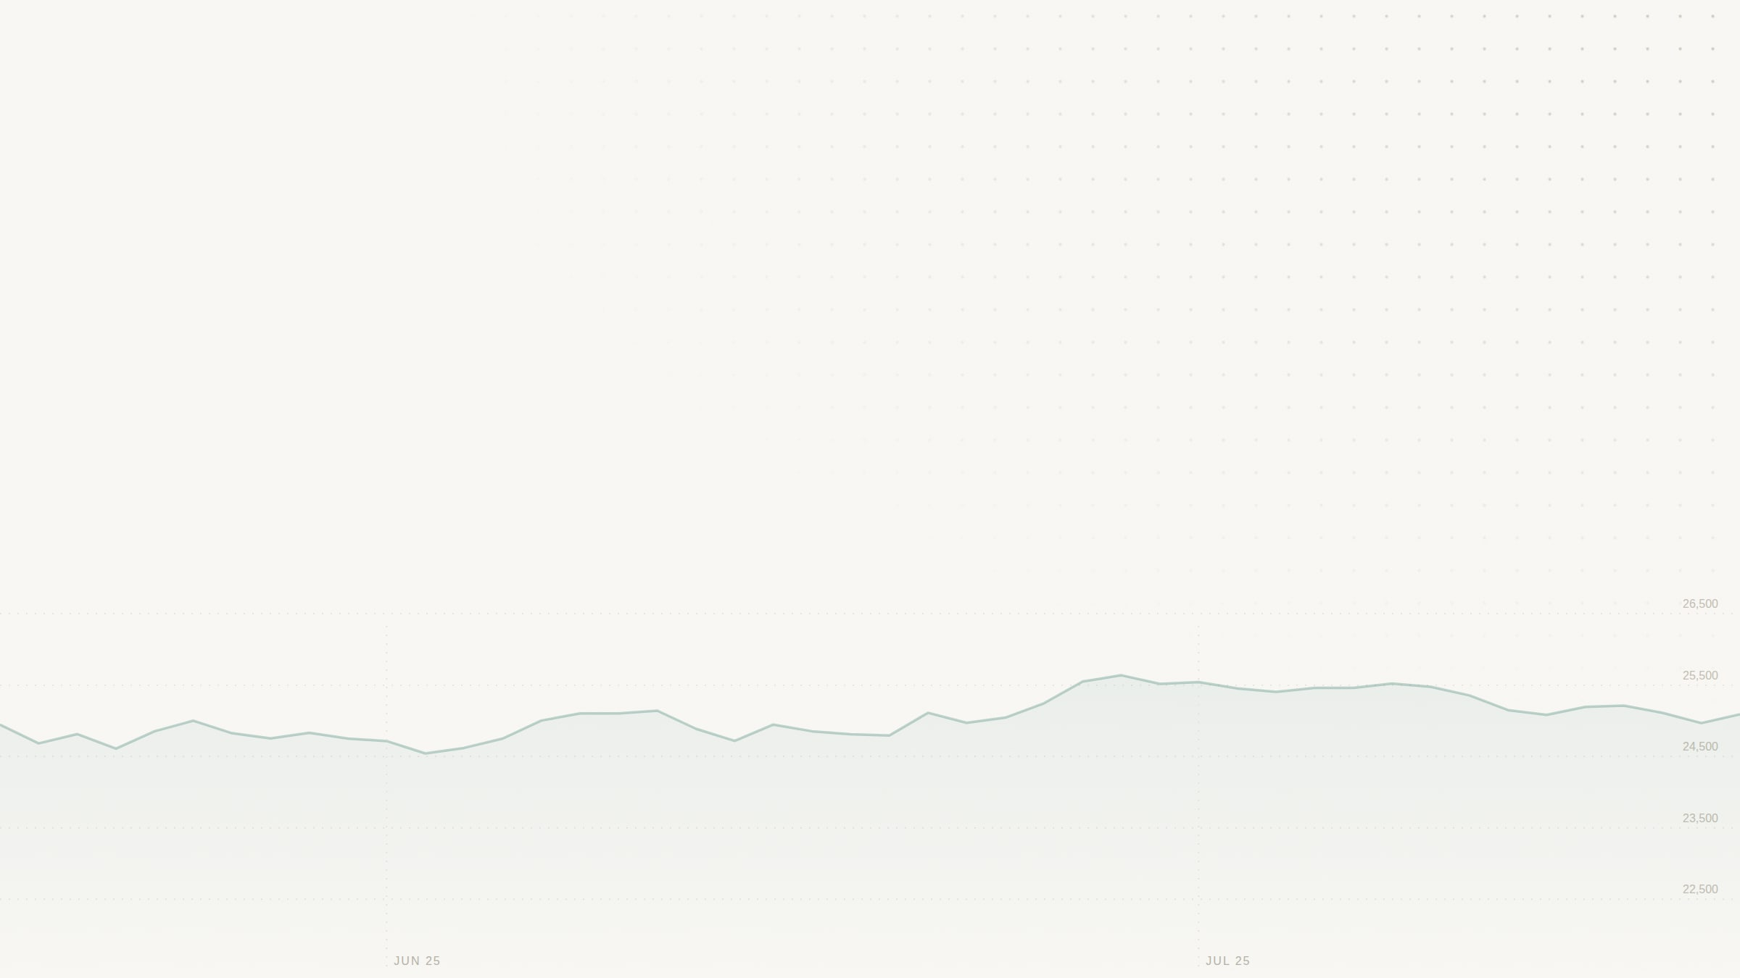
No. 04 EXISTING SYSTEM
No. 05 PROPOSED SYSTEM
Simulators that flatter.
MarketLens shows the friction.
COSTS
COSTS
Zero or flat fees. STT, GST and stamp duty are ignored.
Seven charges on every order, from one fee schedule shared by both engines.
MARKET HOURS
MARKET HOURS
Orders fill instantly at any hour, weekends included.
9:15 to 3:30 IST, holidays closed, intraday square-off at 3:15 PM.
DATA
DATA
A static CSV, or a made-up number when a feed fails.
Live Yahoo, NSE, mfapi and Google News data. A dash and the source name when a feed is down.
RESEARCH
RESEARCH
Backtests that can peek ahead, with results nobody can re-check.
Next-bar fills, Decimal money, and SHA-256 fingerprinted runs the database will not let anyone edit.
AI
AI
Insight locked behind a paid API key.
A scenario engine that works offline. Groq, Gemini or Grok if you paste a key.
MarketLens
05 / 12
Notes:
SHREYA SHARMA · about 60 s
Let us compare. Typical paper-trading simulators and student projects charge nothing, or a flat fee, and ignore STT, GST and stamp duty. They fill orders at any hour. Their data is a static file, and when a feed fails some of them fill the gap with a made-up number. Their backtests can peek at future prices, and nobody can re-check the results. Our proposed system, MarketLens, puts seven charges on every order, from one fee schedule. It enforces Indian session hours and the 3:15 square-off. It uses live data, and shows a dash and the source name when a feed is down. Its research fills orders at the next bar, keeps money as exact decimals, and fingerprints every run so nobody can edit it. And its scenario engine works offline, with Groq, Gemini or Grok as an option if you paste your own key.

Slide 6

No. 06 SYSTEM ARCHITECTURE / BLOCK DIAGRAM
A small stack, with the research core kept apart.
Browser
API
Public sources
React 19 and TypeScript, plain CSS, SVG charts. Hosted on Vercel; screens refresh every 15 s.
JSON
FastAPI on Render. 17 read-only GET routes and a 10-second quote cache.
FETCH
Yahoo chart API: quotes, candles, search
NSE website: IPOs
Google News RSS: headlines
mfapi.in: fund NAVs
OPTIONAL
PUBLISHED RUNS
AI providers
Research core
Optional. Groq, Gemini or Grok, called from the browser with the user's own key. An offline engine runs when there is none.
Normalizer
Backtester
Forecaster
Validator
Publisher
Runs offline on a 224-bar synthetic fixture. Publishes fingerprinted, read-only runs to SQLite, which the API serves.
Solid: the live request path. Dashed: optional or offline paths. 13,109 listings (2,611 NSE, 10,498 BSE). No order ever reaches a broker.
MarketLens
06 / 12
Notes:
SHREYA SHARMA · about 55 s
Here is the block diagram. The browser runs React 19 with TypeScript, hosted on Vercel, and refreshes every fifteen seconds. It talks to a FastAPI service on Render, which has 17 read-only routes and caches quotes for ten seconds. The API fetches quotes, candles and search from Yahoo's chart API, IPOs from the NSE website, headlines from Google News and fund NAVs from mfapi.in. Two paths are dashed. The AI providers are optional, and the browser calls them directly with the user's own key. The research core, a normalizer, backtester, forecaster, validator and publisher, runs offline on a synthetic fixture and publishes runs that the API serves. Keeping it apart from the live feed is what makes its numbers auditable. No order ever reaches a broker.

Slide 7
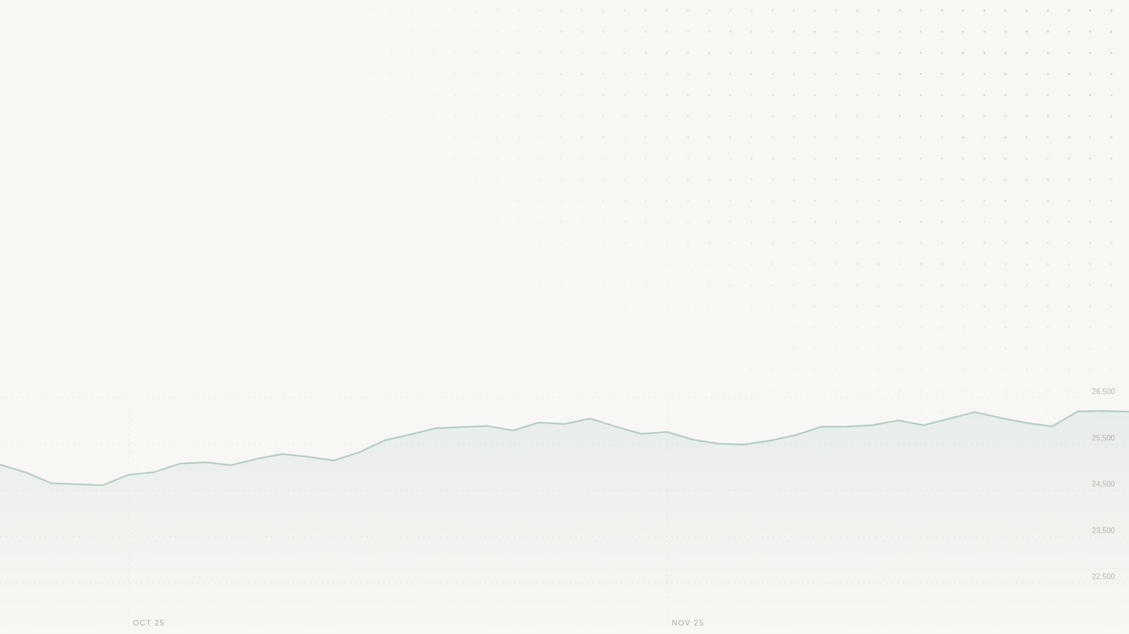
No. 07 TECHNOLOGIES USED: SOFTWARE AND HARDWARE
A small stack on free tiers.
SOFTWARE
LAYER
TECHNOLOGY
USED FOR
HARDWARE
Frontend
React 19.3 · TypeScript 7.0 · Vite 8.3 · CSS3
Nine-page interface, SVG charts, no UI library
Development
Ordinary laptops running Node.js 22 and Python 3.12. No special hardware.
Backend
Python 3.12 · FastAPI 0.156 · Uvicorn 0.54 · HTTPX 0.28
17 read-only routes, async data fetching
Research
Python Decimal · SQLite · SHA-256
Backtest, forecast, tamper-proof runs
Hosting
Vercel edge network for the web app. Render free instance for the API: 512 MB RAM, 0.1 CPU.
Data
Yahoo chart API · NSE website · Google News RSS · mfapi.in
Quotes, candles, IPOs, news, fund NAVs
AI, optional
Groq · Gemini · Grok · offline engine
Scenario text with the user's own key
Client
Any modern browser. Tested at phone, tablet and desktop widths, in light and dark themes.
Testing
Vitest · Playwright · axe-core · unittest
Front-end, browser, accessibility and backend tests
MarketLens
07 / 12
Notes:
SHREYA SHARMA · about 60 s
The technologies. The front end is React 19, TypeScript 7 and Vite 8, with plain CSS and charts drawn as SVG, so there is no UI or chart library. The back end is Python 3.12 with FastAPI, Uvicorn, and HTTPX for asynchronous fetching. The research core keeps money in Python's Decimal type, stores runs in SQLite and fingerprints them with SHA-256. The data comes from free public sources, the AI is optional, and we test with Vitest, Playwright, axe-core and Python's unittest. On the hardware side this is a software project: we built it on ordinary laptops with Node 22 and Python 3.12. The web app is served from Vercel's edge network, and the API runs on Render's free tier, with 512 megabytes of RAM and a tenth of a CPU. A user needs only a browser, on a phone or a desktop.

Slide 8
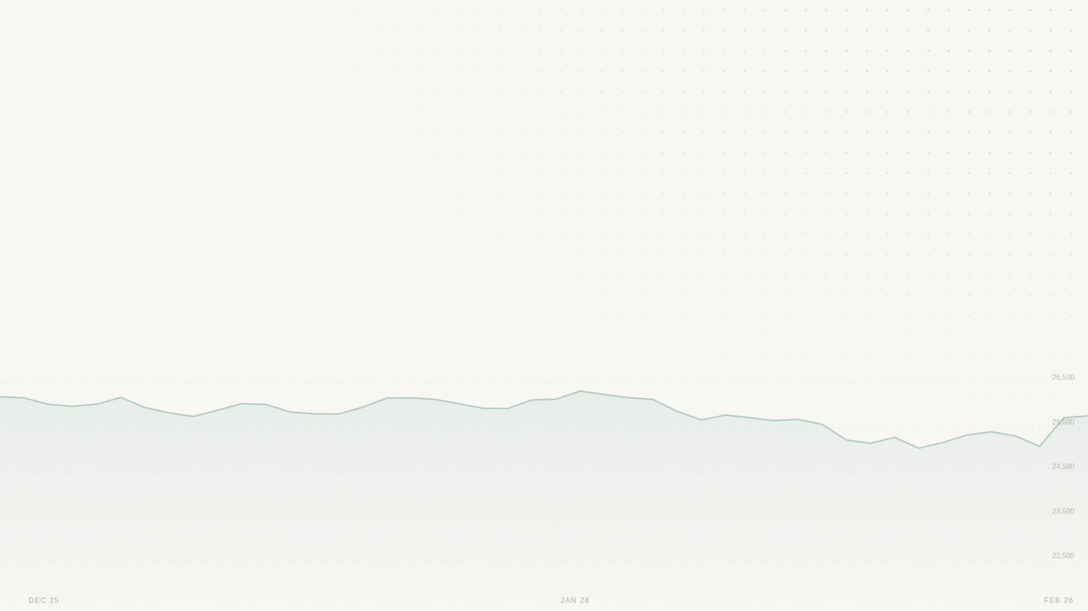
No. 08 METHODOLOGY / WORKING PROCESS
From a quote to an audited result, in five steps.
1
2
3
4
5
Ingest
Analyse
Model
Simulate
Account and audit
Quotes, candles, IPOs, NAVs and news from public sources, cached 10 s. Gaps flagged, never filled.
SMA 20 and 50, RSI 14, VWAP and volatility, computed from the stock's real daily bars.
Bull, base, bear and black-swan scenarios, plus 500 Monte Carlo paths over 30 days.
A paper order needs a live price and an open session. Intraday positions close at 3:15 PM.
Seven charges itemised per order. Research runs fingerprinted with SHA-256 and stored read-only.
gross − charges − slippage = net
Fills at the next bar's open: no look-ahead
Money in Decimal, rounded to the paisa
Data split 60 / 20 / 20 in time order
SQLite triggers refuse edits and deletes
Checked for every trade, for the whole run, and again by an independent validator.
MarketLens
08 / 12
Notes:
SHREYA SHARMA · about 65 s
Our working process has five steps. Ingest: pull quotes, candles, IPOs, fund NAVs and news, cache them for ten seconds, and flag any gap instead of filling it. Analyse: compute the 20 and 50 day moving averages, RSI 14, VWAP and volatility from the stock's real daily prices. Model: generate bull, base, bear and black-swan scenarios, and run 500 Monte Carlo paths over 30 days. Simulate: a paper order needs a live price and an open session, and intraday positions close at 3:15. Account and audit: every charge is itemised, and research runs are fingerprinted and stored read-only. Under all of it is one identity: gross, minus charges, minus slippage, equals net. It is checked for every trade, for the whole run, and again by an independent validator. The backtest fills at the next bar's open, so it never sees the future, and the data is split 60, 20, 20 in time order.
HAND-OFF: Krish will show you the implementation.

Slide 9

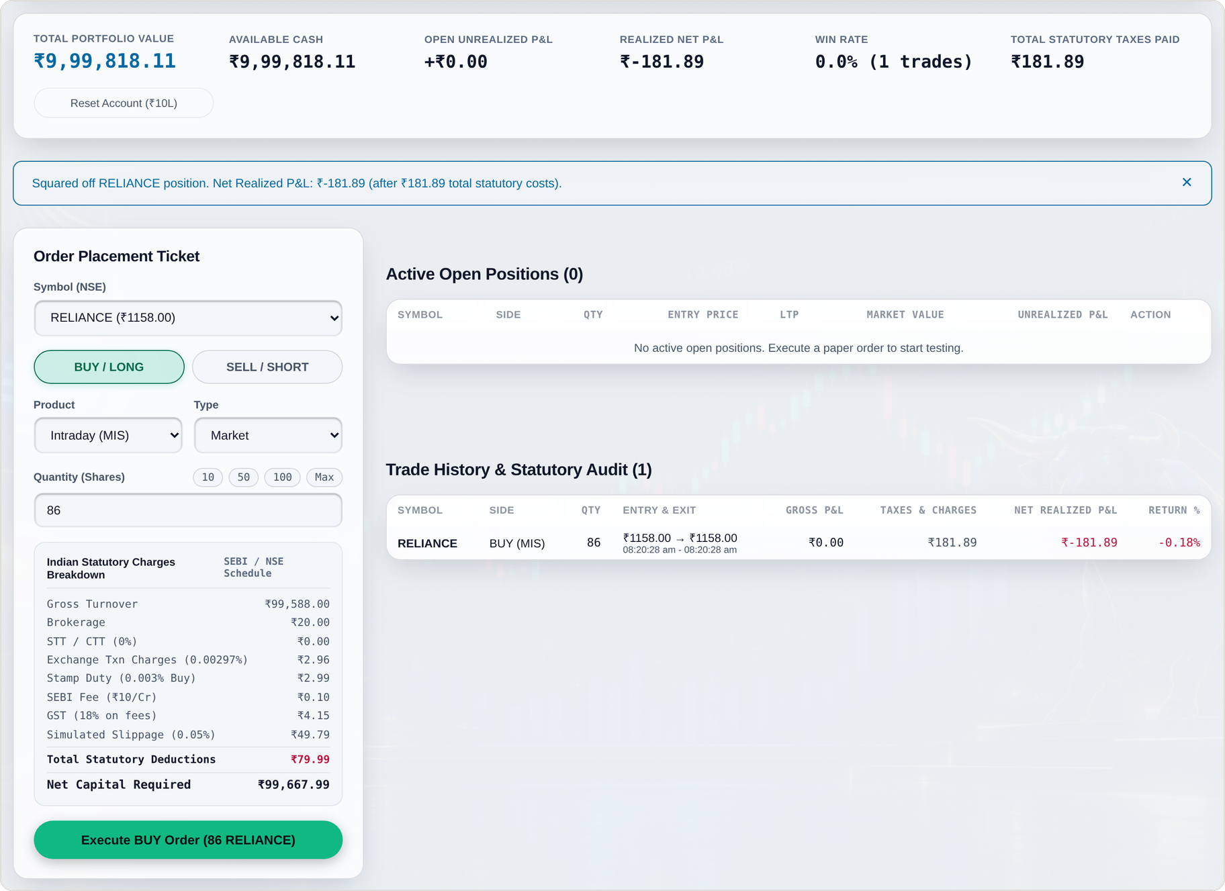
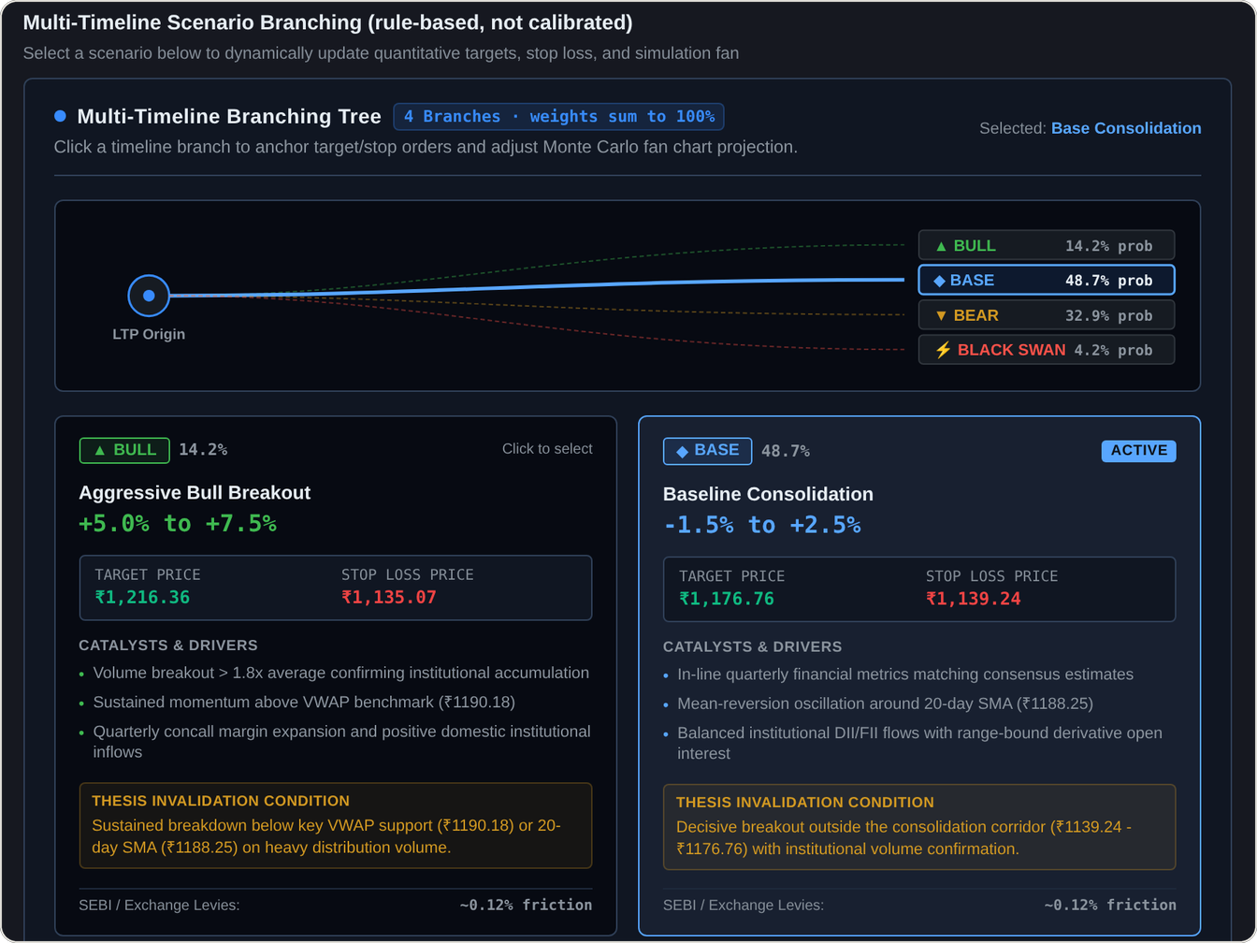
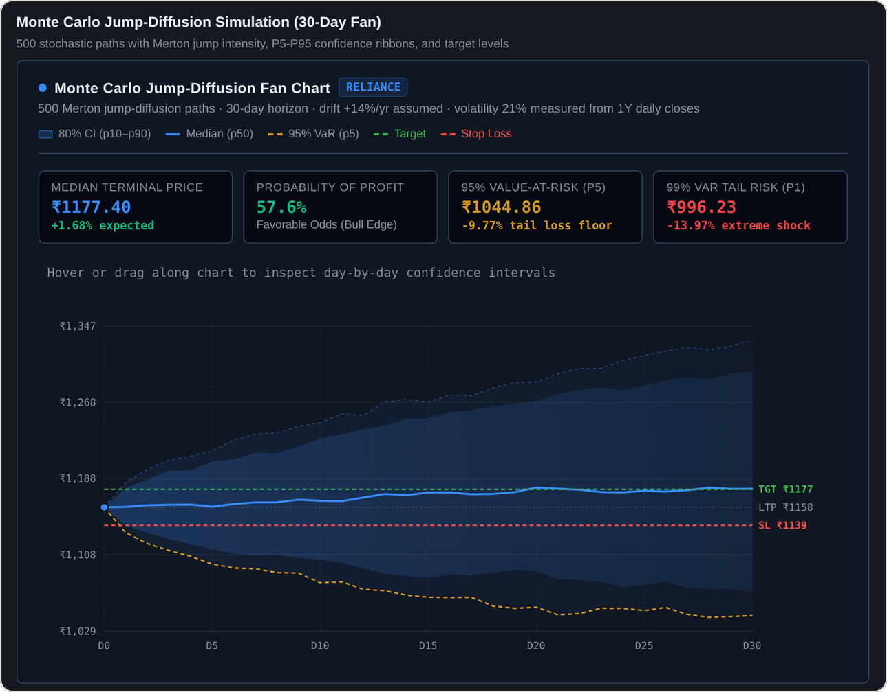
No. 09 IMPLEMENTATION / SCREENSHOTS
Built, deployed, and running on live data.
Fig. 3 AI Strategy Lab: four scenarios, each with a target, a stop and an invalidation condition.
Fig. 4 Monte Carlo fan: 500 paths over 30 days, value at risk at 95 and 99%.
THE CODE
web/
React front end: nine pages, 112 tests
backend/
FastAPI service and the research core, 107 tests
Fig. 2 Paper trading: 86 RELIANCE shares bought and sold at ₹1,158.00. Gross ₹0.00, net −₹181.89 after charges.
e2e/
Playwright tests against a fake upstream, 15 tests
deploy
Vercel (web) and Render (API) from one GitHub repo
MarketLens
09 / 12
Notes:
KRISH POTANWAR · about 65 s
This is the implementation, running on live data. On the left is the paper-trading terminal after one round trip. We bought and sold 86 shares of Reliance at the same price, 1,158 rupees. The gross profit is zero, but the trade lost 181 rupees 89 to charges. That is the 0.18 percent from earlier, now in the real app. On the right is the AI Strategy Lab. It builds four scenarios, each with a target, a stop and an invalidation condition, and the screen labels them rule-based, not calibrated. Next to it is the Monte Carlo fan chart: 500 jump-diffusion paths over 30 days, with value at risk at 95 and 99 percent. The code is one repository with a React front end, a FastAPI back end that holds the research core, and end-to-end tests that run against a fake upstream. It deploys to Vercel and Render.

Slide 10
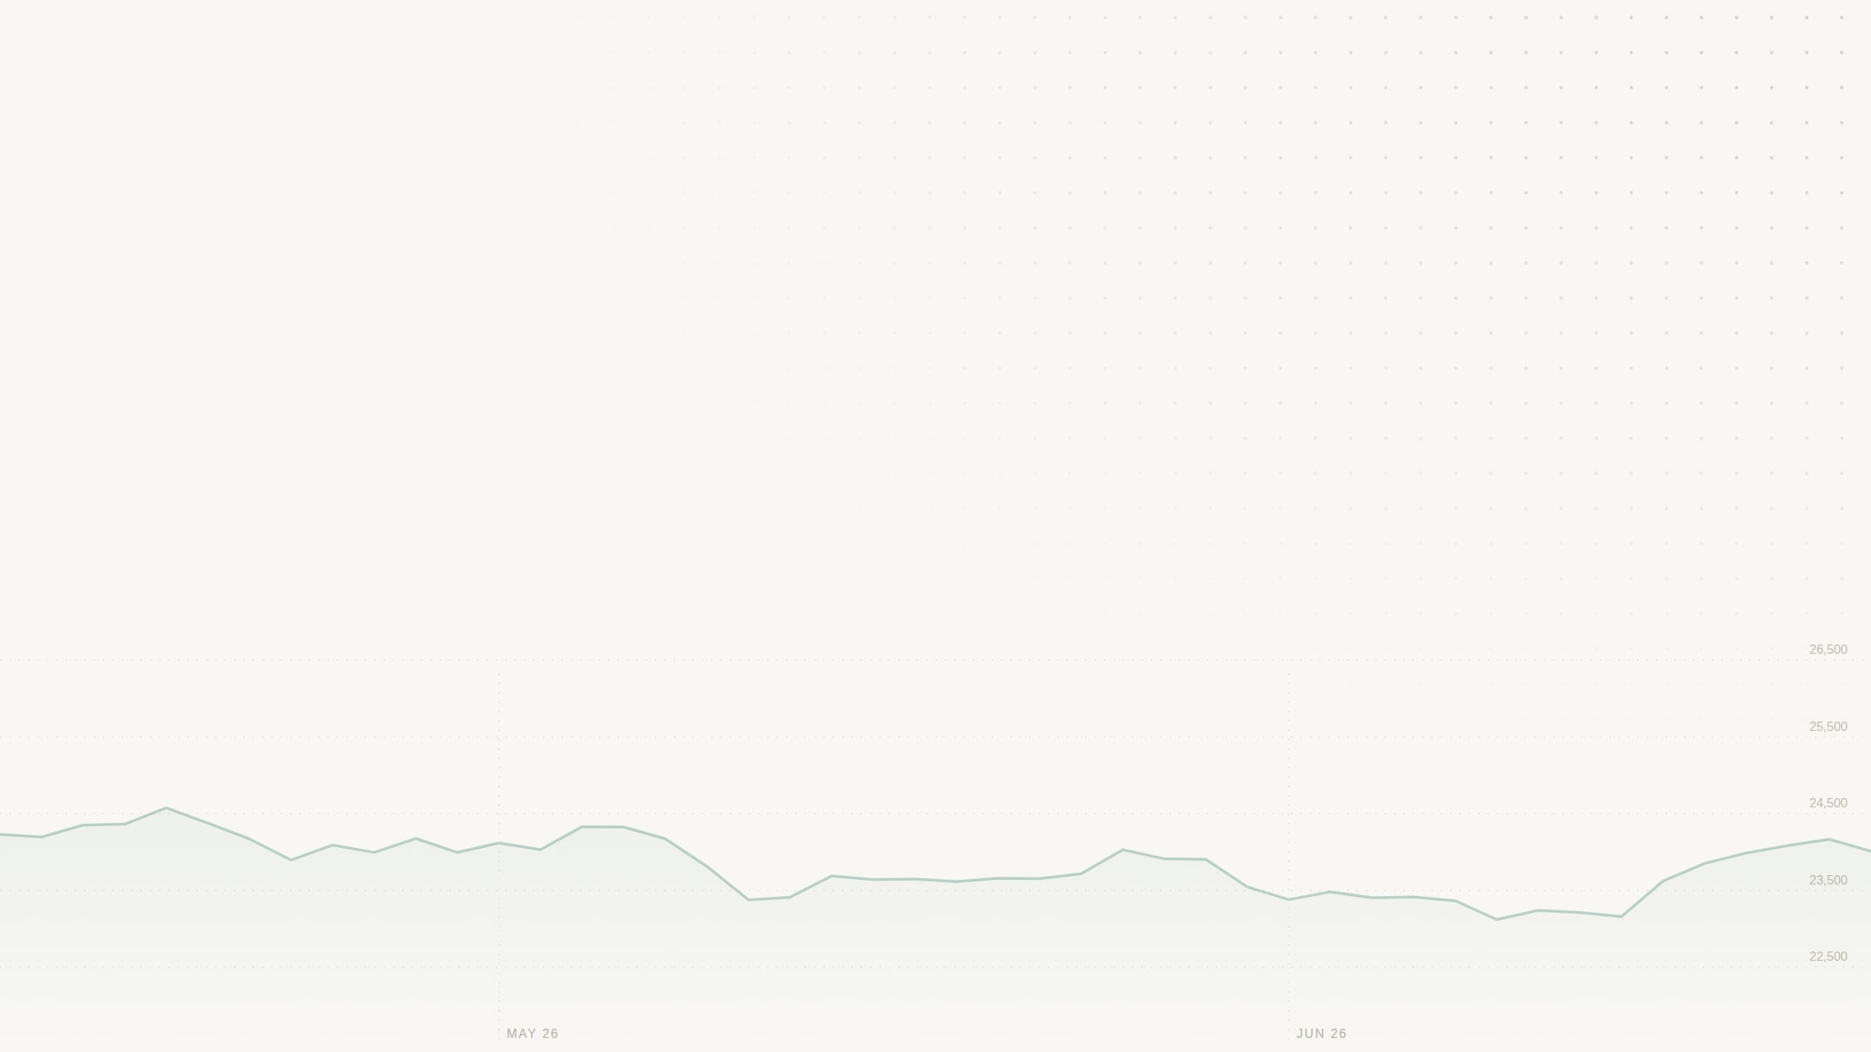
No. 10 RESULTS AND DISCUSSION
Honest numbers, including the unflattering ones.
COST OF A ₹1,00,000 ROUND TRIP
RESEARCH RUN, 224-BAR FIXTURE
TESTED LIKE A USER
₹182.44
0.537
138
0.18% of the trade, gone before any profit.
Brier score, against 0.334 for repeating the base rate. Lower is better.
browser checks on live data, 0 console errors.
Trades
0
Market feed switched off
124
Net profit
₹0.00
Backend not running
124
Buy and hold
−₹589.29
Browser tests, offline
15 / 15
Forecasts scored
69
Backend tests
107
No edge found, and the system says so.
Front-end tests
112
Serious accessibility issues
0
App check: an 86 RELIANCE round trip lost ₹181.89.
Discussion The user-style run caught what unit tests missed: a retired Tata Motors ticker, a −99% value at risk printed as rupees, and an unreadable light theme. Each is fixed and now has a test.
MarketLens
10 / 12
Notes:
KRISH POTANWAR · about 90 s
The results. First, cost. A one-lakh round trip costs 182 rupees 44. Slippage is the largest part at 100 rupees, then brokerage 40, STT 25, GST about 8, exchange fee about 6, stamp duty 3, and the SEBI fee 20 paise. Second, the research run on our 224-bar synthetic fixture. It made zero trades, so net profit is zero, while buy-and-hold lost 589 rupees. The forecast scored a Brier of 0.537, worse than the 0.334 you get by repeating the training base rate. So there is no edge, and the system reports that instead of hiding it. Third, quality. We drove the app in a real browser, the way a user would: 138 checks on live data with zero console errors, and 124 each with the market feed off and with no backend, and nothing invented a price. We also have 107 backend tests, 112 front-end tests, 15 browser tests that run offline, and no serious accessibility issues. That user-style run caught what unit tests missed: Tata Motors had no price because Yahoo retired its ticker, a value at risk of minus 99 percent was a percentage printed as rupees, and the light theme was unreadable. Each one is fixed and now has a test.

Slide 11
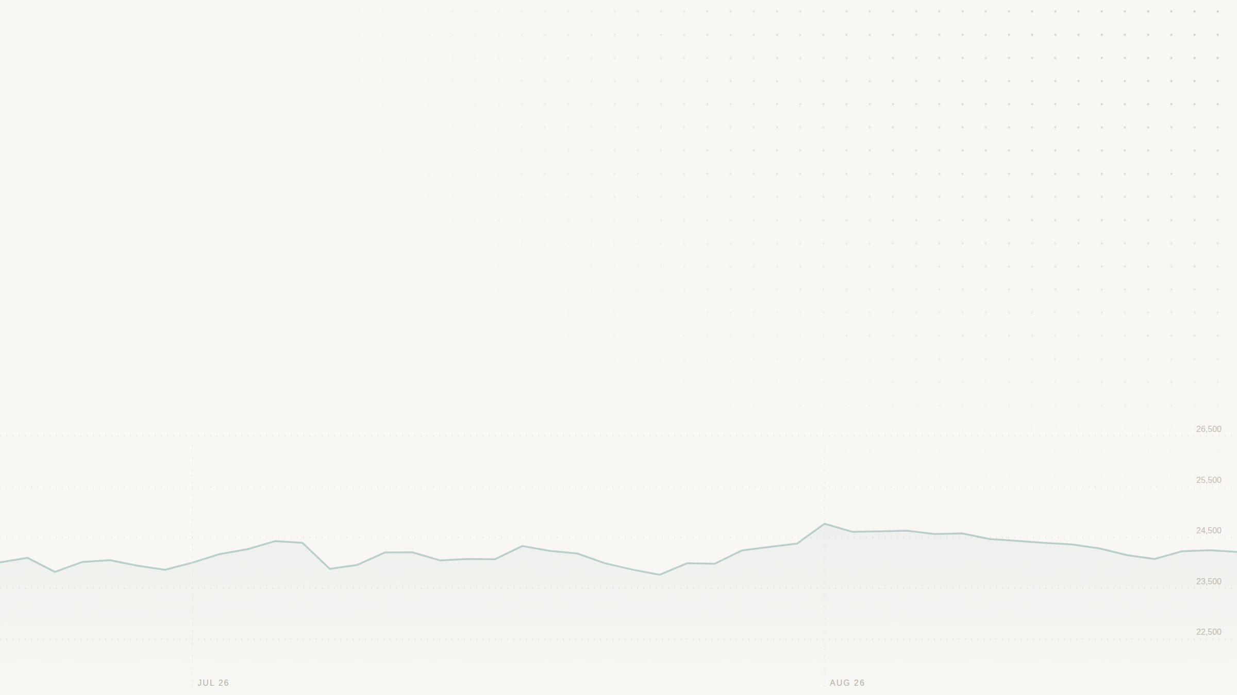
No. 11 ADVANTAGES AND APPLICATIONS
Built for learning what trading really costs.
ADVANTAGES
APPLICATIONS
01
Real costs
02
Real rules
Classrooms
Seven charges itemised on every order.
Indian sessions, holidays and the 3:15 PM square-off.
Teach trading costs and market rules on live data.
New investors
Practise intraday and delivery trades with virtual money.
03
Honest data
04
Auditable
Strategy research
A dash and a named source, never an invented price.
Fingerprinted, read-only runs anyone can re-check.
Test a rule on a reproducible backtest before trusting it.
Data analytics teaching
A full pipeline: ingest, clean, model, validate, visualise.
05
Free to run
06
Works anywhere
No paid data feed or key. The scenario engine works offline.
Phone to desktop, light and dark, no serious axe issues.
Fintech prototyping
A base for a research tool on a licensed broker feed.
MarketLens
11 / 12
Notes:
KRISH POTANWAR · about 45 s
The advantages follow from that. Real costs on every order. Real Indian market rules. Honest data, never an invented price. Research anyone can re-check. Free to run, with no paid feed or key. And it works on a phone or a desktop, in light and dark themes. As for applications: classrooms, to teach trading costs and market rules on live data. New investors, to practise with virtual money. Strategy research, to test a rule on a reproducible backtest before trusting it. Data analytics teaching, because it covers the full pipeline. And as a base for a research tool on a licensed broker feed.

Slide 12
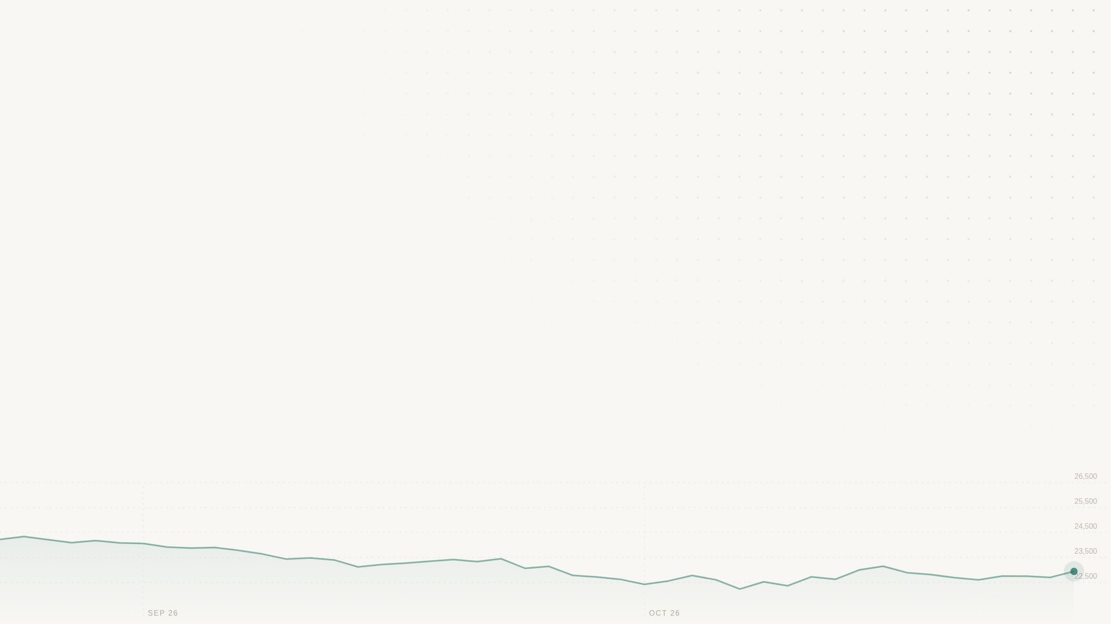
No. 12 CONCLUSION AND FUTURE SCOPE
A dashboard is only as good as the numbers behind it.
CONCLUSION
FUTURE SCOPE
MarketLens covers the whole DAV pipeline: ingest and clean live data, model and validate it, simulate risk with Monte Carlo, and visualise it in an interface people can use. Every number on screen is real, labelled as an assumption, or shown as a dash.
1
Browser tests in CI on every push
2
Rate limiting and stricter CORS on the API
3
A licensed broker data adapter
4
Fee schedule verified against NSE circulars
5
Backtests on real historical data
Thank you.
LIVE DEMO
market-lens-kappa.vercel.app
CODE
github.com/Krishpotanwar/MarketLens
TEAM
Shreya, Krish and Dhanashree
Questions are welcome.
MarketLens
Notes:
KRISH POTANWAR · about 45 s
To conclude. MarketLens covers the whole DAV pipeline: ingesting and cleaning live data, modelling and validating it, simulating risk with Monte Carlo, and visualising it in an interface people can use. Our biggest lesson is that a dashboard is only as good as the numbers behind it. For future scope, we want to run the browser tests in CI on every push, add rate limiting and stricter CORS, build a licensed broker data adapter, verify the fee schedule against NSE circulars, and run the backtest on real historical data. The live demo is at market-lens-kappa.vercel.app, and the code is on GitHub. Thank you. We are happy to take questions.
PRESENTER NOTE: Presenter only, do not read out: the Vercel site updates on every push, but the Render API redeploys on its own schedule and sleeps when idle (the first request can take up to a minute). Before a live demo, open /api/v1/market/status on the Render URL: it should name Yahoo Finance (unofficial), not Angel One SmartAPI.

