Slide 1
Droṇā with new era
Latest Edition V 1.O
Presented by
Droṇā Team

Slide 2
Drone era:
Now a days drones has changes a lot the things are much better and faster than before.
Most of countries they are using drones for emergency and in Disaster prone areas for supplying of medicines.
But in India we hard to get things done. Like delivery boys are more and transports also more but still it is not important to us.
But at this Coronavirus situation we have to use drones to supply the food items and medicines.
We are developing the fast and Disaster drones now it change a future in India.
Like getting the things from any store to door steps.
In coronavirus we can’t go out for every time just sit home give commands through app and send the list and location to drone it automatically take things to your door steps.

Slide 3
Abstract
The usage of drones in the lockdown period is to monitor the movement of people int the town during the lockdown period. another main reason is to sanitize the infected area's way and supply drones and first priority is to deliver and supply is to provide medicines and food to needy people. the main reason to making drones in Maharashtra is to announce the policy measures of COVID -19 in the infected areas and to identify the temperature people. Then we are here using the solar panel and for battery backup with solar cells and its satellite control drone and AI camera detection of COVID patients. In a paper published in the Proceedings of the ACM on Interactive, Mobile, Wearable and Ubiquitous Technologies as a "contactless syndromic surveillance platform" that "aims to expand the current paradigm of influenza-like illness (ILI) surveillance by capturing crowd-level bio-clinical signals directly related to physical symptoms of ILI from hospital waiting areas in an unobtrusive and privacy-sensitive manner."

Slide 4
Drone history
1907: The world’s first quadcopter was created by inventor brothers Jacques and Louis Bréguet.
1917: Launched only 16 years after the Wright Brothers’ pioneering Kitty Hawk flight.
1943: Created for use by the German military during World War II, “Fritz X” was the nickname given to the FX-1400.
2001: In the aftermath of 9/11, the CIA began flying armed drones over Afghanistan as part of the war against the Taliban.
2010: The French company Parrot released their Parrot AR Drone, the first ready-to-fly drone which can be controlled entirely via Wi-Fi, using a smartphone.
2013: In December 2013, Amazon released a concept video showcasing founder Jeff Bezos’ dream for a drone-based delivery system.
2015: The consumer drone industry has gone from strength to strength. However, not everything has been good. Perhaps the biggest disappointment — and one which still leaves a bitter taste in some people’s mouths — was the Lily Camera drone disaster.
2016: Already one of the best drone makers on the marketplace, DJI’s Phantom 4 introduced smart computer vision and machine learning technology.

Slide 5
fig: Literature survey of Drones in world

Slide 6
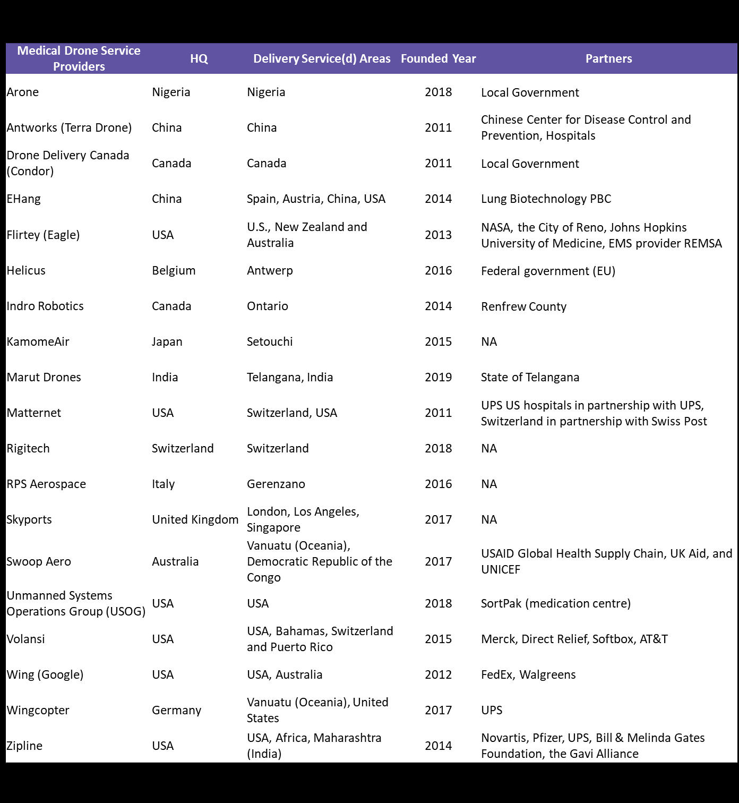

Slide 7
Drone in Medical world
In world Drone already delivering food and medical suppliers.
Drone is delivering of vaccine and medication and supplies to sources could quash outbreaks of life-threatening communicable diseases.
Drones help provide more efficient healthcare to patients from a distance or while mobile.
Transporting Blood and Other Supplies.
Hospital Deliveries.
Delivering Care in Rwanda.
Zipline has been developing the UAS, known as Zips.
Hospital Deliveries.

Slide 8
Developing Drones in new era
From 1970 – 2019 drones has used in various operations, but still they are some more requirement to the world.
We are developing a drone with AI camera and more faster than other drones.
Now-a-days AI has came to existence in every life, Why not in drones ?
We can make more powerful than with other drones.
DJI is NO.1 company drone making they introduced AI drones.
But we are making an App for Drones.
It is Disaster relief response Drones, any one can send a message to that drone with in a minutes of time it will be there at location.
In medical emergency also it works more speed.
It can get testing samples from patients or persons.

Slide 9
Drone specification.
Here is a comparison in Drones and Birds.
In Drones and Birds will show target Low RCS and causes a confusion in surveillance against non-corporative drones.
They argued that gliding birds and plastic-rotor UAVs are characterized by insigniﬁcant micro Doppler signature (MDS) and poor RCS modulation.
CLASSIFICATION OF DRONES vs. DRONES
They trained a linear and a non-linear SVM as well as a Naive Bayes classiﬁer. Data were collected using a CW radar by ﬂying eleven objects(two ﬁxed-wing, three helicopters, one quad-rotor, an artiﬁcial bird, and four stationary rotors) for 30 seconds each.

Slide 10
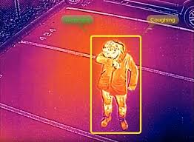
Why we here?
We are coming with solution with Multiple Drone-Cell Deployment Analyses and Optimization in Drone Assisted Radio Access Networks.
And another solution is Machine Learning-Based Drone Detection and Classification: State-of-the-Art in Research.
Design and Implementation of On-board Hybrid Generator for Rotary Wing Drone.
We design side rotated wings which can move fast.
We are developing faster object detection with drone.
Drones work in the Rescue Operations also.

Slide 11
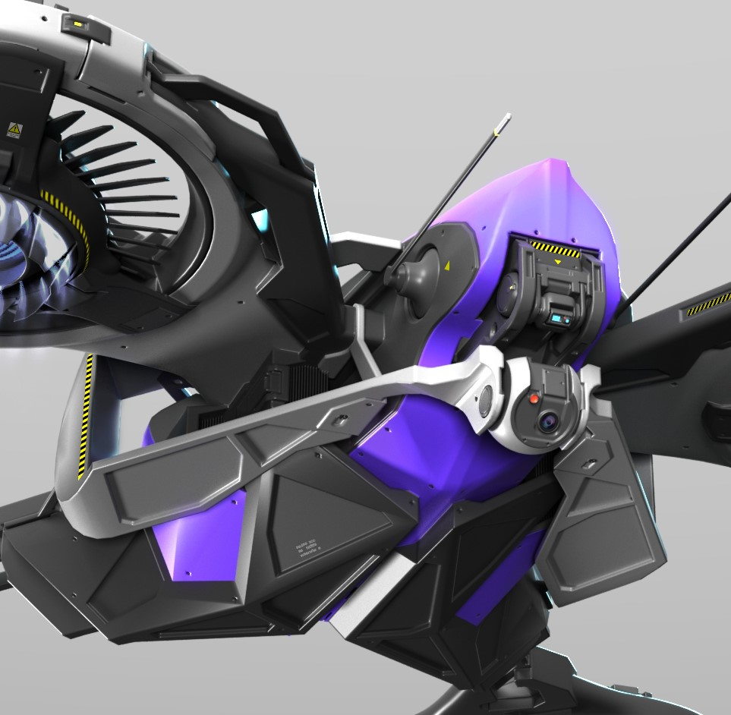
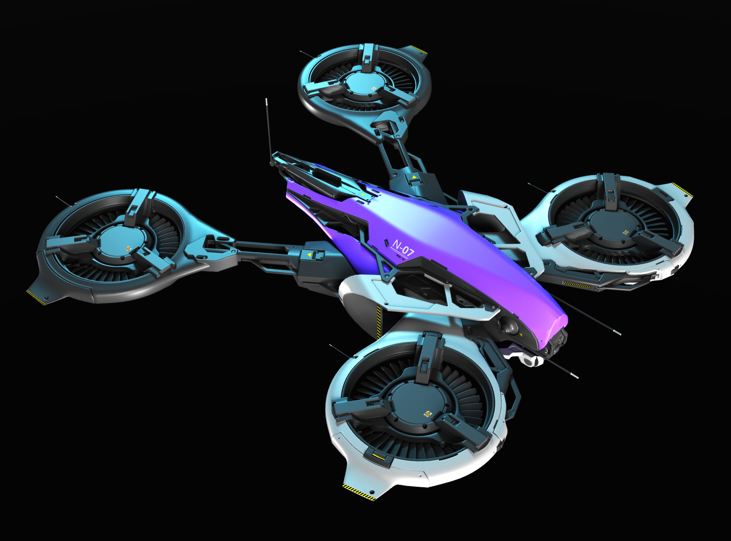
3D MODEL OF DRONES

Slide 12
Conclusion:
The use of drones for medical purposes brings many advantages, such as quick help, shortening the time of traveling to the patient, reduction of complications in the injured owing to a short time to wait for rescue, support and improvement of basic operations of medical emergency teams, and the opportunity to reach places inaccessible for basic means of medical transport.
Maintaining the integrity of specimens during delivery – Temperature control – The need for special equipment (packaging)
• Payload capacity
• Battery life
• Security for controlled substances
• Regulations; Federal, state and local (All must agree on operational procedures.)
• Consumer Demand

Slide 13
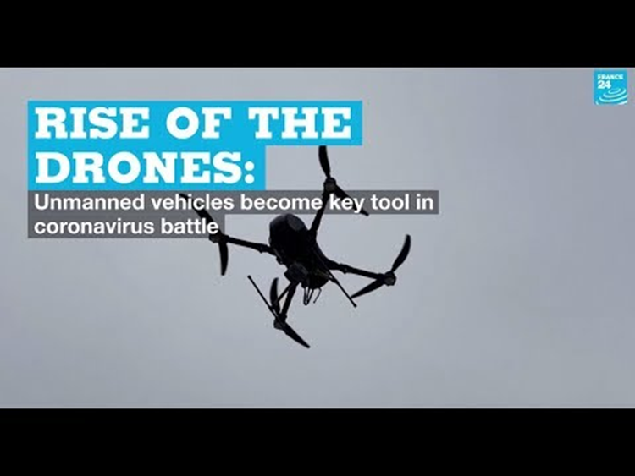
Drone Era in Medical field

Slide 14


