Slide 1
MyFirstMicrogame
By: Krishiv Bhalani

Slide 2
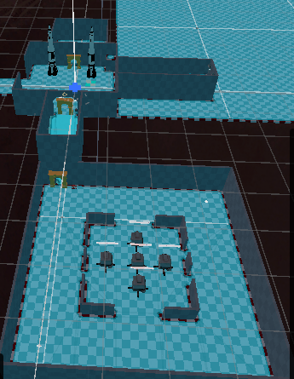
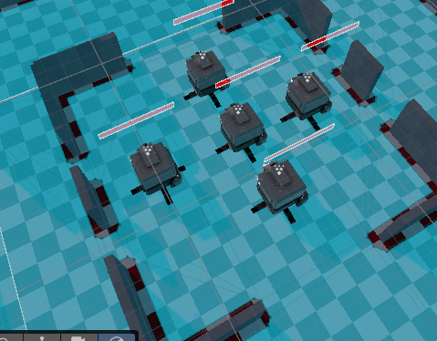
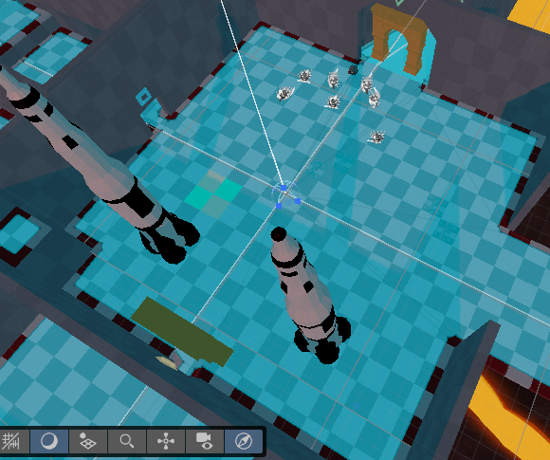
Screenshots

Slide 3
Custumization
I added these door frames that look like some roman pillars to the entrances I also added many more enemy turrets so I can make the game more challenging. I also added some rocketships because I felt it looked very nice with the games asthetic.

Slide 4
Reflection
Overall I found this assignment very challenging, due to the unity layout it was very messy and hard to find what the tutorials were saying and it was very hard to move inside of your game while trying to view it. I don’t feel anything went well in this assignment and moving forward I will try to ask for my help in these particular assignments. I would rate my experience with this project a 3/10.

