Slide 1
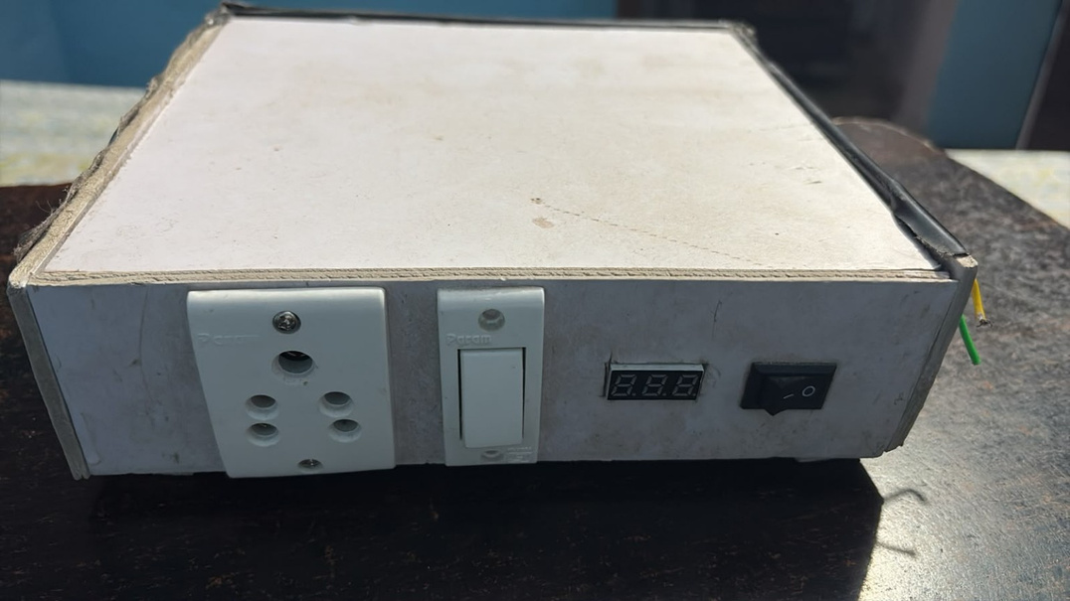
MINI
INVERTER
A compact system that converts battery power into AC power – with logic gates
Presented by:
Chandra shekhar singh - 202510101150154
Raunak jaiswal - 202510101150164
Krish soni - 202510101150177
Sameer pal - 202510101150152
Abhishek singh - 202510101150166
Shashikant Singh - 202510101150163
Abhinav yadav - 202510101150137
Our mini inverter prototype
Course :
Btech cse (ds+ai)
Submitted to :
MR Prabhat srivastava
Group :
35 - 36
Subject :
Digital Electronics (UEC3001)

Slide 2
INTRODUCTION
What is a Mini Inverter?
A mini inverter is a compact power-conversion device. It takes DC electricity from a battery and converts it into AC electricity for suitable appliances.
DC INPUT
CONVERSION
AC OUTPUT
The battery stores electrical energy as direct current (DC).
Logic-gate oscillator and switching circuit switch and transform the electrical energy.
The output socket can supply AC to a compatible load, if the design is rated for it.
Main idea: Battery (DC) → Logic gates + inverter circuit → AC output

Slide 3

Prototype Overview
Our Mini Inverter – Front View
OUTPUT SOCKET
Connection point for a compatible AC load.
ON / OFF SWITCH
Used to switch the unit on or off.
DIGITAL DISPLAY
Likely a voltage/status display; exact reading depends on its wiring.
The white switch beside the socket may be a separate control. Confirm its function from the circuit wiring.

Slide 4
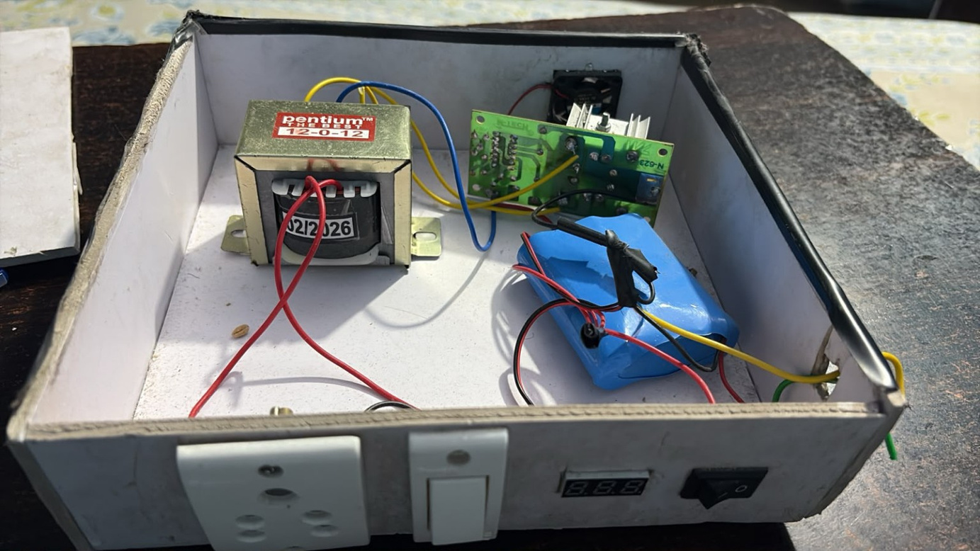
Main visible parts
Inside the Prototype
12-0-12 TRANSFORMER
Label suggests a 12-0-12 winding.
BATTERY PACK
Stores energy, gives the DC supply.
CONTROL PCB
Logic-gate/switching control components.
COOLING FAN
Helps remove heat from electronics.

Slide 5
Energy flow
Basic Working Principle
BATTERY
LOGIC GATES
SWITCHING
TRANSFORMER
AC OUTPUT
DC supply
Oscillator (square wave)
MOSFET / driver
Voltage conversion
Socket / load
The battery provides DC. Logic gates generate a square-wave signal that rapidly switches this power to create an alternating waveform. The transformer then adjusts the voltage before it reaches the output.
Note: This is a simplified block diagram. The exact circuit sequence depends on the PCB design.

Slide 6
Component details
Function of Each Component
Battery
Transformer
PCB / Logic gates
Provides stored DC energy to run the inverter.
Transfers energy between windings and can step voltage up or down.
Gates create the clock signal and control the switching that produces AC from DC.
Output socket
Switch & display
Cooling fan
Allows a suitable appliance to be connected.
Provide user control and a visual indication (function to be verified).
Moves air to help prevent overheating.

Slide 7
Digital Electronics link
Role of Logic Gates in the Inverter
An inverter needs a precise ON/OFF (digital) signal to switch the battery current. Logic gates produce and control that signal.
1. Oscillator (clock)
2. Complementary signals
NOT / NAND gates with a resistor and capacitor form an astable oscillator that makes a ~50 Hz square wave.
A NOT gate gives the opposite signal (Q and Q'), so the two MOSFETs switch alternately.
3. Enable / control
4. Alarm / protection
AND logic: output runs only when the switch is ON and the battery level is OK.
OR logic: low battery OR overload OR over-temperature can trigger a warning or cut-off.
Note: Standard gate-based design shown. Confirm the exact IC number printed on our PCB.

Slide 8
Logic gate basics
Basic Logic Gates and Truth Tables
NOT
AND
OR
NAND
Y = A'
Y = A · B
Y = A + B
Y = (A · B)'
A | Y
0 | 1
1 | 0
A | B | Y
0 | 0 | 0
0 | 1 | 0
1 | 0 | 0
1 | 1 | 1
A | B | Y
0 | 0 | 0
0 | 1 | 1
1 | 0 | 1
1 | 1 | 1
A | B | Y
0 | 0 | 1
0 | 1 | 1
1 | 0 | 1
1 | 1 | 0
Inverts the signal
HIGH only if both HIGH
HIGH if any is HIGH
Opposite of AND
0 = LOW (0 V) | 1 = HIGH (supply voltage)

Slide 9
How gates make AC
Logic Gates → Switching → AC
GATE OSCILLATOR
SQUARE WAVE
NOT GATE
MOSFETS
TRANSFORMER
NAND/NOT + RC
~50 Hz clock
Q and Q'
Switch alternately
12-0-12 → AC
Q HIGH: current flows in one half of the 12-0-12 winding.
Q' HIGH: current flows in the other half, in the opposite direction.
Direction keeps reversing, which gives AC at the output.
Q → MOSFET 1
Q' → MOSFET 2
Opposite signals: when one MOSFET is ON, the other is OFF.
Note: Typical push-pull design. Exact ICs and frequency should be confirmed on our PCB.

Slide 10
Applications of logic gates
Logic Gates Used in Our Project
Gate | Use in mini inverter | Example
NOT | Inverts the clock to drive the second MOSFET | Q → Q'
NAND / NOR | Builds the oscillator (astable multivibrator) with R and C | ~50 Hz square wave
AND | Enable logic: run only when all conditions are OK | Switch ON AND battery OK
OR | Combines fault signals into one alarm / cut-off | Low battery OR overload
Flip-flop / counter | Divides a fast clock down to the output frequency | Clock ÷ 2
Tick the gates/ICs that are actually on our PCB before presenting.

Slide 11
Where can it be useful?
Applications & Advantages
Possible applications
Advantages
Small backup loads such as a suitable LED light, router, or other low-power device – only if the inverter rating supports it.
Compact size • Portable design • Demonstrates DC-to-AC conversion • Shows real use of logic gates • Useful learning project
A mini inverter is useful for understanding:
POWER CONVERSION
How electrical energy changes from DC to AC.
LOGIC GATES
How digital gates create the switching signal.
BASIC ELECTRONICS
How a PCB, transformer and battery work together.
PRACTICAL DESIGN
Why cooling, insulation and correct ratings matter.

Slide 12
Use Responsibly
Safety & Important Limitations
Mains-voltage danger
Do not overload
The output may be hazardous even though the battery is low voltage. Never touch exposed wires or terminals.
Connect only loads within the verified power rating. Overloading can overheat or damage the unit.
Battery precautions
Enclosure & ventilation
Use the correct battery voltage and chemistry. Prevent short circuits and use suitable protection.
Keep wiring insulated, secure the enclosure, and do not block the cooling fan.
Important: The photos do not show the full ratings or protection circuit. Do not assume the output is 230 V or connect household appliances until a qualified person verifies the design and tests it safely.

Slide 13
Summary
Conclusion
This mini inverter prototype demonstrates the basic idea of converting battery DC power into AC power using logic-gate-based electronic switching and a transformer.
INPUT
PROCESS
OUTPUT
Battery – DC energy
Logic gates + PCB + transformer
AC at the socket
Thank you! | Any questions?

