Slide 1
IBM BOB AI HACKATHON
YIELD
HUNTERS
Wafer Lot Yield Intelligence Platform
AI-powered monitoring • driver analysis • planned-lot risk simulation
AI TRACK
From production data → actionable yield intelligence
01

Slide 2
THE CHALLENGE
Semiconductor yield problems are expensive to investigate
The gap is not just data availability — it is turning data into decisions quickly.
01
LOW-YIELD LOTS
02
COMPLEX PROCESS DATA
03
SLOW INVESTIGATION
Yield excursions can be missed until they become costly production issues.
Temperature, pressure, power, gas flow and defect data create a high-dimensional problem.
Teams may need several disconnected analyses to identify likely drivers and evaluate planned conditions.
CORE QUESTION
How can an engineer move from “something looks wrong” to “here is what to investigate next” in one workflow?
YIELD HUNTERS • Wafer Lot Yield Intelligence Platform
02

Slide 3
OUR SOLUTION
One workflow: monitor → detect → analyze → simulate
Yield Hunters brings lot-level analytics into a single interactive dashboard.
01
02
03
04
LOAD
MONITOR
ANALYZE
SIMULATE
→
→
→
Upload lot-level CSV or use the demo dataset.
Track yield, defects and SPC behavior.
Rank influential process factors and inspect die patterns.
Evaluate planned recipe conditions against historical behavior.
Decision-support loop
See the excursion → focus the investigation → inspect spatial evidence → test the next lot
YIELD HUNTERS • Wafer Lot Yield Intelligence Platform
03

Slide 4
SYSTEM ARCHITECTURE
From raw lot data to decision-ready insight
A lightweight Python analytics stack powers an interactive Streamlit experience.
DATA INPUT
PREPROCESSING
ANALYTICS
VISUALIZATION
EXPERIENCE
CSV / Demo Data
Pandas + NumPy
Statistics + ML
Plotly
Streamlit Dashboard
→
→
→
→
Lot yield, process parameters, defect information
Validation, transformation and feature preparation
SPC, distributions, Random Forest driver ranking
Interactive charts and spatial wafer inspection
One interface for monitoring and simulation
Technology stack
Python • Streamlit • Pandas • NumPy • Plotly • Scikit-learn • SciPy • Statsmodels
YIELD HUNTERS • Wafer Lot Yield Intelligence Platform
04

Slide 5
KEY CAPABILITIES
Five capabilities, one investigation workflow
Designed around the questions an engineer needs to answer.
Yield & Defect Analytics
SPC Monitoring
Driver Analysis
What is the current yield picture?
Is process behavior changing?
Which factors deserve attention?
KPIs • distribution • excursion detection
Run chart • control limits • rolling mean
Random Forest feature importance ranking
Wafer Die Map
Lot Risk Simulator
Where are defects concentrated?
What if we run this recipe?
Spatial pass/defect inspection
Planned setpoints vs historical baseline
YIELD HUNTERS • Wafer Lot Yield Intelligence Platform
05

Slide 6
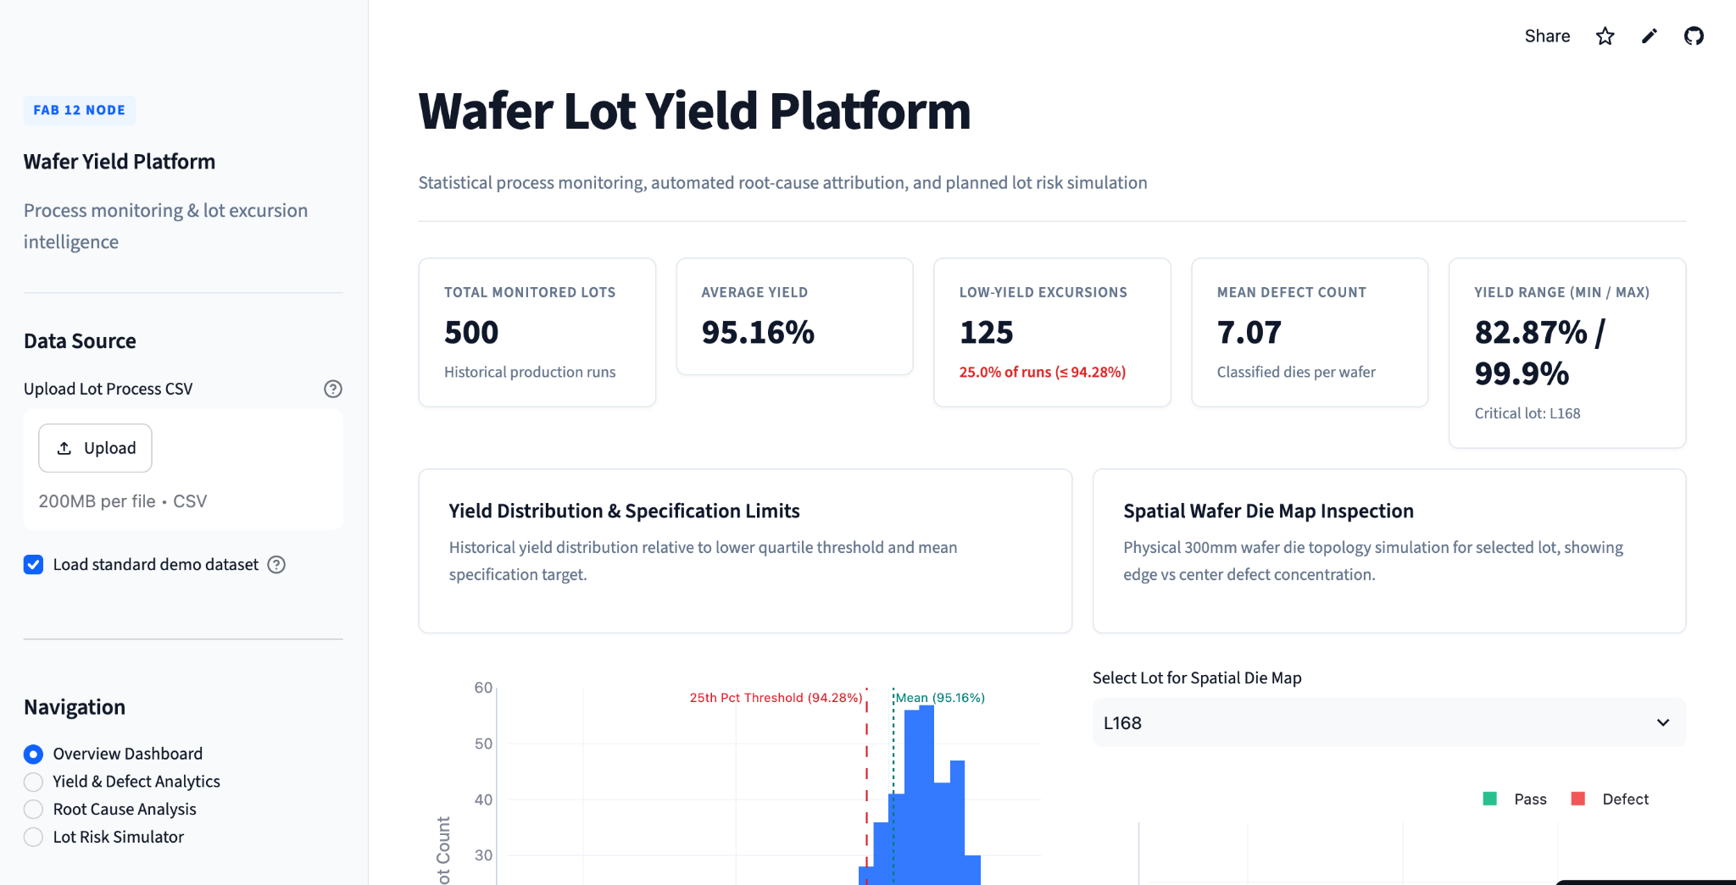
PRODUCT DEMO
Live dashboard: the operational overview
A single screen surfaces lot volume, average yield, excursions, defects and spatial evidence.
MONITOR
Start with the health of the lot population, then drill into the outliers.
YIELD HUNTERS • Wafer Lot Yield Intelligence Platform
06

Slide 7
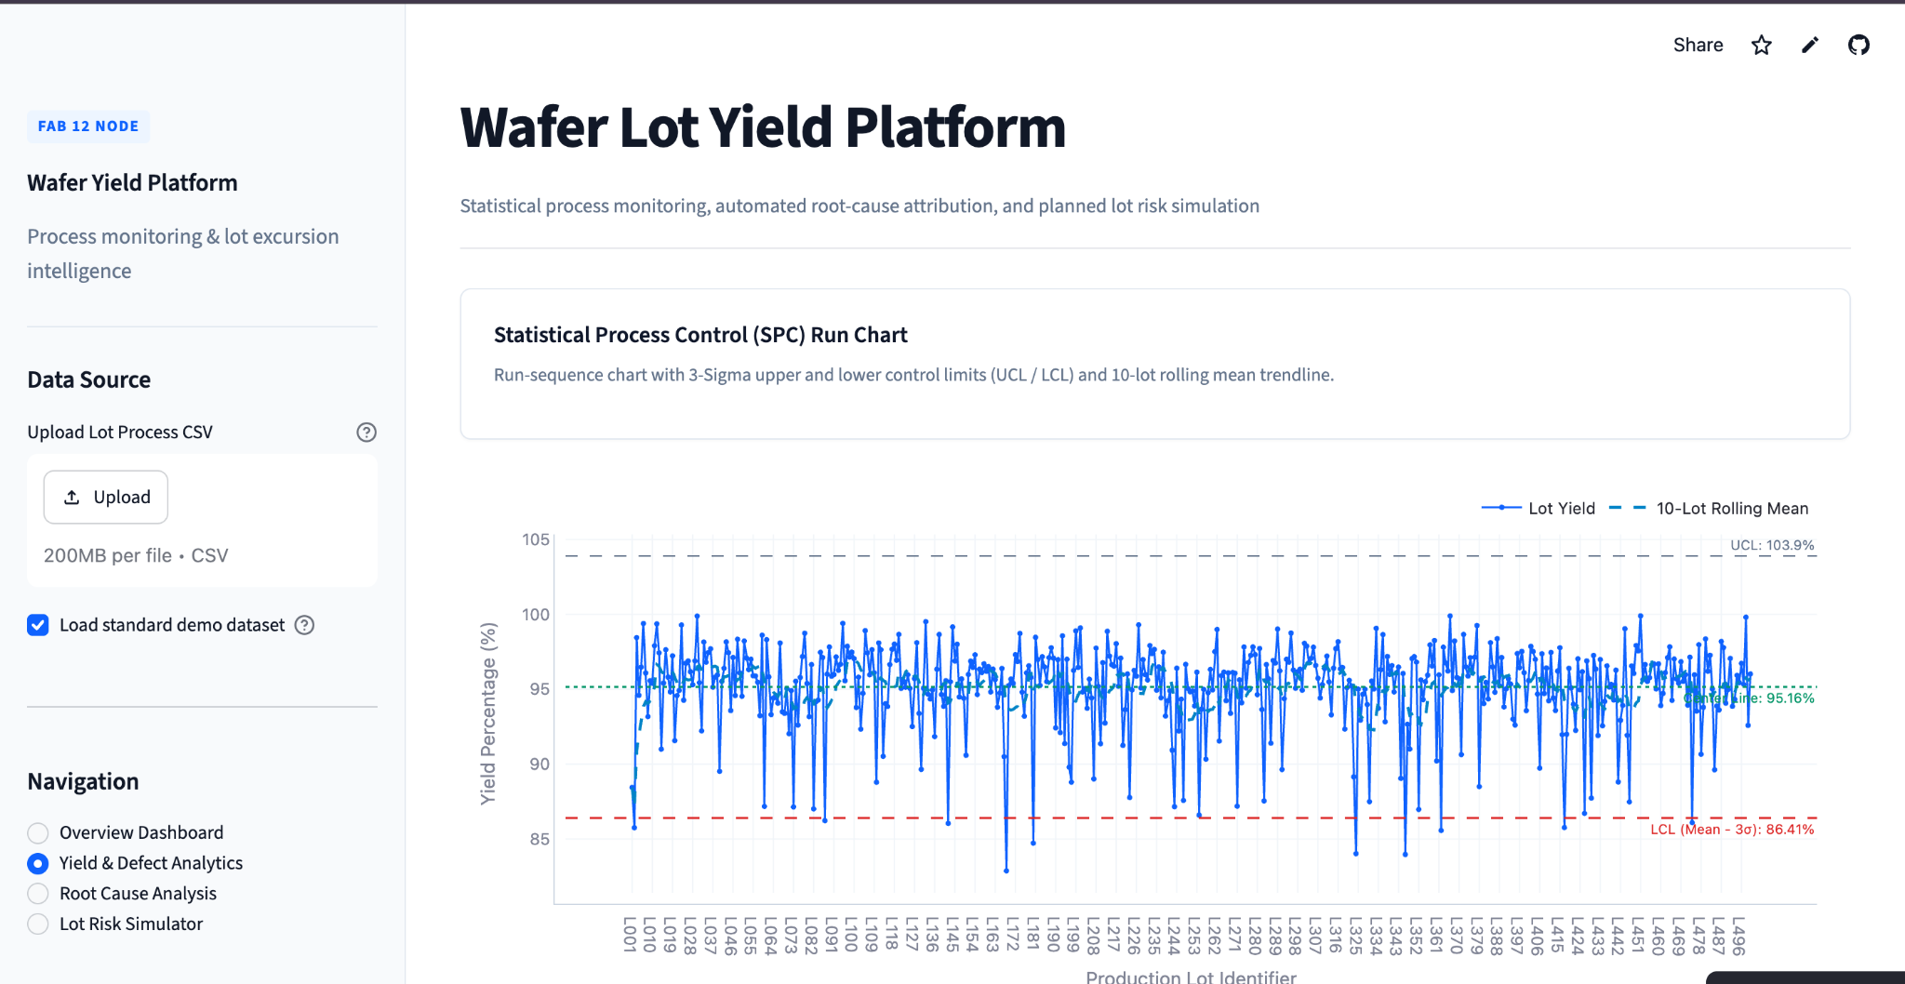
PRODUCT DEMO
Yield & defect analytics: detect excursions early
SPC-style monitoring turns a long lot history into a visual signal for process variation.
DETECT
Control limits and thresholds make unusual yield behavior easier to spot and prioritize.
YIELD HUNTERS • Wafer Lot Yield Intelligence Platform
07

Slide 8
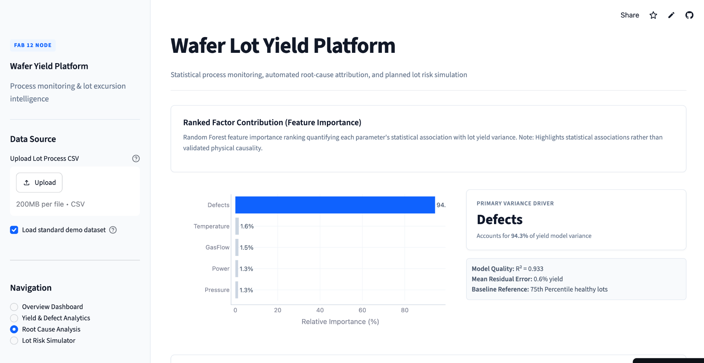
PRODUCT DEMO
Driver analysis: focus the investigation
Feature importance ranks process variables that are most useful for predicting yield in the available data.
ANALYZE
Use ranked drivers to guide engineering review — not as a substitute for process validation.
YIELD HUNTERS • Wafer Lot Yield Intelligence Platform
08

Slide 9
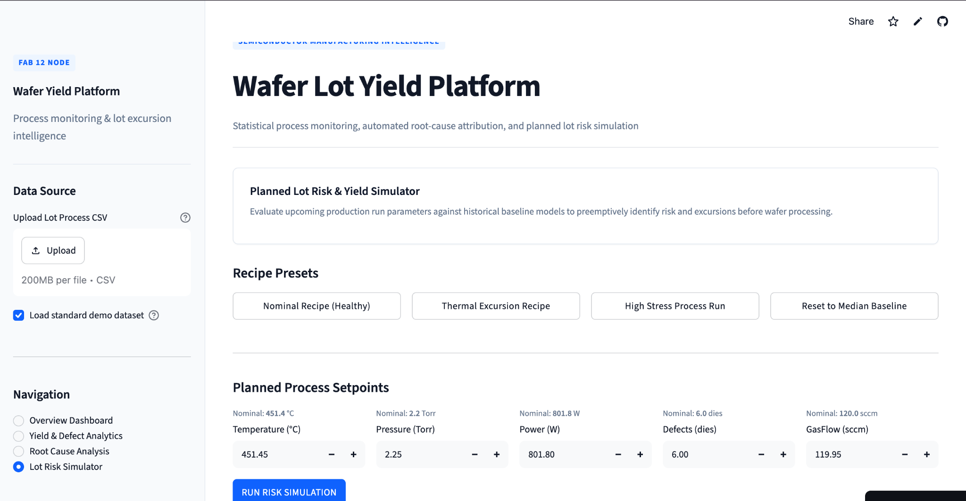
PRODUCT DEMO
Lot risk simulator: test planned conditions before processing
Compare planned setpoints with historical behavior to flag potential risk before a lot is run.
SIMULATE
Shift the workflow from reactive analysis toward proactive recipe evaluation.
YIELD HUNTERS • Wafer Lot Yield Intelligence Platform
09

Slide 10
VALUE
What Yield Hunters changes for the engineering workflow
The prototype is built to reduce analysis friction and improve investigation focus.
FASTER DETECTION
Surface low-yield behavior and excursions without manually stitching together multiple views.
FOCUSED INVESTIGATION
Rank candidate drivers so engineers can prioritize what to examine first.
SPATIAL VISIBILITY
Use wafer die maps to see whether defects cluster by location.
PROACTIVE THINKING
Evaluate planned process conditions against historical baseline behavior.
Current scope
Functional prototype using demo / historical lot data with an interactive web dashboard.
YIELD HUNTERS • Wafer Lot Yield Intelligence Platform
10

Slide 11
NEXT STEP
Prototype today. Production integration tomorrow.
A clear path from hackathon proof-of-concept to an engineering-ready platform.
NOW
NEXT
LATER
Functional prototype
Production integration
Closed-loop intelligence
→
→
Interactive dashboard, lot analytics, SPC, driver ranking and risk simulation.
MES / database connectivity, model validation, authentication and alerts.
Continuous monitoring, stronger model governance and deployment hardening.
YIELD HUNTERS
Turn wafer data into the next engineering decision.
THANK YOU
Questions & Demo
11

