Slide 1

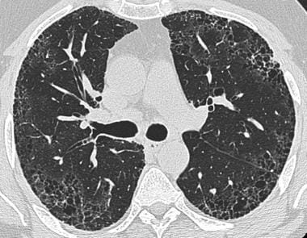
What is Pulmonary Fibrosis?
Pulmonary fibrosis is a lung disease that occurs when lung tissue becomes damaged and scarred
Patients diagnosed with pulmonary fibrosis experience symptoms like shortness of breath and as the condition progresses, overall lung function of the patient declines.
Problem and Motivation
Problem:
wide variation in how the disease progresses in each patient
Unpredictability in rate of decline – Leads to anxiety for patients and causes problems in treatment planning
Need to Solve – Why predict lung function decline ?:
It would significantly aid patients and doctors to make much more informed medical decisions and build better treatment strategies
Understanding prognosis would help in managing the disease better

Slide 2
Literature Survey:
Sampurna Mandal et al. has used three models, they have shown the comparisons among various ML (Machine learning) models' performance to analyse disease Progression. Among Quantile Regression, Ridge Regression and ElasticNet reported that the ElasticNet model has given the best results
Alexander Wong et al. proposes a new neural network named Fibrosis-Net to predict FVC, they claim that their model has explainability driven performance as it was able to exhibit correct decision-making behavior by leveraging clinically-relevant visual indicators in CT images when making predictions on pulmonary fibrosis progress
Anju Yadav et al. uses the honey combing pattern in the lung images to study the lungs and used their own Neural network called FVC-Net to predict the FVC, they applied image processing (edge detection) techniques to calculate the degree of honey combing and edge detection which can tell about the lung deterioration and subsequently to predict FVC

Slide 3
Data Description:
The data provided is collected in a longitudinal study
Two kinds of Data were provided:
Structured data:
Excel sheet files: Demographic Information of the patients (Patient ID, week, FVC(Forced Vital Capacity), Age, Sex, Percent, and Smoking status)
Unstructured Image Data: CT scan of the Patients
The CT scan is taken once at the beginning of the study and FVC measurements are taken on ongoing weeks (weeks need not be consecutive also) through out the study
As CT scan is 3d image, there were different number of slices for each patient as there could be devices with different resolution, hence we sampled 30 slices for each.(For scans <30 slices we retained them as they are)

Slide 4
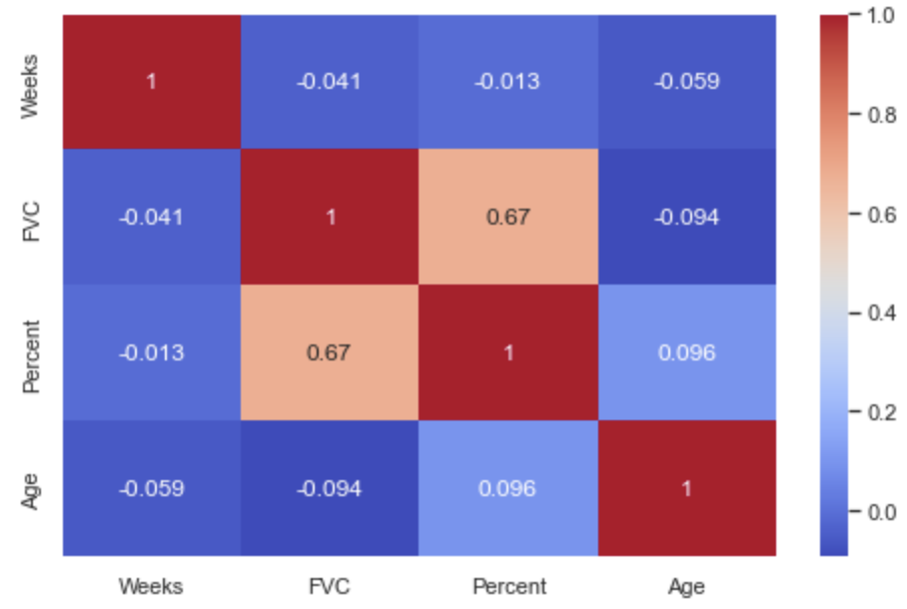
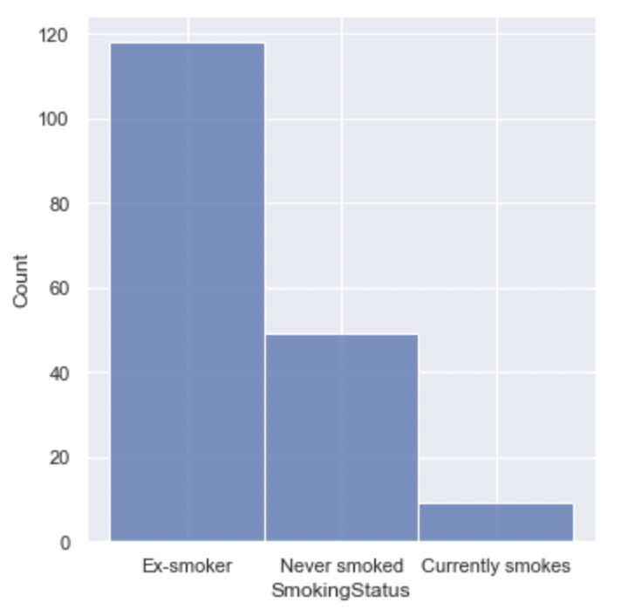
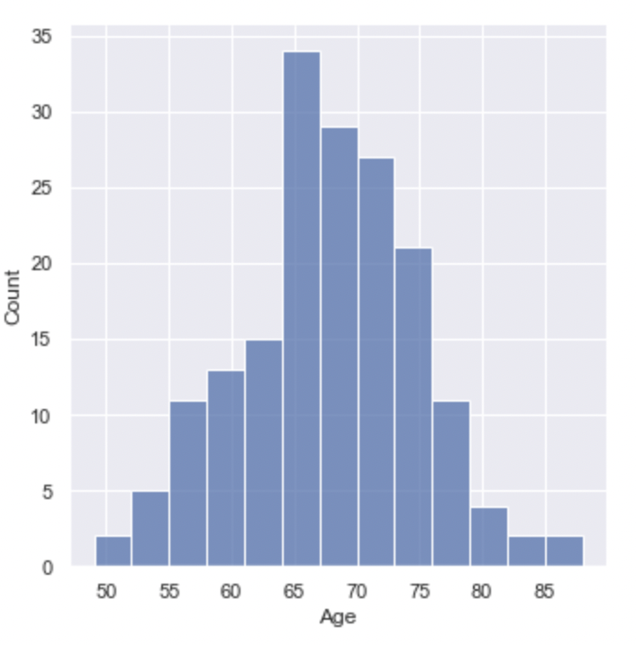
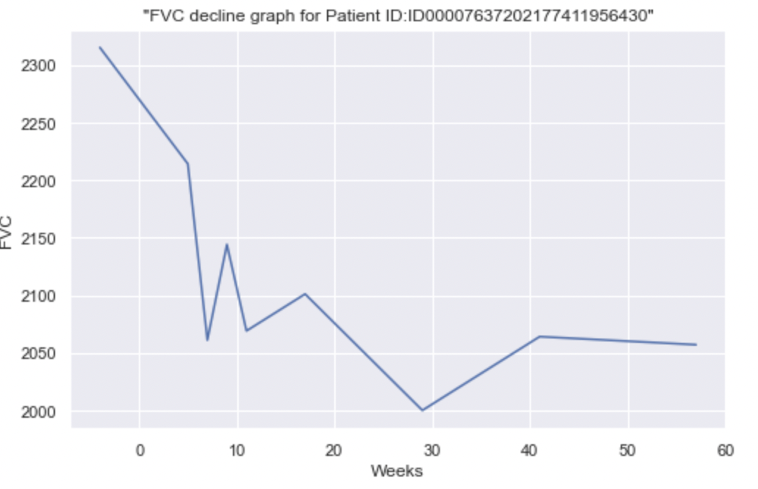
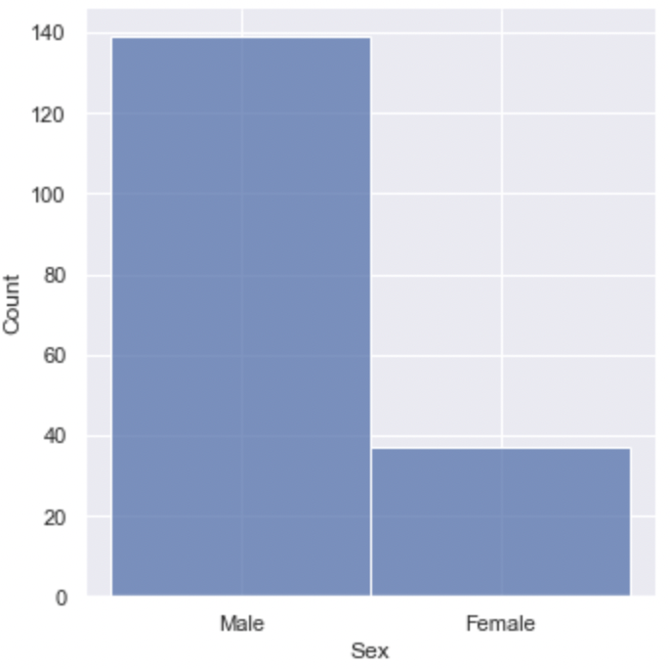
Data Exploration and Visualization:

Slide 5
Approach - Overall Pipeline to predict decline
Split Patients Train –Test-Val
Extract Patient Demographic Data
Extract Week 0 CT Scan
Segmentation of Lungs
Combine all three Features concepts
Extract Latent space features
Encode CT – Latent Space
Extract Texture and Lung information
Apply Regression Model
Predict Decline
FVC prediction for a week
Evaluate

Slide 6
Approach – Three Stages
Extract Demographic features
Extract handcrafted features
Extract latent features
Stage 1 – Demographic features
The demographic features for each patient are provided in excel format. For Each Patient ID we get the following features
Age
Gender
Smoking Status
Percentage Health
Gender and Smoking status being categorical – We encode them using dummy variables

Slide 7
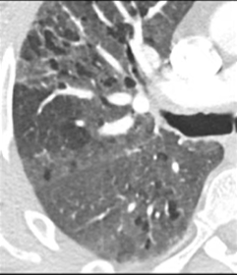
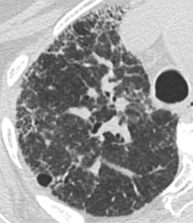
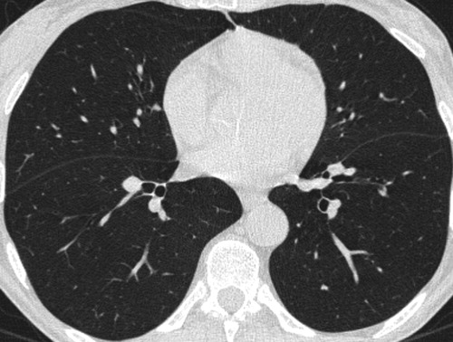
Stage 2 – Generating Handcrafted Features
What do Radiologists /Doctors Look into CT for diagnosing Pulmonary Fibrosis:
Glassy visuals
Honeycombing structures
Normal Lung – CT mid slice
Glassy Lung – CT mid slice
Honey comb like structures
What are we trying to extract ?
We see clear Textural variations – Can we extract texture?

Slide 8
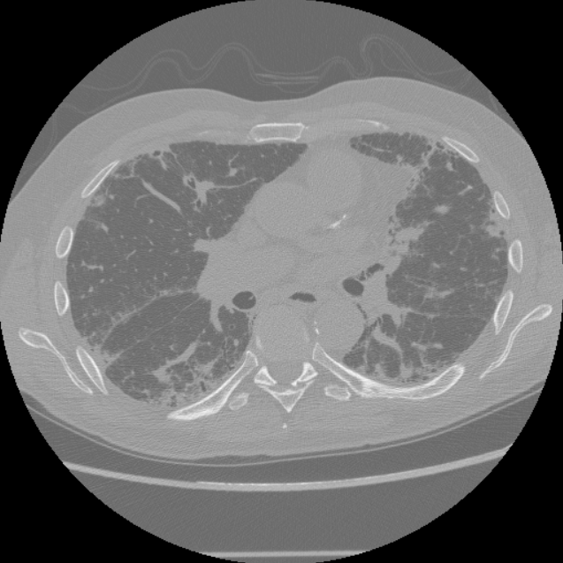
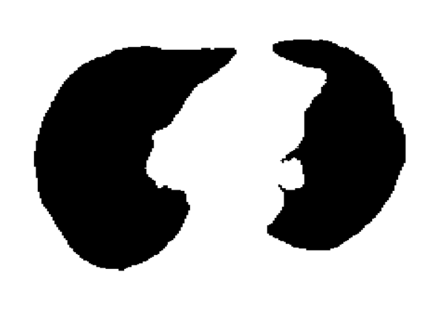
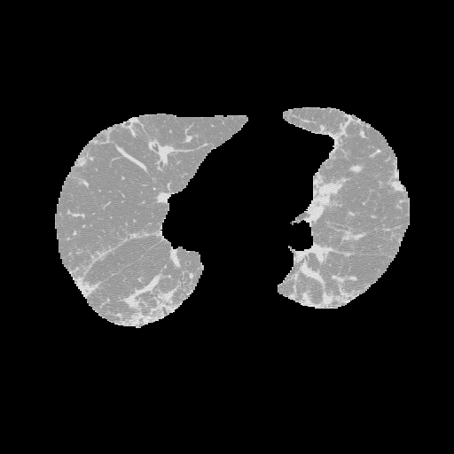
Stage 2 – GLCM Features and Lung Anatomy Information
Segmentation result Sample
Gray-Level Co-Occurrence Matrix (GLCM) – Statistical method to examine spatial relationships of pixels
Generates :
Contrast , Correlation , Entropy and Momentum features
Stage 2 Overall Process:
Get CT Scan – Scan has n slices
Segment lungs in each slice – Using pretrained UNET architecture already available *
Apply GLCM on each extracted lungs
Divide scans into top – Middle – Lower Lobes of lungs – Get average GLCM for top, middle and lower lobes
Extract lung volume – Useful since we are predicting FVC
*- Git - JoHof/lungmask

Slide 9
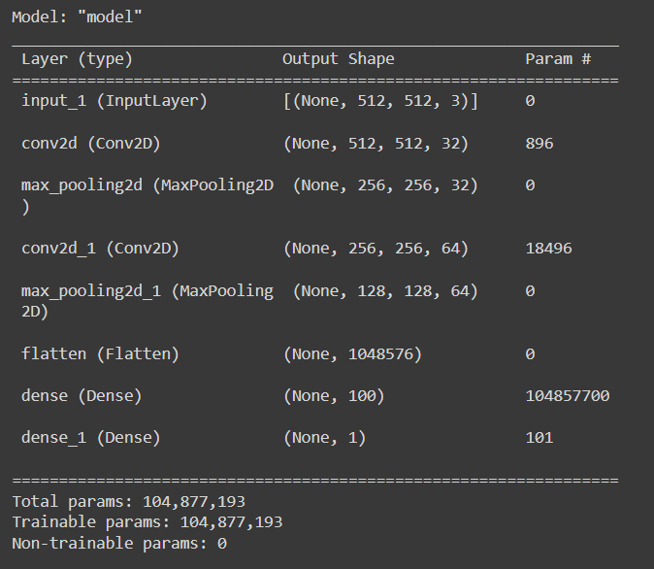
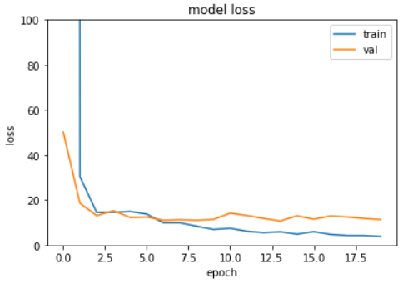
Stage 3 – Encoding and Latent Space Features
Unet encoder part – inspired architecture
Architecture:
Stage 3 Overall Process:
Get Lung Segmented CT Scan – Scan has n slices
Scale each slice of each scan into 512x512 shape
For each scan extract 3 slices – Highly representative of Top lobe , Middle Lobe and Bottom Lobe
The Percentage health from patient demographic information is used to train the network
Loss used to train network : MAE
Extract the penultimate layer – 100 features per scan

Slide 10
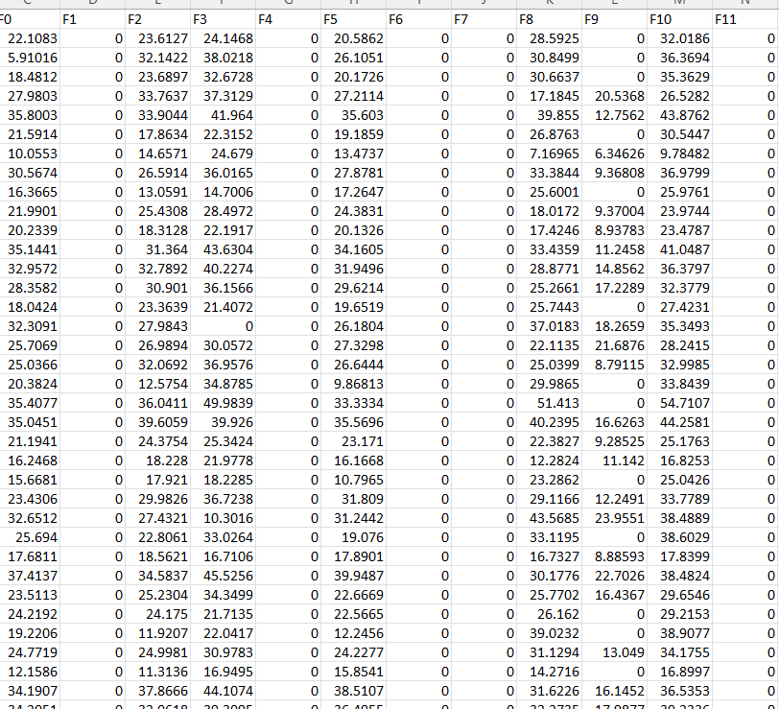
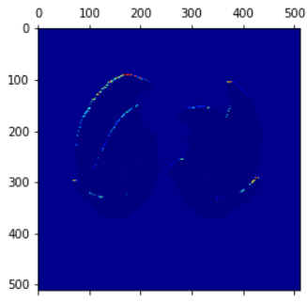
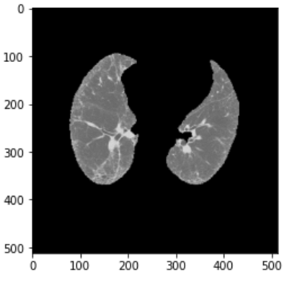
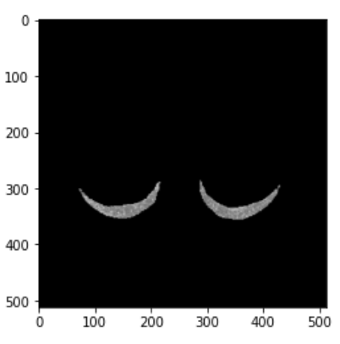
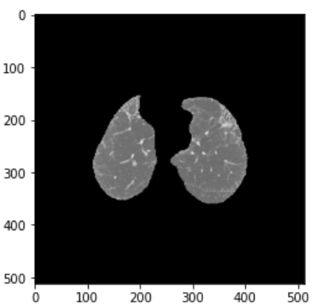
Stage 3 – Encoding and Latent Space Features
Analysing our Network – Grad CAM
Is it looking in the right places ?
Some Extracted Features of F0 to F99

Slide 11
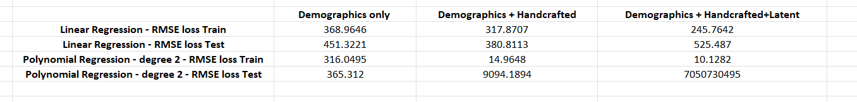
Predicting FVC
We combine all the three feature concepts – Demographics , handcrafted and latent features
Totally we have 118 features to estimate FVC
We built linear and polynomial regression models and compared performances based on RMSE loss
Results
Observations
The polynomial model seems to be over fitting and also with latent features we see overfitting generally
Overall loss looks not that great but when analysed against true value we were able to understand the behaviour. The true FVC is highly fluctuating and that resulted in higher RMSE value

Slide 12
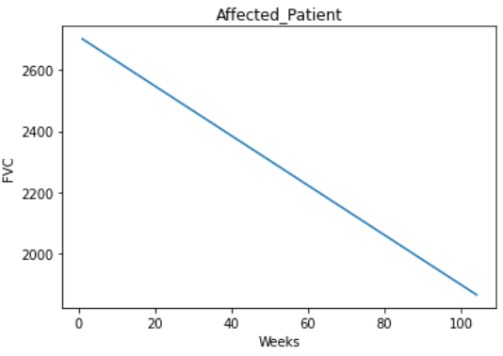
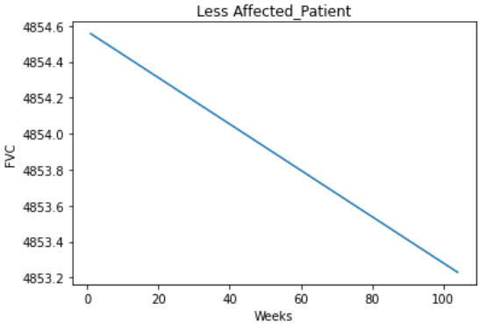
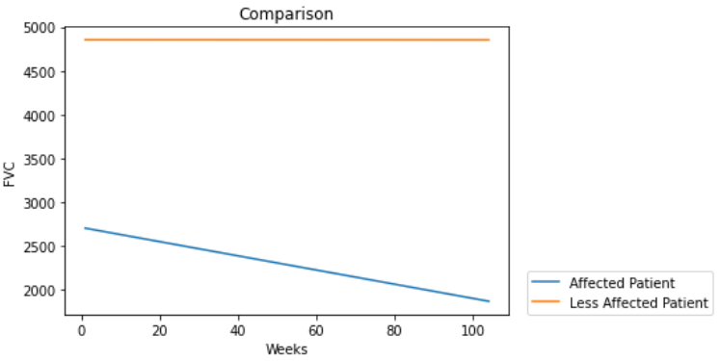
Visual Results – Discussion and Conclusion
We took two patients – Highly affected and less affected and predicted FVC for 104 weeks
Both show decline in lung function – FVC decreases over time
For highly affected patient the rate of decline is faster – The model seems to be predicting the trend properly
Conclusion and Future Works:
The model seems to be good in predicting the overall trend in decline but is not great in predicting the exact FVC value
In future, if we allow FVC’s initial seed values as part of feature matrix – the rmse might reduce
Also if we have a memory based networks we might be able to capture non-linear trends better

