Slide 1

Skin Color Analyze
Image recognition using RGB
Zhimin Li
Instructor: Dr.Hu
9/7/2021

Slide 2
Program based on Python(opencv)
How it works
Problem Solved
Background influence
High frequency components
Test result

Slide 3
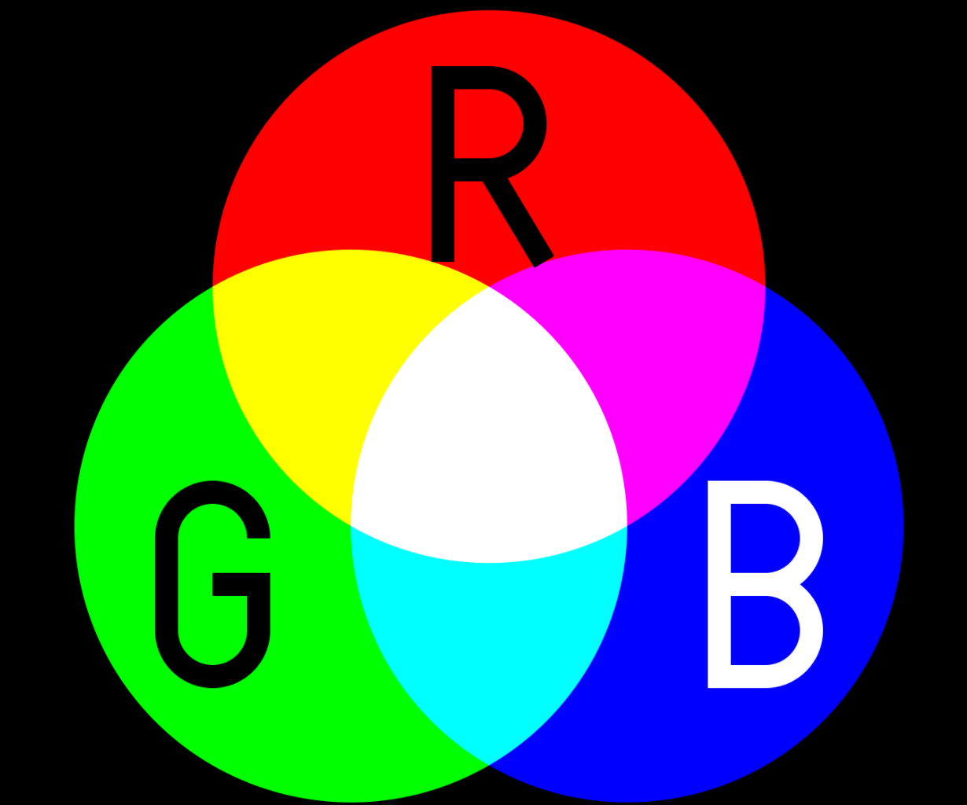
It works with a standard RGB color model!
The RGB color model is an additive color model in which the red(R), green(G), and blue(B) primary colors of light are added together in various ways to reproduce a broad array of colors. The name of the model comes from the initials of the three additive primary colors, red, green, and blue.
A picture is made up of many pixel points based on RGB principles.

Slide 4
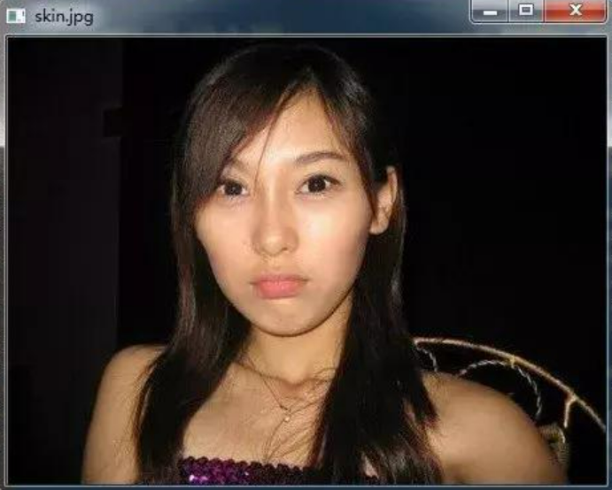
Problem Solved-1 (Background)
What is the problem?
For a single picture I showed on the right side, we can see there are lots of parts(pixel points) we don’t want to calculate all of their RGB.
Because we just need to calculate the RGB of skin part’s pixel points. We use a method called YCrCb color space based Cr component + Otsu method threshold segmentation algorithm
Cr reflects the difference between the red part of the RGB input signal and the brightness value of the RGB signal

Slide 5

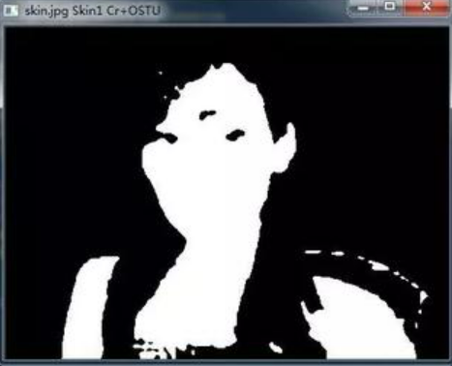
What we do using that algorithm
Convert RGB images to YCrCb color space and extract Cr component images
Self-binarization threshold segmentation for Cr OSTU method
After we have done this, we would have a image which just has two colors: white and black!
Now we can see the white part in this picture is actually skin pixel position.
Then we can use the Coordinates of that white part to calculate the RGB of original skin part.

Slide 6
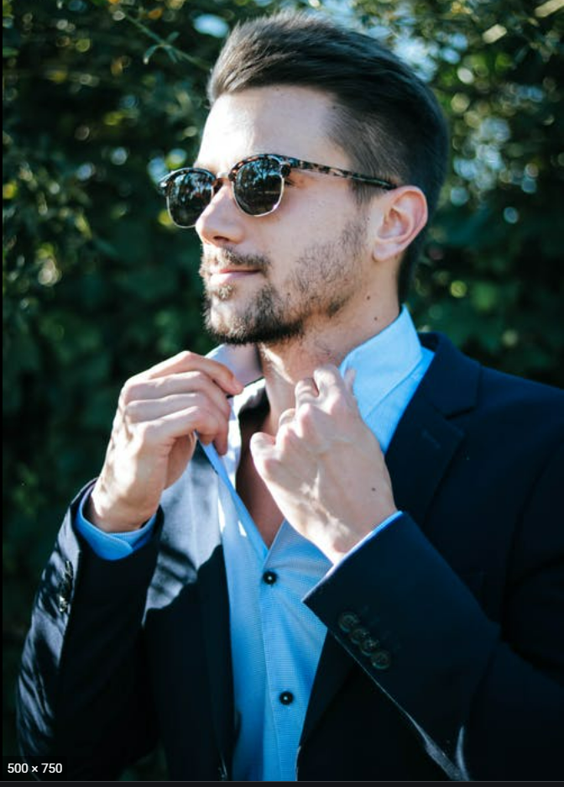
Problem Solved-2 (High Frequency component)
What is the problem and How to solve?
For a single picture I showed on the right side, we can see it has a high exposure on this handsome men’s face(that white part).
We don’t want that part RGB be calculated in our total RGB calculation. Therefore, we use Gaussian filtering to filter that part of high exposure which is also known as High Frequency components in Graphology.
x

Slide 7
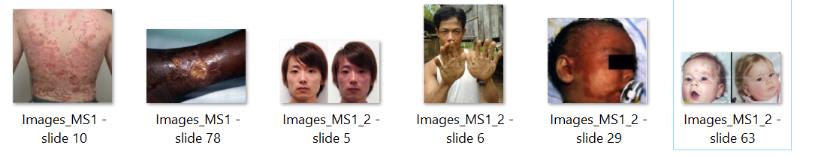
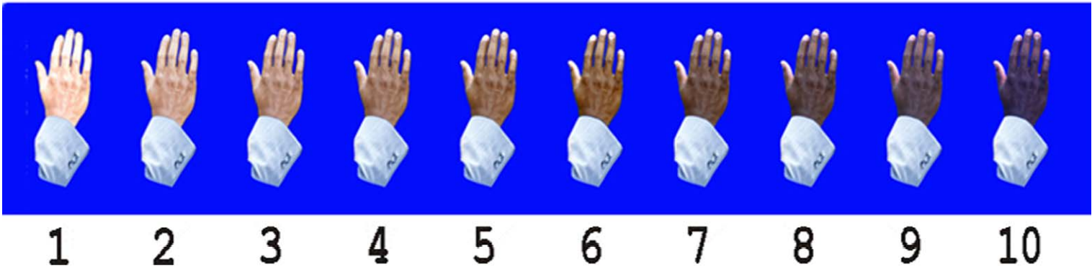
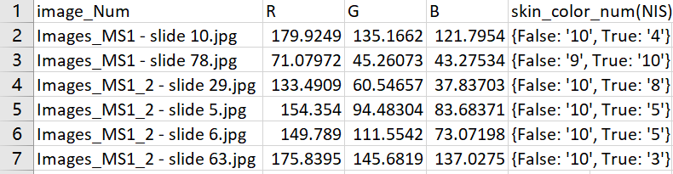
Te……st
I have selected a few pictures of more representative patients to test the accuracy of my program:
The scale of skin color(low resolution):
Test result:

Slide 8
Thank you!

