Slide 1
Formula 1 Winner predictor by Krissh Diwedy
Dev Dhara
Samardeep Singh

Slide 2
Index
Project Description
Experiments Performed
Practical 1
Practical 2
Practical 3
Practical 4
Practical 5

Slide 3
Project Description
Formula 1 is one of the most data-heavy sports, where countless factors driver skill, car performance, track type, and even weather combine to decide who wins a race.
Predicting race winners is a tough but exciting challenge, since it pushes machine learning to deal with complex, real-world data.
The goal is to build a model that can forecast the winner of a race before lights out. We treat this as a multi-class classification problem where the label is the winning driver among all participants.
Only pre-race information like qualifying positions, track features, historical stats, and team performance is used for prediction.

Slide 4
Experiments performed till now
Performing Pandas and Numpy Operations
Visualizing Data to Identify Possible Features
Preprocessing of Gathered Data
Performing Linear and Polynomial Regression
Applying Naïve Bayes

Slide 5
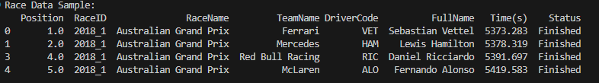
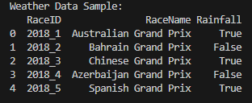
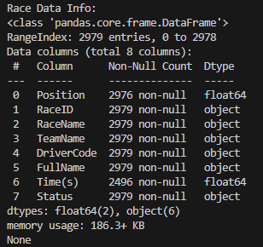
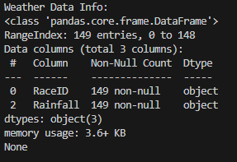
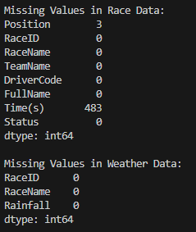
Practical 1
Pandas and NumPy operations

Slide 6
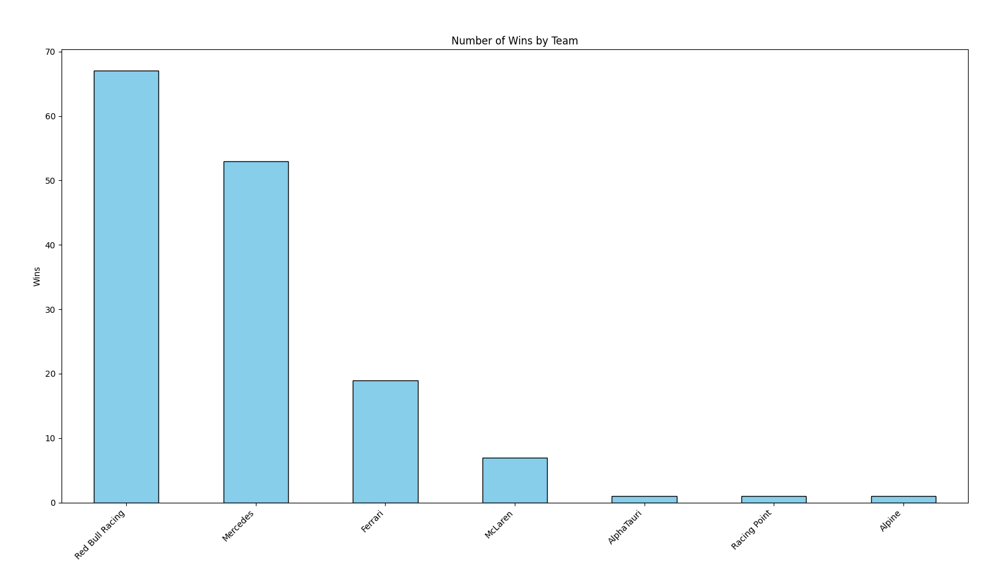
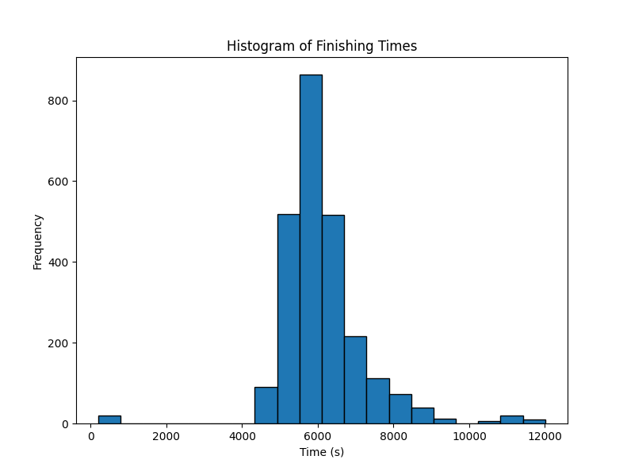
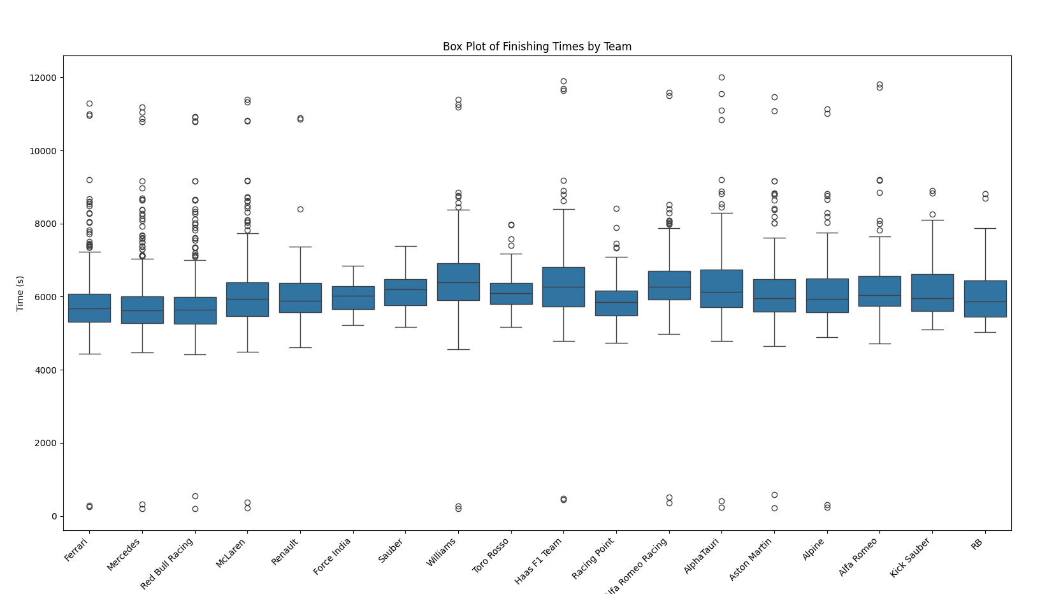
Practical 2
Visualizing data

Slide 7
Practical 3
Data preprocessing
Before

Slide 8
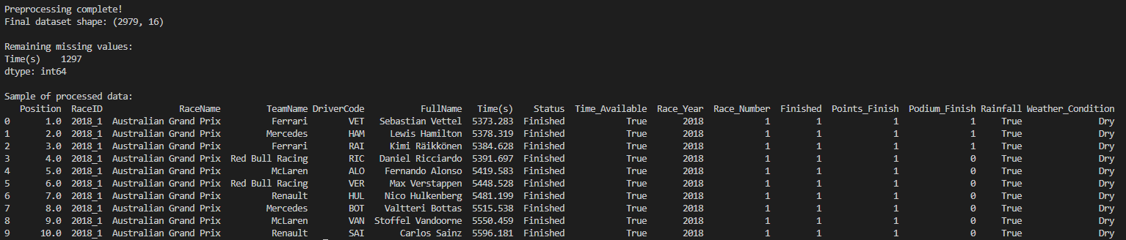
After

Slide 9
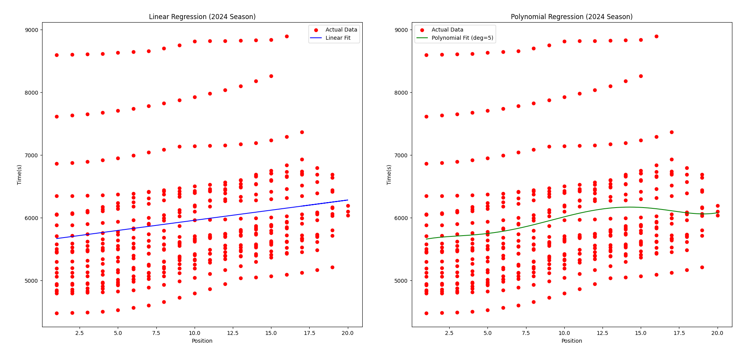
Practical 4
Linear and polynomial regression

Slide 10

Practical 5
Naïve Bayes

Slide 11
Thank you
Krissh Diwedy – 1/23/SET/BCS/405
Dev Dhara – 1/23/SET/BCS/381
Samardeep Singh – 1/23/SET/BCS/383

