Slide 1
AN INTELLIGENT TLDR SOFTWARE FOR SUMMARIZATION
Under the guidance of Dr. K. Vijayalakshmi
Akkenapally Sharanya -1202
Mahima Chowdary Maddineni -1226
Krishna Vamsi Rokkam -1246

Slide 2
Contents
Problem Statement
Objective
Abstract
Introduction
Hardware and Software Requirements
Architecture Diagram
UML diagrams
Advantages
Disadvantages
Applications
Conclusion
Future Scope
Bibliography

Slide 3
Problem Statement
An AI/ML based solution that generates short summaries of websites for easy and more targeted dissemination of the information to the people. Such a TL,DR(Too Long, Didn’t Read) software.

Slide 4
Objective
It requires ample time to go through and keep up with all the data present, as billions of articles are generated every day. There is a need to reduce much of this text data to shorter, focused summaries that capture the salient details, both so we can navigate it more effectively and check whether the larger documents contain the information we are looking for. Since manual text summarization is a time-expensive and generally uphill task, the automatization of the task is gaining increasing fame and therefore constitutes an excellent motivation for academic research. This increasing availability of documents has demanded exhaustive research in the NLP area for automatic text summarization.

Slide 5
Abstract
In the big data era, there has been an explosion in the amount of text data from a variety of sources. This volume of text is an inestimable source of information and knowledge which needs to be effectively summarised to be useful. It requires large time to go through and keep up with all the data present as billions of articles is being generated every single day. There is a great need to reduce much of this text data to shorter, focused summaries that capture the salient details, both so we can navigate it more effectively as well as check whether the larger documents contain the information that we are looking for. Since manual text summarization is a time expensive and generally laborious task, the automatization of the task is gaining increasing popularity and therefore constitutes a strong motivation for academic research. This increasing availability of documents has demanded exhaustive research in the NLP area for automatic text summarization. The real question is “Is there any software which can help us in absorbing the data more effectively and in less time?” So, The main objective of summarization system is to identify the most important information from the given and present it to the end users. Summarization in NLP is the process of summarising the text information in large texts for easy interpretation and for quicker consumption . We are proposing a solution for this problem by implementing an application for text summarization using Natural Language Processing by accepting an input (plain text, text scrapped from a website, or text extracted from an image) and the outlined text is given as output. Natural language along with machine learning processing made it simpler to summarise lengthy amounts of text into a cohesive and fluent summary that only includes the article's important ideas.

Slide 6
Introduction
Summarization is the task of condensing a piece of text to a shorter version, reducing the size of the initial text while at the same time preserving key informational elements and the meaning of content.
This shortens the time it takes to comprehend long materials like research articles while without removing significant information.
The ideal of automatic summarization work is to develop techniques by which a machine can generate summarize that successfully imitate summaries generated by human being.

Slide 7
Hardware and Software Requirements
Hardware Requirements:
•Processor :: INTEL Quad Core Processor or higher.
•System Specifications :: 4 GB RAM DDR4 , 64-bit-Operating System
•Hard disk :: 20 GB
Software Requirements:
•IDE for Python :: Spyder
•Package Manager :: Anaconda
•Operating System Suggested :: Windows 10

Slide 8
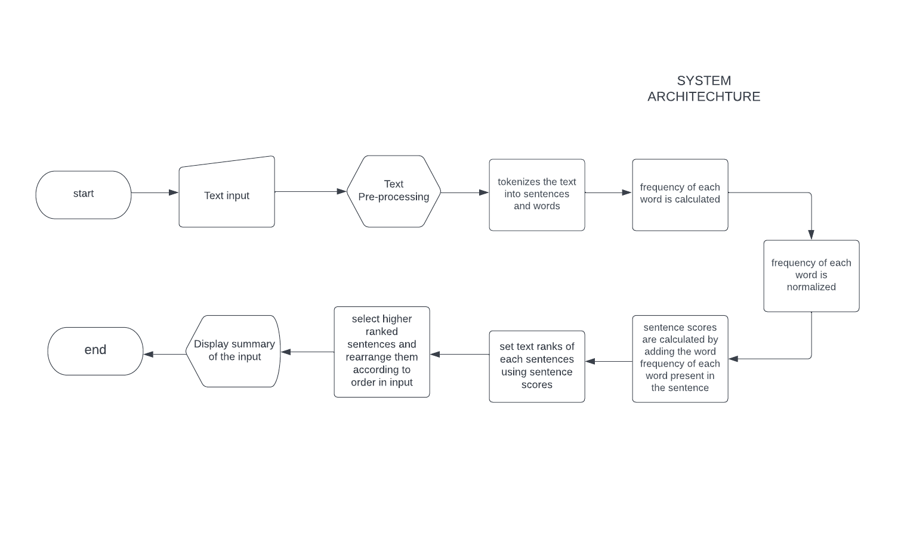
Architecture Diagram

Slide 9
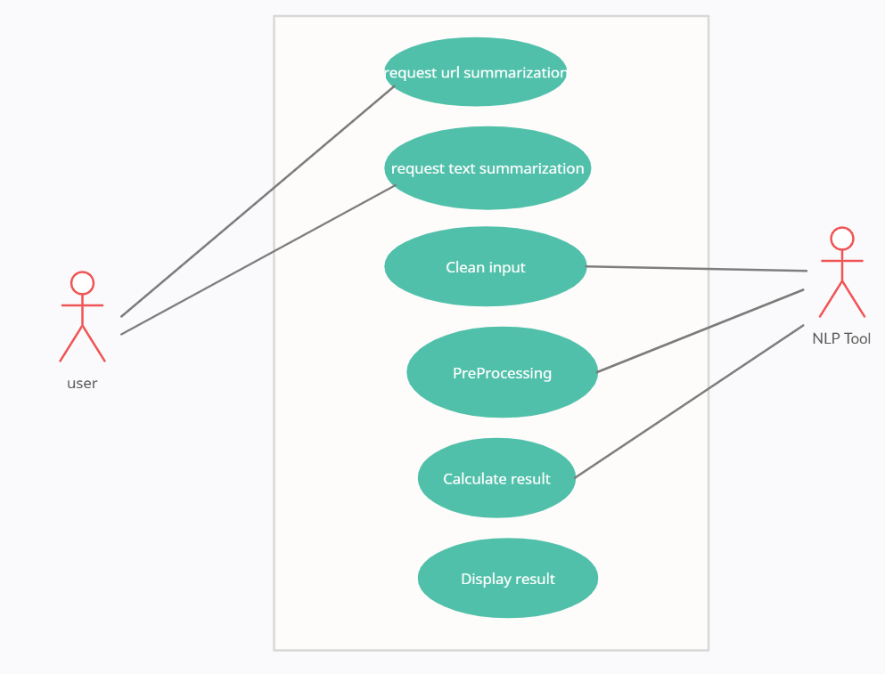
Use case Diagram

Slide 10
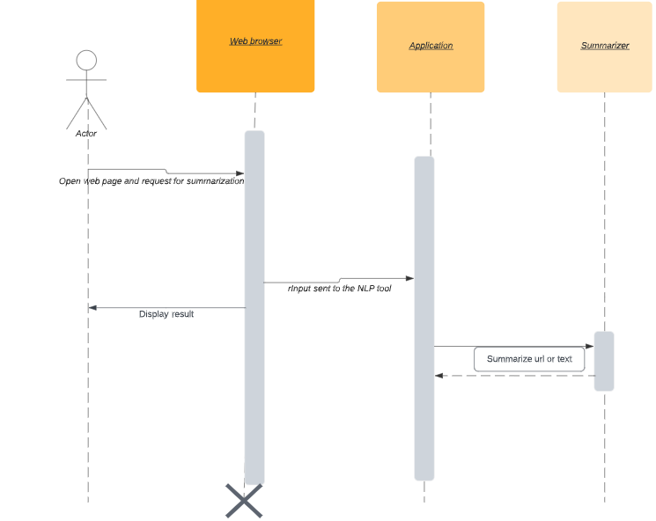
Sequence Diagram

Slide 11
Advantages
Text Summarization decreases reading time, speeds up the research process, and expands the quantity of information that may fit in a given space
Increased productivity
Instantly effective
Efficient for indexing
Automatic summarization algorithms are less biased than human summarizes
Doesn’t miss out important facts

Slide 12
Disadvantages
Lack of fluency and coherence sometimes
Sometimes it may misinterpret the author’s original idea
Difficult for evaluation

Slide 13
Applications
Search Engine Optimization
Media
Medical Cases
Literature
Search Marketing

Slide 14
Conclusion
Summarization processes have to produce a compelling summary in a brief time with less redundancy having linguistically correct sentences.
Summarizing methods are all extractive, although the community is rapidly moving toward abstract summarization.
An abstractive summarising can be created by using phrase compression and textual entailment techniques, even though a complete abstractive summarization would require a better grasp of natural language.

Slide 15
Future Scope
The challenge arises in creating accurate summaries with proper semantics including all the features of text summarization, image summarization, article summaries, and multiple document summary.
We can also integrate translation and text-to-speech features that make the model more versatile and makes the model more user friendly.

Slide 16
Bibliography
https://medium.com/analytics-vidhya/simple-text-summarization-using-nltk-eedc36ebaaf8#:~:text=Text%20summarization%20is%20the%20process,relevant%20information%20within%20the%20Text.
https://machinelearningmastery.com/gentle-introduction-text-summarization/

