Slide 1
Travelbook Share your journeys!
Tsvetina Gramova
Kristiyan Ivanov
JAVA EE S07

Slide 2
What did we do?
Login/logout & register
Add post with map location, picture and video
Comment and like/dislike posts
Follow/unfollow users
Update profile
Forgot password
Search posts by tags, destination and author
Search user
Browse through posts and users

Slide 3
How we did it? Used technologies:
POJO
Collections and exceptions
Design patterns: DAO & Singleton
Object managers (post and user manager)
Spring MVC
JSP/JSTL
HTML/CSS/JavaScript/AJAX
VCS - github
Email API, Google Maps API

Slide 4
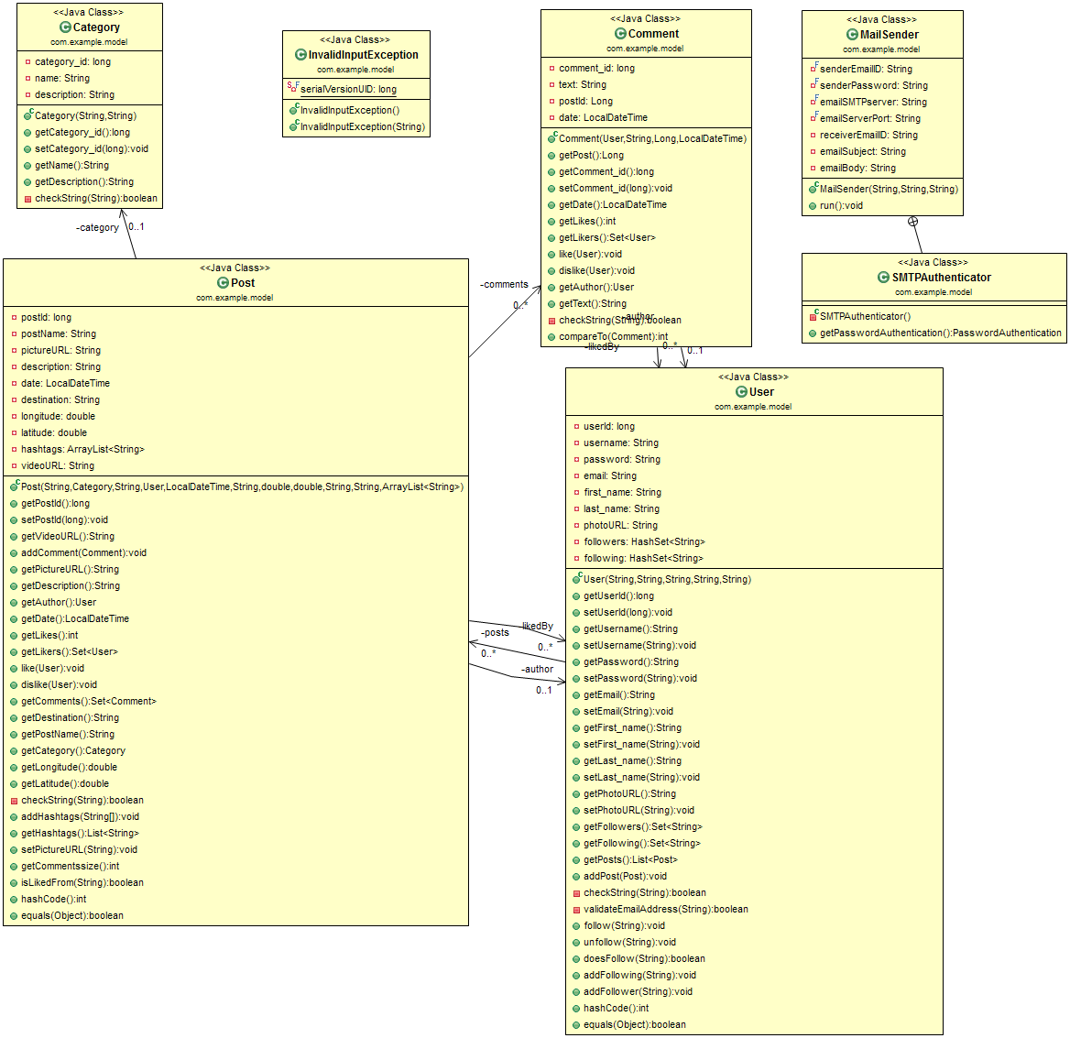

Slide 5
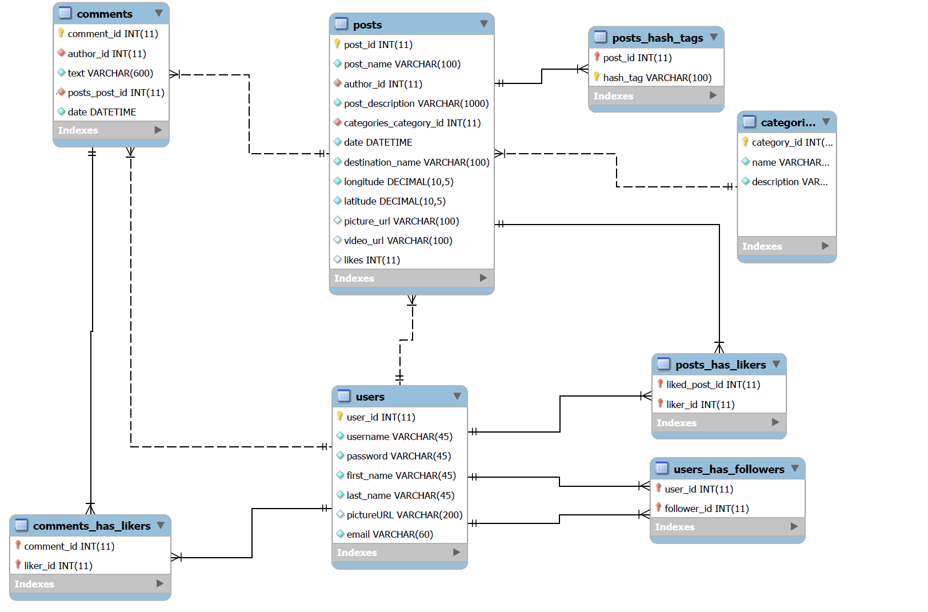

Slide 6

DEMO

Slide 7
Future plans
Mutual followers
All posts on map
Wish list
Messages
Lock profile/block other users
Groups

Slide 8

Come join us!

