Slide 1

Travelbook Share your journeys!
Tsvetina Gramova
Kristiyan Ivanov
JAVA EE S07

Slide 2
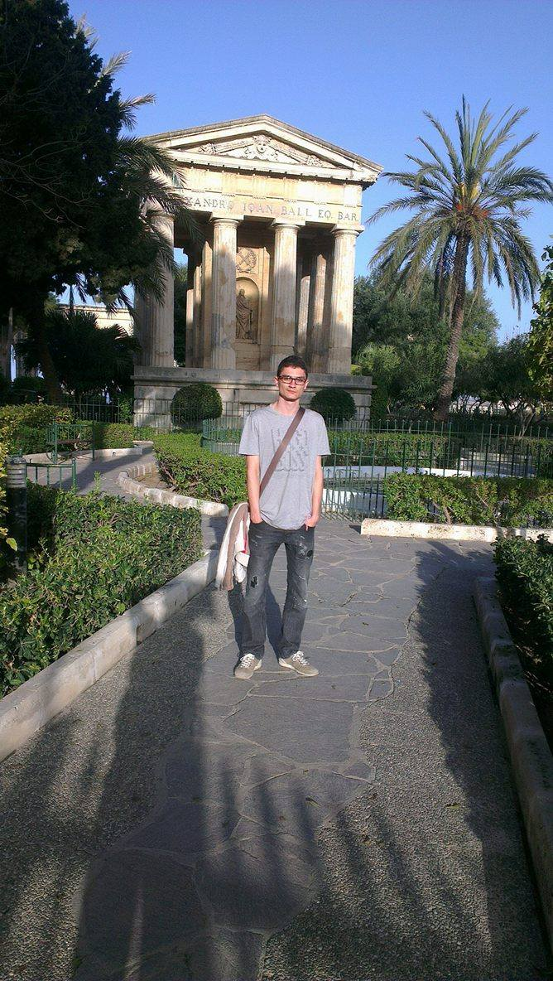
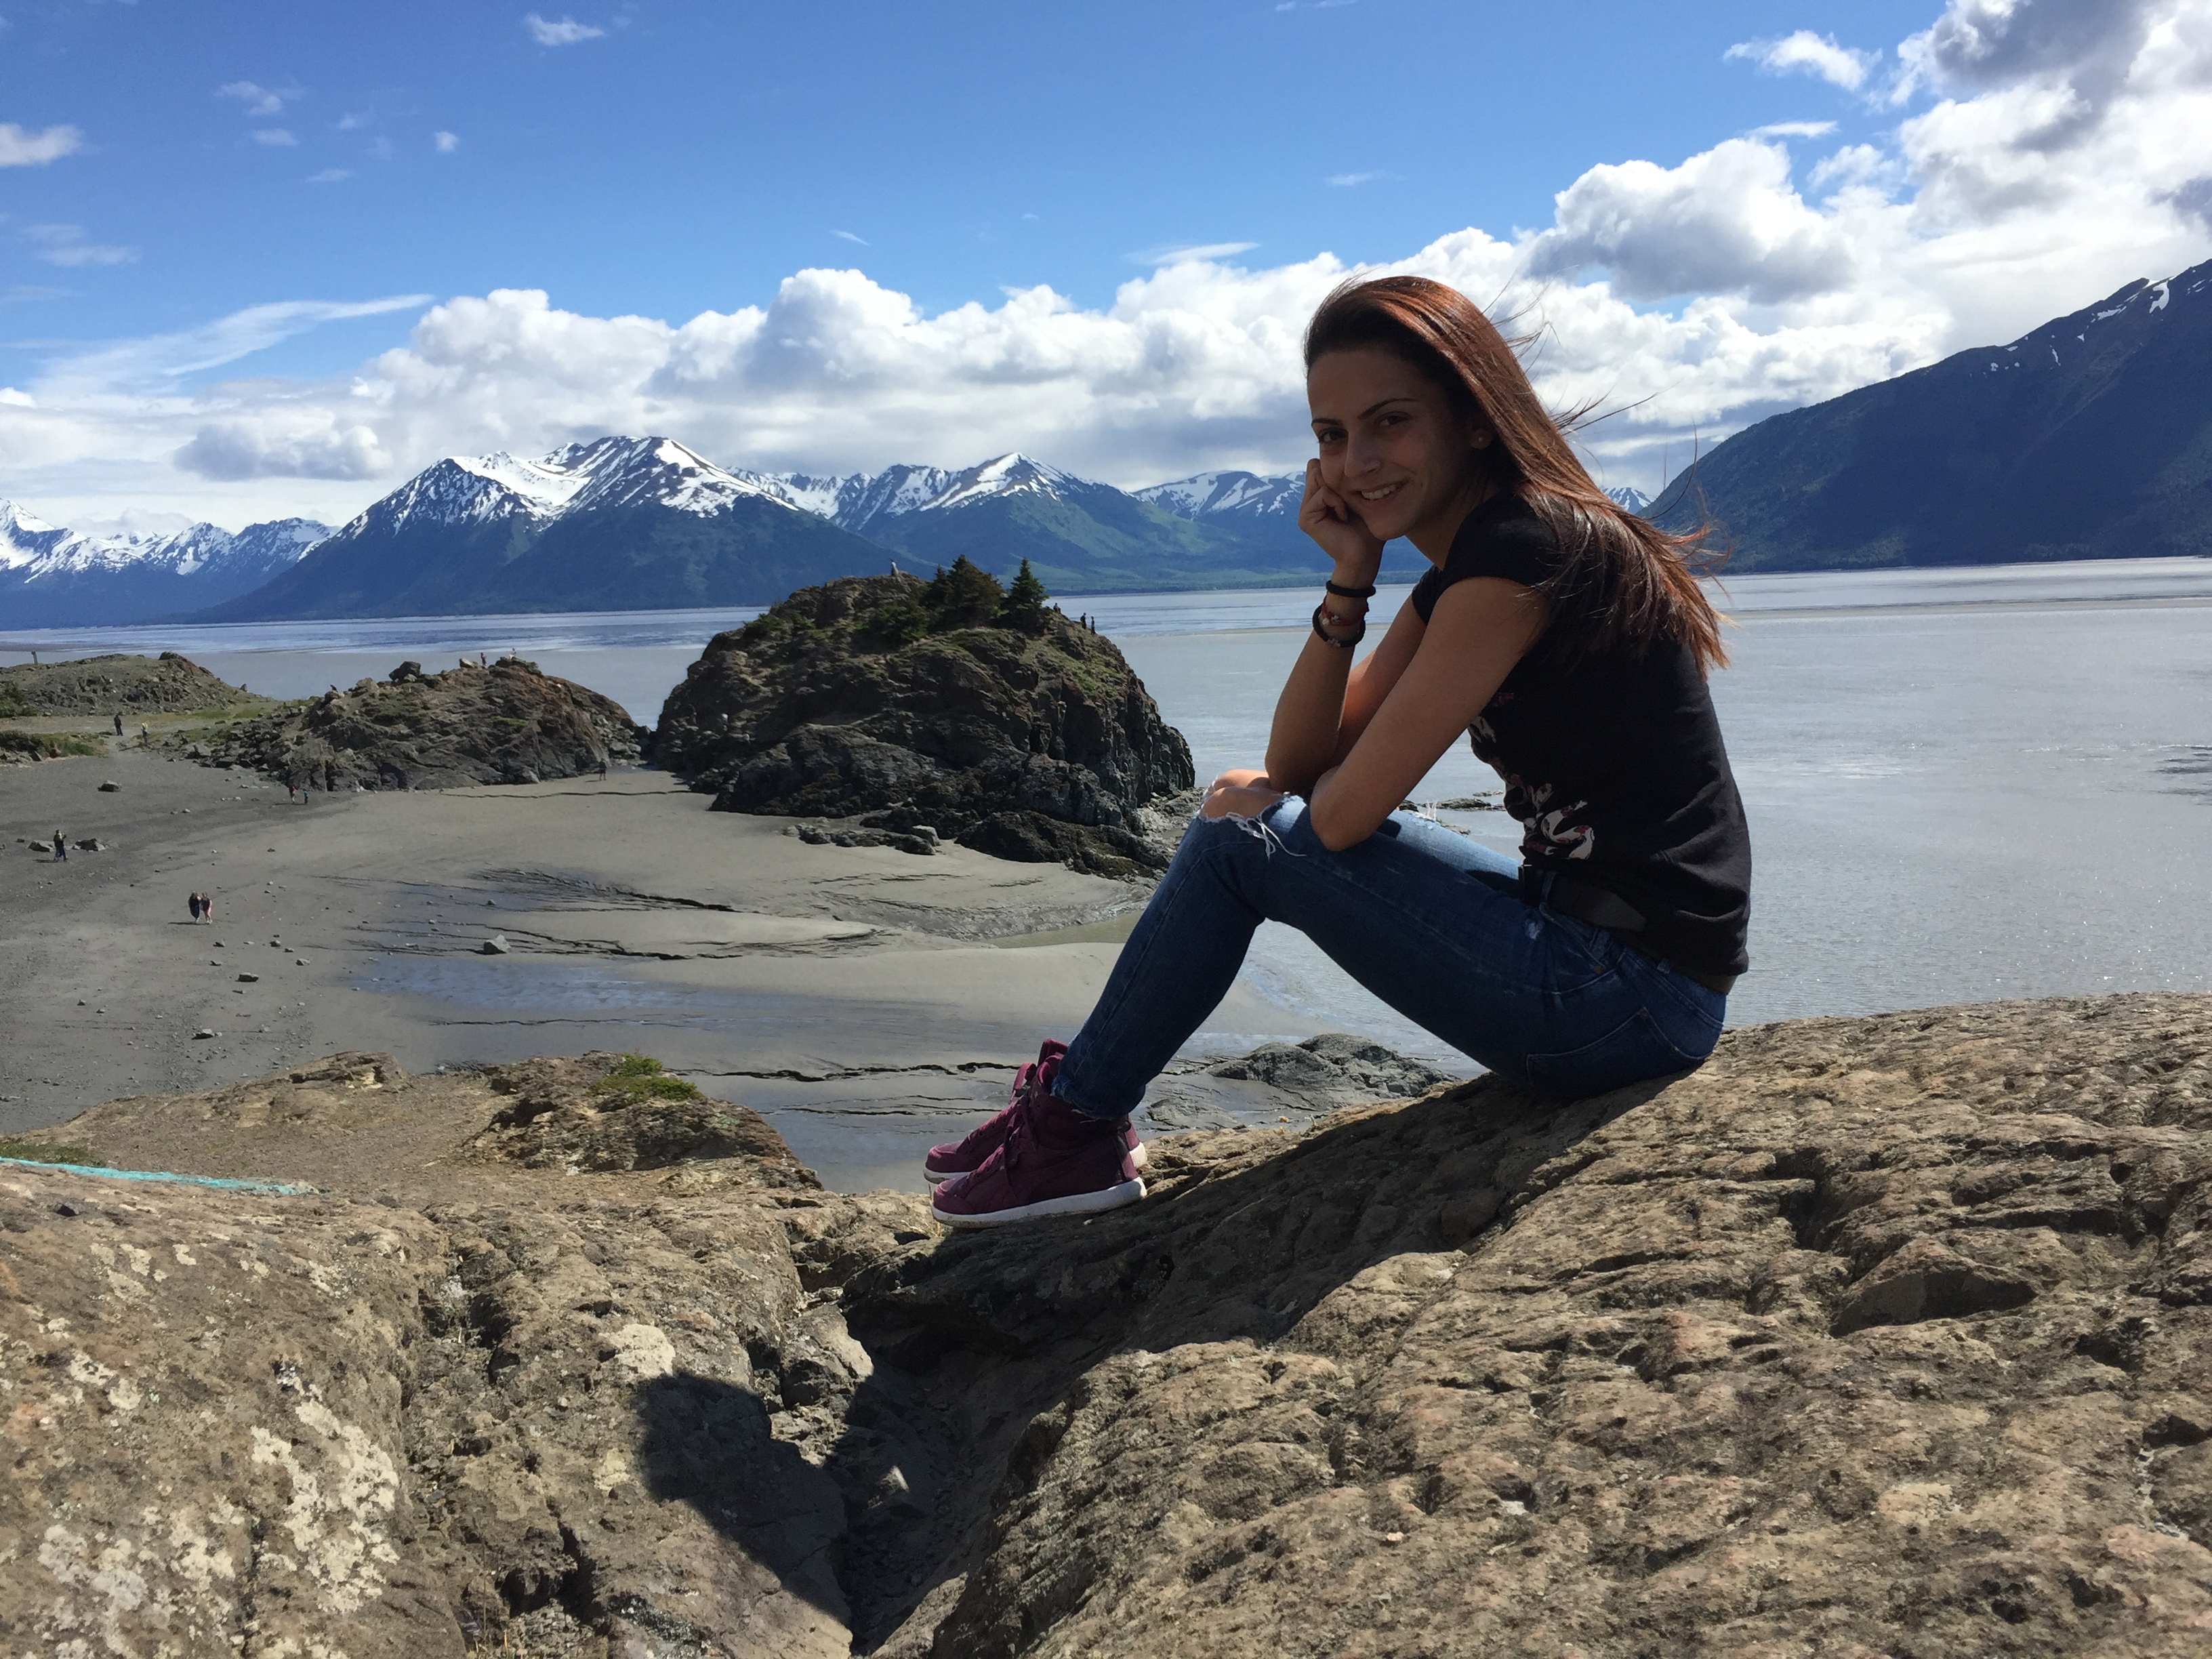
Who are we?

Slide 3
What did we do?
We developed a social media site for adventurers which combines the functionality of a social media and the convenience of a traveler’s guide. The idea is to help people socialize over their passion to travel sharing their journeys with each other.

Slide 4
What does it do?
Registering as user with personal information and a profile picture; Logging in/out;
Adding post with map location, picture and video;
Commenting and liking/disliking posts;
Following/unfollowing users and having news feed with followers’ posts;
Updating profile;
Recovering password;
Searching posts by tags, destination and author;
Searching users;
Browsing through posts and users;

Slide 5
How we did it? Used technologies:
Core java
Design patterns: DAO & Singleton
Object managers (post and user manager)
Spring MVC
JSTL
HTML/CSS/JavaScript/AJAX
VCS - github
Email API, Google Maps API

Slide 6
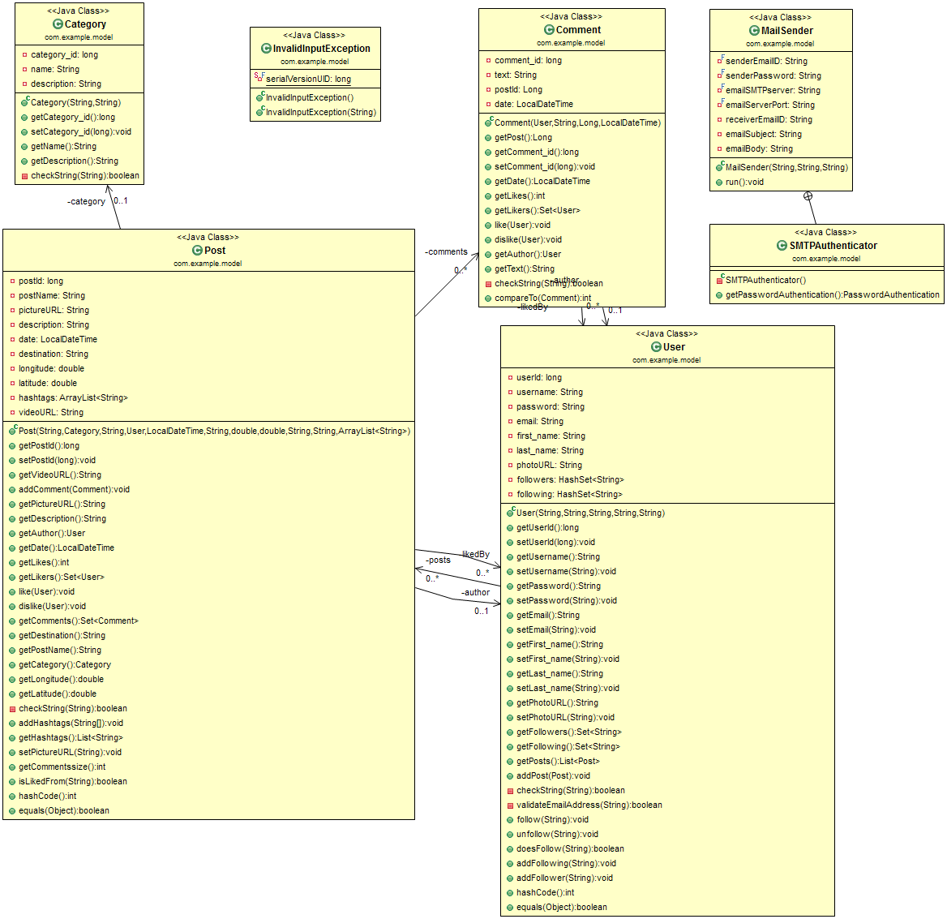

Slide 7
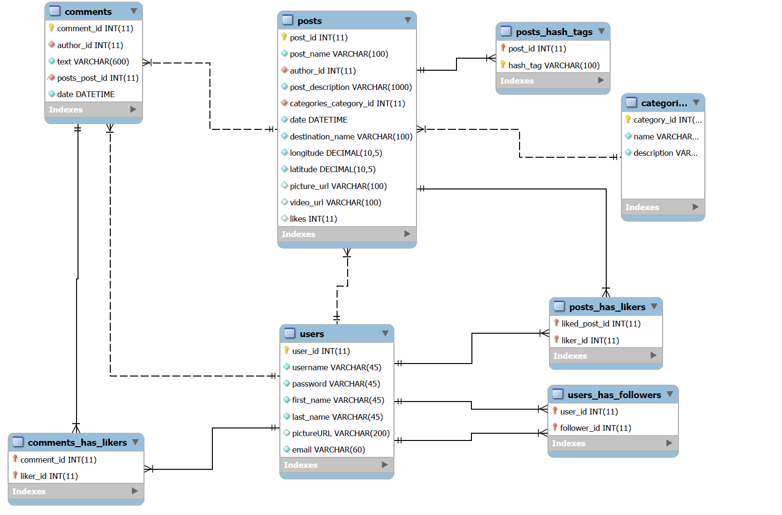

Slide 8
DEMO

Slide 9
Future plans
Mutual followers
All posts on map
Wish list for adding all desired destinations
Visited destinations
Rating posts
Messaging other users
Lock profile/block other users
Groups

Slide 10
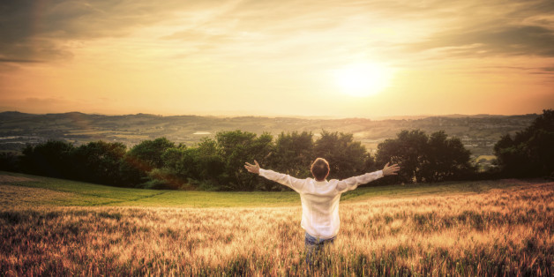
Come join us!

