Slide 1
Multiple Linear Regression on USA Real Estate dataset D214 – Data Analytics Graduate Capstone Western Governors University By: Krista Moik

Slide 2

Agenda:
Introduction
Data Analysis Process
Research Question and Hypotheses
The Data
Findings
Limitations
Proposed Actions
Benefits
Sources

Slide 3

Introduction
Wife, car enthusiast, rescuer of unwanted furniture, avid shopper and sneakerhead
Bachelor of Arts in Humanities – 2012
Insurance claims specialist for almost 10 years
Data Enthusiast
Google Data Analytics Certificate – 2023
Western Governor’s University - Master’s of Science in Data Analytics – started 2023

Slide 4
Data Analysis Process
Data Acquisition
Locate appropriate dataset
Import dataset into IDE
Data Cleaning
Handle duplicates, nulls, and outliers appropriately
Data Exploration and Wrangling
Visualize and obtain statistics of variables
Re-express categorical variables
Predictive Modeling
Create the model – Multiple Linear Regression
– Ordinary Least Squares
Variable Selection
VIF
Backward Stepwise Elimination
Evaluate the Model
R-squared and adjusted R-Squared, p-values
Visualizations and Reporting
Residual Plots
Q-Q Plots
MSE, RMSE
Business Understanding
Research Question
Hypotheses

Slide 5

Business Understanding
Research Question
Can a multiple linear regression model be constructed based on the research dataset to determine which variables are most significant to the sale price of homes in Florida?
Hypotheses
Null hypothesis - H0: A predictive MLR model cannot determine which variables are most significant to the sale price of homes in Florida with an r-squared value of 0.5 or less.
Alternate Hypothesis - H1: A predictive MLR model can determine which variables are most significant to the sale price of homes in Florida with an r-squared value greater than 0.5.

Slide 6

Data Acquisition: The Dataset
USA Real Estate Dataset
4,069,420 total rows
345,881 rows for house sales in Florida
Columns used:
Bed
Bath
Acre_lot
House_size
City
Zip_Code

Slide 7
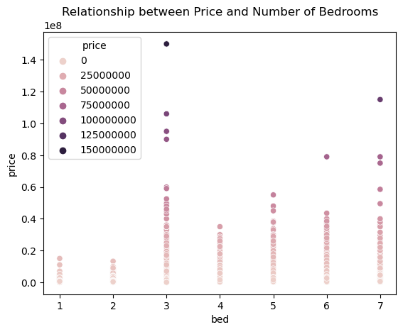
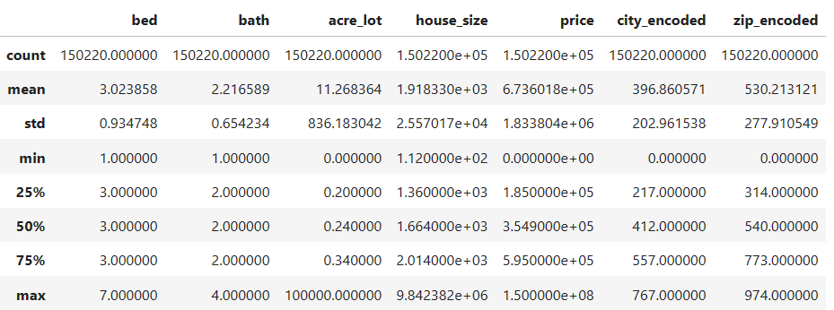
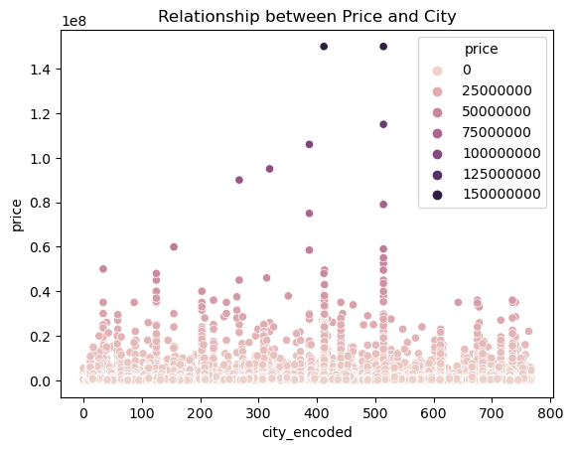
Data Exploration

Slide 8
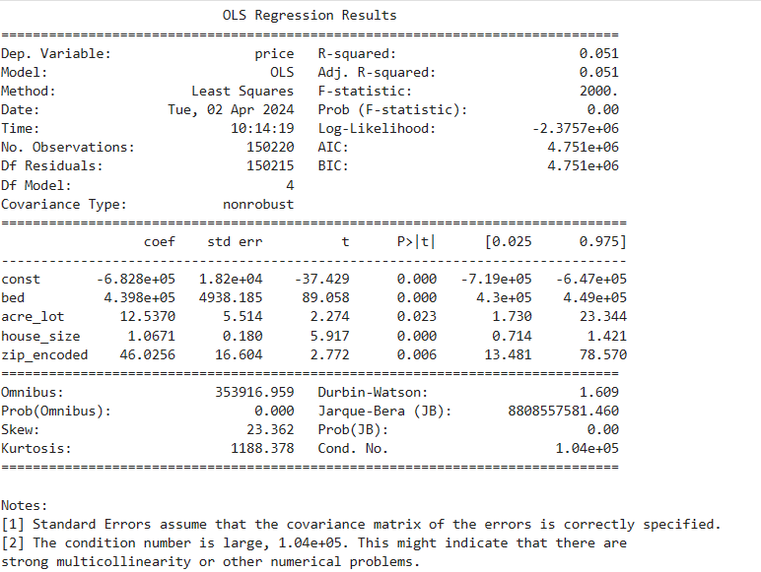
Predictive Modeling: The Final Model:
Notes:
VIF and backward stepwise elimination were used - it is important to note that this method can lead to false confidence in the model by underestimating the standard of errors, which can lead to possible overfitting, and it may not provide the best model (Smith, 2018).
Based on the final OLS model, the final equation is: price = -6.828e+05 + 4.398e+05 * bed + 12.5370 * acre_lot + 1.0671 * house_size + 46.0256 * zip_encoded
The r-squared and adjusted r-squared values of the final model are 0.051, indicating this model only explains about 5% of the variance in home sale prices in Florida. Thus, while my variables were determined to be statistically significant, based on the r-squared value, we must accept the null hypothesis as our model did not have an r-squared value greater than 0.5.
Residual plots for each independent variable in the final model were created. As none of the variables exceeded the absolute value of 3, it can be assumed none of the observations are outliers. However, most values were greater than 0, indicating that the observed value was usually greater than the predicted value (Bobbitt, 2020).

Slide 9
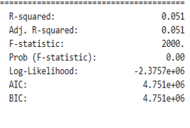

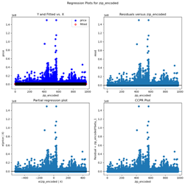
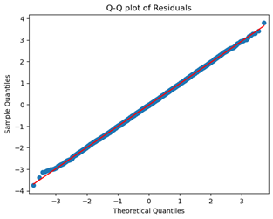
Evaluating the Model and Visualizations
R-Squared, P-Values, MSE, RMSE
Residual plots for each independent variable in the final model were created. Several of the variables were unbalanced with most of the points being vertically spread around 0 on the x-axis. This confirms the model is generally accurate but indicates there could be heteroscedasticity (Qualtrics, n.d.).
Q-Q Plot of the residuals confirms a normal distribution, which is in line with the assumption that there is a linear relationship between the dependent and independent variables, and also indicates the model is capturing the relationships between those variables well (Frost, n.d.).

Slide 10

Findings
-6.828e+05 is the predicted sale price of houses when all other variables are equal to 0.
Assuming all else remains constant:
an increase of 1 bedroom increases the sale price by 4.398e+05.
an increase of 1 unit for acre_lot results in an increase in price by 12.5370.
an increase of 1 unit for house_size results in an increase in price by 1.0671.
an increase in 1 unit for zip_encoded results in an increase in price by 46.0256.

Slide 11
Limitations
The dataset and variables available
The dataset is lacking in seemingly important house characteristics such as upgrades, neighborhoods, amenities
Assumption of accuracy
Data only goes back 2 years
Multiple Linear Regression and Ordinary Least Squares
In choosing a multiple linear regression model and ordinary least squares, several assumptions must be adhered to. First, it is assumed that the relationship between the dependent and independent variables is linear, and that the independent variables are not strongly correlated with each other. The model also assumes that the errors are independent of each other, show homoscedasticity, and follow a normal distribution (Sampaio, 2023).

Slide 12
Proposed Actions
Obtain More Data
Obtain more data such as information regarding condition, recent upgrades, amenities, neighborhood, schools, HOAs, environmental risks
Variable Selection Methods
Try different variable selection methods such as PCA or ridge regression to deal better with multicollinearity
Other Models
Try a different model altogether such as a random forest

Slide 13
Benefits
Real estate companies would be able to better serve their home sellers by competitively pricing the home and could better serve their home buyers by knowing the fair price of the house.
Real estate developers and home renovation specialists would understand what increased or decreased house prices in the specified area and could tailor their work to increase profits.
Employers can use this information to ensure that employee salaries were commensurate with the cost of living and housing in the area to attract and retain top talent for their companies.

Slide 14
Sources
Frost, Jim. (n.d.). QQ Plot: Uses, Benefits & Interpreting. Retrieved April 2, 2024, from https://statisticsbyjim.com/graphs/qq-plot/
Interpreting Residual Plots to Improve Your Regression. (n.d.). Retrieved April 4, 2024, from https://www.qualtrics.com/support/stats-iq/analyses/regression-guides/interpreting-residual-plots-improve-regression/
Sampaio, Vitor. (2023, June 2). Understanding Ordinary Least Squares (OLS): The Foundation of Linear Regression. Retrieved April 1, 2024, from https://medium.com/@VitorCSampaio/understanding-ordinary-least-squares-ols-the-foundation-of-linear-regression-1d79bfc3ca35
Smith, Gary. (2018, September 15). Step Away from Stepwise. Retrieved April 2, 2024, from https://journalofbigdata.springeropen.com/articles/10.1186/s40537-018-0143-6#:~:text=The%20stepwise%20regression%20method&text=A%20backward%2Delimination%20rule%20starts,the%20equation%20is%20statistically%20significant
USA Real Estate Dataset. (n.d.). Retrieved March 26, 2024, from https://www.kaggle.com/datasets/ahmedshahriarsakib/usa-real-estate-dataset

Slide 15
Thank you
Krista Moik
Western Governors University
MSDA Program

