Slide 1

2016-2019 Findings

Slide 6
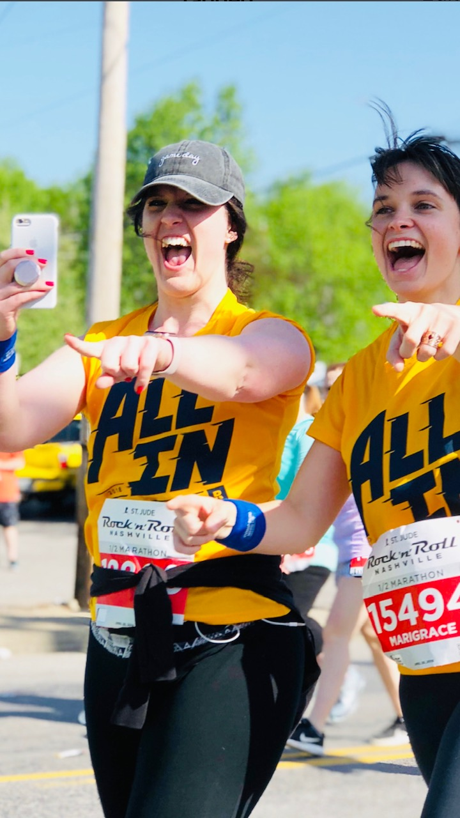
Me and a work friend pretending we weren’t dying…

Slide 7
Why was everyone slower in 2017?

Slide 11
Weather (especially heat) matters!

Slide 12
Oprah has the time to beat!

Slide 15
Jen Jakob Anderson conducted a survey of 1,298,588 marathon results in 2014.

Slide 16
Jen Jakob Anderson conducted a survey of 1,298,588 marathon results in 2014.
World average is 4:21:21.

Slide 17
Jen Jakob Anderson conducted a survey of 1,298,588 marathon results in 2014.
World average is 4:21:21.
Women – 4:42:33 Men – 4:13:23

Slide 18
The Weitecha Factor

Slide 20
The End

