Slide 1
Python 3D Kriging

Slide 2
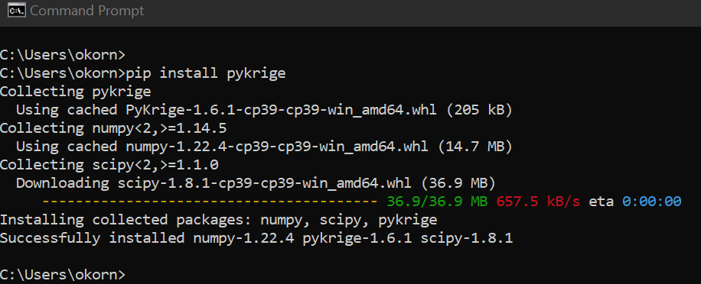
Use python version 3.9.10
Main package (pykrige) not compatible with 3.9.10
In command prompt, have to install pykrige:

