Slide 1

Instacart Market and customer analysis

Slide 2
Instacart – Background
Investigate sales patterns by performing exploratory data analysis on sales data for Instacart. Gain insight into customer demographics, purchasing behaviors and suggest potential market segmentation.
Data sets
Instacart Data
2017 accessed via Kaggle
Customer data
Generated by Career Foundry
Tools
Python
Pandas
Numpy
Seaborn
Matplotlib
Jupyter
Anaconda Navigator
Analytical Skills
Use Jupyter notebooks for Python coding
Basic descriptive and exploratory analysis in Python using Pandas
Data wrangling and subsetting in Pandas
Perfom consistency checks for missing values and duplicates
Combine data sets
Derive new variables
Grouping and aggregation
Data visualization in Python
Create report including methodology, results, and recommendations for stakeholders

Slide 3
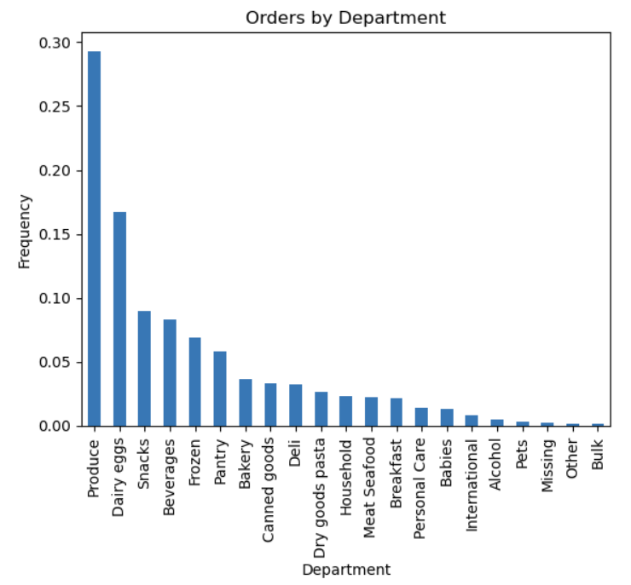
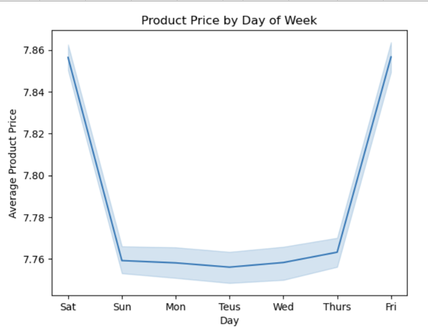

Slide 4
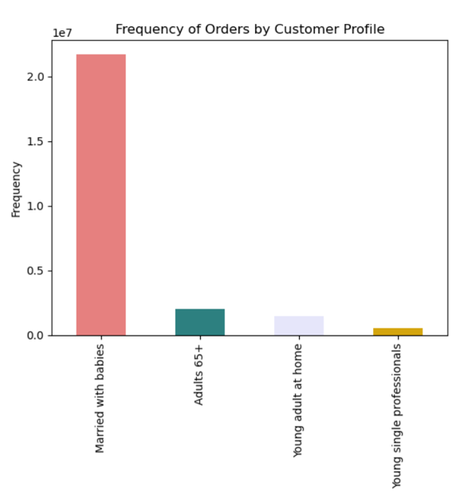
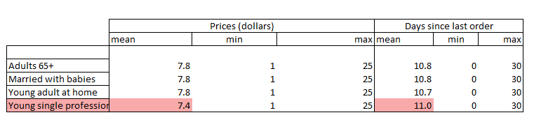

Slide 5
Instacart– Results
Insights
Recommendations
Produce, dairy eggs, and snacks get the most orders. Other and bulk get the least.
On average customers buy the highest priced items on Friday and Saturday. Perhaps they are buying higher prices snack or party items during these days as opposed to typical day to day goods during the week.
The majority (69.9%) of customer base is married with babies. The next highest is adults 65+ which only make up 6.3% of customers. Instacart doesn’t have any customers who are married without children.
Young single professionals wait the longest before ordering again. On average they wait 11 days. They also buy the lowest priced items.
Bulk, pets, and alcohol are the departments that get the least orders. They might benefit from increased promotions.
Consider running ads on Tuesdays and Wednesdays when orders are lowest
None of your customers are married without children. This is an untapped market with more disposable income.
Target young single professionals to decrease days between orders and increase average item price.

