Slide 1
Human Foods Program

Slide 2
Toxicokinetic Chemical Simulator (ToCS): A Graphical User Interface for High-Throughput Chemical Analysis
Kristen Windoloski, Contractor Office of Scientific Coordination and Computational Sciences (OSCCS) Office of Laboratory Operations and Applied Science (OLOAS)

Slide 3
Session I: Introduction to ToCS

Slide 4

Overview of ToCS
ToCS stands for ‘Toxicokinetic Chemical Simulator’ and is an easy-to-use graphical user interface (GUI) tool
Utilizes computational modeling software to make high-throughput toxicokinetic (TK) chemical predictions
Predict ADME profiles and characteristics, prioritize chemicals using in vitro to in vivo extrapolation, and generate TK parameters
No programming skills are required

Slide 5
Overview of ToCS
Use ToCS to:
Conduct a high throughput preliminary screening, prioritization, and characterization of chemicals
Perform a post market assessment of food relevant compounds
Obtain parameters to use in other predictive models or compare with in vivo data
Simulate ingredients used in products marketed as dietary supplements

Slide 6
Outputs of ToCS
Concentration-Time Profiles Module ADME time course data (Amounts and concentrations over time) Summary statistics (Tmax, Cmax, and AUC) | Steady State Concentrations Module Analytical steady state in desired concentration/tissue Estimate of the time (days) it takes to reach steady state behavior following constant oral dosing
In Vitro to In Vivo Extrapolation (IVIVE) Module OEDs (the external dose needed to produce the internal bioactive conc.) compared with exposure data (if provided by the user) BERs if exposure data is provided by the user | Parameter Calculations Module Toxicokinetic parameters (half-life, total plasma clearance, elimination rate, volume of distribution) Partition coefficients in different tissues
Abbreviations: ADME – absorption, distribution, metabolism, excretion; Cmax – maximal concentration; Tmax – time to Cmax; AUC – area under the curve; OED – oral equivalent dose; BER – bioactivity exposure ratio

Slide 7
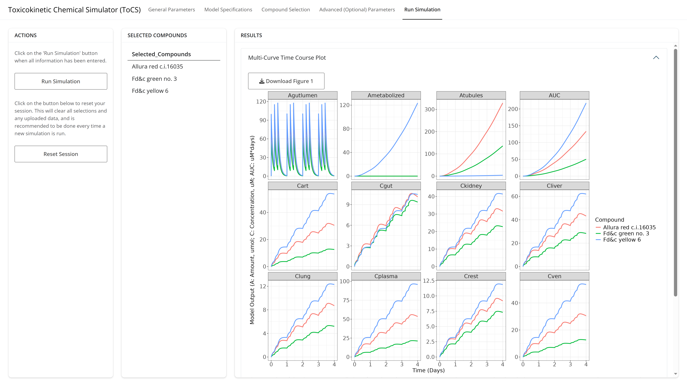
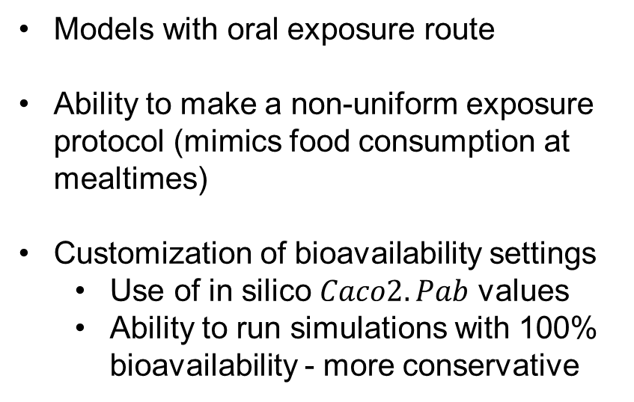
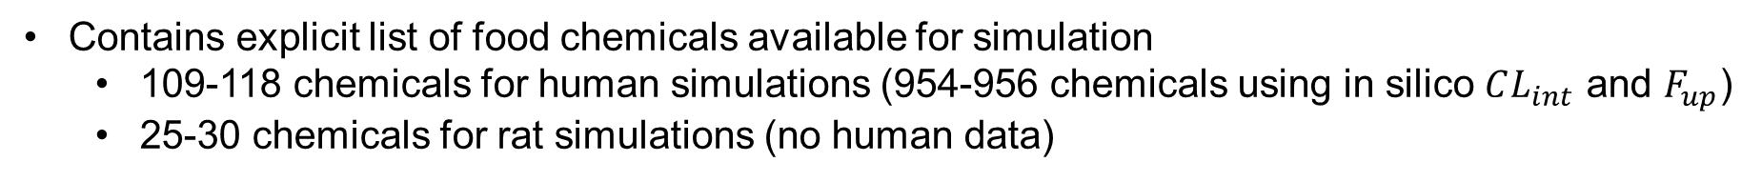
Food Relevant Features
Models with oral exposure route
Ability to make a non-uniform exposure protocol (mimics food consumption at mealtimes)
Customization of bioavailability settings
Use of in silico $Caco2.Pab$ values
Ability to run simulations with 100% bioavailability - more conservative
Contains explicit list of food chemicals available for simulation
109-118 chemicals for human simulations (954-956 chemicals using in silico $CL_{int}$ and $F_{up}$)
25-30 chemicals for rat simulations (no human data)

Slide 8
Comparison of ToCS to Other GUIs
Feature | ToCS | ICE* |  | Feature | ToCS | ICE*
httk software version | 2.7.3 | 2.2.2 |  | Analytical SS concentrations | Plasma and all tissues | Plasma only
Species | Human, rat, mouse, dog, rabbit | Human, rat |  | Estimates days to plasma SS | Yes | No
Food chemical subset | Yes | No |  | OED calculation | Plasma and all tissues | Plasma only
Loads in silico caco-2 permeability values | Yes | No |  | Convert nominal in vitro bioactive conc to free conc | Yes | No
Customize parameter calculation methods | Yes | No |  | OED quantile returned | User’s choice | 5% and 50%
Dosing routes | Oral | Oral, iv, inhalation |  | Option to view all OED samples | Yes | No
ADME dosing | Single, evenly recurring, and non-uniform | Single, evenly recurring |  | Built-in bioactivity data | No | Yes
Inclusion of full pregnancy model | Yes | No |  | Bioactivity exposure ratio (BER) calculation | Yes | No
AUC and Tmax calculated for plasma and all tissues | Yes | Plasma only |  | Volume of distribution, elimination rate, total plasma clearance, and partition coefficient calculations | Yes | No
*Integrated Chemical Environment (https://ice.ntp.niehs.nih.gov/)

Slide 9
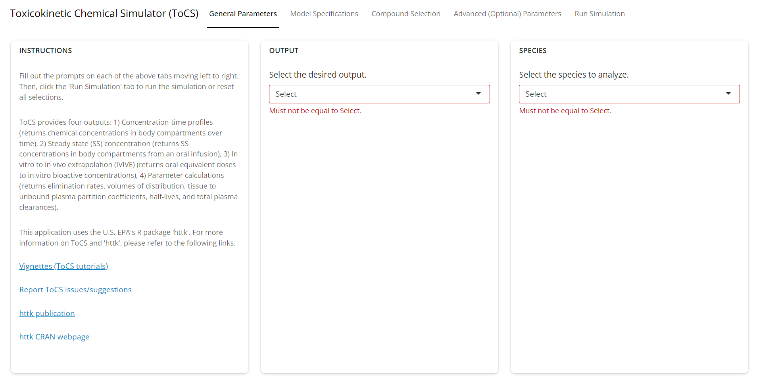
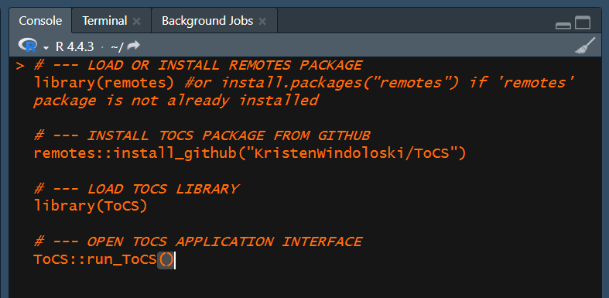
Accessing the ToCS Interface
Web Application
pub-connect.foodsafetyrisk.org/tocs1
No programming needed
R Package
Install in R from the ToCS GitHub
Some programming needed

Slide 10
Interface Structure
Select model conditions
Select model solver parameters
Select bioavailability parameters
Specify output parameters
Select model and model parameters
Select in silico parameter preference
Specify dosing scenario/parameters
Resources
Select module
Select species
Select preloaded compounds
Upload new compounds
Upload other data
Run simulation button
Outputted plots and tables
Notes:
Explain slide and then open the interface in Posit, showing the tabs in the top bar

Slide 11
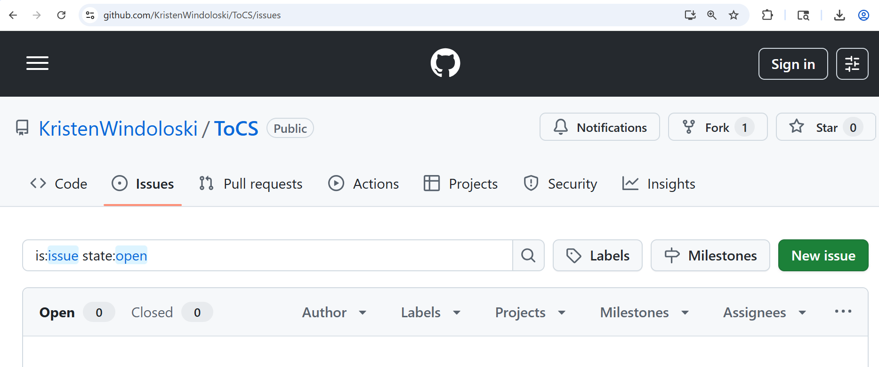
Getting Help and Reporting Issues
README file (https://github.com/KristenWindoloski/ToCS)
Vignettes (https://github.com/KristenWindoloski/ToCS/tree/main/vignettes)
Click the “New Issue” button if any bugs or errors arise when using ToCS
Notes:
Explain slide and then go to README file, the vignettes folder, and the issues tab on GitHub.

Slide 12
Limitations and Challenges
Generalized models - no chemical-specific physiological components, pathways, or compartments
Targeted use case for reporting high-throughput preliminary toxicokinetics and risk estimation
Suggest ToCS be used as an earlier stage analytical software for screening and to guide further chemical studies
Use caution when using the optional in silico parameters
A different output is achieved if the parameter data sets were loaded in another order

Slide 13
An Overview of the httk R Package

Slide 14
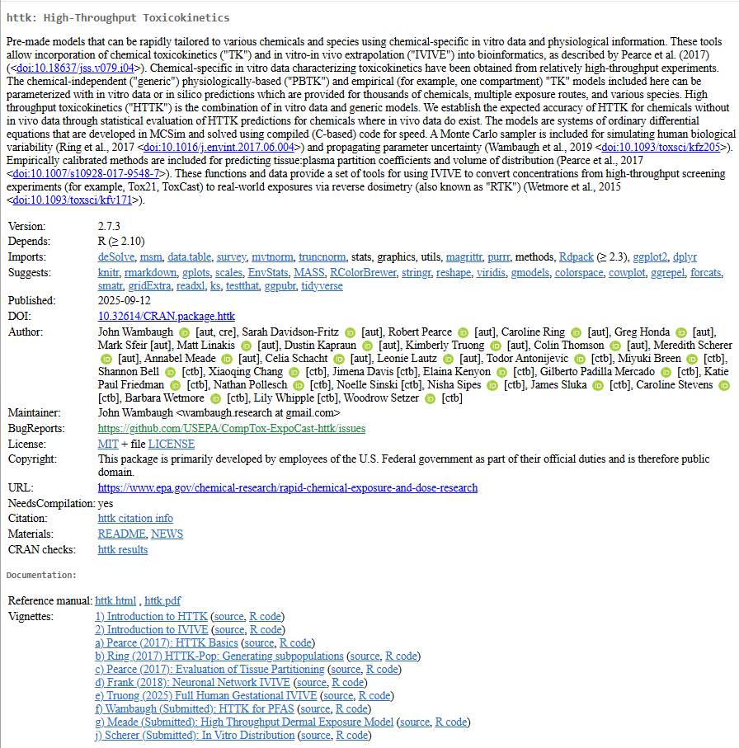
The httk R package
Built by the U.S. EPA in 2015 and is continually maintained and updated
Provides toxicokinetic analysis models and functions for chemical compounds
Contains chemical data for over 17,000 compounds
Newest version (2.7.3) contains time-varying parameter pbtk models, a three-trimester pregnancy model, and a PFAS model

Slide 15
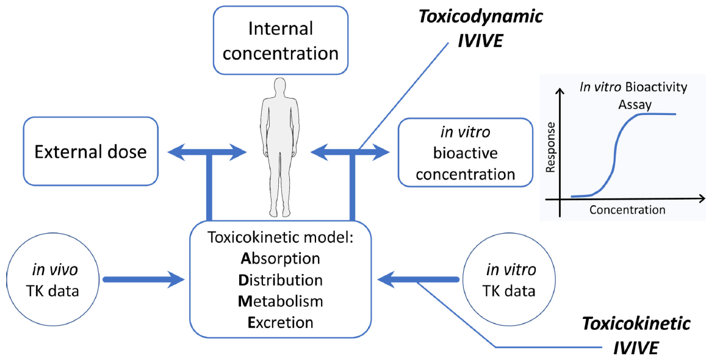
The httk R package
Contains generalized mathematical models (same structure for each chemical, but use of chemical-specific parameters)
Chemical specific parameters include:
In vitro intrinsic hepatic clearance
In vitro fraction unbound in plasma
Molecular weight
Octanol water partition coefficient
Many others…
Breen, M., Ring, C.L., Kreutz, A., Goldsmith, M.R. and Wambaugh, J.F. (2021). High-throughput PBTK models for in vitro to in vivo extrapolation. Expert opinion on drug metabolism & toxicology

Slide 16

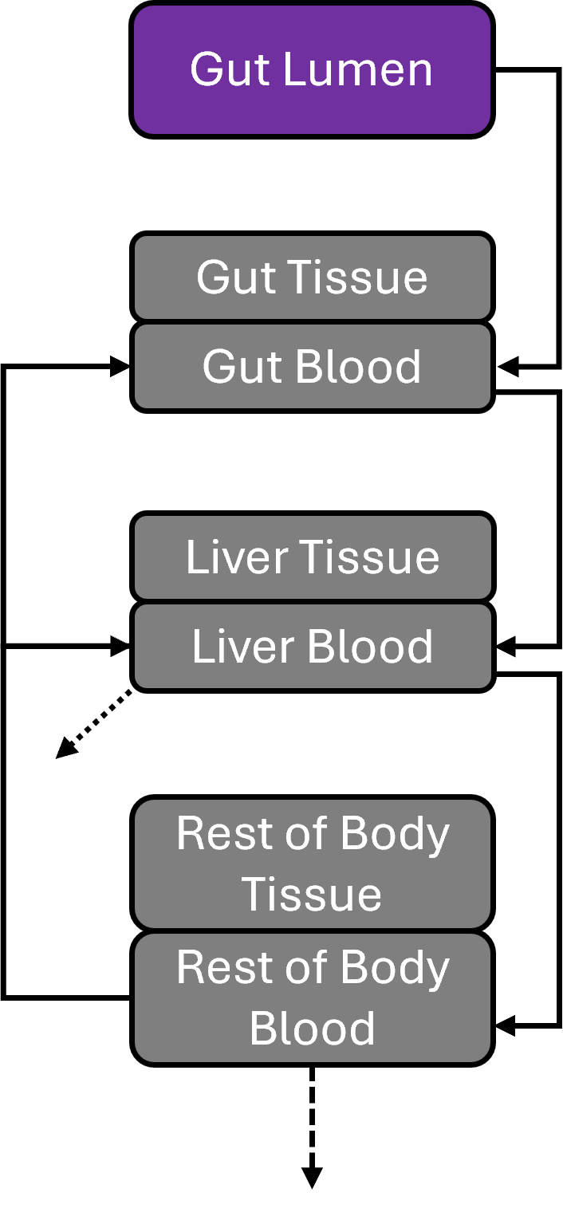
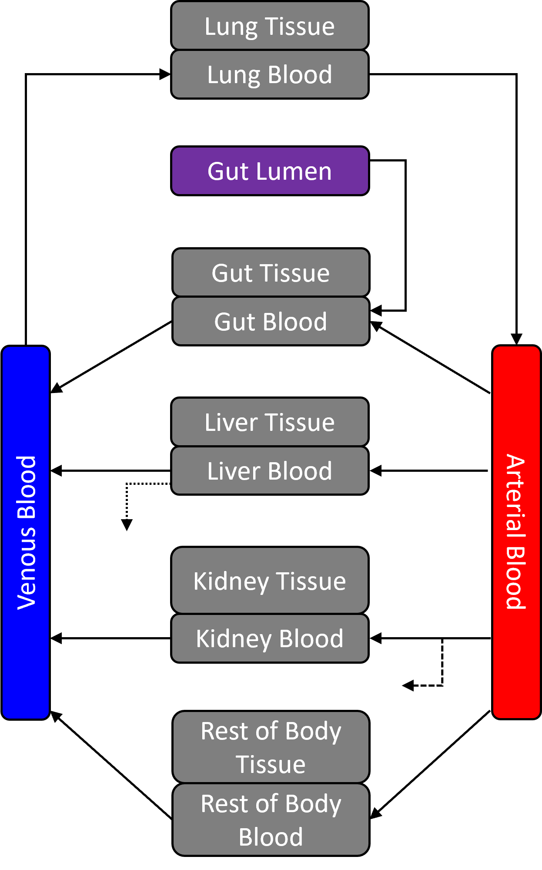
httk Models
1compartment
3compartment
pbtk
Hepatic clearance
Passive glomerular
filtration

Slide 17
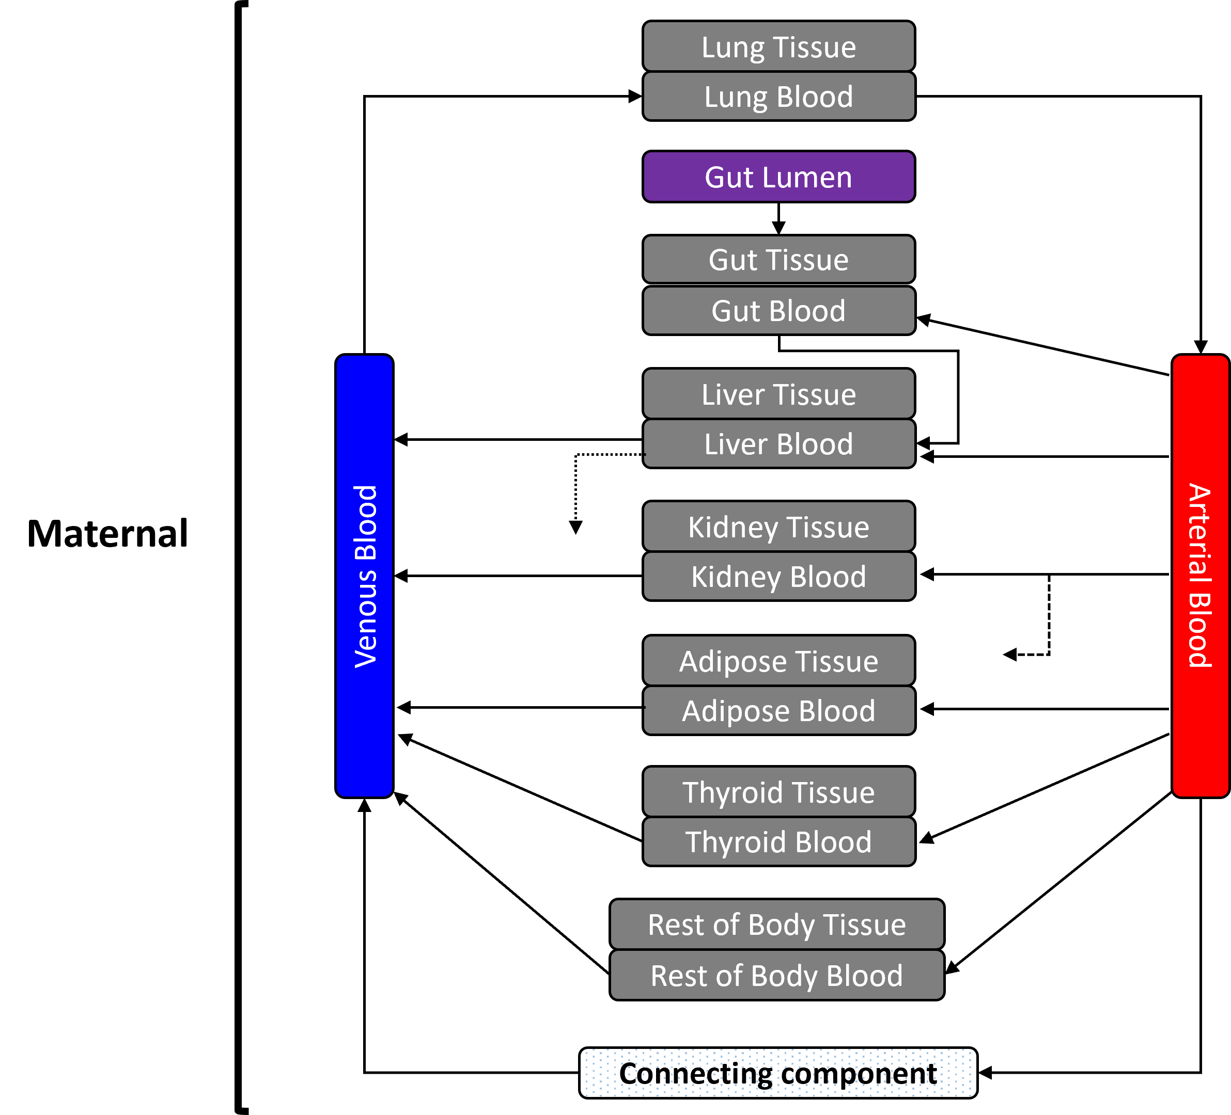
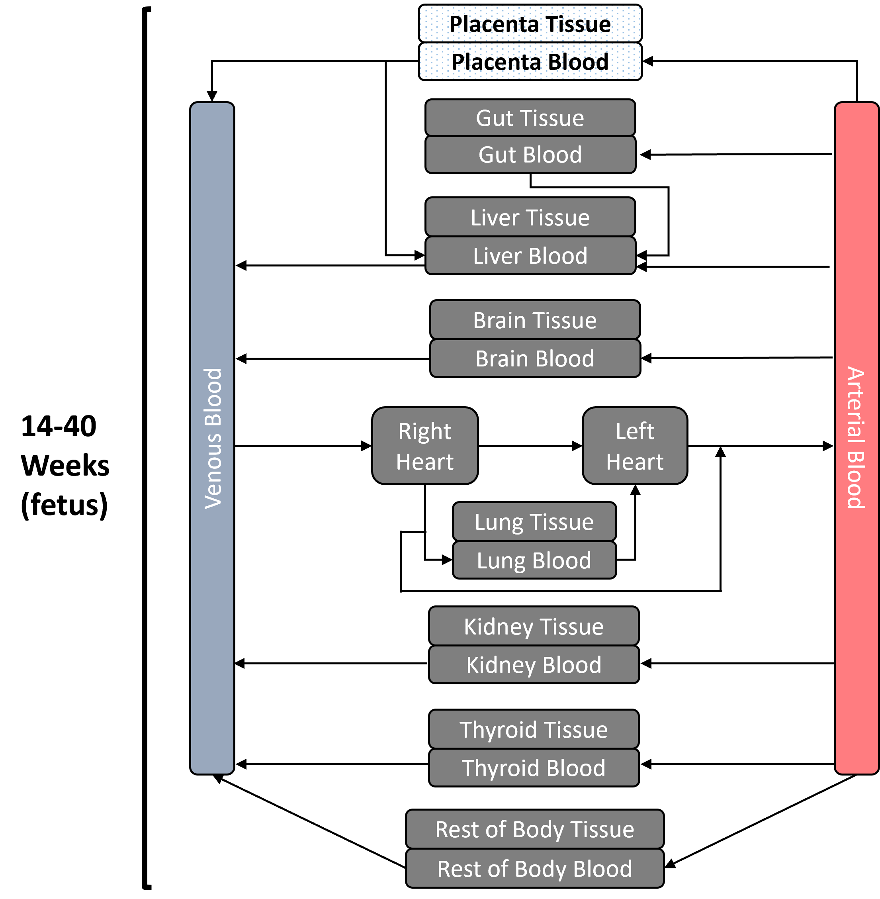
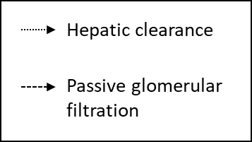
httk Models
fetal_pbtk model (2nd and 3rd trimesters)
Fetal
Placenta Tissue
Placenta Blood

Slide 18
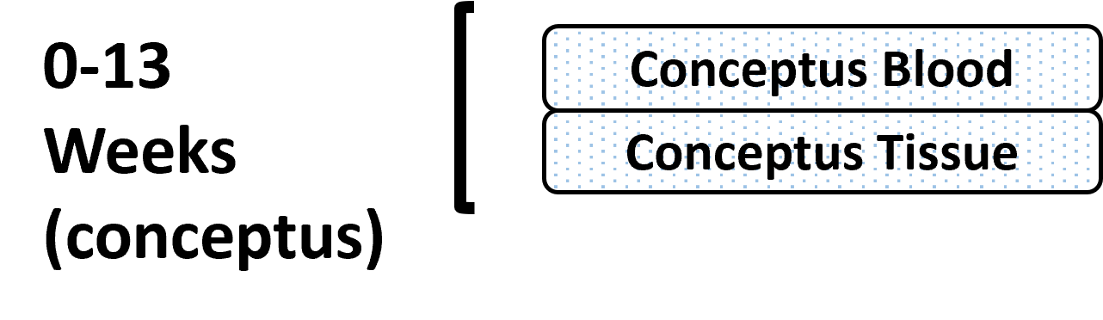
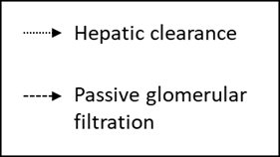
httk Models
full_pregnancy model

Slide 19
Additional Information on httk
Websites
https://github.com/USEPA/CompTox-ExpoCast-httk
https://cran.r-project.org/web/packages/httk/index.html
Select Publications
Breen, M., Ring, C.L., Kreutz, A., Goldsmith, M., and Wambaugh, J.F. (2021). High-throughput PBTK models for in vitro to in vivo extrapolation. Expert Opin. Drug Metab. Toxicol. 17(8), 903–921. doi: 10.1080/17425255.2021.1935867.
Breen, M., Wambaugh, J.F., Bernstein, A., Sfeir, M., and Ring, C.L. (2022). Simulating toxicokinetic variability to identify susceptible and highly exposed populations. J. Expo. Sci. Environ. Epidemiol. 32(6), 855-863. doi: 10.1038/s41370-022-00491-0.
Kapraun, D.F., Sfeir, M., Pearce, R.G., Davidson-Fritz, S.E., Lumen, A., Dallmann, A., et al. (2022). Evaluation of a rapid, generic human gestational dose model. Reprod. Toxicol. 113, 172-188. doi: 10.1016/j.reprotox.2022.09.004.
Pearce, R.G., Setzer, R.W., Strope, C.L., Wambaugh, J.F., and Sipes, N.S. (2017). httk: R package for high-throughput toxicokinetics. J. Stat. Softw. 79(4), 1-26. doi: 10.18637/jss.v079.i04.
Truong, K.T., Wambaugh, J.F., Kapraun, D.F., Davidson-Fritz, S.E., Eytcheson, S., Judson, R.S., et al. (2025). Interpretation of thyroid-relevant bioactivity data for comparison to in vivo exposures: A prioritization approach for putative chemical inhibitors of in vitro deiodinase activity. Toxicology 515, 154157. doi: 10.1016/j.tox.2025.154157.
Wambaugh, J.F., Wetmore, B.A., Ring, C.L., Nicolas, C.I., Pearce, R.G., Honda, G.S., et al. (2019). Assessing toxicokinetic uncertainty and variability in risk prioritization. Toxicol. Sci. 172(2), 235-251. doi: 10.1093/toxsci/kfz205.
Notes:
Explain slide and then show the two linked websites

Slide 20
Chemical Selection

Slide 21
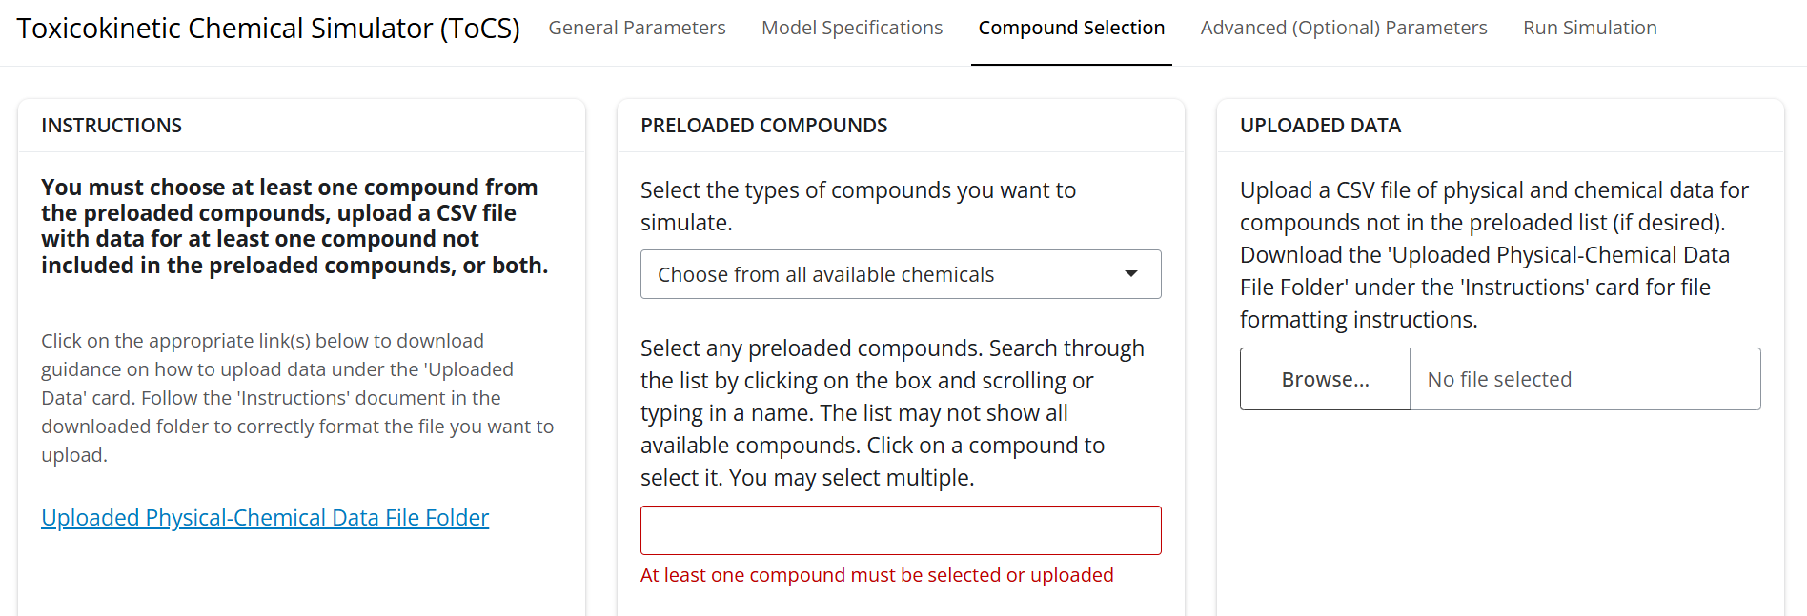
Compound Selection Interface
Downloadable folder detailing how to upload physicochemical data to simulate new compounds
Drop-down list of chemicals with data already preloaded into httk, contains only compounds with adequate data for simulation
Click here to upload a CSV file of physicochemical data for chemicals not available in the preloaded drop-down list

Slide 22
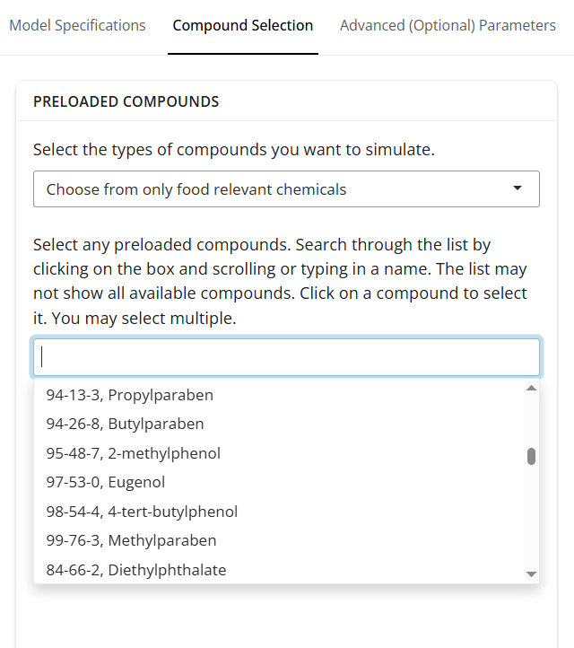
Compound Selection: Preloaded Drop-Down List
Contains compounds with data already in httk
Search the drop-down list by:
Typing in the CAS number (recommended)
Typing in the compound name
Scrolling the list (all compounds are not visible)

Slide 23
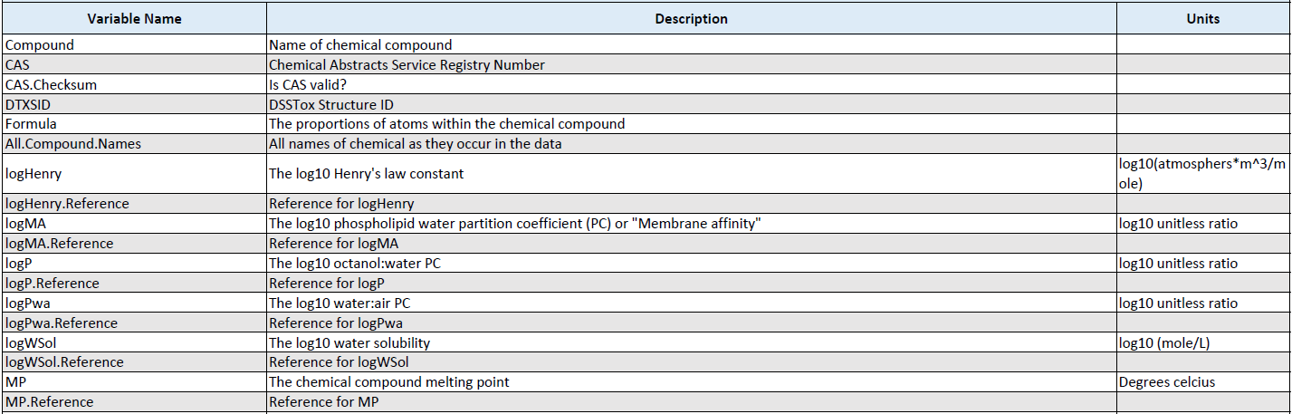
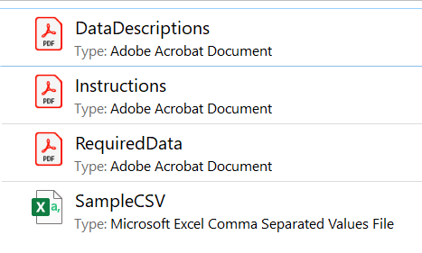
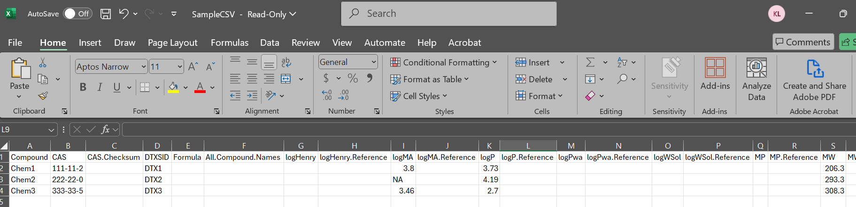
Compound Selection: Upload Your Own Compounds

Slide 24
Compound Selection: Uploaded Data
Required Data
Compound name
CAS number
DTXSID
Molecular weight
Log10 octanol:water partition coefficient
In vitro intrinsic hepatic clearance
In vitro fraction unbound in presence of plasma proteins
Optional Data
Log10 Henry’s law constant
Log10 phospholipid water partition coefficient
Log10 water air partition coefficient
Log10 water solubility
Melting point
Hydrogen acceptor equilibria concentration
Hydrogen donor equilibria concentration
In vivo measured fractional systemic bioavailability of an oral dose
Caco‐2 apical‐to‐basal membrane permeability
Probability that there is no clearance observed
In vivo fraction of oral dose absorbed and entering gut lumen
In vivo fraction of oral dose surviving first pass metabolism in the gut
In vivo fraction of oral dose surviving first pass hepatic clearance
Ratio of blood to plasma chemical concentration

Slide 25
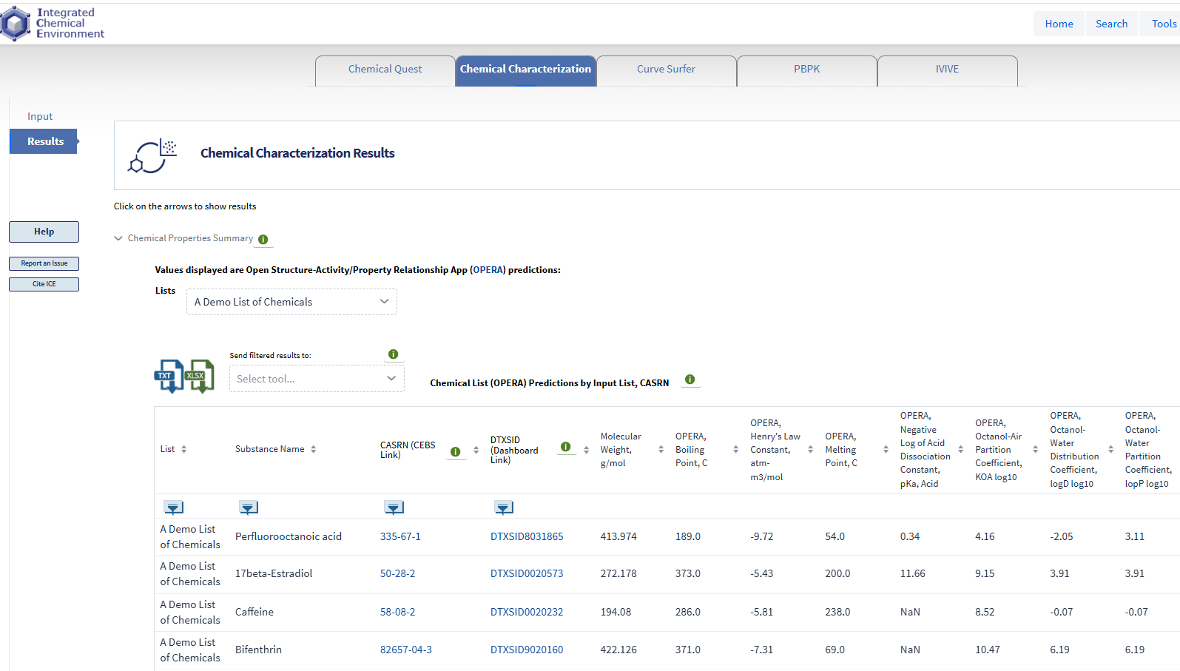
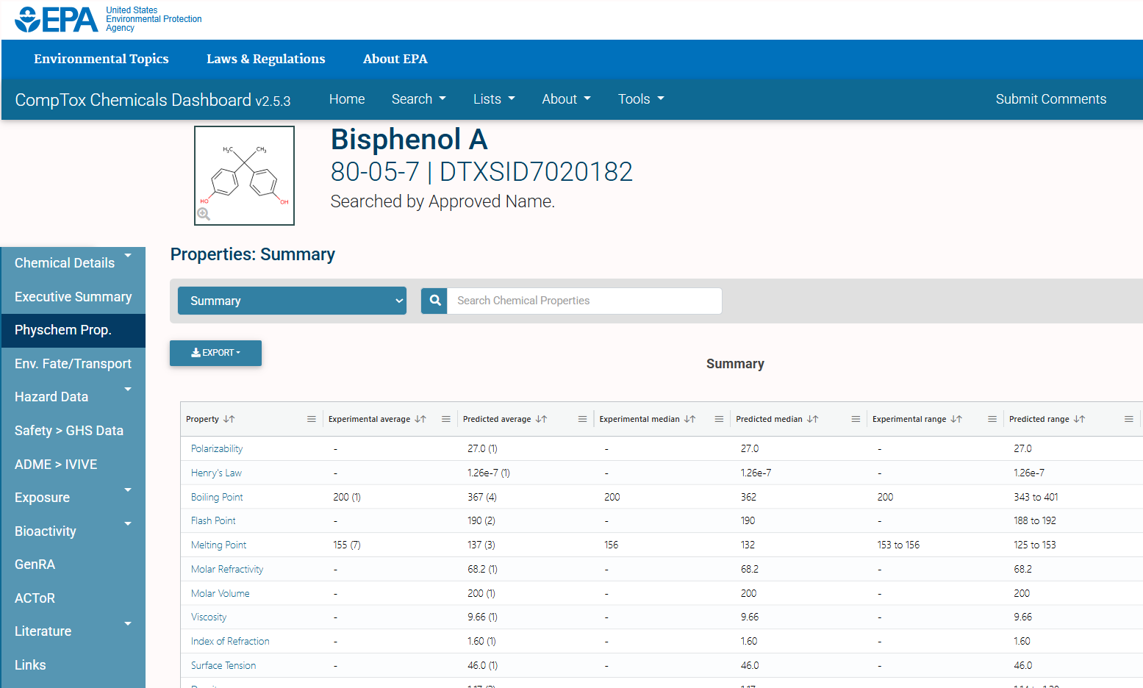
Where Can I Find Physicochemical Data?
NTP’s Integrated Chemical Environment (ICE)
(https://ice.ntp.niehs.nih.gov/)
EPA’s CompTox Chemicals Dashboard (https://comptox.epa.gov/dashboard)
Notes:
Explain slide and then go to the websites of both links

Slide 26
Demo: Uploading Chemical Data
Calcium Benzoate
A direct food additive used as an antimicrobial agent
Notes:
Go to a double screen and show both slides and the interface/internet

Slide 27
Demo: Uploading Physicochemical Data
Download physicochemical data folder
Copy SampleCSV file to a new file to edit
Search for chemical data within EPA’s CompTox Dashboard
Update appropriate fields in new CSV file
Save CSV file and upload within ToCS interface

Slide 28
Demo: Uploading Physicochemical Data
Download physicochemical data folder
Click here to download the folder

Slide 29
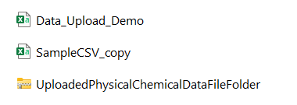
Demo: Uploading Physicochemical Data
Copy SampleCSV file to a new file to edit

Slide 30
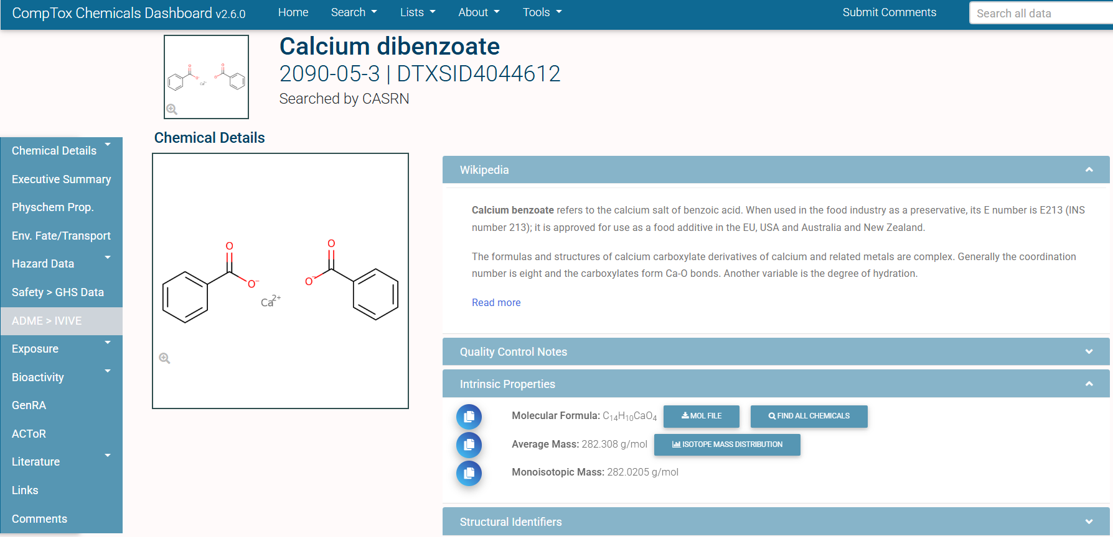
Demo: Uploading Physicochemical Data
Search for chemical data within EPA’s CompTox Dashboard

Slide 31
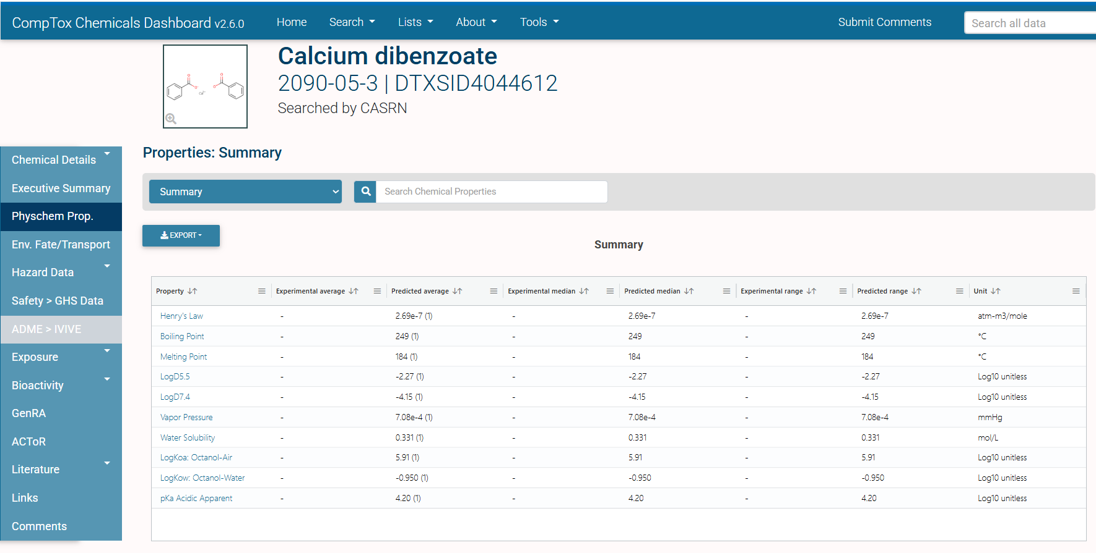
Demo: Uploading Physicochemical Data
Search for chemical data within EPA’s CompTox Dashboard
Need to log10 these values!

Slide 32
Demo: Uploading Physicochemical Data
No real data available, so we set the clint and Funbound.plasma as 0.2 and 0.95 in this example
Update appropriate fields in new CSV file
-6.57

Slide 33
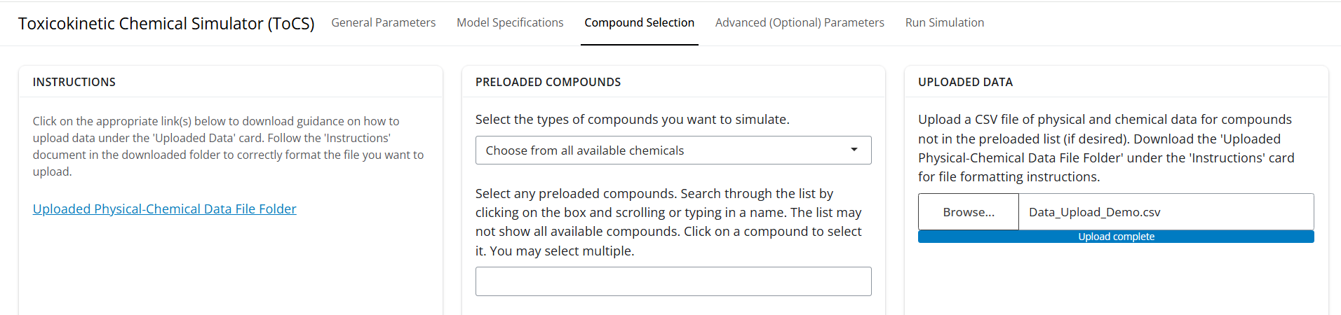
Demo: Uploading Physicochemical Data
Save CSV file and upload within ToCS interface

Slide 34
Questions?

Slide 35
10-Minute Break

