Slide 1
Large Datasets / Intro to Databases
Topics
SQL: Language for database queries
Google BigQuery: Cloud database for large datasets
ArcMap: Spatial joins & layer styling
MUSA 620: Week 5

Slide 2
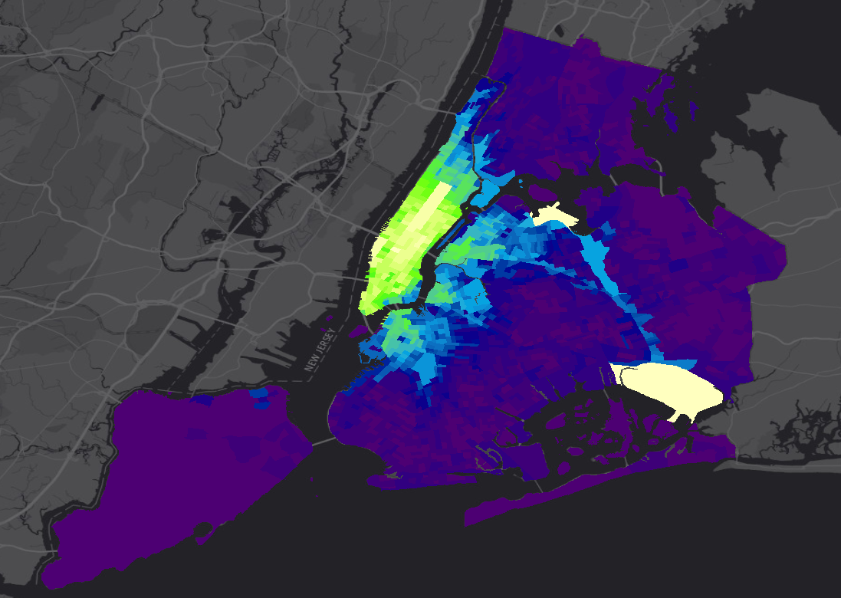
Distribution of Taxi Pickups in NYC

Slide 3
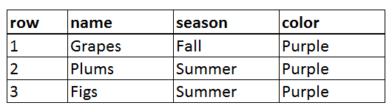
SQL (Structured Query Language)
A typical SQL* query has the form:
SELECT field1, field2, … fieldn
FROM [database.datatable]
WHERE condition1 AND/OR condition2 AND/OR … condition
SELECT name, season, color
FROM [food.fruits]
WHERE color = ‘purple’
* Exact query syntax will vary from database to database, but most use a modified version of SQL with this general structure

Slide 4
Google BigQuery: Example Queries
SELECT Passenger_count, Pickup_longitude, Pickup_latitude
FROM [TaxiTrips.example_table]
SELECT *
FROM [TaxiTrips.example_table]
SELECT *
FROM [TaxiTrips.example_table]
WHERE Trip_distance > 1
SELECT Passenger_count, COUNT(*) AS number_of_trip, AVG(Total_amount) AS average_fare
FROM [TaxiTrips.example_table]
GROUP BY Passenger_count

Slide 5
Google BigQuery: Example Queries
Returns the passenger count and coordinates of every taxi pickup.
SELECT Passenger_count, Pickup_longitude, Pickup_latitude
FROM [TaxiTrips.example_table]
SELECT *
FROM [TaxiTrips.example_table]
Returns the entire data table. * = All columns.
SELECT *
FROM [TaxiTrips.example_table]
WHERE Trip_distance > 1
Returns every taxi trip longer than 1 mile.
SELECT Passenger_count, COUNT(*) AS number_of_trips, AVG(Total_amount) AS average_fare
FROM [TaxiTrips.example_table]
GROUP BY Passenger_count
Returns the number of trips and average fare by passenger count

Slide 6
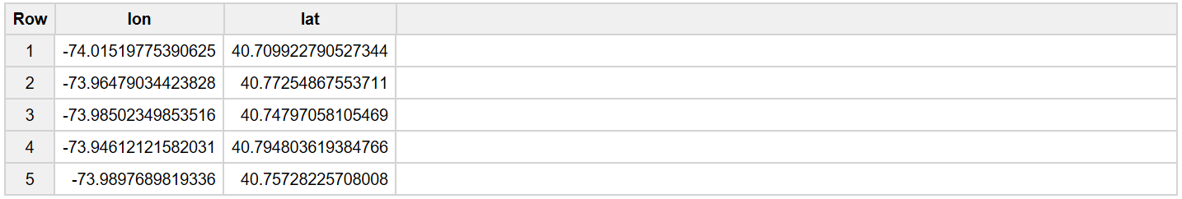
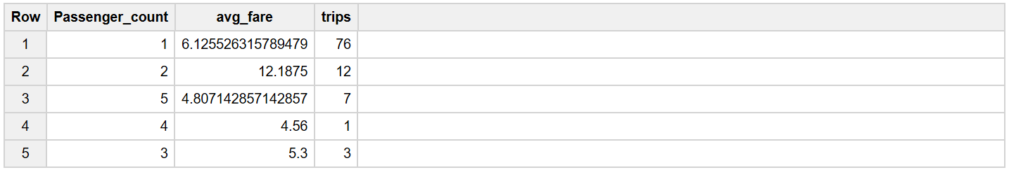
SQL: Continued
AS: Assigns a name to a column
SELECT Pickup_longitude AS lon, Pickup_latitude AS lat
FROM [TaxiTrips.example_table]
SUM / COUNT / AVG …. GROUP BY: Aggregates the data with summary-level stats
SELECT Passenger_count, AVG(Total_amount) as avg_fare, COUNT(*) as trips
FROM [TaxiTrips.example_table]
GROUP BY Passenger_count

Slide 7
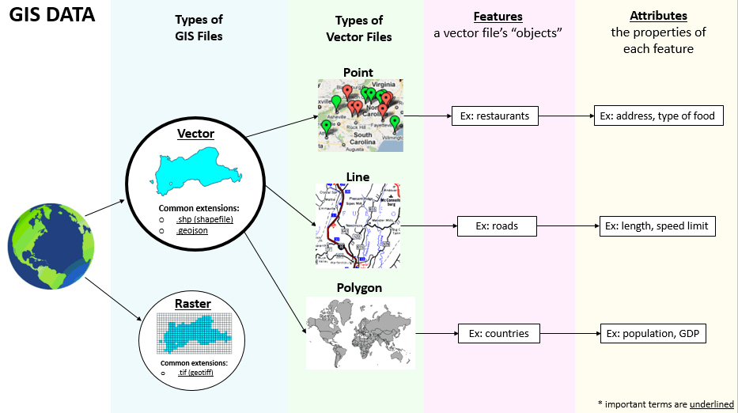
GIS Refresher: Types of GIS Data

Slide 8
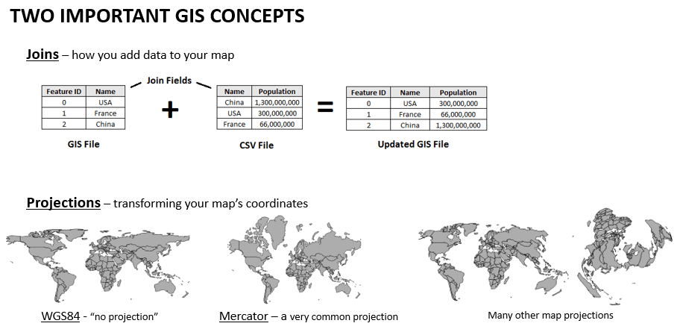
GIS Refresher: Joins and Projections

Slide 9
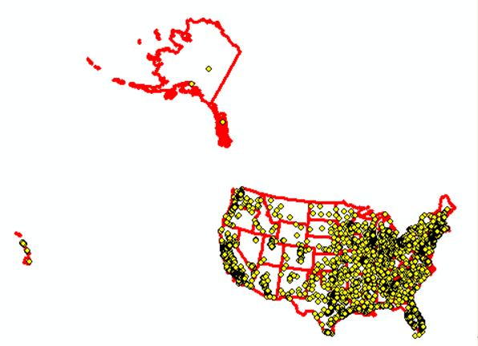
GIS: Spatial Joins
Match features by location
Uses for spatial joins:
Associate each point with its corresponding state
Count the number of points in each state
Find each point’s nearest state border
Remove points that fall outside the U.S.
Filter the map to show only points in Pennsylvania
Many others…

Slide 10
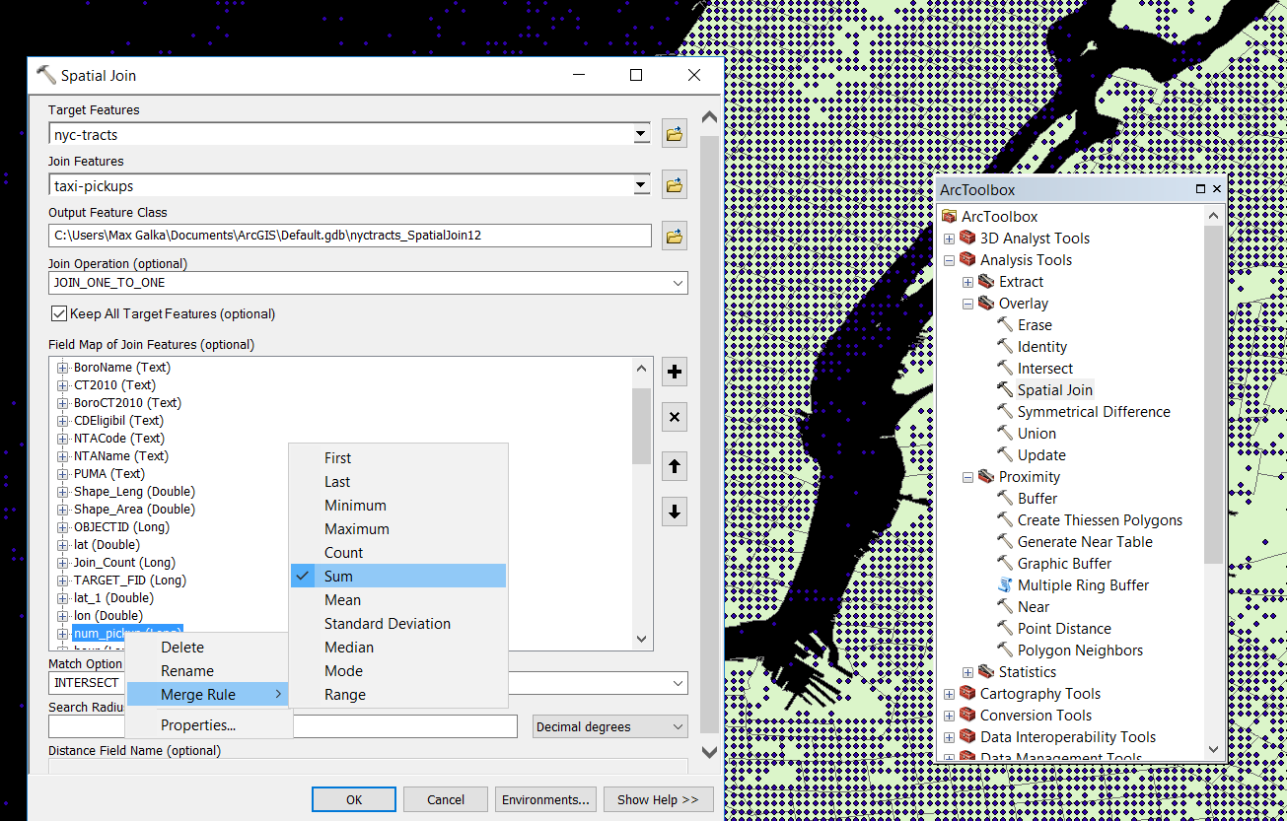
Spatial Joins: Calculate the Number of Taxi Pickups in Each Census Tract
Spatial join tool: Geoprocessing > ArcToolbox > Spatial Join
Target Features: NYC census tracts polygon layer Join Features: Taxi pickups point layer
For the “num_pickups” attribute, set the merge rule to “Sum”

Slide 11
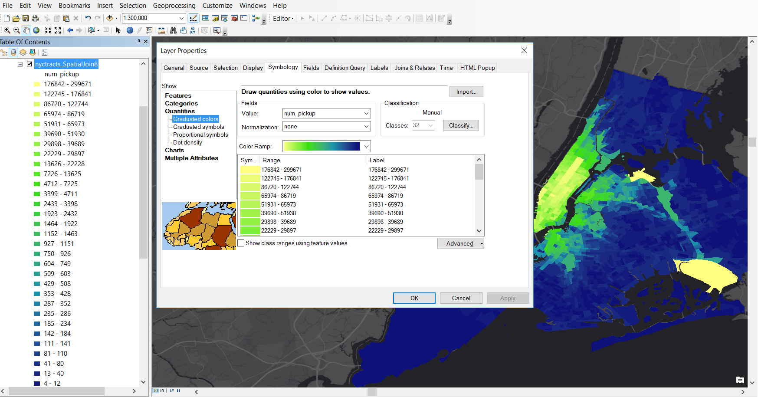
Apply a Color Ramp Based on Number of Taxi Pickups
Color Ramp: Layer Properties > Symbology > Graduated Colors

Slide 12
Assignment (Not Required)
Option 1
Option 2
Using population data from the U.S. Census, color each census tract according to the number of taxi pickups normalized by population.
Color each NYC Census tract according to the average time it takes to get to JFK Airport by taxi.
Borough <-> County Conversions for joining the Census data
Borough | Borough Code | County | County Code
Bronx | 2 | Bronx County | 5
Brooklyn | 3 | Kings County | 47
Manhattan | 1 | New York County | 61
Queens | 4 | Queens County | 81
Staten Island | 5 | Richmond County | 85

