Slide 1
Spatial Databases
Topics
SQL Continued: DISTINCT ON, ORDER BY
PostGIS: Spatial database
ArcMap: Database connections, spatial queries
MUSA 620: Week 5

Slide 2
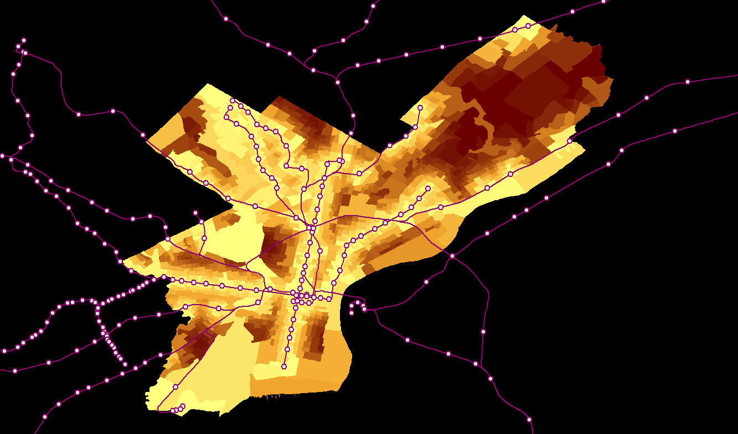
Distance from Nearest SEPTA Station
Census Block Groups, Philadelphia

Slide 3
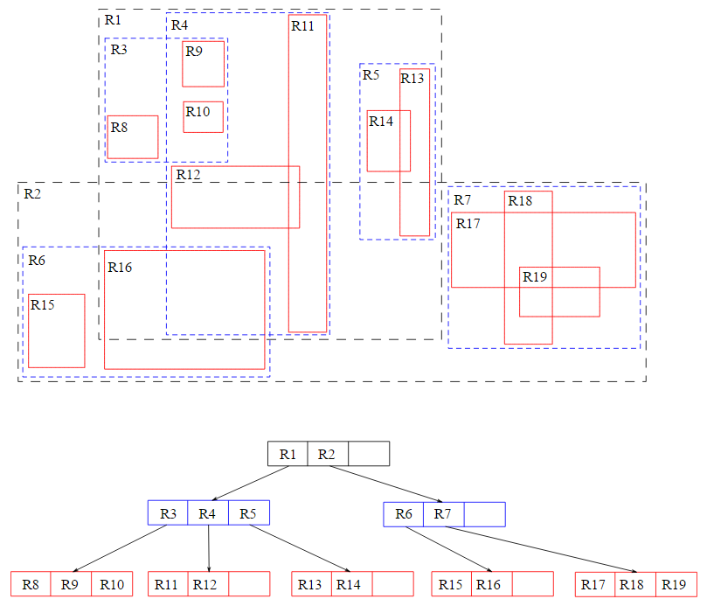
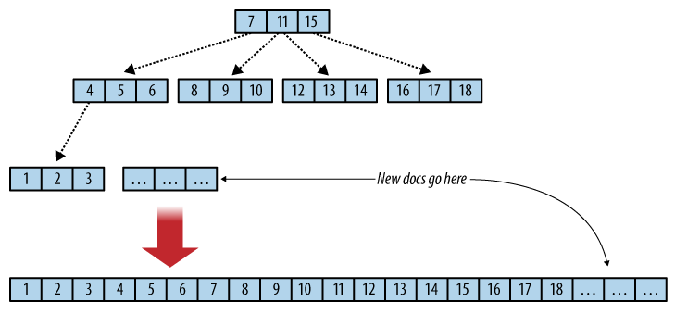
Database Concept: Indexing
B-Tree: One-dimensional index for normal queries
R-Tree: Multi-dimensional index for spatial queries

Slide 4
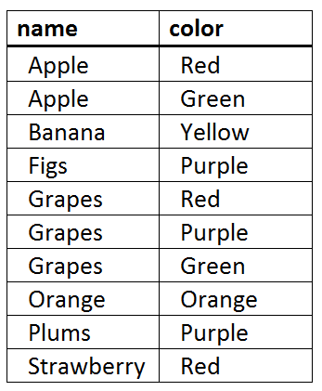
SQL: Sorting (ORDER BY)
SELECT field1, field2, … fieldn
FROM database.datatable
ORDER BY fieldx1 [ASC / DESC], …. fieldxm [ASC / DESC]
SELECT name, color
FROM food.fruits
ORDER BY name ASC, color DESC

Slide 5
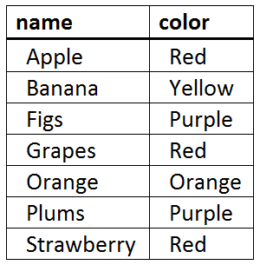
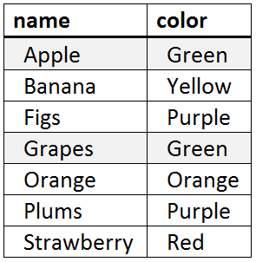
SQL: Removing Duplicates (DISTINCT ON)
SELECT DISTINCT ON (fieldk) field1, field2, … fieldn
FROM database.datatable
*ORDER BY fieldk [ASC / DESC], …. fieldxm [ASC / DESC]
SELECT DISTINCT ON (name) name, color
FROM food.fruits
ORDER BY name ASC, color DESC
SELECT DISTINCT ON (name) name, color
FROM food.fruits
ORDER BY name ASC, color ASC

Slide 6
PostgreSQL (Postgres) / PostGIS
Postgres: just another SQL database (similar to MySQL, MariaDB, MS SQL Server, Google BigQuery, and others).
PostGIS: extends Postgres, allowing SQL queries to be used on geospatial objects.
Adds Geometry (“geom”) field, to the database with its own set of operators.
Enables spatial searches using r-tree indexing,

Slide 7
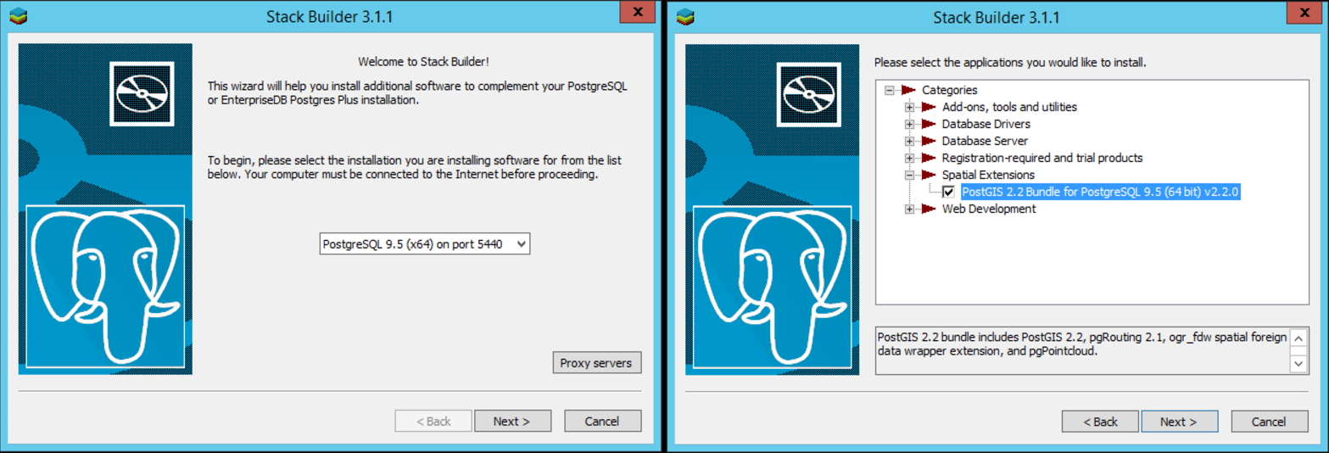
PostgreSQL (Postgres) / PostGIS
Getting set up: https://www.enterprisedb.com/downloads/postgres-postgresql-downloads

Slide 8
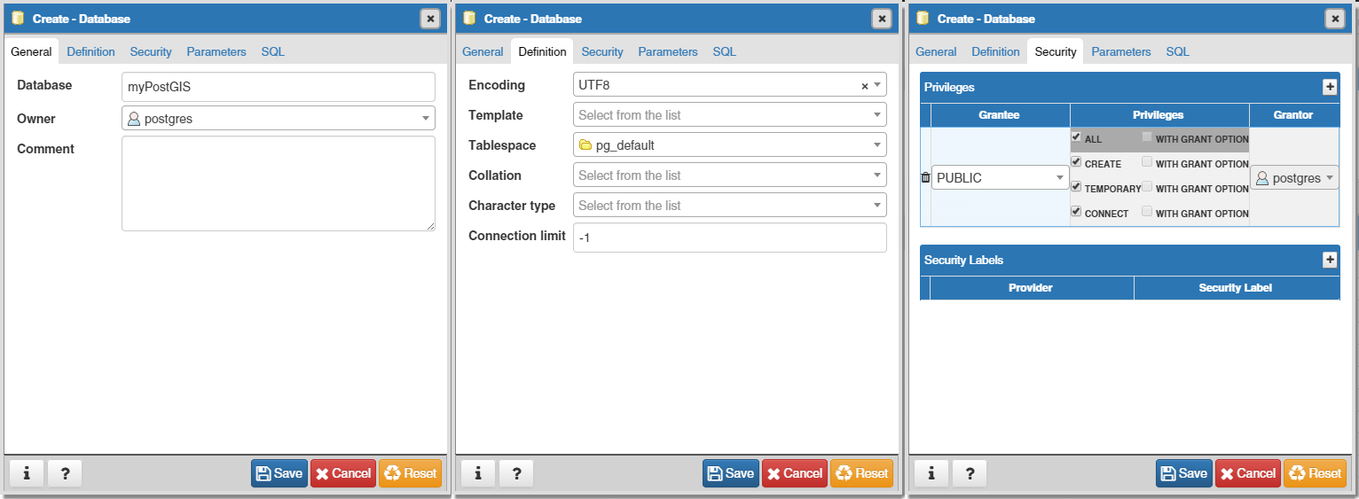
Create a New Database in PGAdmin

Slide 9
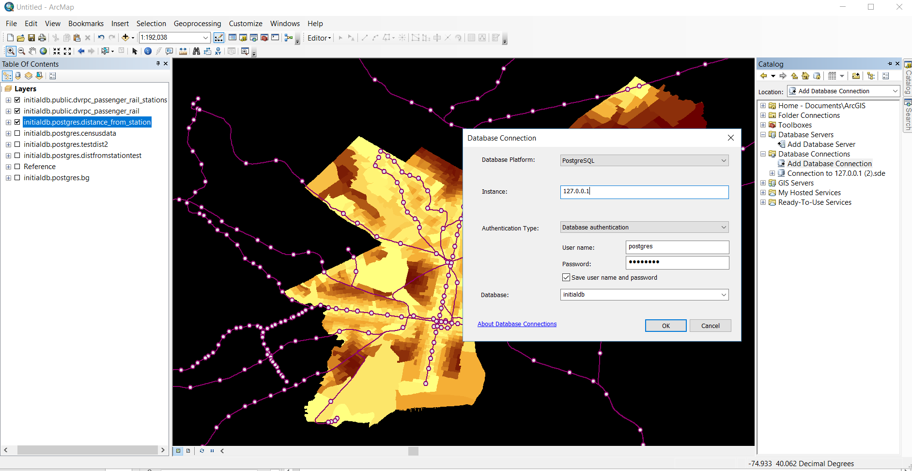
Database Connections in ArcMap
Catalog > Add Database Connection

Slide 10
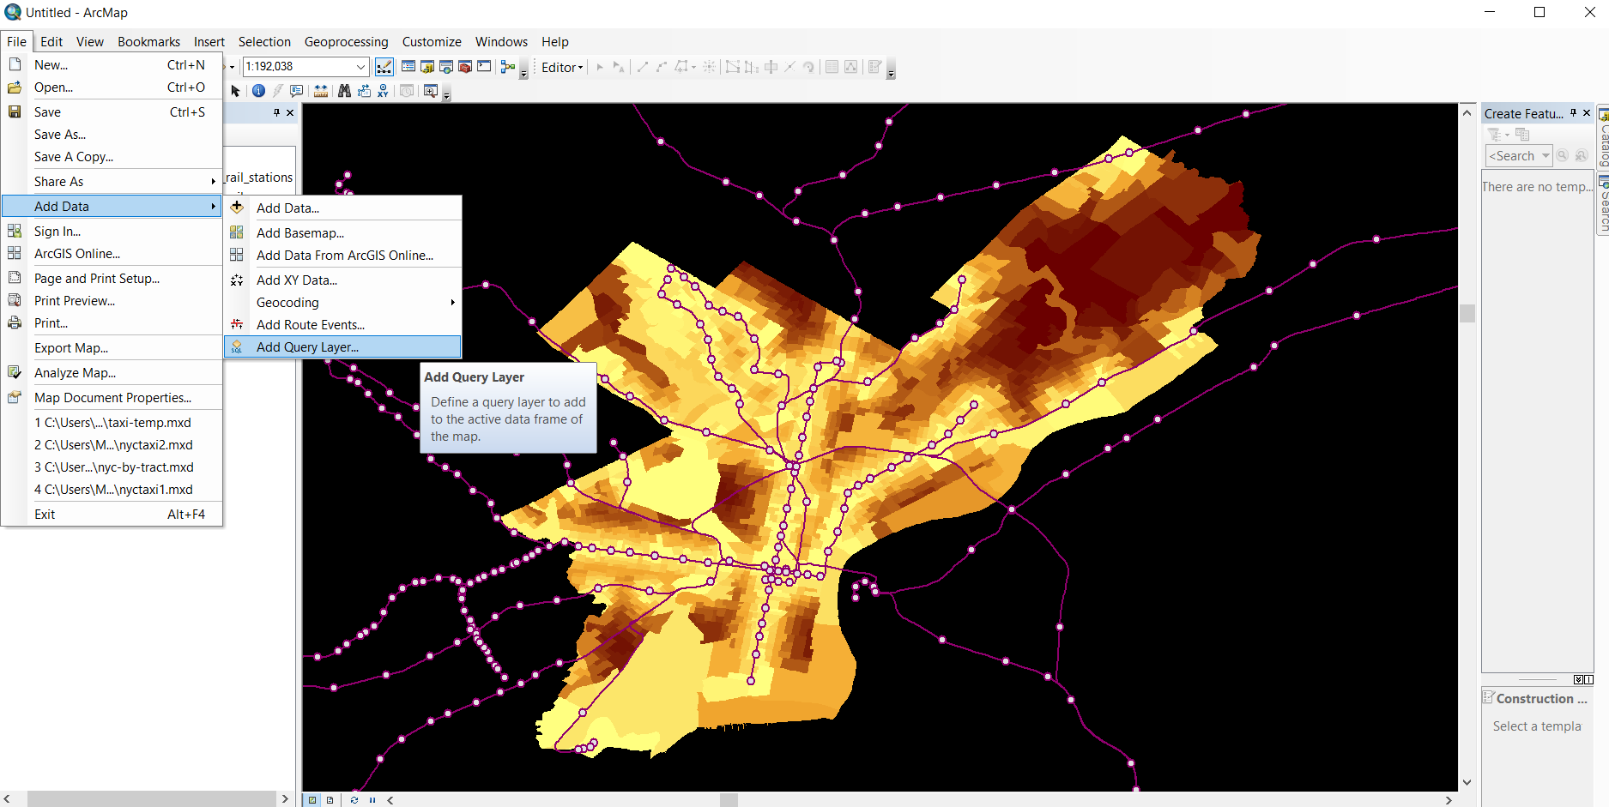
Spatial Queries in ArcMap
File > Add Data > Add Query Layer

